Slide 1

Department of Avionics,
Indian Institute of Space Science and Technology
AV224 - Computer Organization & Operating Systems
Instructor: Vineeth B. S. (vineethbs@iist.ac.in)
Lecture 35
05/04/2017
Some of the figures in these lecture slides are taken from Silberschatz et al.'s
Operating System Concepts and the xv6 book.

Slide 2
Review ...
Processes
Threads
Concurrent execution - race conditions
Synchronization
Deadlocks
Today's class
Scheduling of processes

Slide 3
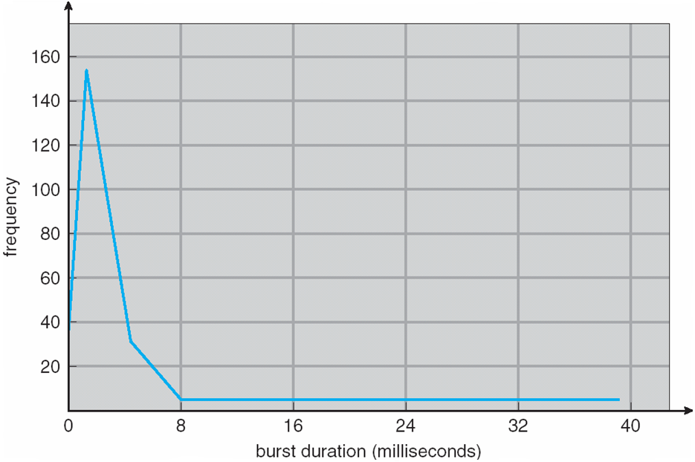
CPU scheduling
Consider the case of a single CPU
Burst of CPU use interwoven with I/O use and therefore waiting (remember I/O bound and processor bound processes?)
CPU bursts are of small duration
Maximize CPU utilization by time sharing bursts of different processes !

Slide 4
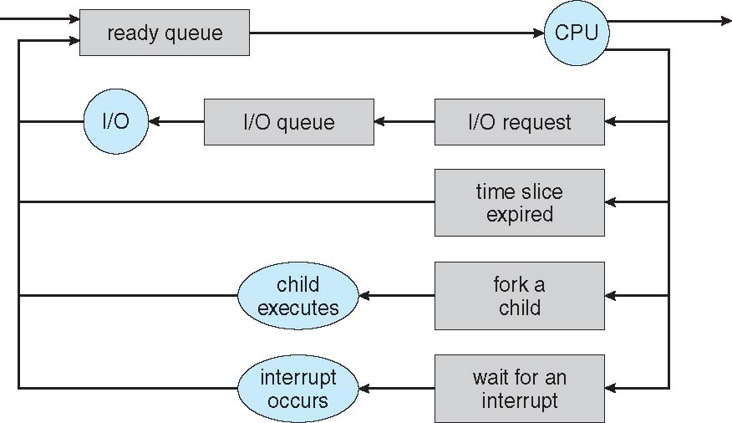
Short term scheduler
Short term scheduling decisions are taken at a fast time scale
The scheduler decides which process in the ready queue should be run next
CPU scheduling decisions can be non-preemptive or preemptive
Preemptive scheduling
Examples
Dispatcher module gives control of the CPU to the process selected by the short-term scheduler; this involves: switching context, switching to user mode, jumping to the proper location in the user program to restart that program
The time it takes for the dispatcher to stop one process and start another running is called dispatch latency

Slide 5
Performance metrics in process scheduling
Max CPU utilization
Fraction of time the CPU is used
Max throughput
Number of processes which finish execution in unit time
Min turnaround time
amount of time to execute a process
Min waiting time
amount of time a process spends waiting in queue
Min response time
amount of time from when a process is first started to the first time it is scheduled

Slide 6
First come first served schedule
Processes and the CPU burst times
P1 - 24, P2 - 3, P3 - 3
Order of arrival is P1, P2, and P3
Waiting time for P1 = 0
For P2 = 24
For P3 = 27
Average waiting time is 17
What happens if the order is P2, P3, and P1?s

Slide 7
Shortest job first (SJF) scheduling
Each process also has the length of its burst (or estimated length)
The burst time can be estimated from earlier bursts
Exponential averaging
Schedule the process with the shortest burst first amongst all processes in the ready queue
SJF is optimal for the average waiting time
Pre-emptive version is shortest remaining time first (SRTF)

Slide 8
Shortest remaining time first
Consider 4 processes
With preemptive scheduling we have the following order in which the processes are executed
Process | Arrival Time | Burst Time
P1 | 0 | 8
P2 | 1 | 4
P3 | 2 | 9
P4 | 3 | 5

Slide 9
Priority scheduling
Each process will have a priority associated with it
Priority is indicated by an integer (rank - smaller means more priority)
Scheduling can be preemptive or non-preemptive
Priority scheduling suffers from starvation which can be solved by aging
Consider the example
With priority scheduling we have
Process | Burst Time | Priority
P1 | 10 | 3
P2 | 1 | 1
P3 | 2 | 4
P4 | 1 | 5
P5 | 5 | 2

Slide 10
Round robin scheduling
Each process gets a quantum of CPU time after which it is pre-empted and added back to the ready queue
Timers are used to preempt after every quantum of time
Process | Burst Time
P1 | 24
P2 | 3
P3 | 3

Slide 11
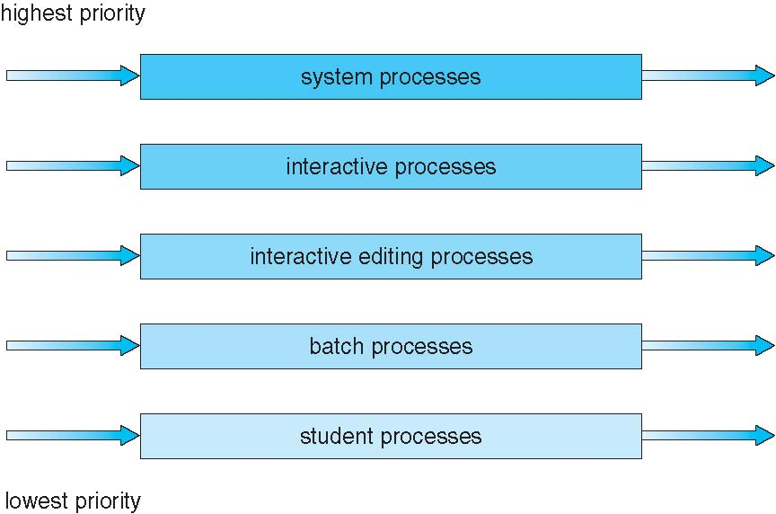
Multilevel queues
The ready queue is assumed to be made up of two queues
Foreground queue (interactive processes)
Background queue (batch processes)
A process is put in either one of the queues and it will rejoin the same queue
Each queue has its own scheduling algorithm
Foreground queue - RR
Background queue - FCFS
Scheduling between queues
Fixed priority - again may lead to starvation
Time slicing - 80 % of time to foreground, 20 % to background
Extended to multilevel feedback queues

Slide 12
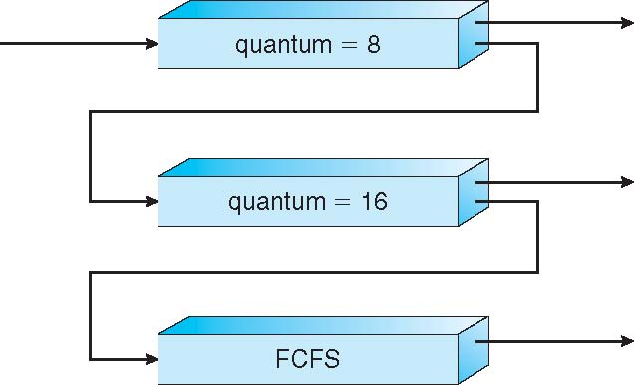
Multilevel feedback queues
Processes can move among multiple queues
Exercise: How can aging be implemented in this way?
A process starts in the first queue - receives 8 quanta
If not completed is put in the second queue - again receives 8 quanta
If not completed then in the third queue - which has FCFS service

Slide 13
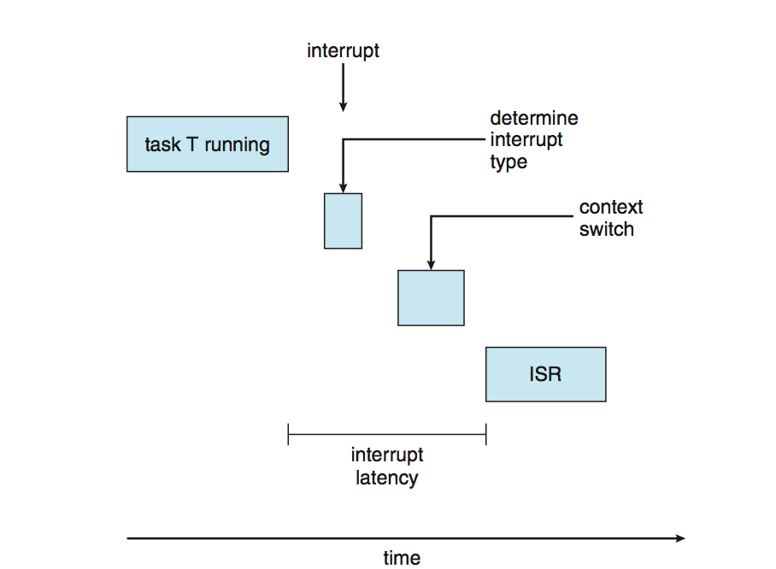
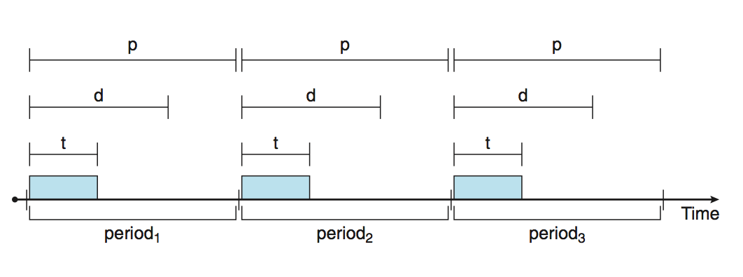
Real time CPU scheduling
Soft and Hard real time systems
Hard constraints: have to finish tasks before their deadline
Latencies which affect real time performance
Interrupt latency
Dispatch latency
For real time systems we need preemptive priority based scheduling - at least get soft real time from this
Usually in systems with real time requirements we also have periodic processes

Slide 14
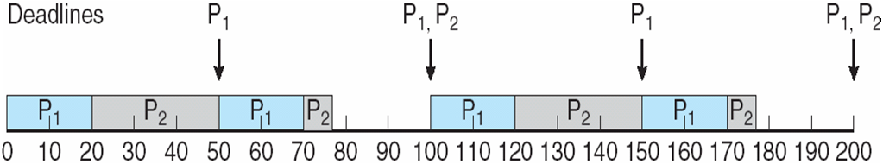
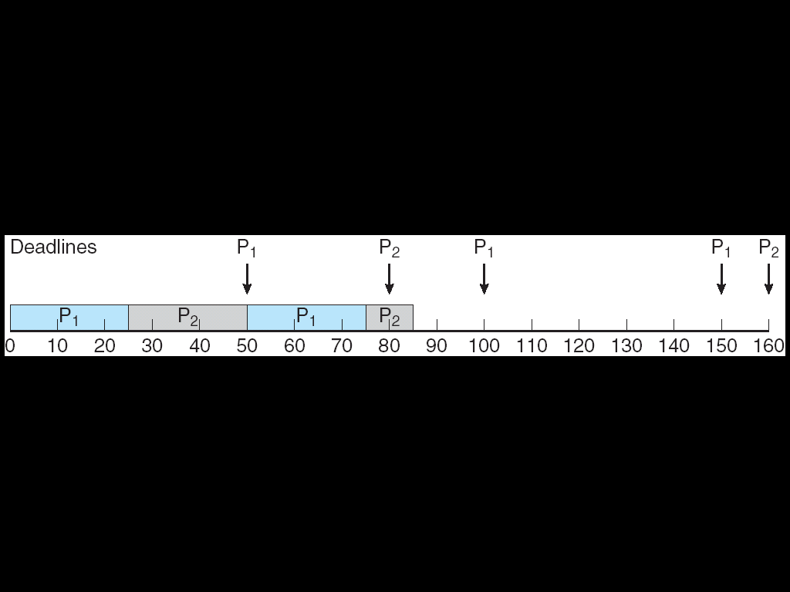
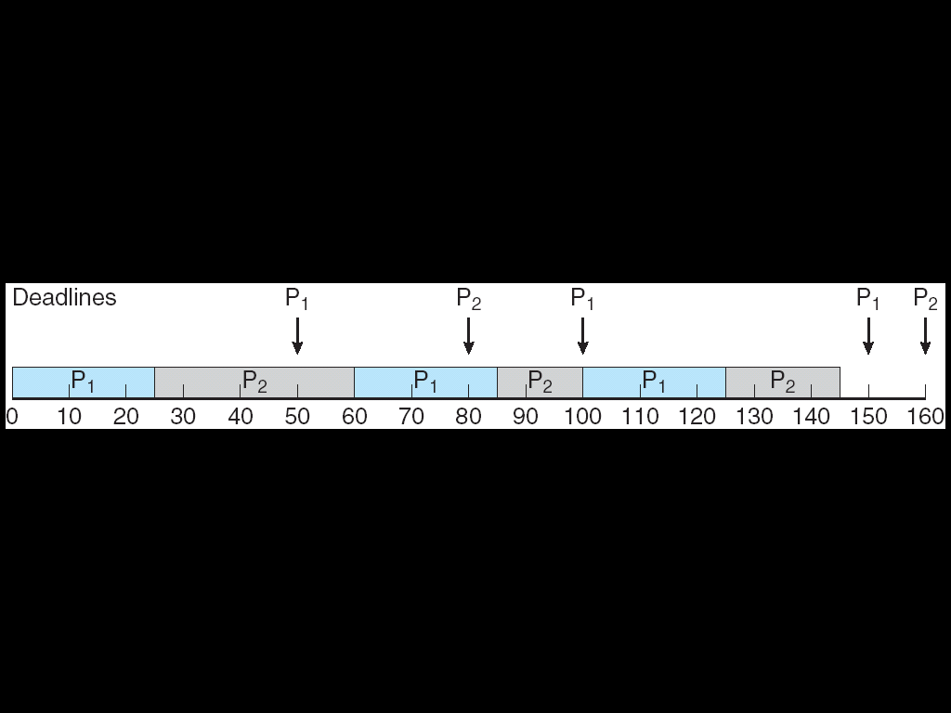
Real time CPU scheduling
Rate monotonic scheduling for periodic processes
Shorter periods - higher priority
Longer periods - less priority
Priority is inverse of the period
Deadlines can be missed
Earliest deadline first (EDF)
Earlier deadline - higher priority

Slide 15
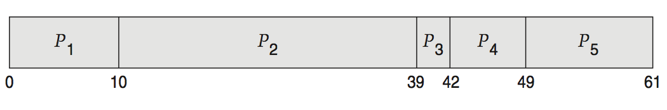
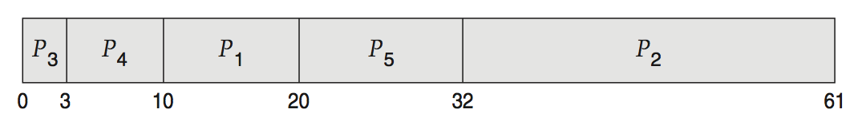
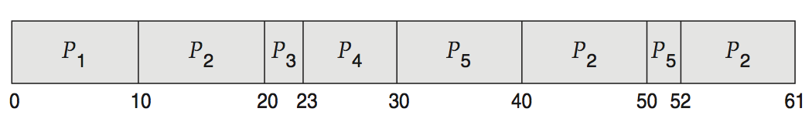
Evaluation of scheduling algorithms
Deterministic approaches
Suppose there are 5 processes arriving at time 0 with burst times 10, 29, 3, 7, 12
Evaluation for each kind of scheduling algorithm: FCFS, non-preemptive SJF, RR
Queueing theory
Uses probability models for describing how processes are generated, and what their burst times are
Analytical results for average queue length, average delay
Fundamental result - Little's law
Simulations

Slide 16
Summary
Scheduling policies for CPU
Performance metrics
Common scheduling methods
FCFS
SJF
SRTF
Priority
RR
Multilevel queues
Real time scheduling
Rate monotonic
EDF
Performance analysis - Little's law
Reference: Silberschatz et al. (Topics from Ch. 6)

