Slide 1

Department of Avionics,
Indian Institute of Space Science and Technology
AV224 - Computer Organization & Operating Systems
Instructor: Vineeth B. S. (vineethbs@iist.ac.in)
Lecture 14
09/02/2017
Figures in these lecture slides are taken from Hennessy and Patterson's
Computer Organization and Design
(Copyright © 2014 Elsevier Inc. All rights reserved)

Slide 2
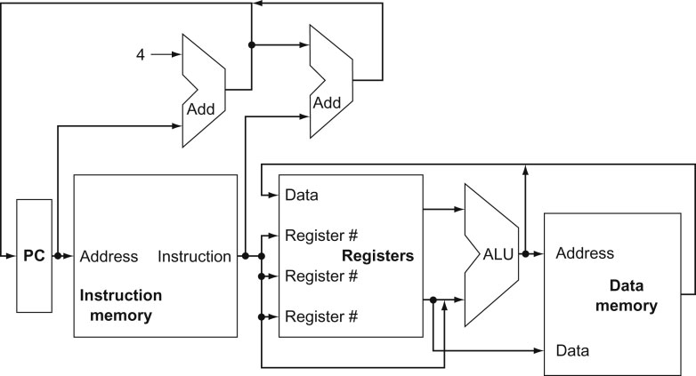
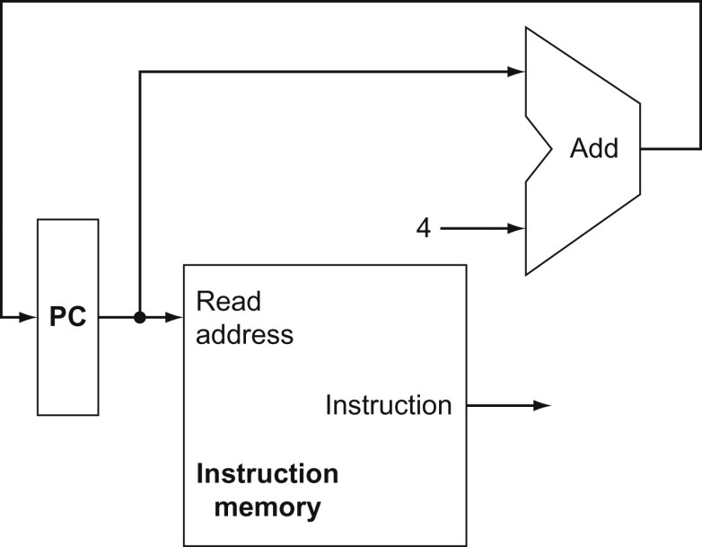
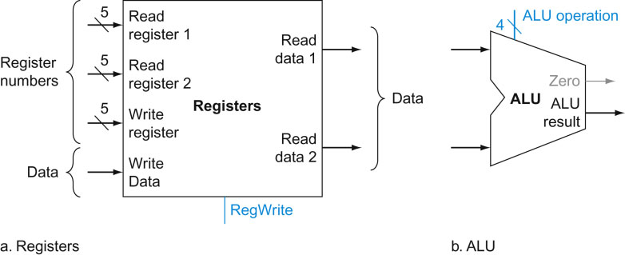
Review
Processor data path implementation
Implementation of instruction fetch datapath
Implementation of add r1, r2, r3

Slide 3
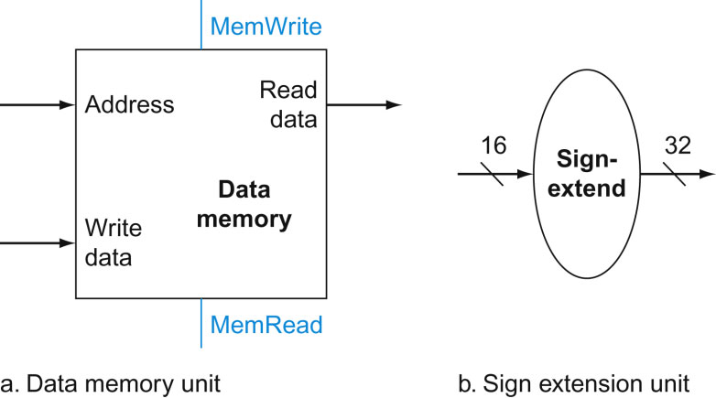
Implementing load and store instruction
The load instruction is
load r1, [r2 + offset]
The components that we need are
A data memory unit - for storing data and reading data from
Offsets are added to or subtracted in the ALU
But the ALU operates on 32 bit quantities
So we need a sign extender that takes 16 bit inputs and puts out sign extented 32 bit values
OpCode | rsource (e.g. r2) | rdest (e.g. r1) | offset

Slide 4
Implementing load - load r1, [r2 + offset]
OpCode
rsource (e.g. r2)
rdest (e.g. r1)
offset/ immediate
r2

Slide 5
Implementing store - store [r2 + offset], r1
OpCode
rmem (e.g. r2)
rsource (e.g. r1)
offset/ immediate
r2
r1

Slide 6
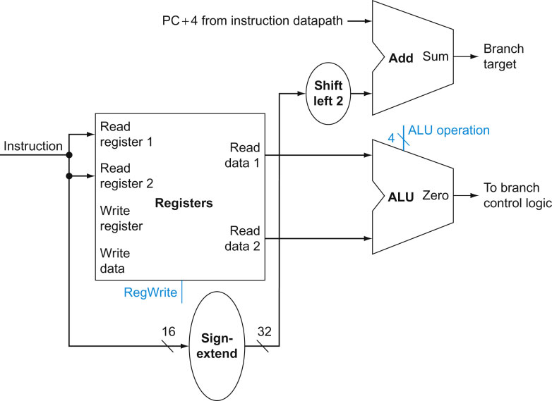
Implementing conditional branch instructions
The conditional branch instruction is
beq r1, r2, offset
r1 and r2 are compared for equality
if they are equal then the execution shifts to (PC + 4) + offset
We note that since instructions are 32 bits wide, the offset can indicate words. So the offset is shifted to the left by 2 bits
OpCode
rcomp1 (e.g. r2)
rcomp2 (e.g. r1)
offset/ immediate

Slide 7
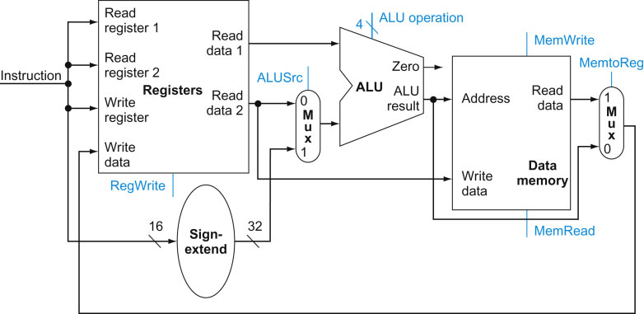
Obtaining a single data path for different instructions using multiplexers
add r1, r2, r3

Slide 8
Obtaining a single data path for different instructions using multiplexers
load r1, [r2 + offset]

Slide 9
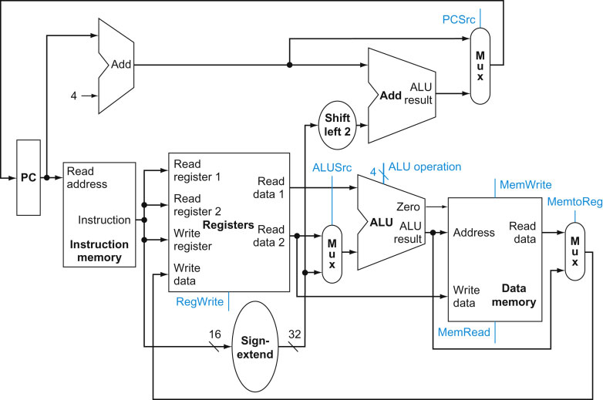
Obtaining a single data path for different instructions using multiplexers
beq r1, r2, offset

Slide 10
Obtaining a single data path for different instructions using multiplexers
revisiting add r1, r2, r3

Slide 11
Obtaining a single data path for different instructions using multiplexers
Exercise
Draw the complete path taken for the load and store instructions

Slide 12
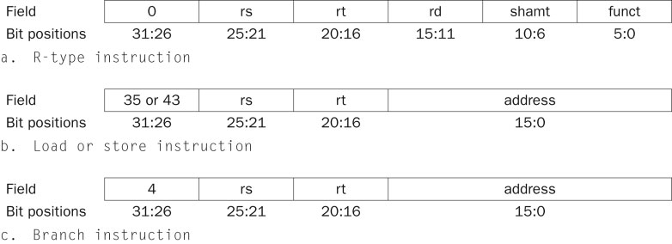
Implementing control signals
The three instruction classes (R-type, load and store, and branch) use two different instruction formats.
Instruction format for R-format instructions,
opcode of 0
three register operands: rs, rt, and rd
Fields rs and rt are sources, and rd is the destination
The ALU function is in the funct field
Instruction format for load and store
load (opcode = 35_{ten}) and store (opcode = 43_{ten})
the register rs is the base register that is added to the 16-bit address field to form the memory address.
For loads, rt is the destination register for the loaded value.
For stores, rt is the source register whose value should be stored into memory.
Instruction format for branch equal
opcode =4
the registers rs and rt are the source registers that are compared for equality
the 16-bit address field is sign-extended, shifted, and added to the PC + 4 to compute the branch target address.

Slide 13
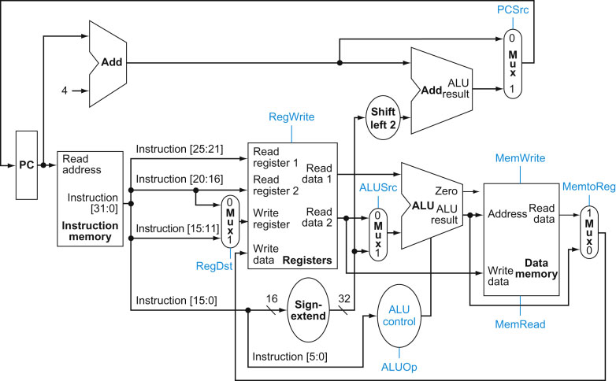
A much more refined view of the processor

