Slide 1

Department of Avionics,
Indian Institute of Space Science and Technology
AV224 - Computer Organization & Operating Systems
Instructor: Vineeth B. S. (vineethbs@iist.ac.in)
Lecture 15
09/02/2017
Figures in these lecture slides are taken from Hennessy and Patterson's
Computer Organization and Design
(Copyright © 2014 Elsevier Inc. All rights reserved)

Slide 2
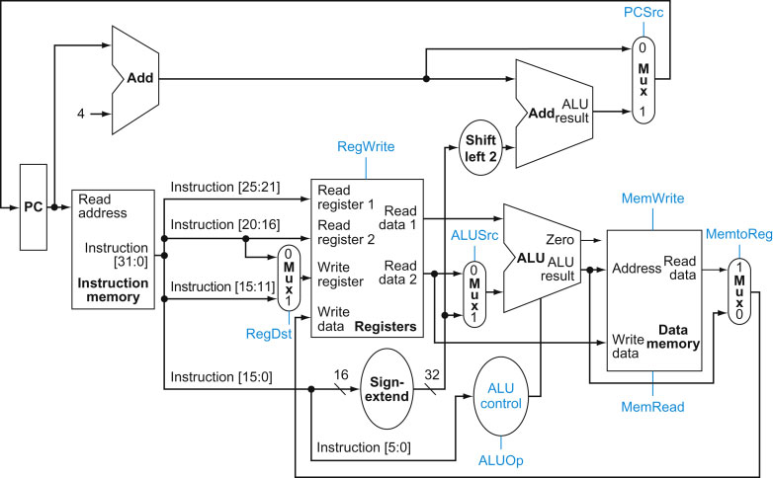
A much more refined view of the processor

Slide 3
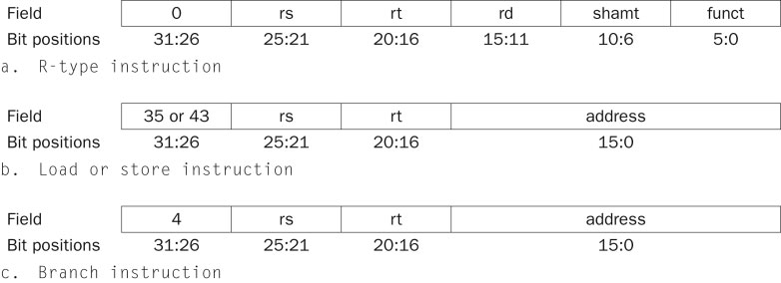
Control signals
ALU control | Function
0000 | AND
0001 | OR
0010 | add
0110 | subtract
1100 | NOR
How to generate control signals for the ALU?

Slide 4
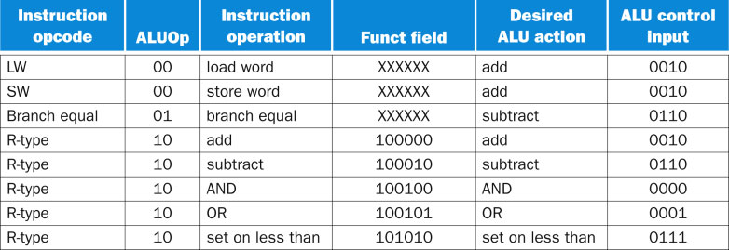
Generating ALU Control signals
How to generate control signals for the ALU?
Cannot use the "funct" field always
Depending on the opcode we need to generate the control inputs
If we have load/store, then ALU should add
If we have beq, then ALU should subtract for comparison

Slide 5
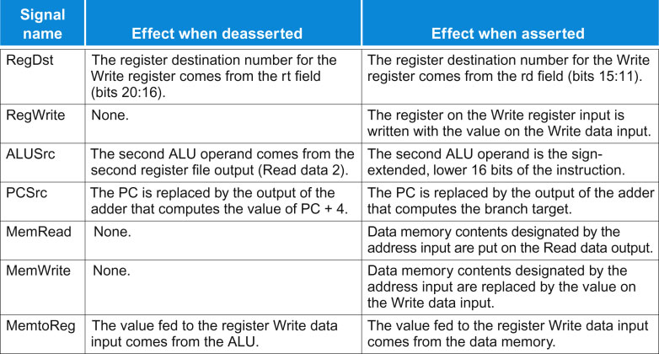
Summary of other control signals

Slide 6
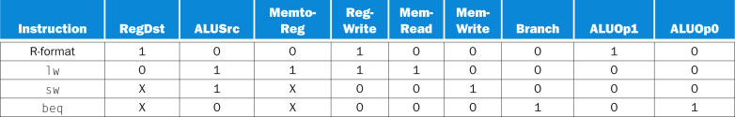
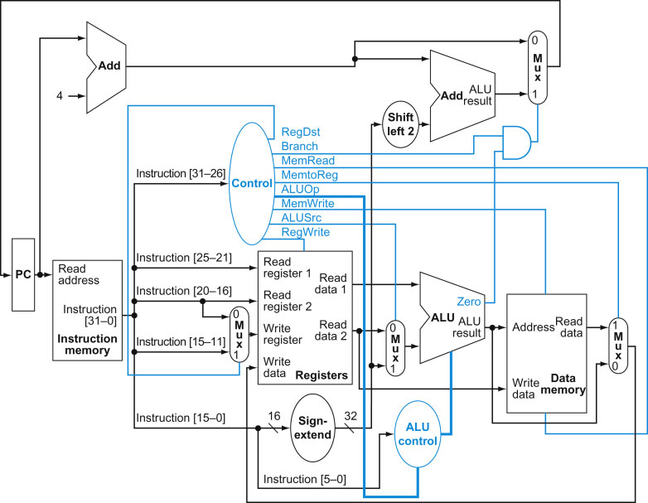
Control unit for generating control signals
All control signals can be generated based on the opcode itself, except for the beq instruction
For the beq instruction depending on Zero, the mux control signal is changed

Slide 7
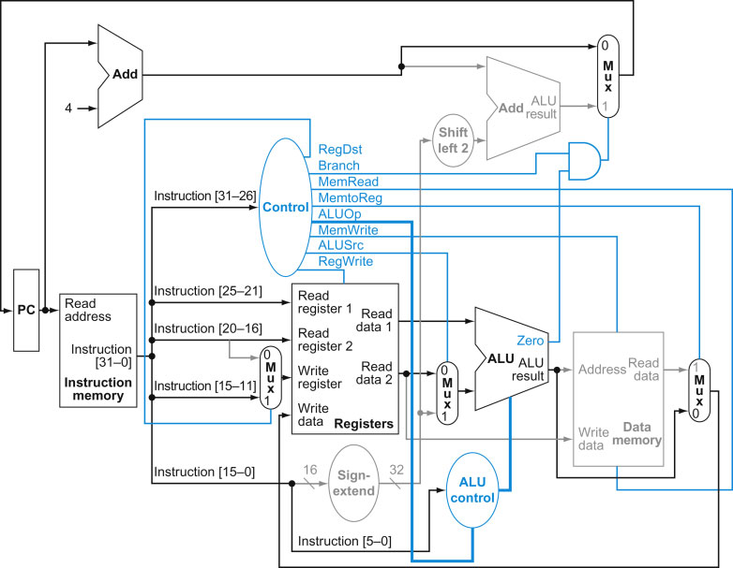
Executing the add r1, r2, r3 instruction

Slide 8
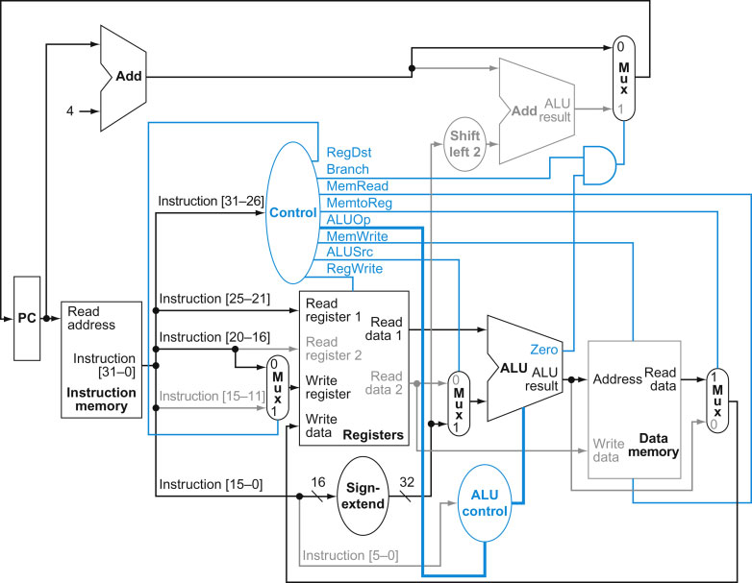
Executing the load r1, [r2 + offset] instruction

Slide 9
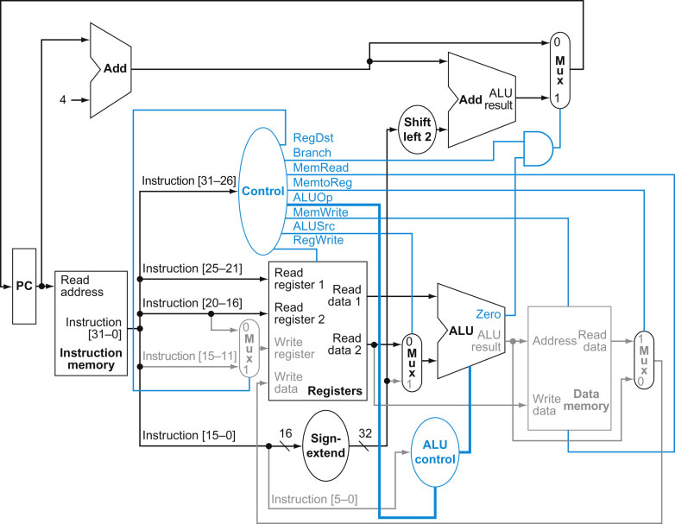
Executing the beq r1, r2, offset instruction

Slide 10
Adding an unconditional jump instruction
The instruction format is different from the formats that we have seen.
The PC is 32 bits wide. How to compute the value that the PC should be updated with ?
31-28 bits of current PC + 4 | 26 bits from the instruction | 00

Slide 11
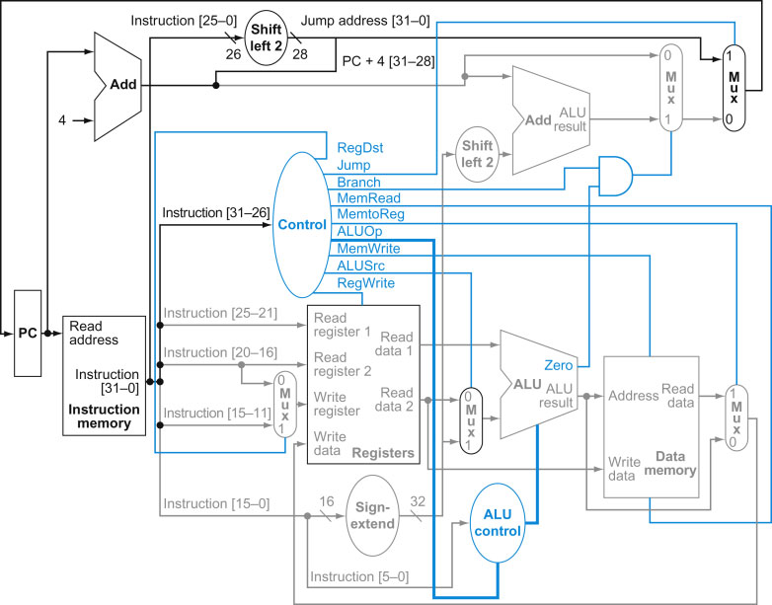
Adding an unconditional jump instruction
31-28 bits of current PC + 4 | 26 bits from the instruction | 00

Slide 12
Single cycle data path processors
The instructions that we have seen are implemented so that each instruction takes one clock cycle to complete - single cycle data paths
We need multiple copies of the same component - for example adders in our processor design. There is less reuse of component.
The clock period is therefore decided by the slowest instruction
The instruction that has the most propagation delays is the slowest instruction
Violates a design principle of making common cases fast
Not feasible to vary the clock period depending on the instruction - added complexity in the design

Slide 13
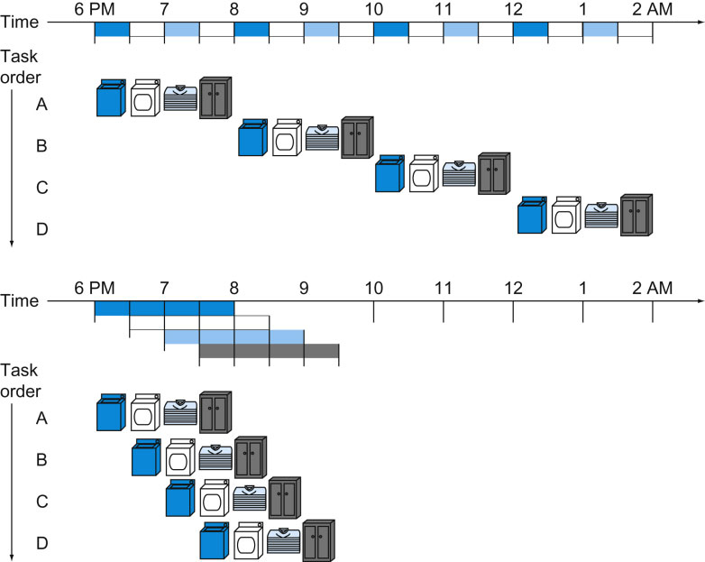
Introduction to Pipelining
Each task consists of a series of steps
Each step can be independently executed on a device/circuit devoted to that step
The improvement is on the total time to execute a number of tasks, not on the total time for a single task

