Slide 1

Department of Avionics,
Indian Institute of Space Science and Technology
AV224 - Computer Organization & Operating Systems
Instructor: Vineeth B. S. (vineethbs@iist.ac.in)
Lecture 24
02/03/2017
Figures in these lecture slides are taken from Hennessy and Patterson's
Computer Organization and Design
(Copyright © 2014 Elsevier Inc. All rights reserved)

Slide 2
Review
Locality principles
Spatial
Temporal
Hierarchy of memories
Terminology: Hit, miss, hit rate, miss rate, miss penalty
Caches
Basics of caches
Block sizes for caches
Measurement of cache performance
Improving cache performance - associativity & multi level caches
Processor
Large and slow
memory
holds all items
Small and fast
memory
holds items recently accessed, items near items recently accessed.

Slide 3
Virtual memory
The main memory or (D)RAM is used as a cache for the hard disk
Programs get an extremely large (but virtual) memory (e.g. 4 GB even though the main memory is only 1 GB)
Each program actually gets its own virtual memory space which is protected from other programs - other programs cannot read or write into this space. Very important for a processor to run multiple programs at once
Programs refer to virtual addresses in the virtual memory address space
The hardware and the operating system together translates these virtual addresses into physical addresses used by the devices which actually store the data
The OS and the hardware can make sure that programs are protected from one another
Usually the commonly used parts of a program - either instruction or data are kept in main memory - while the rest of the program is kept on the hard disk. This is locality principle in action!

Slide 4
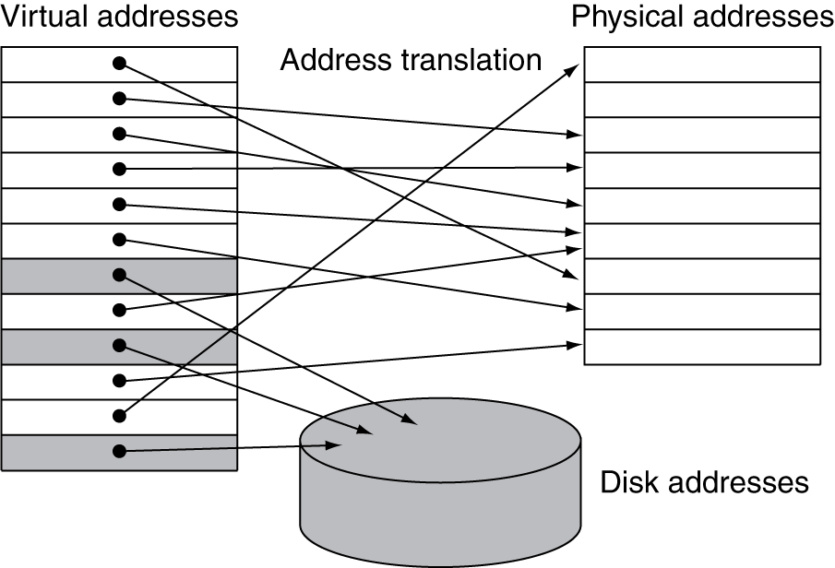
Virtual memory
A block of virtual memory is called a page
A virtual memory miss is called a page fault
The processor produces a virtual address which is translated by a combination of hardware and software into a physical address using address mapping/translation.

Slide 5
Virtual memory during progam loading
Programs are organized as pages
The operating system needs to find a sufficient number of free pages in main memory to start running the program
No need to get contiguous memory
No need to load the program at a specific location in main memory
Virtual memory can be used to provide relocation

Slide 6
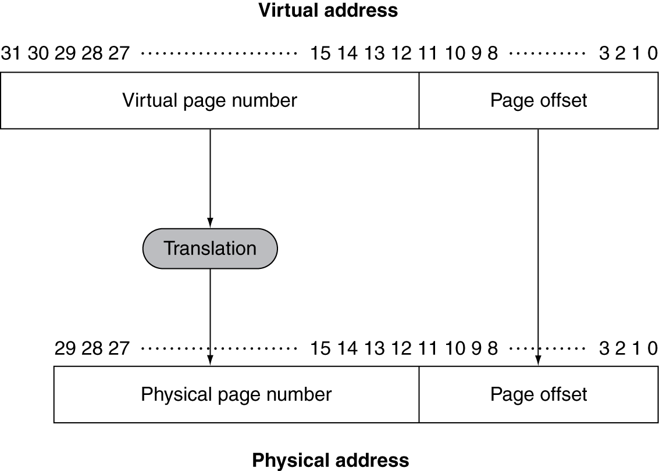
Virtual memory - addresses and address translation
The virtual address is split into two parts
The page offset
The virtual page number
The virtual page number is translated into a physical page number, which shows the location in main memory
Pages in this case (or blocks) are large - 4 KB to 16 KB to even 64 KB in size
Page faults are handled by the operating system
Write through is not used; usually write back is used.
Page faults (misses) are very expensive
Use fully associative method
Use better replacement algorithms than LRU
Usually virtual address space is much larger compared to the actual memory available

Slide 7
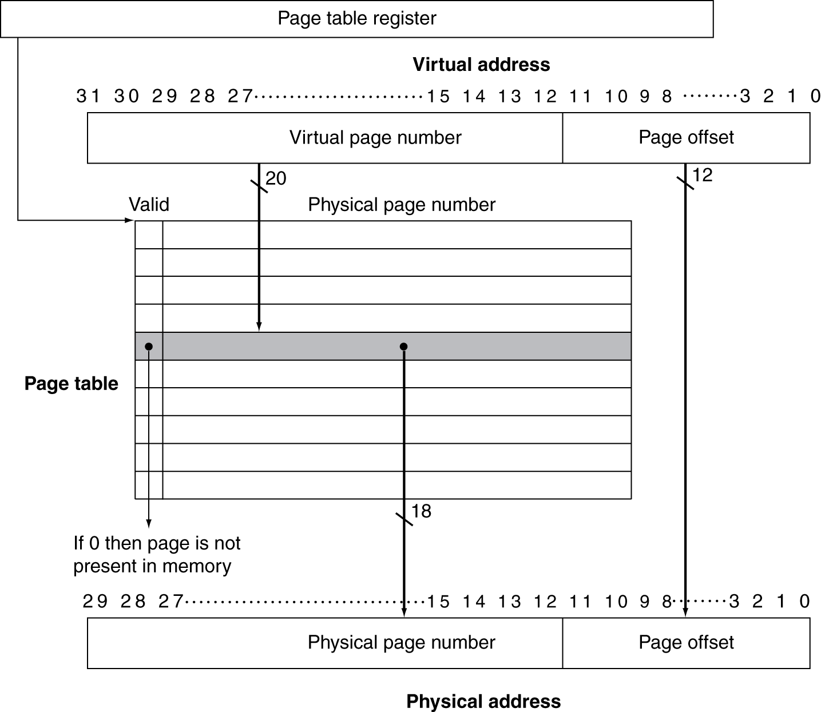
Virtual memory - implementing fully associative caching of pages
Searching all the pages in main memory is difficult!
Implemented using a page table
The index of the page table is the page number from the virtual memory address
The contents at that index is the physical address of the page
The whole virtual address space is mapped
Some virtual pages may not be stored in main memory
This is indicated using the valid bit
How is this different from caching?
The page table is itself stored in memory
Processors have a page table register that points to the page table
Each program can have its own page table
OS needs to change the page table register when different programs are run
Process: Programs along with such state variables

Slide 8
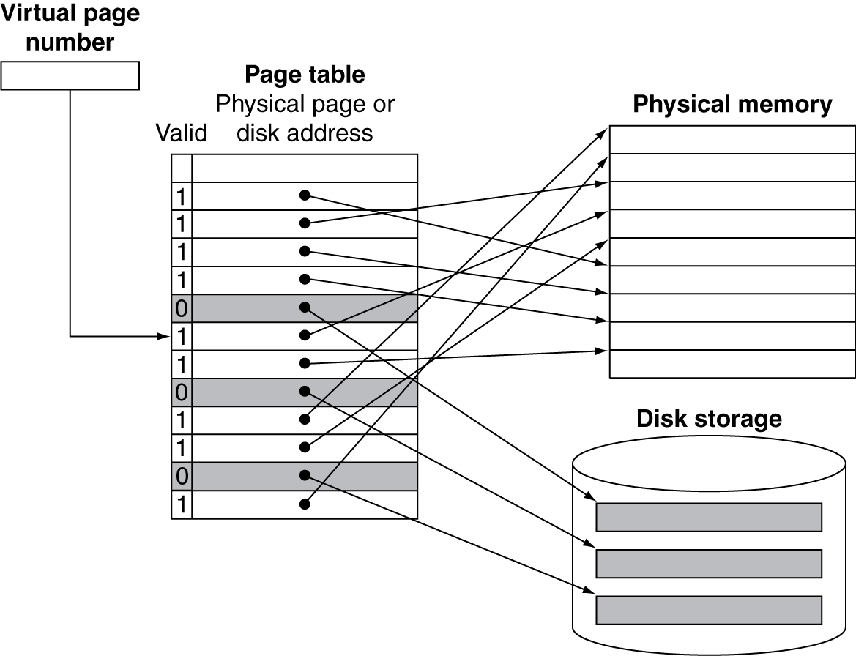
Virtual memory - handling page faults
Suppose the valid bit is zero for a virtual memory address
Then that page is not cached - so a page fault
The control passes to the operating system which has to load that page from the hard disk into the specified location in memory
Operating system uses the swap space to store the all pages of a program
Also records where each virtual page is stored on disk
For example, it can use the page table to do this
If all pages in the main memory are in use, then the operating system uses a policy - such as LRU - to decide which page needs to be replaced
Reference bit in the page table is set when a page is used. The OS clears the reference bit periodically. So it can use just one bit to get an idea of whether a page was recently accessed

Slide 9
Size of page tables - example
32 bit virtual address
4 KB pages
4 bytes per page table entry
4 KB = 12 bits
20 bits for page address
Page table size = 2²² = 4 MB
What if there are multiple programs running?
Limit the size of page tables - allow page tables to grow if needed

Slide 10
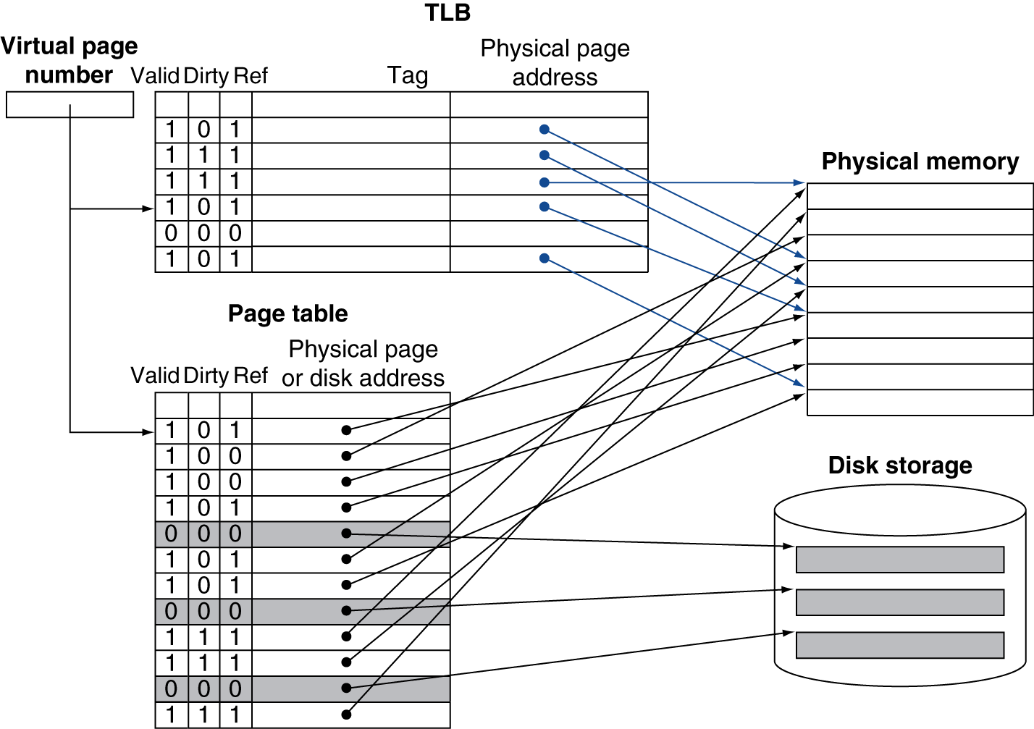
Virtual memory - dirty pages
Suppose there is a page in main memory and one of the words in that page was written to
Write through is not efficient, as we don't want to write to the disk everytime to maintain consistency (disk access is of the order of millions of processor cycle times)
Write back is used
The page table also consists of a dirty bit.
The bit is set whenever any word on a page is modified
If the dirty bit is set for a page which has to be replaced, then it needs to be written back to the disk

Slide 11
Virtual memory - Translation Lookaside Buffers (TLBs)
Page tables are stored in main memory
Each main memory access actual requires two memory accesses!
One to access page table using the virtual address
And the next to access the actual physical address obtained from the page table
Locality of reference to the page table comes to the rescue
Special cache for recent translations (from virtual to physical addresses)
Translation Lookaside Buffer or Translation Cache

Slide 12
Translation Lookaside Buffer operation
If TLB hit, then translate directly and use
If TLB miss
Not in TLB but in page table
Load from page table to TLB (just like a cache miss)
Page fault
The page needs to the loaded into the memory, possibly swapped

Slide 13
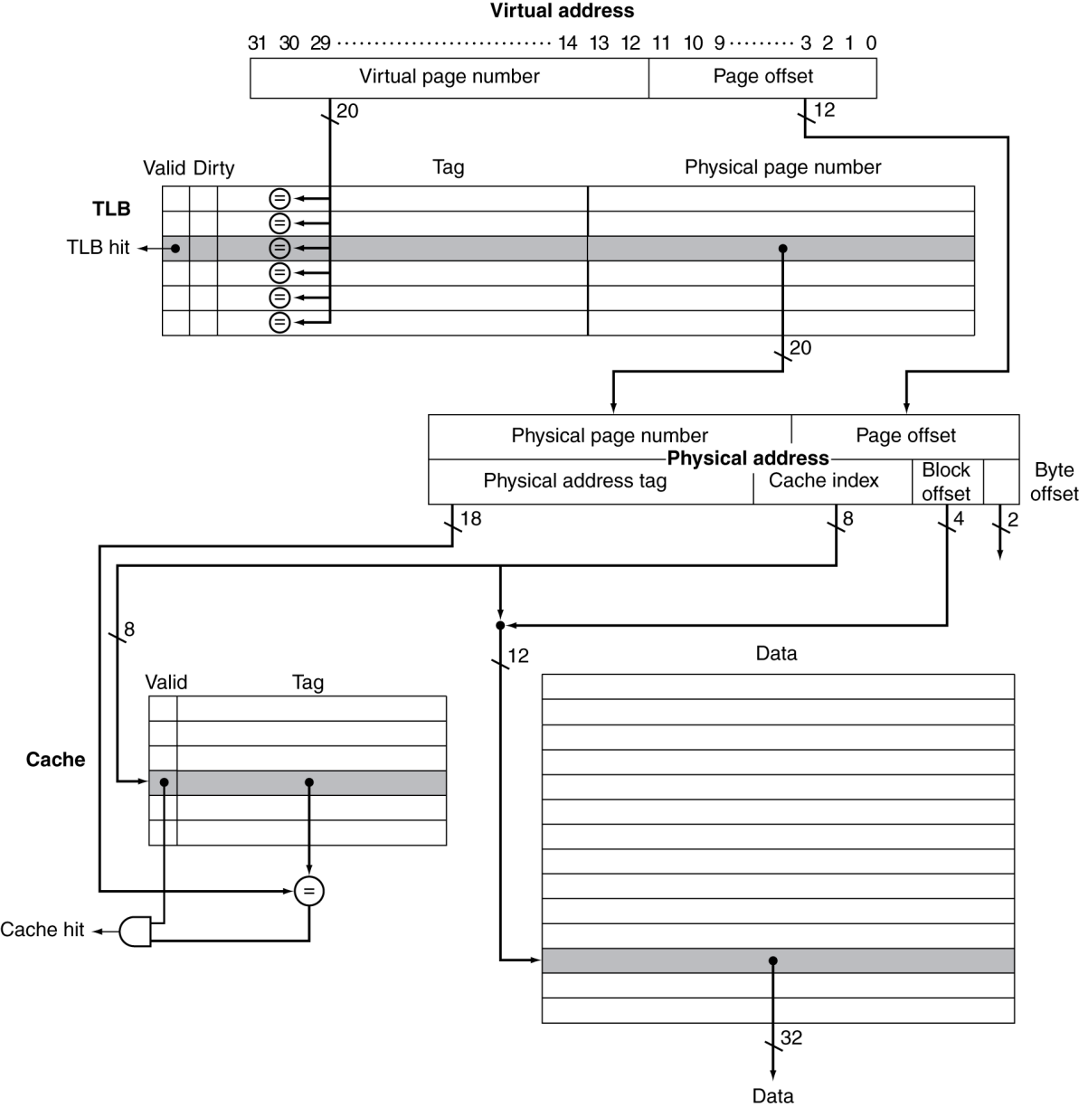
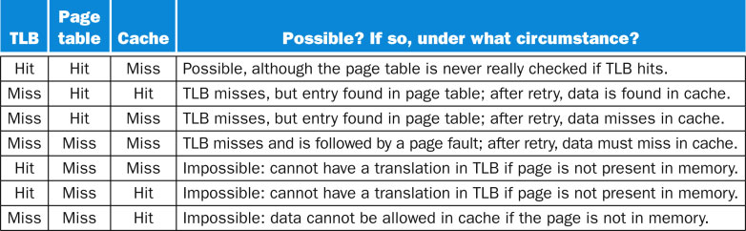
Translation Lookaside Buffer along with Caches
Virtual memory and caches work together as a hierarchy
If the cache tag uses physical address then we need a scheme that does virtual to physical translation
Several possibilities arise in the hierarchy as shown below

Slide 14
Memory protection
TLB usually contains a write access bit - indicating whether the page can be written to
Protection is implemented by the operating system with support from the underlying hardware
Two modes - kernel/supervisor and user
In user mode, several important registers (page table register, page table) are only readable
In kernel mode, the operating system can control these registers
System calls - from user mode to kernel mode (an exception)
ERET - return from exception, from kernel mode to user mode
How to make sure that processes don't read other program's data?

