Slide 1

Department of Avionics,
Indian Institute of Space Science and Technology
AV224 - Computer Organization & Operating Systems
Instructor: Vineeth B. S. (vineethbs@iist.ac.in)
Lecture 25
08/03/2017
Figures in these lecture slides are taken from Hennessy and Patterson's
Computer Organization and Design
(Copyright © 2014 Elsevier Inc. All rights reserved)

Slide 2
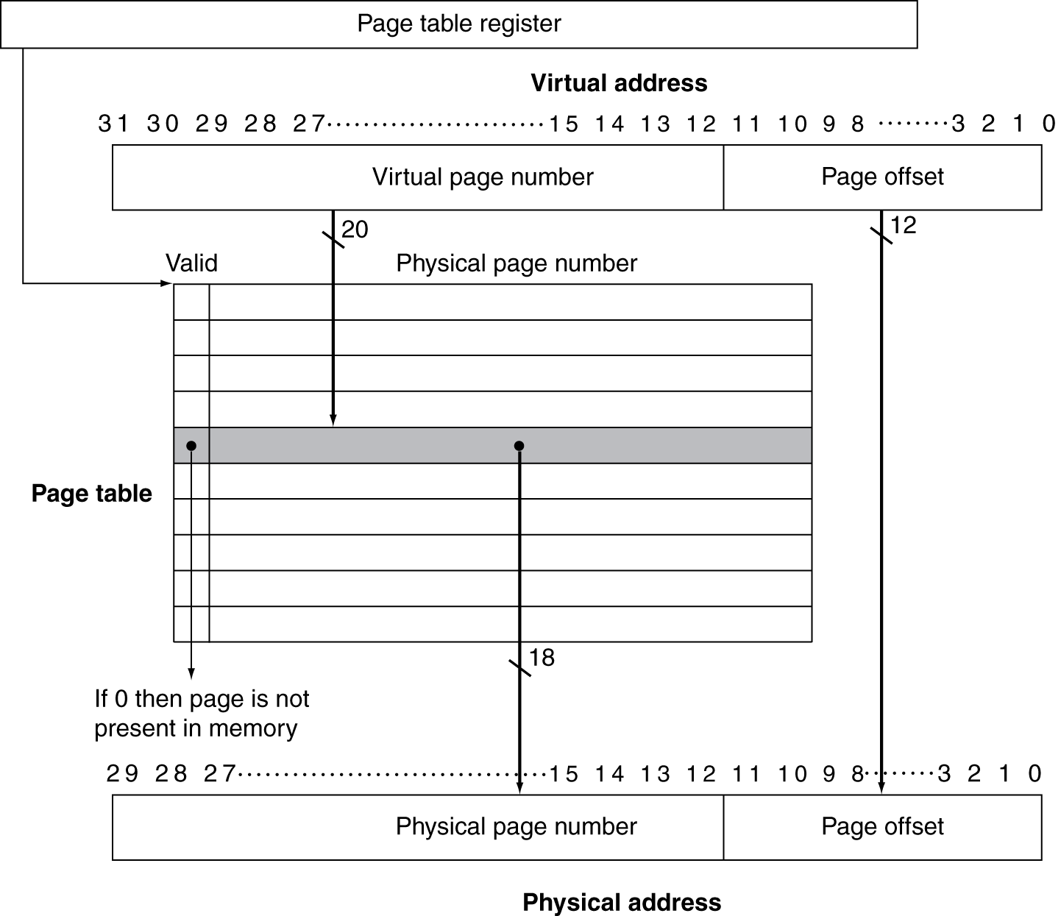
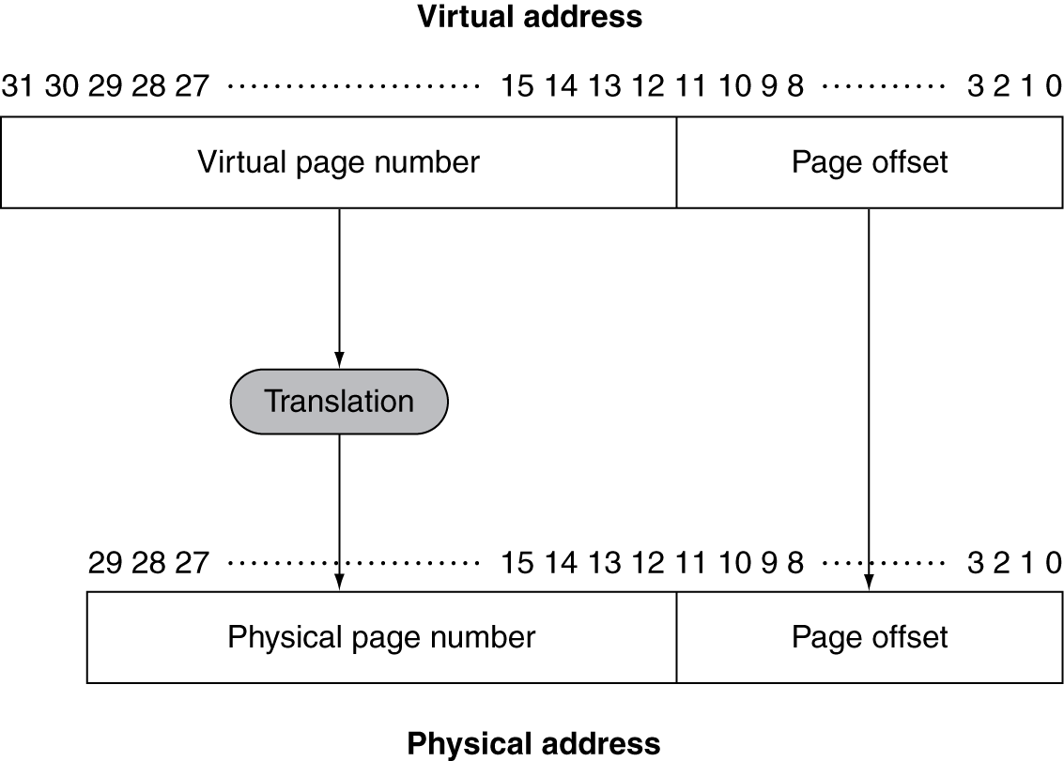
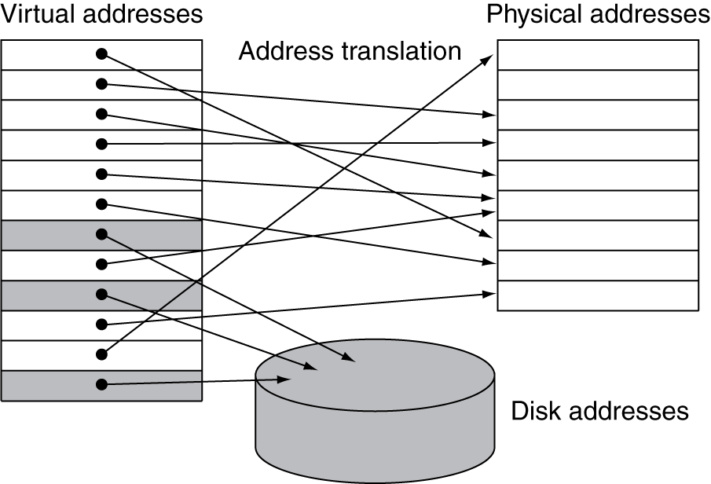
Review
Locality principles
Spatial
Temporal
Virtual memory
Main memory and Hard disk (swap space)
Virtual and Physical address
Address translation
Page tables for address translation
Examples
Handling page faults - Exceptions
Translation lookaside buffers

Slide 3
Memory protection
TLB usually contains a write access bit - indicating whether the page can be written to
Protection is implemented by the operating system with support from the underlying hardware
Two modes - kernel/supervisor and user
In user mode, several important registers (page table register, page table) are only readable
In kernel mode, the operating system can control these registers
System calls - from user mode to kernel mode (an exception)
ERET - return from exception, from kernel mode to user mode
How to make sure that processes don't read other program's data?
This is done by the operating system when populating the page tables
The programs should not be able to change the page tables
Only modifiable in kernel mode
Issues with TLB and caches
When a processor switches between two processes - we have a context/process switch
After a switch the TLB and caches would contain data from the process we have switched from
Clear TLB and caches? - too much overhead if processor switches very fast
Extend virtual address space using process or task identifier
The tag field in caches is also extended using this identifier
Hit occurs only if the process or task identifiers match

Slide 4
Summary of memory hierarchies
Where can a block be placed?
Direct mapped
n-way set associative
fully associative
How is a block found?
Direct mapped - index
n-way set associative - index into set and then search within set
fully associative - search all
Which block should be replaced on a cache miss?
LRU or Random
What happens on a write?
Write back or Write through
Reference - Chapter 5 of the textbook Hennessy and Patterson

Slide 5
Where are we?
Program 1
Program 2
Program n
...
Operating System
ISA
Interface to H/W
Hardware
Processor
Memory
Chapter 6
Input, Output, & Storage

Slide 6
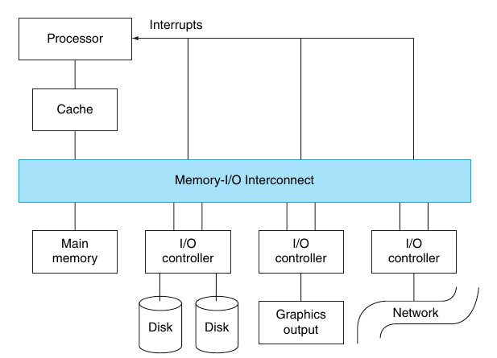
An illustration
Reference - Chapter 6 of the textbook Hennessy and Patterson

Slide 7
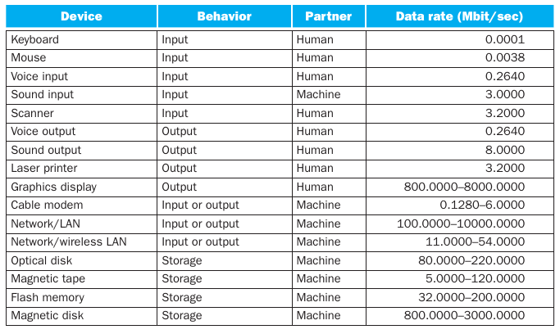
Input, Output, and Storage devices
More emphasis on
Dependability, Reliability rather than performance
Expandability and ability to handle diverse devices
I/O devices have the following three characteristics (useful for classifying these devices)
Behaviour: Input (Read only), Output (Write only, cannot be read), or Storage (re-read and re-written)
Partner: Human or Machine at the other end
Data Rate

Slide 8
Magnetic storage
Consists of a rotating platter with discs surfaces coated with magnetic material
Each disc has two surfaces (upper and lower)
Each platter may have 1 - 4 discs
Platter rotation - 5400 to 15000 rpm
Movable read write head to access the disk
Non volatile storage
Each disc surface is divided into concentric circles called tracks
Typically 10,000 to 50,000 tracks per surface
Each track is divided into sectors
Each track can contain 100 to 500 sectors
Each sector is 512 bytes in size
When storing each sector also contains a sector number and an error correction code
Variable number of sectors per track
All disk heads move together
The disk heads are placed on the same track for every disc in the platter
The set of tracks forms a cylinder
Accessing data from disks
CHS and LBA
Seek time (movement of heads)
Rotational latency (rotation to get the correct sector)
Transfer time
Control time
Reading assignment:
RAID
Flash storage

Slide 9
Connecting the processor to other devices - Bus
A single set of wires (or lines)
Shared by multiple devices
Extensible - easy to add more devices
Has to support multiple devices with different speeds
Communication bottleneck
Bus components
Control lines
Requests and acknowledgements
Type of data
Data lines
Bus classification
Topologies
Parallel and Serial Buses
Synchronous and Asynchronous buses
Processor-Memory buses and I/O buses
I/O buses are connected to memory using a backplane bus
Bus transaction
Addressing
Sending or receiving the data
Handshaking protocols for asynchronous protocols

Slide 10
Examples of buses (standards)
Standard buses enable separation between computer designers and device designers
Some example standards
Firewire
USB
SATA, PATA
PCI, PCI-Express
Reading assignment:
Bus standards from Hennessy and Patterson

Slide 11
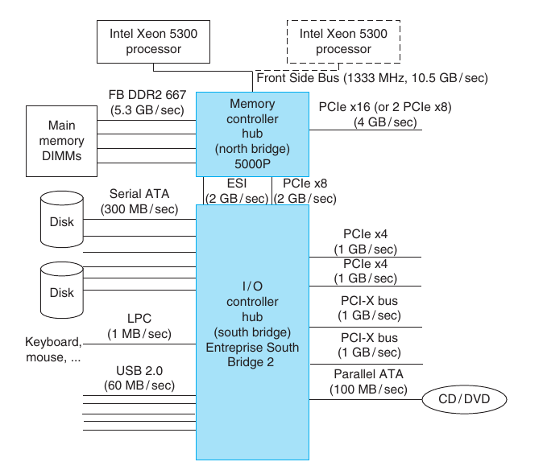
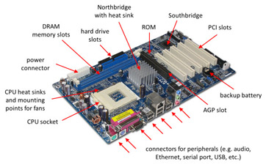
The processor along with other devices

Slide 12
More about interfacing devices with the processor and memory
Bus standard or protocol specifies how a word or block of data is made available
What is the program's or programmer's view of the bus, bus transactions?
The operating system plays a major role
Multiple programs (more precisely, processes) use the same I/O devices
I/O systems uses interrupts - interrupts cause branching to interrupt handlers which are part of the OS
Control of I/O systems is very detailed and done by OS drivers
The OS which runs on the processor has to command (write to) the I/O system or get information/data from the I/O system (read from)
There are two ways in which this is done
Memory mapped I/O - part of the address space is dedicated to I/O devices
Special instructions for accessing I/O
OS prevents access to I/O - how can it use virtual memory for this?
Communicating with the processor
Polling
Interrupts - with priorities
Transferring data between devices and memory
Using the above two schemes - the processor is an intermediary; good for low bandwidth devices
Direct memory access - DMA; processor needs to setup a DMA transfer and on completion do some checks

Slide 13
Summary
A large variety of I/O devices
Storage
Magnetic storage
Buses
Common features and concepts
I/O, Processor and Memory
Memory mapped I/O
Polling and interrupt driven I/O
DMA
Putting all components together
The motherboard of a computer
Reference - Chapter 6 of the textbook Hennessy and Patterson

