Slide 1

Department of Avionics,
Indian Institute of Space Science and Technology
AV224 - Computer Organization & Operating Systems
Instructor: Vineeth B. S. (vineethbs@iist.ac.in)
Lecture 23
02/03/2017
Figures in these lecture slides are taken from Hennessy and Patterson's
Computer Organization and Design
(Copyright © 2014 Elsevier Inc. All rights reserved)

Slide 2
Review
Locality principles
Spatial
Temporal
Hierarchy of memories
Terminology: Hit, miss, hit rate, miss rate, miss penalty
Caches
Direct mapped caches
Accessing direct mapped caches
Cache miss
Writing into caches
Processor
Large and slow
memory
holds all items
Small and fast
memory
holds items recently accessed, items near items recently accessed.

Slide 3
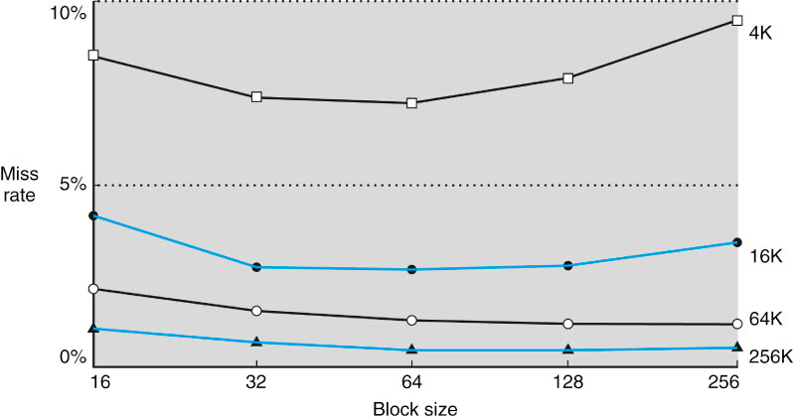
Block size for caches
Larger block sizes should reduce the miss rate or reduce the running time
Due to spatial locality
But how much spatial locality is there?
Cache sizes are fixed
Fewer blocks means competition between blocks
Larger miss penalty

Slide 4
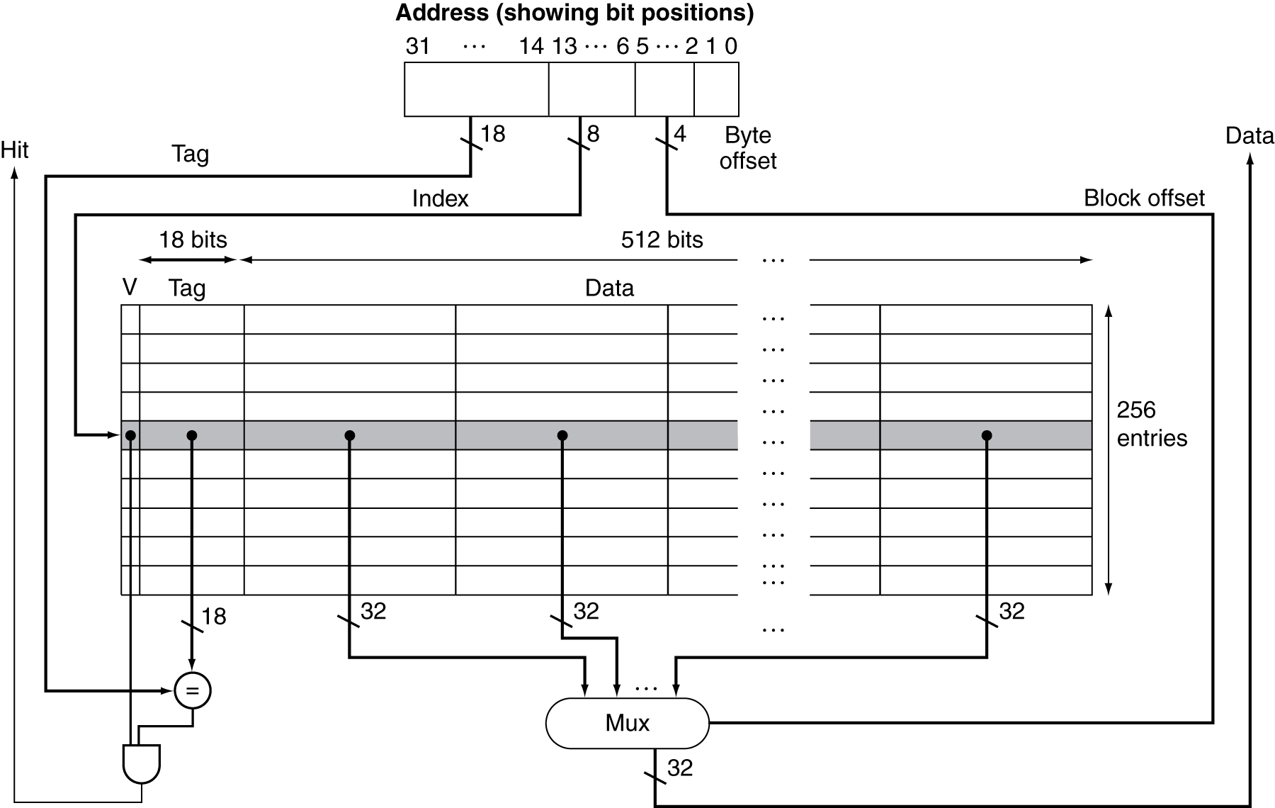
Caches with a block size more than a word
Need a multiplexor to select the right word from a block
Suppose the cache has 64 blocks
Each block has 16 bytes or 4 words (what happens if blocks are not the same as words)
Suppose the processor addresses the byte 1200
This comes in the floor( 1200 / 16 ) = 75th block
Since there are only 64 blocks, the block address in the cache is 75 modulo 64 = 11
Note that the byte offset is also used in this example!
6 bits
8 bits

Slide 5
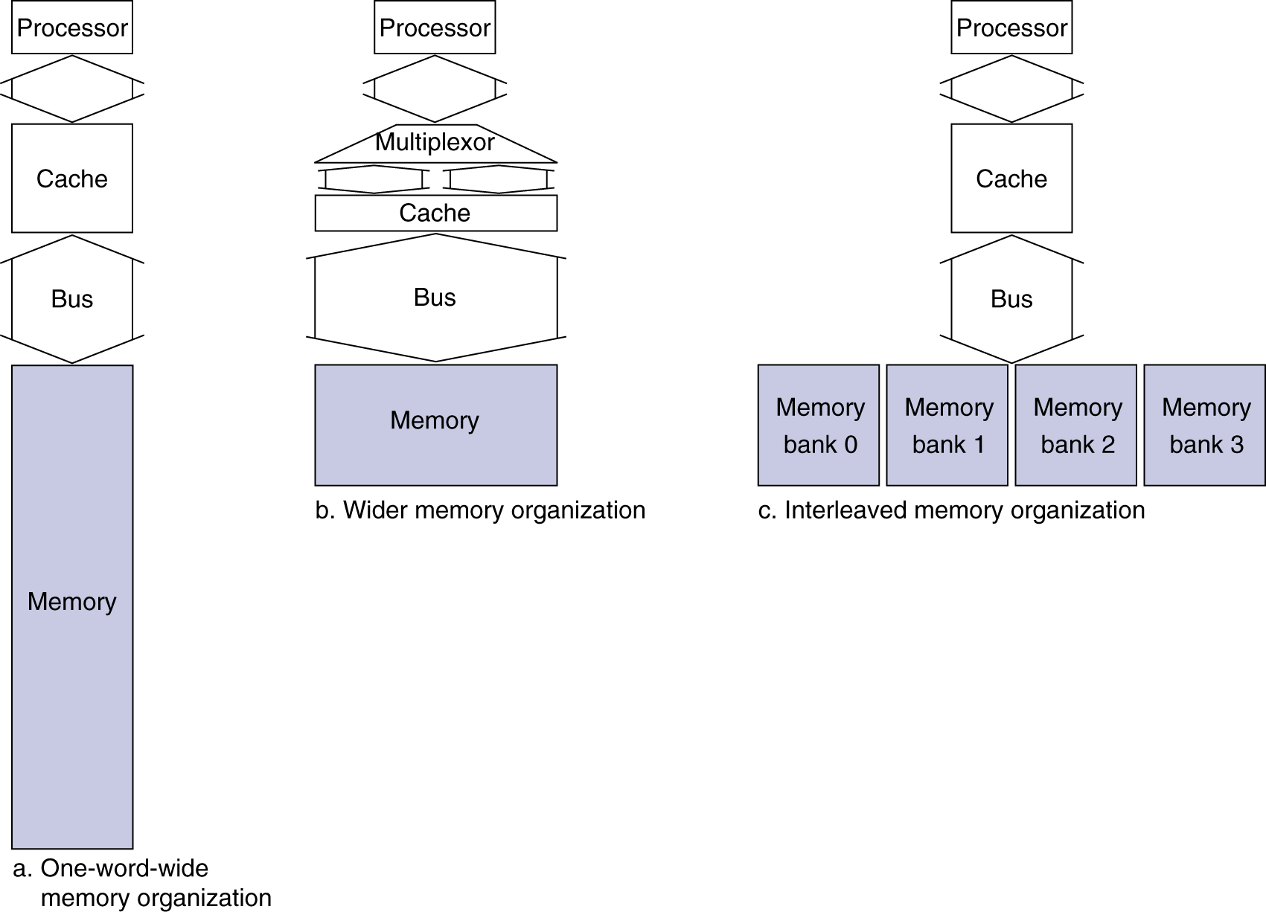
Memory organization for supporting caching
There is an optimal block size (number of words in the block) that we need to implement.
There are many ways to organize main (DRAM) memory
Which is best in terms of memory access times?
Assume
1 memory bus clock cycle to send the address
15 memory bus clock cycles to access the DRAM
1 memory bus clock cycle to send a word back from memory
If cache block is 4 words long, then the miss penalty is 1 + 4 x 15 + 4 x 1 = 65 memory bus clock cycles for the case where memory itself is 1 word wide

Slide 6
Memory organization for supporting caching
Assume
1 memory bus clock cycle to send the address
15 memory bus clock cycles to access the DRAM
1 memory bus clock cycle to send a word back from memory
If memory is 2 words wide and the bus is also 2 words wide, then the number of bus cycles needed is 1 + 2 x 15 + 2 x 1 = 33
If we arrange memory in banks, then it is possible to have the advantage of wider memory but lesser bus width.
When an address is put on the address lines the memory banks are accessed independently. However, data transfer occurs sequentially from each bank
For example, number of bus cycles needed is 1 + 1 x 15 + 4 x 1 = 20

Slide 7
Measuring cache performance
Total CPU time = CPU clock cycle time x (# CPU execution clock cycles + # memory stall clock cycles)
# memory stall clock cycles = # read stall cycles + # write stall cycles
# read stall cycles = reads/program x read miss rate x read miss penalty
# write stall cycles = writes/program x write miss rate x write miss penalty + # write buffer stalls
If write buffer is properly designed, then
# memory stall clock cycles = memory accesses/program x miss rate x miss penalty = instructions/program x misses/instruction x miss penalty
An example
Miss rate of an instruction cache is 2% per instruction
Miss rate of a data cache is 4% per instruction
Processor CPI is 2 clocks per instruction
Miss penalty is 100 cycles
Percentage of loads and stores in the program is 36%
Instruction miss cycles is 2 % x 100 = 2 per instruction
Data miss cycles is 36 % x 4 % x 100 = 1.44 per instruction
Processor takes on average 2 + 2 + 1.44 cycles per instruction
Exercise: Complete this example from the textbook, where the performance with an ideal cache is compared with the above case

Slide 8
Improving cache performance - reducing conflict between blocks mapped into same locations in cache
Direct mapped caches - a fixed rule tells us where the contents of a particular block in memory should be placed in the cache
Conflict between two blocks might decrease cache performance
Fully associative caches
A block in main memory can be placed at any location in the cache
To check whether there is a hit or not, all the blocks and associated address information in the cache should be searched
Need as many address comparators as there are blocks - so expensive hardware
Set associative caches
There are n fixed locations where a block can be placed (instead of one in a direct mapped scheme)
However, the block cannot be placed in any other location
This is called an n-way set associative cache
Each block in memory maps to a unique set of locations in the cache, and the block can occupy any location within that set
The set address of a block is given by
block number (modulo) number of sets in the cache
But we need to search all blocks in a cache set at once - requires lesser number of comparators compared to fully associative cache

Slide 9
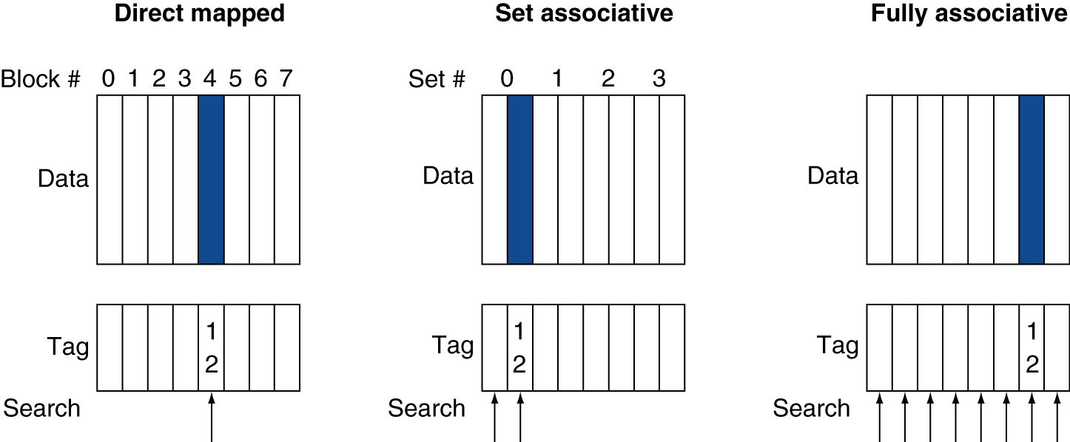
Improving cache performance - reducing conflict between blocks mapped into same locations in cache
Direct mapped caches - a fixed rule tells us where the contents of a particular block in memory should be placed in the cache
Conflict between two blocks might decrease cache performance
Fully associative caches
A block in main memory can be placed at any location in the cache
To check whether there is a hit or not, all the blocks and associated address information in the cache should be searched
n-way set associative caches
Each block in memory maps to a unique set of locations in the cache, and the block can occupy any location within that set
The set address of a block is given by
block number (modulo) number of sets in the cache

Slide 10
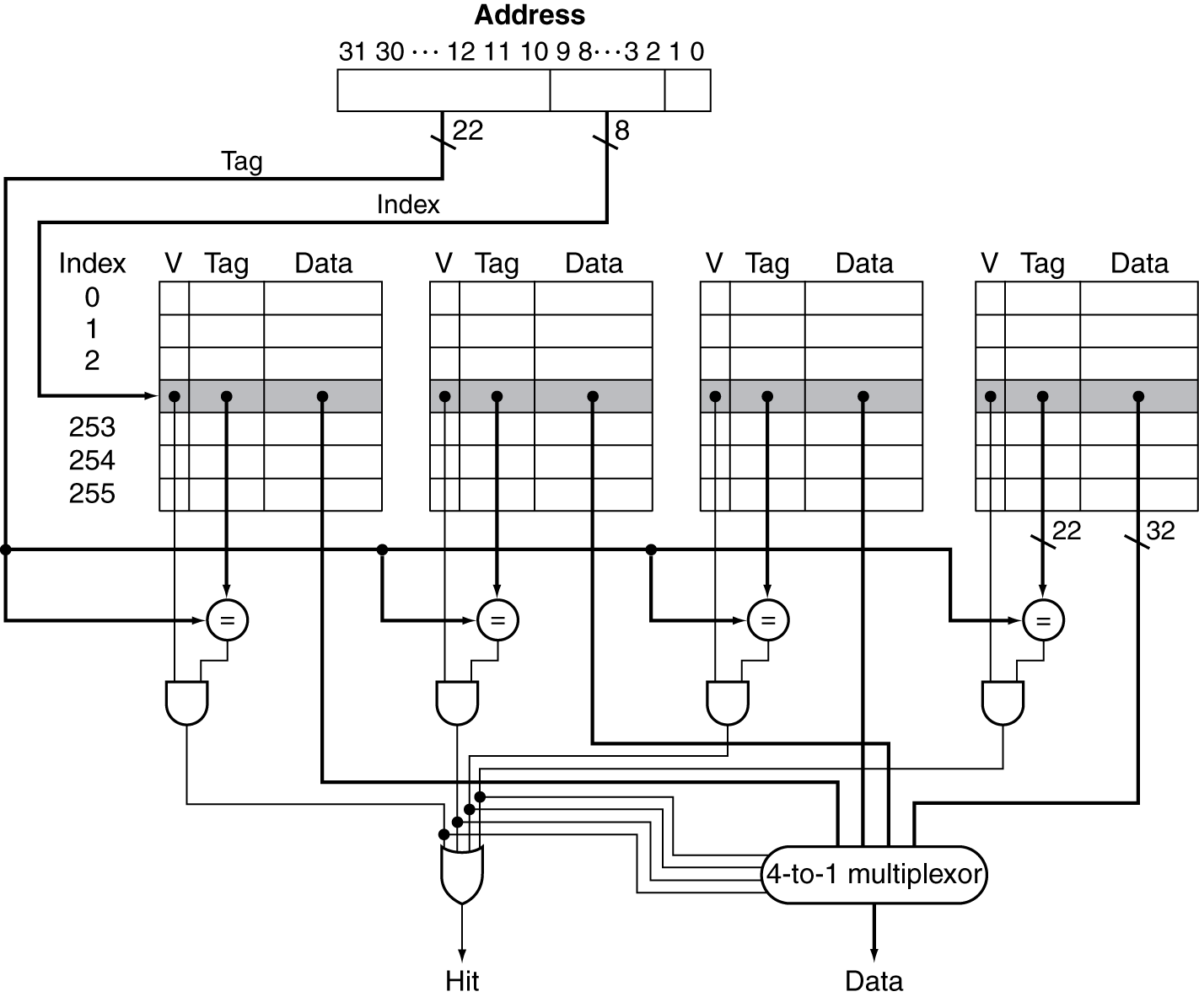
A set associative cache
Suppose there are 256 sets
The number of blocks in each set is 4
Suppose each block = 1 word = 32 bits

Slide 11
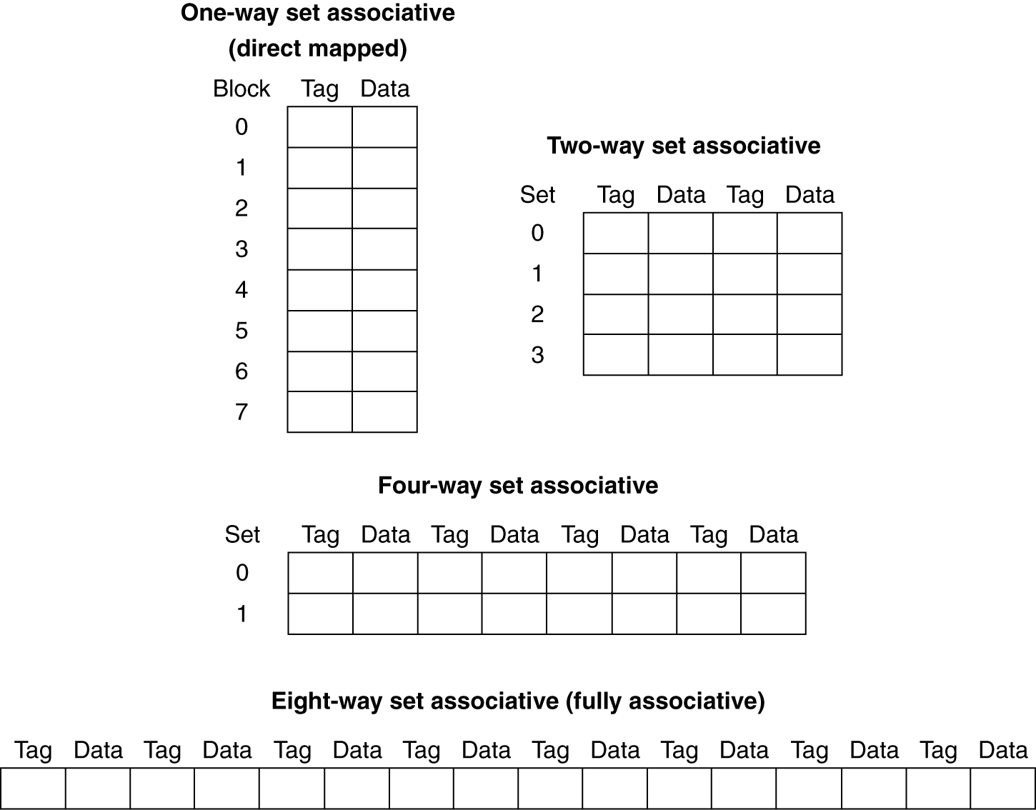
Various forms of associativity
Consider a cache with 8 blocks
Associativity should decrease miss time
But it can potentially increase the hit time

Slide 12
Various forms of associativity
Direct mapped
Consider a cache with 4 blocks
Each block is 1 word
Suppose the processor accesses the locations 0,8,0,6,8
Schemes for block replacement
If non-valid entry, then use that!
No option in direct mapped
In fully associative any other block can be replaced
In set associative any other block in the set can be replaced
Least recently used
Random
Block address | Cache index | Hit/miss | Cache content after access
 |  |  | 0 | 1 | 2 | 3
0 | 0 | miss | Mem[0]
8 | 0 | miss | Mem[8]
0 | 0 | miss | Mem[0]
6 | 2 | miss | Mem[0] |  | Mem[6]
8 | 0 | miss | Mem[8] |  | Mem[6]
2 way set associative
Block address | Cache index | Hit/miss | Cache content after access
 |  |  | Set 0 |  | Set 1
0 | 0 | miss | Mem[0]
8 | 0 | miss | Mem[0] | Mem[8]
0 | 0 | hit | Mem[0] | Mem[8]
6 | 0 | miss | Mem[0] | Mem[6]
8 | 0 | miss | Mem[8] | Mem[6]
Fully associative
Block address |  | Hit/miss | Cache content after access
0 |  | miss | Mem[0]
8 |  | miss | Mem[0] | Mem[8]
0 |  | hit | Mem[0] | Mem[8]
6 |  | miss | Mem[0] | Mem[8] | Mem[6]
8 |  | hit | Mem[0] | Mem[8] | Mem[6]

Slide 13
Improving cache performance - using multi level caches
Multiple levels of cache between the processor and the main memory
Level 1 or L1 cache nearest to the processor
Level 2 or L2 cache on the same chip as the processor
Serves misses from the L1 cache
Does this improve performance?
Example
Processor has a CPI of 1
Clock rate is 4 GHz = 0.25 ns
Main memory access time is 100 ns = 400 clock cycles
Miss rate per instruction at L1 is 2 %
L2 cache has 5 ns (= 20 clock cycles) access time
L2 cache reduces the miss rate to main memory by 0.5 % per instruction
If only L1 then CPU CPI = 1 + 2 % x 400 = 9
If L1 and L2 present then
CPU CPI = 1 + 2% x 20 + 0.5% x 400 = 3.4

Slide 14
Summary
The importance of an optimal block size for caches
Memory organizations for realizing the above block size
Cache organziation for a block size = n words
Example of cache performance computation
Improving cache performance
Using associativity
Using multilevel caches
Reference: Hennessy and Patterson

