Slide 1


Tourism Package & Travel Booking DBMS
PBL · CS302
RELATIONAL ARCHITECTURE
Centralized Relational Architecture for Enterprise Travel Management
Vineeth Emmanuel Pilli (25WU0102203)
Project-Based Learning (PBL) | Woxsen University, School of Technology

Slide 2
Operational friction is hiding in fragmented booking workflows
PROBLEM STATEMENT OPERATIONAL RISK
Decoupled spreadsheets and manual handoffs create silent vulnerabilities at scale.
01
Disconnected data
Spreadsheets create operational silos, stranding booking updates away from customer visibility and accounting ledgers.
02
Capacity conflicts
Unsynchronized inventory triggers seat overselling and departure overbooking during peak seasonal booking windows.
03
Resource overlaps
Guides and transport fleets get double-booked across concurrent itineraries without automated collision detection.
04
Financial leakage
Cancellations, policy penalties, and customer refunds go unverified, leaking agency margins without audit trails.
Data fragmentation
Seat allocation failure
Scheduling clash
Unverified payouts

Slide 3


One relational system turns travel operations into a controlled workflow
SOLUTION ARCHITECTURE WORKFLOW ENGINE
A continuous relational pipeline enforces governance at every operational transition.
STAGE 01
Centralize Master Data
Centralize agency master data into a normalized source of truth.
STAGE 03
Automate Financials
Automate payments, cancellations, and refund workflows.
STAGE 02
Enforce Business Rules
Enforce business rules to prevent resource clashes and overbooking.
STAGE 04
Role-Based Interfaces
Give agents, customers, and guides role-based dashboards.

Slide 4
Three user roles, one functional operating model
Travel Administrator
Governance & Operations
Create packages & day itineraries; assign certified guides to departures; schedule transport fleets & hotels; analyze revenue, capacity, & margins.
FULL ACCESS
Customer / Lead Traveller
Browse scheduled departures; book multi-passenger rosters; execute secure transaction payments.
BOOKING SURFACE
Tour Guide
Access assigned itinerary runs; inspect verified traveller manifest lists; log operational departure status.
FIELD DISPATCH
CENTRAL CONTROL CORE · Central Relational DBMS
Single unified PostgreSQL schema with role-based row-level security · Synchronized State Across All Client Surfaces
RBAC Validation Layer
Strict separation of read, write, and execute permissions
ACID Transaction Isolation
Zero-latency seat locks during payment execution

Slide 5
13 entities map the full travel operation across five zones
SCHEMA TOPOLOGY
CORE BRIDGING ARCHITECTURE
ZONE 3 · HUB
Departure
Bridging Nexus Entity
Binds Package + Guide + Transport to a specific date window, seat quota, and price schedule.
Central foreign-key pivot
ZONE 1
Master Data
Catalog definitions Destination Package Itinerary Day
ZONE 2
Resources
Field logistics assets
Guide Hotel Transport
ZONE 4
Transactions
Customer orders Customer Booking Traveller
ZONE 5
Financials
Settlement & refunds
Payment Cancellation Refund
Relational Cardinality: 1 Package → M Departures; 1 Departure → M Bookings; 1 Booking → M Travellers & Payments.

Slide 6
Integrity rules make the database the control layer
CONSTRAINTS & TRIGGERS
Enforced in Engine
GATE 01
Capacity Control
Passenger count cannot exceed departure max capacity.
GATE 02
Overlap Prevention
Time-range checks on Guide_ID and Transport_ID.
GATE 03
Financial Limit
Refund amount must be less than or equal to total payment.
GATE 04
Third Normal Form (3NF)
Schema is designed to Third Normal Form (3NF).

Slide 7
CRUD workflows create a full-stack management experience
APPLICATION LAYER FULL-STACK CRUD
Standard relational primitives power the end-to-end operator and traveller lifecycle.
C · CREATE
Create
Schedule new seasonal departures, register individual travellers, and generate structured payment transactions.
R · READ
Read & Search
Execute real-time seat availability queries, dynamic revenue reports, and dedicated guide assignment itineraries.
U · UPDATE
Update
Re-assign standby guides, adjust hotel allocations, and transition booking records from Pending to Confirmed.
D · DELETE
Delete / Control
Execute safe soft-cancellations, release reserved inventory, and evaluate automated policy refund eligibility.
INSERT INTO departures
SELECT * JOIN bookings
UPDATE booking_status
SOFT DELETE & REFUND

Slide 8
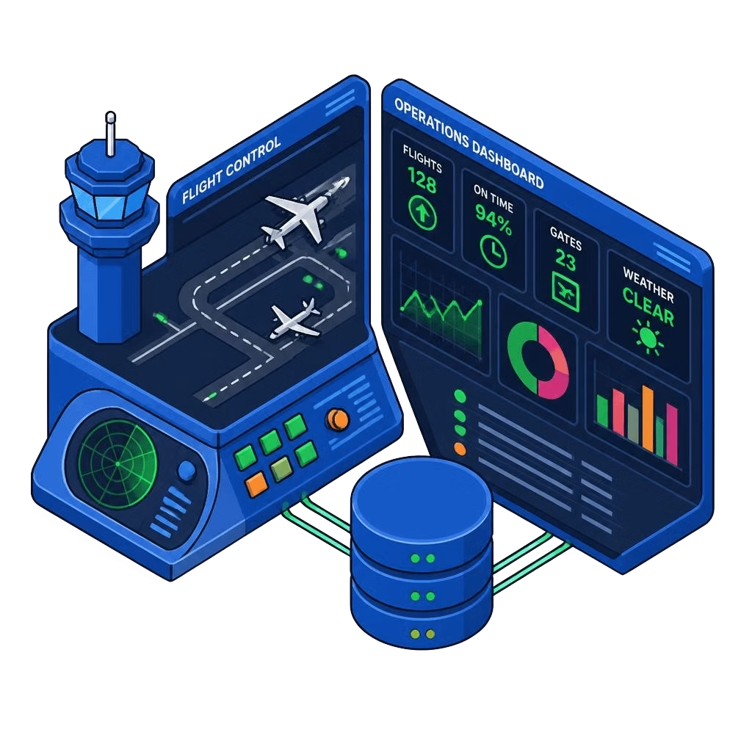
From fragmented booking to measurable operational control
BUSINESS IMPACT SYSTEM OUTCOMES
The DBMS converts travel complexity into reliable, auditable execution.
100%
Elimination of double-booked guides and vehicles
Zero
Overbooking: automated capacity validation triggers
Instant
Reporting: booking velocity, departure yields, and revenue tracking
Before: Manual Disconnect
Disparate sheets, unvalidated capacity, manual math errors.
After: Relational Control
Strict 3NF normalization, automated constraint gates, real-time rosters.

