Slide 1
Coursera Capstone
IBM Applied Data Science Capstone
Opening a Coffee Shop in Cincinnati, Ohio
By: Vineeth Kumar Kondamadugu
JULY 2020

Slide 2
Business Problem
Location of the Coffee Shops is one of the most important decisions that will determine whether the mall will be a success or a failure
Objective: To analyse and select the best locations in the city of Cincinnati, Ohio to open a new coffee shop
This project is timely as the city is currently suffering from oversupply of scoffee shops
Business question
In the city Cincinnati, Ohio, if a property developer is looking to open a new coffee shop, where would you recommend that they open it?

Slide 3
Data
Data required
List of neighbourhoods in Cincinnati
Latitude and longitude coordinates of the neighborhoods
Venue data, particularly data related to coffee shops
Sources of data
Wikipedia page for neighborhoods (https://en.wikipedia.org/wiki/Category:Neighborhoods_in_Cincinnati)
Geocoder package for latitude and longitude coordinates
Foursquare API for venue data

Slide 4
Methodology
Web scraping Wikipedia page for neighbourhoods list
Get latitude and longitude coordinates using Geocoder
Use Foursquare API to get venue data
Group data by neighbourhood and taking the mean of the frequency of occurrence of each venue category
Filter venue category Coffee Shop
Perform clustering on the data by using k-means clustering
Visualize the clusters in a map using Folium

Slide 5
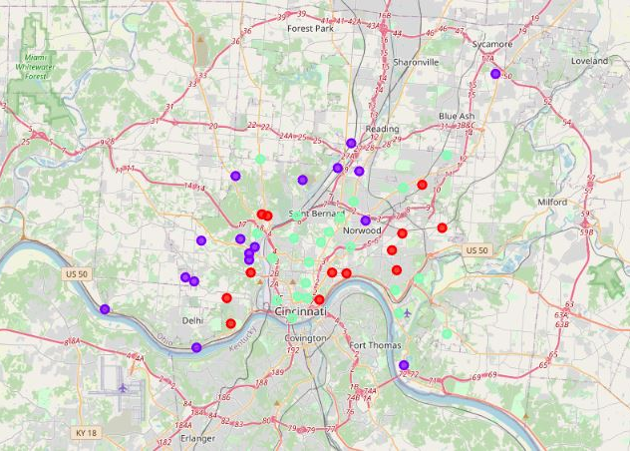
Results
Categorized the neighbourhoods into 3 clusters:
Cluster 0: Neighbourhoods with high number of shopping malls
Cluster 1: Neighbourhoods with low number to no existence of shopping malls
Cluster 2: Neighbourhoods with moderate concentration of shopping malls

Slide 6
Discussion
Most of the Coffee Shops are concentrated in the central area of the city
Highest number in cluster 0 and moderate number in cluster 2
Cluster 1 has very low number to no coffee shops in the neighbourhoods
Oversupply of coffee shops mostly happened in the central area of the city, with the suburb area still have very few shopping malls

Slide 7
Recommendations
Open new coffee shops in neighbourhoods in cluster 1 with little to no competition
Can also open in neighbourhoods in cluster 2 with moderate competition if have unique selling propositions to stand out from the competition
Avoid neighbourhoods in cluster 0, already high concentration of coffee shops and intense competition

Slide 8
Conclusion
Answer to business question: The neighbourhoods in cluster 1 are the most preferred locations to open a new coffee shop
Findings of this project will help the relevant stakeholders to capitalize on the opportunities on high potential locations while avoiding overcrowded areas in their decisions to open a new coffee shop

Slide 9
Thank you!

