Slide 1
Indian Knowledge System
Mathematic and Astronomy in IKS
Module -3

Slide 2
Mathematics
Geometry is an ancient science in India.
Just with a pole anchored on the ground and a thread attached to it, Indians were able to generate complex geometrical shapes.
Indian mathematics is seamless blend of poetry, literature, logic and mathematical thinking weaved into single work.
The use of sutras and pithy (अर्थपूर्थ) verses is characteristic in the Indian mathematical tradition to convey complex ideas and concepts.

Slide 3
Unique aspects of Indian Mathematics
There is a popular thinking among many that the world is divided into those who know and love mathematics and those who don’t.
Mathematics was considered as a part of life. This is why mathematics could be found in temple inscriptions, literary work addressing issues of life and in a discussion on religion or spirituality.
Bhaskaracarya brings interesting mathematical concepts by composing riddles to a students and solving them.

Slide 4
Unique aspects of Indian Mathematics
The use of sutras is characteristics in the Indian tradition to convey ideas and concepts.
These improve the retention of complex ideas and details very easily.
There has been uninterrupted tradition of mathematical thinking and it has widely spread across the length and breadth of India.
One of the important characteristics of Indian Mathematics is its algorithmic approach and the fact it allows approximate solutions based on the needs of real life situations.

Slide 5
Great mathematician and their contribution
Bhaskara
He is also known as Bhaskaracharya. He was born in 1114.
He was the one who acknowledged that any number divided by zero is infinity and that the sum of any number and infinity is also infinity.
The famous book “Siddhanta Siromani” was written by him.
Aryabhata
He was born in 476 CE at Kusumapura.
He was regarded as the first of the major mathematician-astronomers from the classical age.
Aryabhaṭiya and Arya-Siddhanta were his known works.
He worked on the ‘place value system’ using letters to signify numbers and stating qualities.
He discovered the position of the 9 planets and found that these planets revolve around the sun.
He also described the number of days in a year to be 365.

Slide 6
Great mathematician and their contribution
Brahmagupta
He was born in 598 CE near present-day Rajasthan.
The most important contribution of Brahmagupta to mathematics was introducing the concept and computing methods of zero (0).
Srinivasa Ramanujan
He was born on 1887. His important contributions to this field are
Hardy-Ramanujan-Littlewood circle method in number theory
Roger-Ramanujan’s identities in the partition of numbers
Work on the algebra of inequalities
Elliptic functions
Continued fractions
Partial sums and products of hypergeometric series

Slide 7
Great mathematician and their contribution
P.C. Mahalanobis
P.C. Mahalanobis was born in 1893.
He is known for
Mahalanobis distance
Feldman–Mahalanobis model
Calyampudi Radhakrishna Rao
R Rao was born in 1920. He is a well-known statistician. He is famous for his ‘Theory of estimation’.
He is known for
Cramer–Rao bound
Rao–Blackwell theorem
Orthogonal arrays
Score test

Slide 8
Great mathematician and their contribution
D. R. Kaprekar
D. R. Kaprekar was a recreational mathematician.
He discovered several results in number theory, comprising a class of numbers and a constant named after him.
Satyendranath Bose
He was born in 1894. He is known for his collaboration with Albert Einstein. He is best known for
his work on quantum mechanics.
He famous contributions are
Bose-Einstein correlations
Bose-Einstein condensate
Bose-Einstein distribution
Bose-Einstein statistics
Photon gas
Ideal Bose equation of state

Slide 9
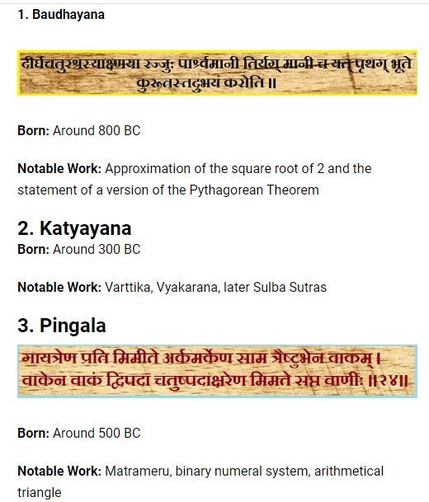
Great mathematician and their contribution

Slide 10
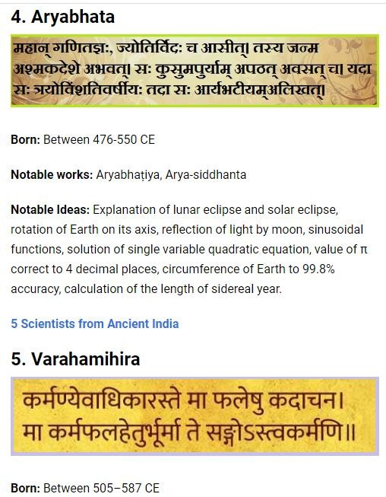
Great mathematician and their contribution

Slide 11
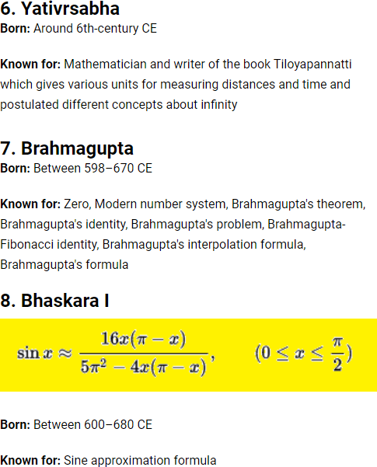
Great mathematician and their contribution

Slide 12
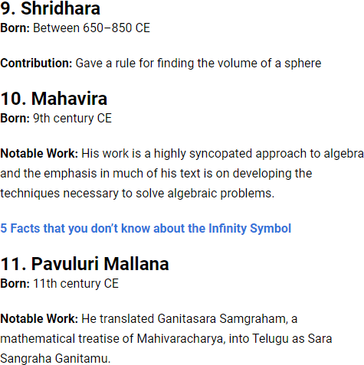
Great mathematician and their contribution

Slide 13
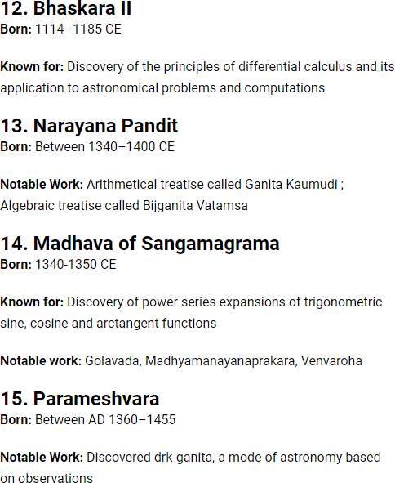
Great mathematician and their contribution

Slide 14
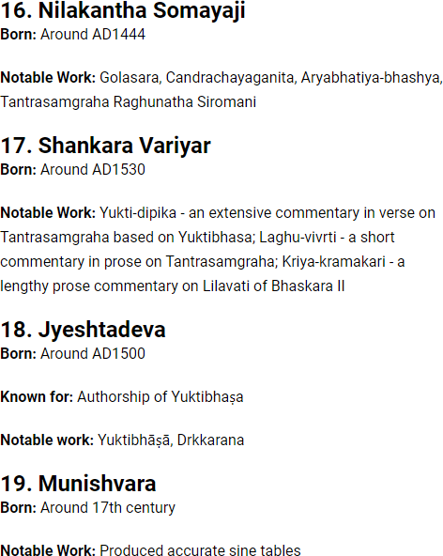
Great mathematician and their contribution

Slide 15
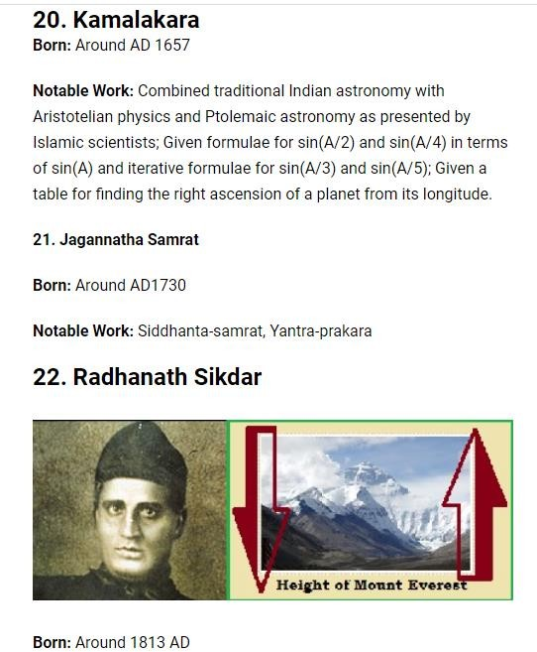
Great mathematician and their contribution

Slide 16
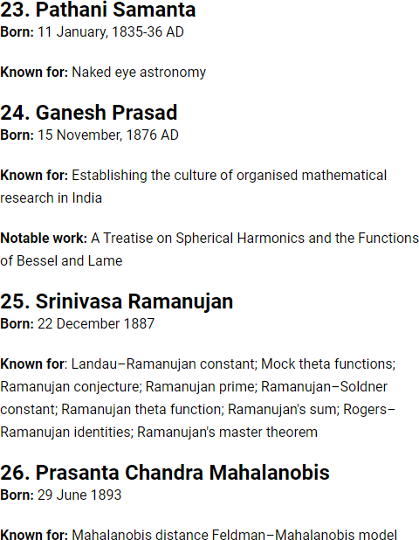
Great mathematician and their contribution

Slide 17
Arithmetic
Arithmetic is an elementary part of mathematics that consists of the study of the properties of the traditional operations on numbers— addition, subtraction, multiplication, division, exponentiation, and extraction of roots.
Arithmetic developed first of all in India and only then came to Western Europe. In the seventeenth century the needs of astronomy, mechanics, and more difficult commercial calculations put before arithmetic new challenges regarding methods of calculation and gave an impetus to further development.

Slide 18
Geometry
Geometry arose as the field of knowledge dealing with spatial relationships. Geometry was one of the two fields of pre-modern mathematics, the other being the study of numbers. Classic geometry was focused in compass and straightedge constructions.
In ancient India, geometry was used extensively in constructing fire altars without the use of modern measuring devices.
By using ropes, they were able to form right angles and various shapes and to transform one shape into another with the same area.

Slide 19
Vedic India geometry
The Indian Vedic period had a tradition of geometry, mostly expressed in the construction of elaborate altars. Early Indian texts (1st millennium BC) on this topic include the Satapatha Brahmana and the Śulba Sūtras.
The Baudhayana Sulba Sutra, the best-known and oldest of the Sulba Sutras (dated to the 8th or 7th century BC) contains examples of simple Pythagorean triples, such as: (3,4,5), (5,12,13), (8,15,17), (7,24,25), and (12,35,37) as well as a statement of the Pythagorean theorem for the sides of a square.

Slide 20
Trigonometry
In Indian astronomy, the study of trigonometric functions flourished in the Gupta period, especially due to Aryabhata (sixth century CE), who discovered the sine function. During the Middle Ages, the study of trigonometry continued in Islamic mathematics, by mathematicians such as Al-Khwarizmi and Abu al-Wafa.
The Siddhantas and the Aryabhatiya contain the earliest surviving tables of sine values and versine (1 − cosine) values, in 3.75° intervals from 0° to 90°, to an accuracy of 4 decimal places.^{[25]} They used the words jya for sine, kojya for cosine, utkrama-jya for versine, and otkram jya for inverse sine. The words jya and kojya eventually became sine and cosine respectively after a mistranslation described above.

Slide 21
Algebra
The subject of Algebra originated in India. Its origin can be traced back to the Shatapatha Brahmana (शतपर्ब्राह्मर्) (2000 BCE) and the Sulba sutras (800-500 BCE). Algebra was used to design and construct the vedis. The Indian name for algebra is Bijaganita (बीजगणर्त).
Bija (बीज) means analysis and ganita (गणर्त) means “the science of calculation”. Thus Bijaganita literally means “the science of analytical calculation”. Algebra is also called अव्यक्त गणर्त (avyakta ganita), that is the “the science of calculation with unknowns” (avyakta means unknown). Whereas Arithmetic is व्यक्त गणर्त (vyakta ganita), that is the “the science of calculation with knowns”.

Slide 22
Binary Mathematics and Combinatorial
Problems in Chandah-śāstra of Pingala
Acharya Pingala (piṅgala; c. 3rd–2nd century BCE) was an ancient Indian poet and mathematician, and the author of the Chandaḥśāstra (also called the Pingala-sutras), the earliest known treatise on Sanskrit prosody.
he Chandaḥśāstra is a work of eight chapters in the late Sūtra style, not fully comprehensible without a commentary. It has been dated to the last few centuries BCE. In the 10th century CE, Halayudha wrote a commentary elaborating on the Chandaḥśāstra. Pingala Maharshi was also said to be the brother of Pāṇini, the famous Sanskrit grammarian, considered the first descriptive linguist.

Slide 23
Binary Mathematics
btechnotes.in
and Combinatorial
Problems in Chandah-śāstra of Pingala
The Chandaḥśāstra presents the first known description of a binary numeral system in connection with the systematic enumeration of meters with fixed patterns of short and long syllables. The discussion of the combinatorics of meter corresponds to the binomial theorem.
Use of zero is sometimes ascribed to Pingala due to his discussion of binary numbers, usually represented using 0 and 1 in modern discussion, but Pingala used light (laghu) and heavy (guru) rather than 0 and 1 to describe syllables.
As Pingala's system ranks binary patterns starting at one (four short syllables— binary "0000"—is the first pattern), the nth pattern corresponds to the binary representation of n-1 (with increasing positional values).
Pingala is credited with using binary numbers in the form of short and long syllables (the latter equal in length to two short syllables), a notation similar to Morse code. Pingala used the Sanskrit word śūnya explicitly to refer to zero.

Slide 24
Magic Squares in Indian Mathematics
The oldest datable magic square in India occurs in Varāhamihira's encyclopedic work on divination, Bṛhatsaṃhitā (ca. AD 550). He utilized a modified magic square of order four in order to prescribe combinations and quantities of ingredients of perfume.
It consists of two sets of the natural numbers 1–8, and its constant sum (p) is 18. It is, so to speak, pan‐diagonal, that is, not only the two main diagonals but also all “broken” diagonals have the same constant sum. Utpala, the commentator (AD 967), also points out many other quadruplets that have the same sum.

Slide 25
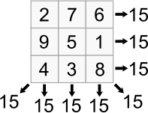
Magic Squares in Indian Mathematics
In recreational mathematics, a square array of numbers, usually positive integers, is called a magic square if the sums of the numbers in each row, each column, and both main diagonals are the same.

Slide 26
Astronomy
Some of the earliest roots of Indian astronomy can be dated to the period of Indus Valley civilization or earlier. Astronomy later developed as a discipline of Vedanga, or one of the "auxiliary disciplines" associated with the study of the Vedas, dating 1500 BCE or older.
Indian astronomy flowered in the 5th–6th century, with Aryabhata, whose work, Aryabhatiya, represented the pinnacle of astronomical knowledge at the time. The Aryabhatiya is composed of four sections, covering topics such as units of time, methods for determining the positions of planets, the cause of day and night, and several other cosmological concepts.

Slide 27
Unique aspects of Indian Astronomy
The Vedanga Jyotisha describes rules for tracking the motions of the Sun and the Moon for the purposes of ritual. According to the Vedanga Jyotisha, in a yuga or "era", there are 5 solar years, 67 lunar sidereal cycles, 1,830 days, 1,835 sidereal days and 62 synodic months.
The divisions of the year were on the basis of religious rites and seasons (Rtu). The duration from mid March—mid May was taken to be spring (vasanta), mid May—mid July: summer (grishma), mid July—mid September: rains (varsha), mid September—mid November: autumn (sharad), mid November—mid January: winter (hemanta), mid January—mid March: the dews (shishir).

Slide 28
Unique aspects of Indian Astronomy
In the Vedānga Jyotiṣa, the year begins with the winter solstice. Hindu calendars have several eras:
The Hindu calendar, counting from the start of the Kali Yuga, has its epoch on 18 February 3102 BCE Julian (23 January 3102 BCE Gregorian).
The Vikram Samvat calendar, introduced about the 12th century, counts from 56 to 57 BCE.
The "Saka Era", used in some Hindu calendars and in the Indian national calendar, has its epoch near the vernal equinox of year 78.
The Saptarishi calendar traditionally has its epoch at 3076 BCE.

Slide 29
Historical Development of Astronomy in India
The Rigveda (c1700-1100 BCE), one of Hinduism's primary and foremost
texts, contains the first records of sophisticated astronomy in India dating back to at least 2000 BCE.
According to the Rigveda, the Indians divided the year into 360 days, which were then divided into 12 months of 30 days.
Two intercalary periods were added every 5 years to bring the calendar back in line with the solar year, ensuring that years averaged 366 days.
The Indian year, however, migrated four days every five years, and Indian
astronomers constantly tweaked and adjusted their calendars over millennia.
The text also demonstrates that the Indians used four cardinal points to ensure that altars were properly oriented.

Slide 30
Historical Development of Astronomy in India
The Jyotisa Vedanga, the first Vedic text to mention astronomical data, records events as far back as 4000 BCE, though many archaeo astronomers believe it may include observations as far back as 11 000 BCE.
They note that some of the records may have been copied from earlier manuscripts, but more research is needed in this area because many of the references are unclear and couched in religious terminology.
Many advances in measuring time and the progression of the heavens occurred during this period, as well as a few proto-theories about the structure of the universe.
More importantly, this time period witnessed the exchange of ideas between Indians, Babylonians, Greeks, and Persians. This exchange of theories and philosophy was critical to the advancement of astronomy.

Slide 31
Historical Development of Astronomy in India
The Jyotisa Vedanga, the first Vedic text to mention astronomical data, records events as far back as 4000 BCE, though many archaeo astronomers believe it may include observations as far back as 11 000 BCE.
They note that some of the records may have been copied from earlier manuscripts, but more research is needed in this area because many of the references are unclear and couched in religious terminology.
Many advances in measuring time and the progression of the heavens occurred during this period, as well as a few proto-theories about the structure of the universe.
More importantly, this time period witnessed the exchange of ideas between Indians, Babylonians, Greeks, and Persians. This exchange of theories and philosophy was critical to the advancement of astronomy.

Slide 32
The Celestial Coordinate System
To understand the concept of celestial coordinates, we must first learn about the celestial sphere.
Whenever we look upwards, all the heavenly bodies appear to lie on the inner surface of a large imaginary sphere, with us being at center of that imaginary sphere.
They appear to lie in the same way as the artificial stars lie on the dome of a planetarium. This large imaginary sphere is known as the celestial sphere.

Slide 33
The Celestial Coordinate System
With the basic information about the celestial sphere in hand, we are now in a position to understand the three basic celestial coordinate systems. So, let’s proceed, beginning with the Horizontal system as follows:
The Horizontal Coordinate System (Altitude and Azimuth)
The Equatorial Coordinate System (Right Ascension and Declination)
The Ecliptic Coordinate System (Celestial Latitude and Longitude)

Slide 34
Elements of the Indian Calendar
The Hindu calendar is based on a geocentric model of the solar system. A large part of this calendar is defined based on the movement of the sun and the moon around the earth (saura māna and cāndra māna respectively).
Furthermore, it includes synodic, sidereal, and tropical elements.
Many variants of the Hindu calendar have been created by including and excluding these elements (solar, lunar, lunisolar etc.) and are in use in different parts of India.

Slide 35
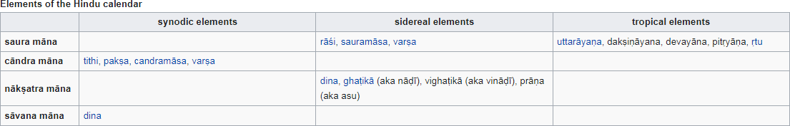
Elements of the Indian Calendar

Slide 36
Indian Astronomy and the Siddhantic Era
During this time, a new branch of astronomy emerged that diverged from the Vedas. The Siddhantic Era began with the Siddhanat, or 'Solutions,' a series of books that charted the solar year, including solstices, equinoxes, lunar periods, solar and lunar eclipses, and planetary movements.
The Siddhantic Era saw three great Indian astronomers, who are sadly little known in the west despite their significant contributions.
At a time when the Greeks were still using celestial crystal spheres to explain the cosmos, Indian astronomers proposed that the stars were exactly like the sun but much further away by the first century CE.
They also recognised that the earth was spherical, and Indian astronomers attempted to calculate the planet's circumference.

Slide 37
Aryabhata
In his magnum opus Aryabhatiya (499), Aryabhata (476-550) proposed a computational system based on a planetary model in which the Earth was assumed to be spinning on its axis and the periods of the planets were given with respect to the Sun.
Many astronomical constants, such as the periods of the planets, times of solar and lunar eclipses, and the instantaneous motion of the Moon, were precisely calculated by him.
Varahamihira, Brahmagupta, and Bhaskara II were among the early followers of Aryabhata's model.

Slide 38
Astronomy During Shunga Empire
During the Shunga Empire, astronomy advanced, and many star catalogues were created. The Shunga period is known as India's "Golden Age of Astronomy."
It saw the development of calculations for various planets' motions and positions, their rising and setting, conjunctions, and eclipse calculations.
By the sixth century, Indian astronomers believed that comets were celestial bodies that reappeared on a regular basis.
This was the view expressed by the astronomers Varahamihira and Bhadrabahu in the sixth century, and the 10th-century astronomer Bhattotpala listed the names and estimated periods of certain comets, but it is unclear how these figures were calculated or how accurate they were.

Slide 39
Significance of astronomy in ancient India
Although Indian astronomy was heavily influenced by their religious and spiritual worldview, it contained many accurate observations of phenomena.
This acted as a catalyst for the growth of mathematics in the subcontinent, and is considered one of India's greatest legacies to the Western world.

