Slide 1

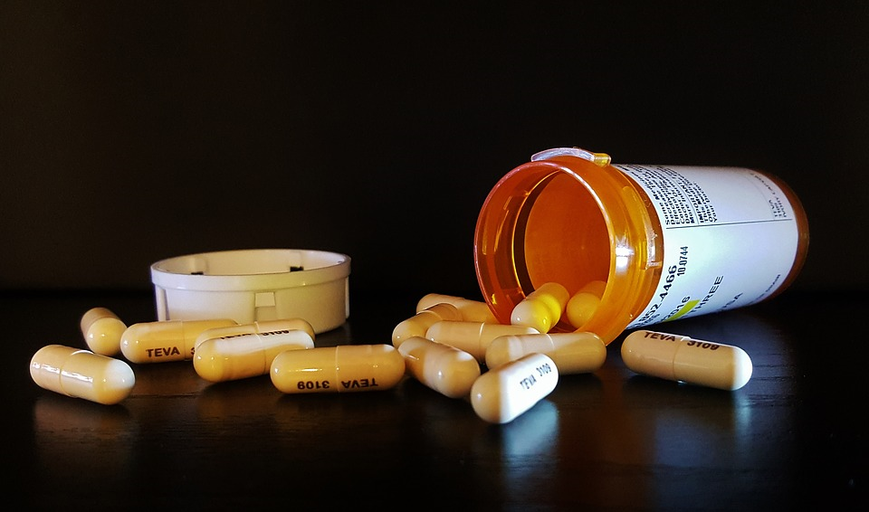
Antibiotic Resistance Mini-Lab
Everyone hopes that the doctor will prescribe an antibiotic when they are sick. Yet, antibiotics are not always 100% effective.
What about the 0.01% that are not killed by the antibiotics?
Why did they survive?
What will happen to the population of 0.01% of bacteria that were not killed by the antibiotics?

Slide 2

Marshmallow/Candy Mini-Lab
Obtain the following materials:
20 mini-marshmallows, 8 hard candy,
1 toothpick, 1 paper plate, 1 paper cup
Put 8 mini-marshmallows and 2 candy on the same plate.
Using ONLY THE TOOTHPICK, pick up the mini-marshmallows or candy ONE AT A TIME and place them in the cup. Pick up as many as possible in 7 seconds.
Count how many are remaining and record this data in the table below.
The remaining mini-marshmallows and candy will now undergo reproduction by fission. Double the amount of mini-marshmallows and candy on the plate.
Repeat steps 3-5 twice for a total of 3 rounds and record all data in the table below.

Slide 3
Make a line graph showing the results of your table.
Marshmallow
(Normal)
16
14
12
10
8
6
4
2
0
candy
(Mutated)
Number of Bacteria
0
D1
R1
D2
R2
D3
R3
Time

Slide 4
Conclusion Questions
What does the paper plate represent?
Your hand
What do the white mini-marshmallows represent?
Normal (non-mutated) bacteria on your hand
What do the candy represent?
Resistant (mutated) bacteria on your hand
What does the process of removing them represent?
Taking a dose of antibiotics.
What does the process of doubling the amount left represent?
The surviving bacteria reproduce to form another generation
Does this change your view on using antibiotics?

Slide 5
Conclusion Questions
What was the mutation and where did it come from?
Hard shell from a random genetic mutation
Where do you see the four points of Darwin’s theory of natural selection?
Competition
Bacteria were competing for resources (space on hand)
Variation
Two different bacteria (soft shell and hard shell)
Survival of the Fittest
Soft shells were easy to remove so hard shells survived
Reproductive Success
Hard shells were able to reproduce and population shifted

Slide 6
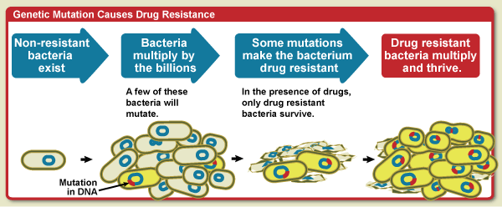
Describe how the following image relates to the mini-lab.

Slide 7
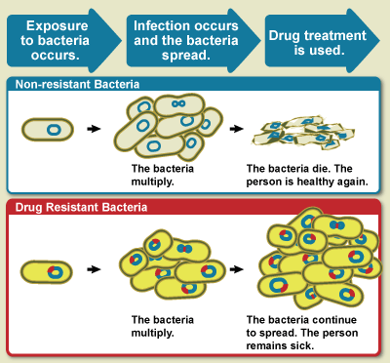
Describe how the following image relates to
real-world scenarios of antibiotic resistance.

