Slide 1

Credit Card Fraud Detection
Project 4 – Group 4

Slide 2
Agenda
Krishna
Project proposal, Team
Dataset source
Technology stack
Overview of different steps involved in building a model
Classification of data
Visualization of dataset
Handling outliers
ML Model
Evaluation of model’s performance

Slide 3
Project proposal and Team
Krishna
Proposal : Develop a fraud detection model for a credit card company that will help identify potentially fraudulent transactions.
Credit card fraud/Identity theft on the rise post pandemic.
According to latest Nilson Report, U.S. is #1 in terms of credit card fraud.
Team Members:
Krishna Patel | Susan Abraham
Vineetha Ramachandra | Nancy K Sakyi
Andi Mysllinj | Surender Raman

Slide 4
Dataset and nature of data
Krishna
Dataset source: Credit Card Fraud Detection (kaggle.com)
- Dataset presents transactions made by credit cards in September 2013 (2 days) by European cardholders.
- Data contains numerical input variables (v1, v2, …….v28) which are the result of a PCA transformation.
- Time and Amount have not been transformed.
- Data classified into Fraudulent and Legitimate transactions.

Slide 5
Technology stack, Data analysis, ML model
Vineetha
Language:
Python
Libraries :
Pandas, scikit-learn, pySpark matplotlib/seaborn, imblearn, etc.
ML Model:
Supervised Learning -> RandomForest

Slide 6
Different steps involved in building a model
1. Data exploration, processing:
Load data.
Analyze feature, class distribution, etc.
Check missing/null values.
2. Outlier Handling, Class imbalance:
Determine IQR “Amount”, identify & remove outliers.
Scale “Amount”, “Time” cols using StandardScaler.
Handle imbalance for binary classified data.
Vineetha
3. Pre-processing, ML model, performance evaluation :
Split pre-processed data into training (70%) and testing (30%) sets.
Random Forest (random_state = 42).
Evaluate model.

Slide 7
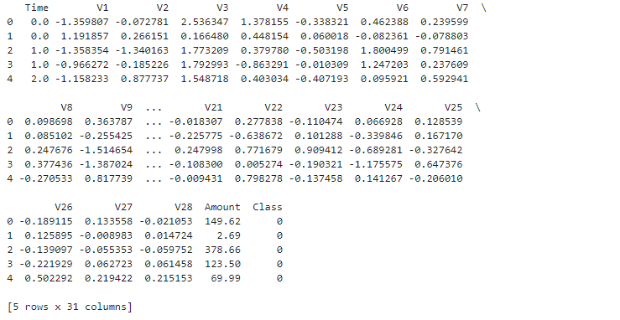
Data classification
Andi
PCA data:

Slide 8
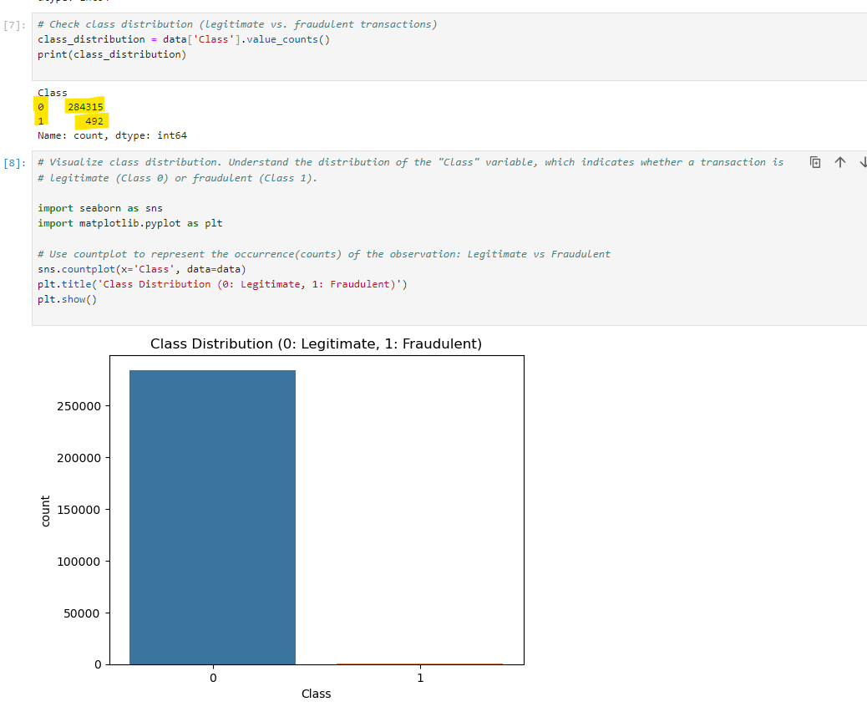
Visualize binary class data
Susan
Class distribution using Matplotlib

Slide 9
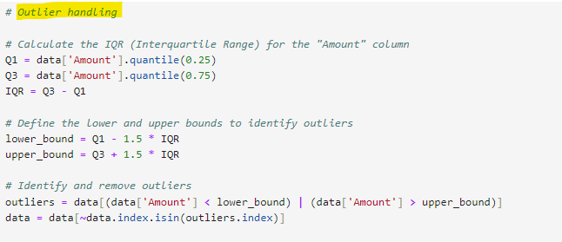
Handle outliers
Nancy
IQR calculation:

Slide 10
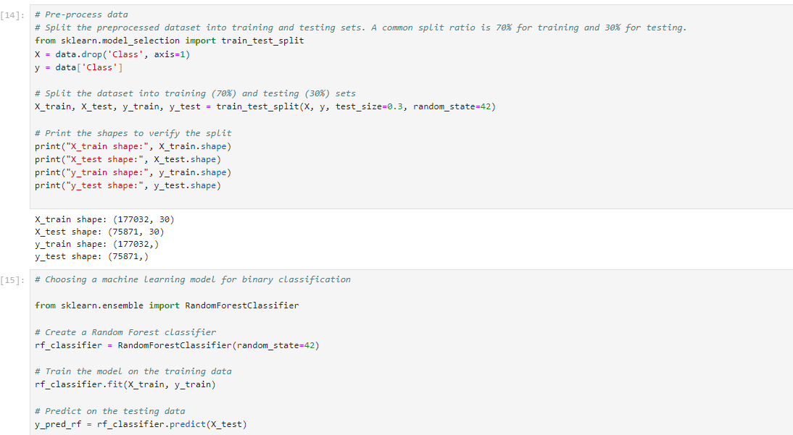
ML Model
Surender
Import Libraries:
Importing the libraries
Data Splitting: The dataset is split into two parts: training data and testing data using ‘train_test_split’ function where X is the independent variable and Y is the variable class
Split Parameters:
This parameter specifies that 30% of the data will be reserved for the testing set, and the remaining 70% will be used for training.
Every time the code is run the same random split is used through ‘random_state: 42’
Printing Shapes
After splitting the code is set to print the shapes of the results.
X_train.shape shows the shape (number of rows and columns) of the training data features.
X_test.shape shows the shape of the testing data features.
y_train.shape shows the shape of the training data target variable.
y_test.shape shows the shape of the testing data target variable.

Slide 11
ML Model
Surender

Slide 12

ML Model
Surender
Random Forest as ML model using RandomForestClassifer.
Train the data using training data.

Slide 13
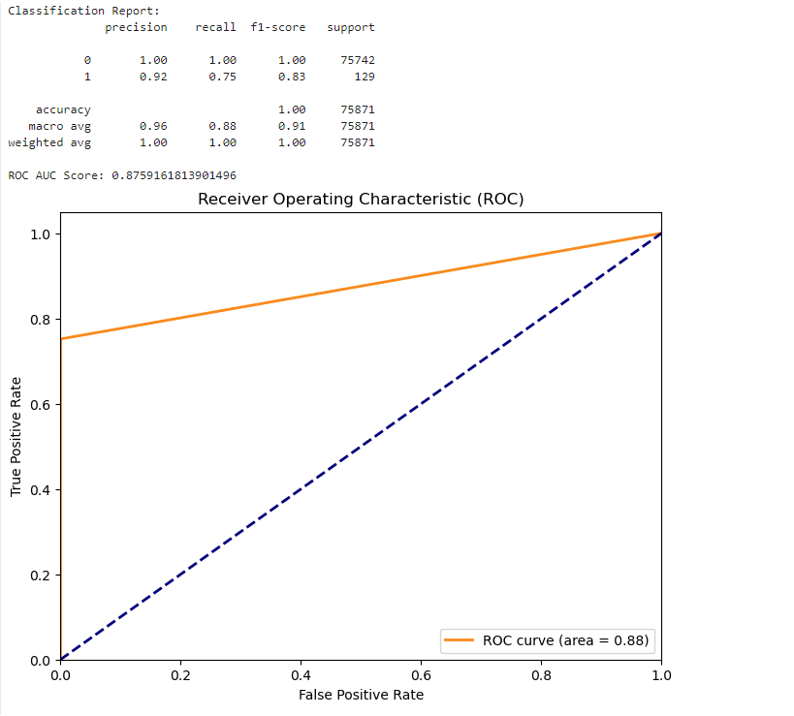
Evaluate model
Vineetha
Conclusion: Model performs well for Class 0. For Class 1, there is room for improvement in recall.

