Slide 1

Credit Card Fraud Detection
Project 4 – Group 4

Slide 2
Agenda
Krishna
Project proposal, Team
Dataset source
Technology stack
Overview of different steps involved in building a model
Classification of data
Visualization of dataset
Handling outliers
ML Model
Evaluation of model’s performance

Slide 3
Project proposal and Team
Krishna
Proposal : Develop a fraud detection model for a credit card company that will help identify potentially fraudulent transactions.
Credit card fraud/Identity theft on the rise post pandemic.
According to latest Nilson Report, U.S. is #1 in terms of credit card fraud.
Team Members:
Krishna Patel | Susan Abraham
Vineetha Ramachandra | Nancy K Sakyi
Andi Mysllinj | Surender Raman

Slide 4
Dataset and nature of data
Krishna
Dataset source: Credit Card Fraud Detection (kaggle.com)
- Dataset presents transactions made by credit cards in September 2013 (2 days) by European cardholders.
- Data contains numerical input variables (v1, v2, …….v28) which are the result of a PCA transformation.
- Time and Amount have not been transformed.
- Data classified into Fraudulent and Legitimate transactions.

Slide 5
Technology stack, Data analysis, ML model
Vineetha
Language:
Python
Libraries :
Pandas, scikit-learn, pySpark matplotlib/seaborn, imblearn, etc.
ML Model:
Supervised Learning -> RandomForest

Slide 6
Different steps involved in building a model
1. Data exploration, processing:
Load data.
Analyze feature, class distribution, etc.
Check missing/null values.
2. Outlier Handling, Class imbalance:
Determine IQR “Amount”, identify & remove outliers.
Scale “Amount”, “Time” cols using StandardScaler.
Handle imbalance for binary classified data.
Vineetha
3. Pre-processing, ML model, performance evaluation :
Split pre-processed data into training (70%) and testing (30%) sets.
Random Forest (random_state = 42).
Evaluate model.

Slide 7
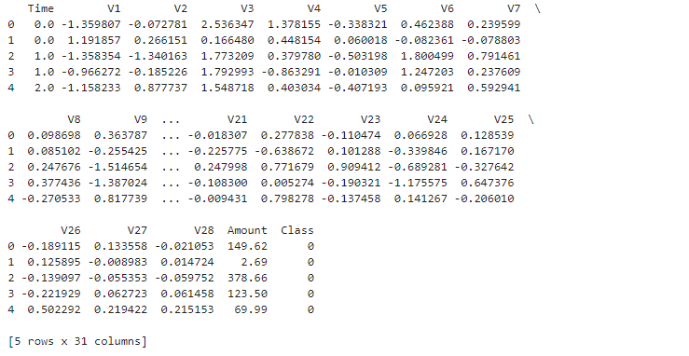
Data classification
Andi
PCA data:

Slide 8
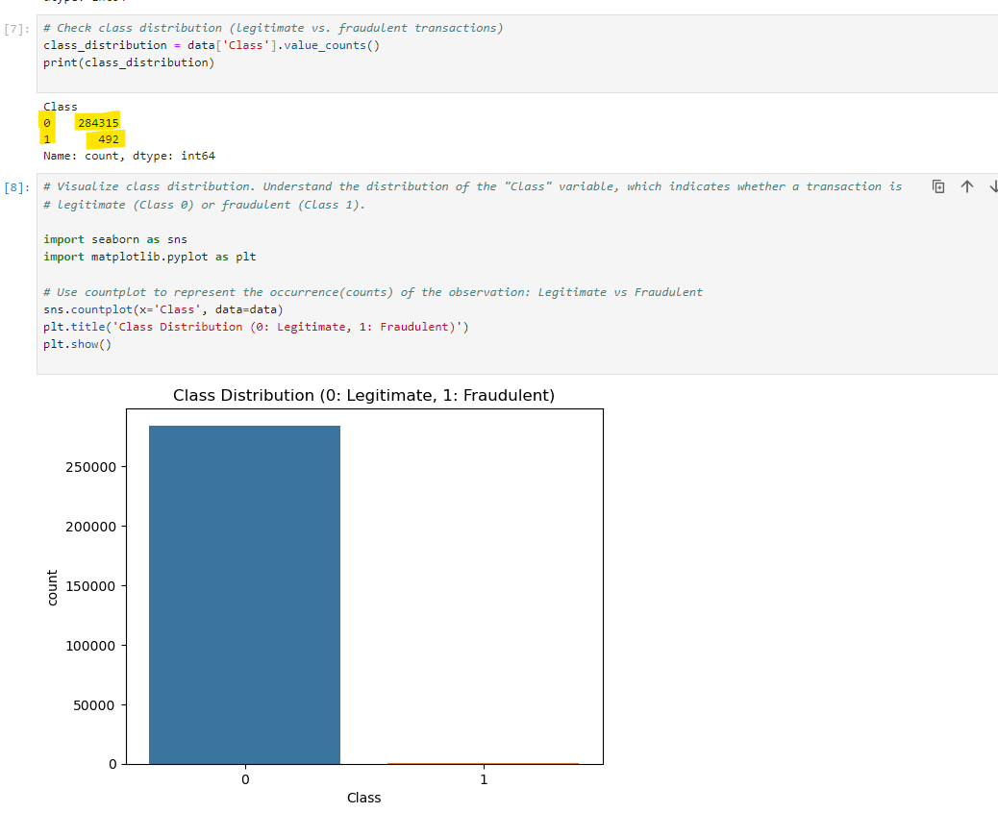
Visualize binary class data
Susan
Class distribution using Matplotlib

Slide 9
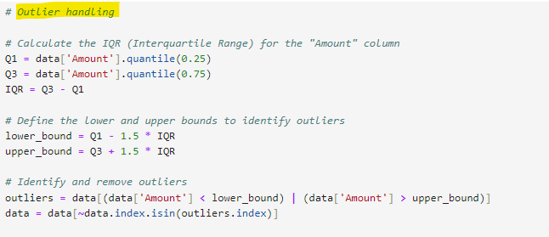
Handle outliers
Nancy
IQR calculation:

Slide 10
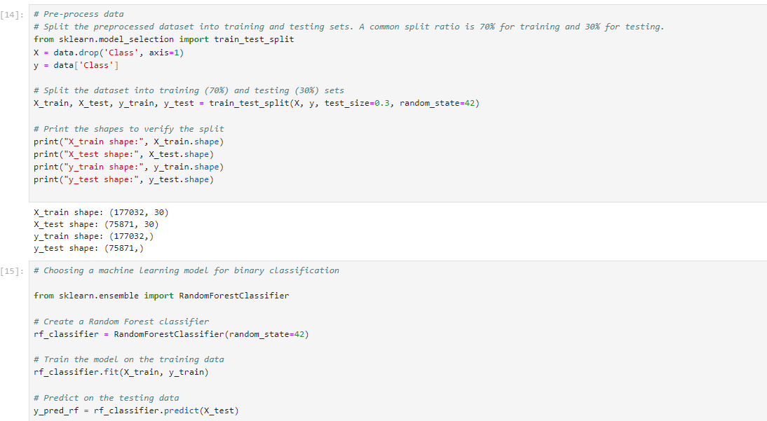
ML Model
Surender

Slide 11

ML Model
Surender
Random Forest as ML model using RandomForestClassifer.
Train the data using training data.

Slide 12
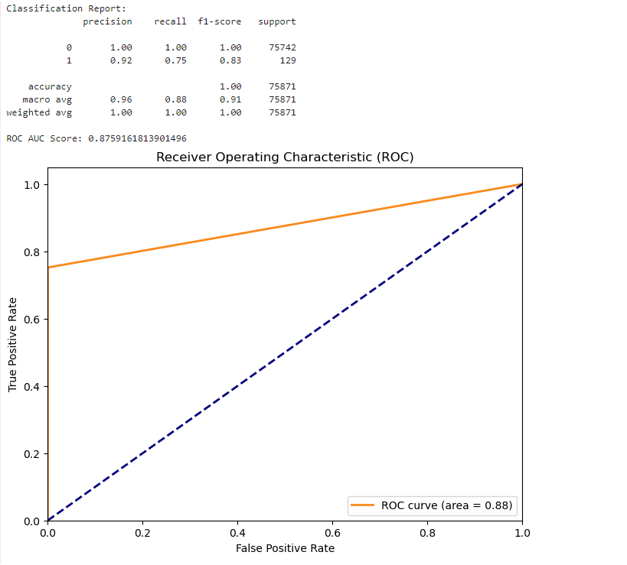
Evaluate model
Vineetha
Conclusion: Model performs well for Class 0. For Class 1, there is room for improvement in recall.

