Slide 1
HireCast – Seasonal Hiring Trends & Forecast
DATA 606 Capstone in Data Science - Fall 2025
Team D: Rithesh Donthoju
Kishan Haravu Pradeep
Vineeth Jutur

Slide 2
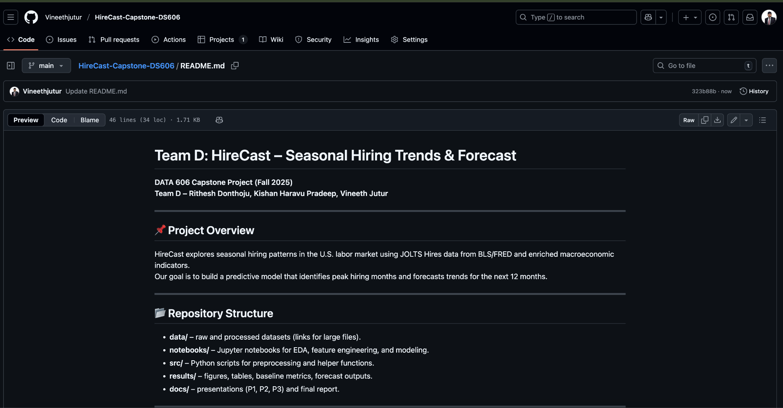
Github Repository link: https://github.com/Vineethjutur/HireCast-Capstone-DS606

Slide 3
Motivation & Research Question
Hiring fluctuates seasonally (holidays, summer, recessions).
Businesses and policymakers want to anticipate hiring peaks/dips.
Research Question:
Which months historically see higher hiring?
Can we forecast the next 6–12 months of hiring activity?

Slide 4
Related Work (Past Approaches)
Title | What they did | Link
Forecasting Labor Demand: Predicting JOLT Job Openings using Deep Learning Model | Used an LSTM model + economic indicators to forecast JOLT job openings. Compared to ARIMA/SARIMA/Holt-Winters. | https://arxiv.org/abs/2503.19048 arXiv
Blending Traditional and Alternative Labor Market Data (CHURN) | Chicago Fed model combining job flows (JOLTS), initial claims, etc., to nowcast the unemployment rate; uses external & traditional inputs. | https://www.chicagofed.org/publications/chicago-fed-letter/2025/506 Federal Reserve Bank of Chicago
Forecasting USA Unemployment Rate Based on ARIMA Model | ARIMA applied to unemployment rate data from 2000 to 2023. Shows how classical time series can be used but with limitations. | https://www.ewadirect.com/proceedings/aemps/article/view/7031 Ewa Direct

Slide 5
Our Contribution (How We Differ)
Expanded Dataset: From 2 columns → 27+ features.
Multivariate: Combine JOLTS + unemployment + claims + macro indicators.
Engineered Features: lags, moving averages, seasonal dummies, event flags.
Predictive Focus: From descriptive reporting → forecasting 12 months ahead.
Modern Methods: SARIMAX (time series + external drivers) and Gradient Boosting (nonlinear ML).
Actionable Outputs: Hiring Calendar + forecast with error metrics, not just descriptive charts.

Slide 6
Primary Dataset
Dataset: JOLTS – Hires (Total Nonfarm, Monthly)
Link: https://fred.stlouisfed.org/series/JTSHIL
Source: Bureau of Labor Statistics via Federal Reserve Economic Data (FRED)
Coverage: Dec 2000 – present (~296 rows)
Columns: month, hires_thousands
Example: Dec 2000 = 5,426,000 hires

Slide 7
Added Features & Sources
Labor Indicators:
Job Openings (JTSJOL): https://fred.stlouisfed.org/series/JTSJOL
Quits Rate (JTUQUR): https://fred.stlouisfed.org/series/JTUQUR
Layoffs Rate (JTSLDR): https://fred.stlouisfed.org/series/JTSLDR
Labor Market Slack:
Unemployment Rate (UNRATE): https://fred.stlouisfed.org/series/UNRATE
Initial Claims (ICSA → monthly): https://fred.stlouisfed.org/series/ICSA
Macro Context:
Industrial Production (INDPRO): https://fred.stlouisfed.org/series/INDPRO
Recession Indicator (USRECP): https://fred.stlouisfed.org/series/USRECP
Indeed Job Postings Index (IHLIDXUS): https://fred.stlouisfed.org/series/IHLIDXUS
Final Dataset Size: 296 rows × 27 features

Slide 8
Data Dictionary (Condensed)
Target: hires_thousands (monthly hires, 000s)
Core Labor Indicators: job openings, quits rate, layoffs rate
Labor Market Slack: unemployment %, claims
Demand Proxy: Indeed postings index
Macro Context: industrial production, recession flag
Engineered Features: lags, moving avg
Seasonality: month dummies (Jan–Dec)

Slide 9
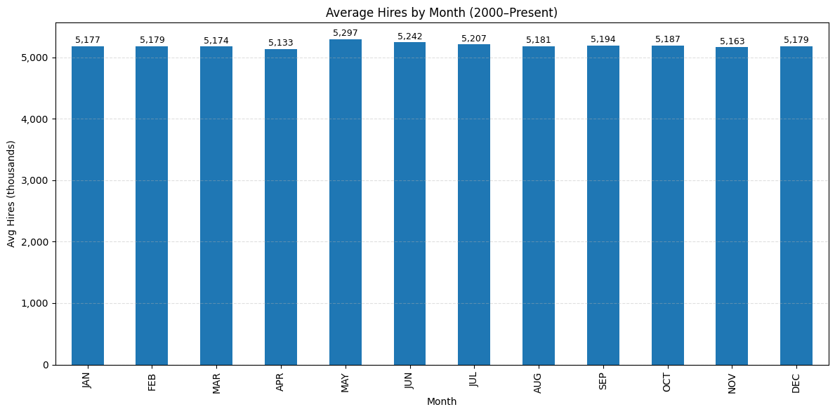
Exploratory Analysis (Seasonality)
Average hires by month (2000–2025).
Peak: May (~5.3M hires).
Low: April (~5.1M hires).

Slide 10
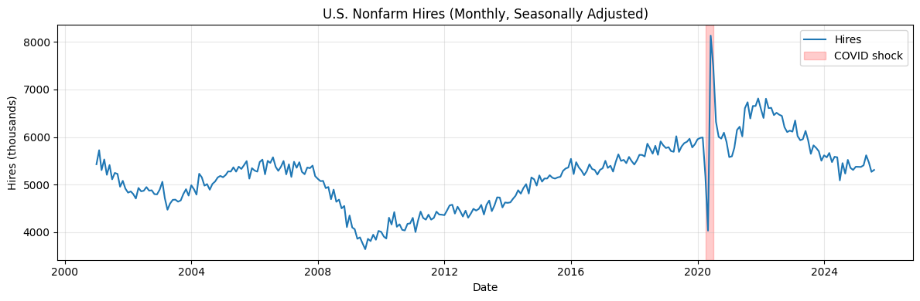
Exploratory Analysis (Trend & Recession)
Hiring dips during recessions (2001, 2008–09, 2020).
Rebounds strong post-recession.

Slide 11
Baseline Model
Method: This month’s forecast = same month last year.
Results:
MAE ≈ 500 (last 5 yrs), 349 (full history)
RMSE ≈ 642 (last 5 yrs), 488 (full history)
MAPE% ≈ 8.3% (recent), 6.8% (overall)
Directional Accuracy ≈ 47% (poor predictive turning ability)
Conclusion: Provides a simple seasonal benchmark, but accuracy leaves room for model improvements

Slide 12
Planned Models
SARIMAX: Captures seasonality + external features (claims, openings).
Gradient Boosting: Captures nonlinear effects and feature interactions.
Compare vs baseline.
Metrics: MAE, RMSE, MAPE, Directional Accuracy.

Slide 13
Deliverables & Goals
Hiring Calendar (historical hot/cold months).
12-month forecast with error analysis.
Visualizations of trends & uncertainty.
Future scope: regional hiring, weather shocks.

Slide 14
References
U.S. Bureau of Labor Statistics (BLS). Job Openings and Labor Turnover Survey (JOLTS):https://www.bls.gov/jlt/
Stock, J.H., & Watson, M.W. (2001). Vector Autoregressions. Journal of Economic Perspectives. https://doi.org/10.1257/jep.15.4.101
Box, G.E.P., Jenkins, G.M., & Reinsel, G.C. (2015). Time Series Analysis: Forecasting and Control. Wiley. https://onlinelibrary.wiley.com/doi/book/10.1002/9781118619193

Slide 15
Any Questions???

