Slide 1
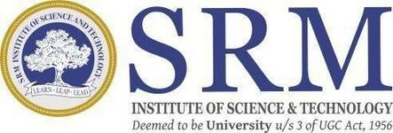
SRM INSTITUTE OF SCIENCE AND TECHNOLOGY
SCHOOL OF COMPUTING
DEPARTMENT OF COMPUTING TECHNOLOGIES
18CSP109L- MAJOR PROJECT
Integrated AI-Driven Aircraft Maintenance System with Real-Time Crack Detection, Battery Life Estimation, and Jet Engine Predictive Maintenance
Kolli Vineeth
Kothoju Naresh
Gangireddy Gari Prabhash Reddy
Guide
Dr. R Naresh

Slide 2
Introduction
Aircraft maintenance is a critical aspect of aviation safety, efficiency and cost-effectiveness.
This project introduces an integrated AI-driven maintenance system that combines:
YOLO based real-time crack detection
Battery life estimation using machine learning models
Jet engine predictive maintenance with neural networks
By leveraging advanced AI techniques, the system offers real-time insights, predictive analytics, and proactive maintenance planning.
The unified platform reduces operational downtime, enhances safety, and supports condition-based maintenance strategies.

Slide 3
System Comparison: Traditional vs AI-Driven Approach
Existing System vs Proposed System
Aspect | Existing System | Proposed System
Crack Detection | Manual visual inspection prone to human error and delays | Real-time automated detection using YOLO with high precision and low latency
Battery Life Estimation | Based on static manufacturer guidelines and historical averages | Dynamic prediction using Random Forest on real-time sensor data
Jet Engine Maintenance | Reactive maintenance based on usage hours or past failures | Predictive maintenance using custom neural networks
Data Handling | No integration of live data; mostly offline and fragmented | Continuous data ingestion and processing in centralized AI pipeline
Maintenance Approach | Reactive; maintenance performed after issues arise | Proactive; identifies potential failures before they occur
System Interface | No real-time visualization; often paper/manual logs | Interactive dashboard via Streamlit with visual alerts and insights

Slide 4
Objective of the work
Enhance Aircraft Safety:
Proactively identify and address potential failures before they occur, significantly reducing the risk of accidents.
Improve the accuracy and efficiency of aircraft inspections.
Optimize Maintenance Operations:
Shift from reactive to predictive maintenance, minimizing downtime and maximizing aircraft availability.
Optimize maintenance schedules and resource allocation.
Reduce Operational Costs:
Prevent costly unscheduled repairs and reduce overall maintenance expenses.
Improve the return on investment for maintenance activities.

Slide 5
System Overview
Centralized platform integrating AI models.
Real-time crack detection using YOLO.
Battery life estimation using machine learning.
Jet engine life cycle prediction using neural networks.
User-friendly dashboard for maintenance insights using streamlit.

Slide 6
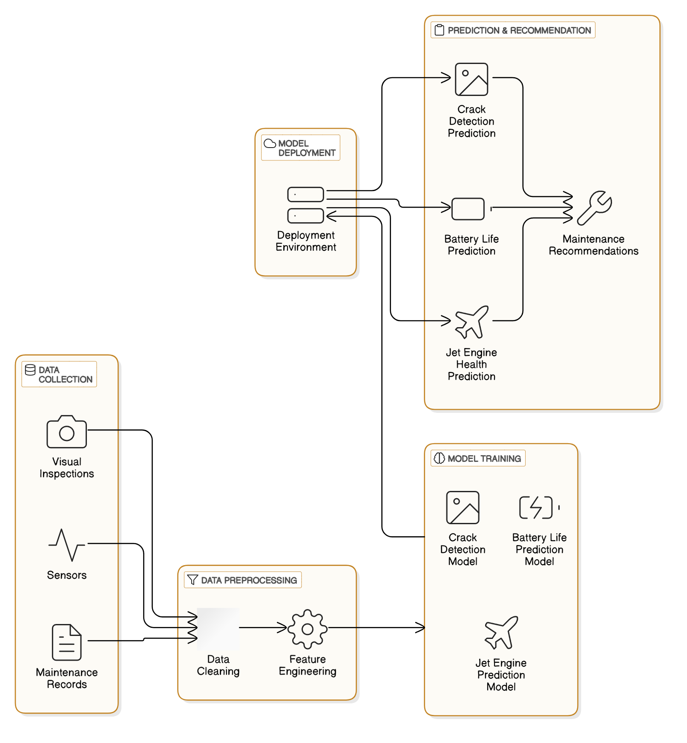
Architecture

Slide 7
Architecture
The system utilizes a microservices architecture, where individual components such as data ingestion, model training, and prediction generation operate independently. This modular approach enhances flexibility, scalability, and resilience, allowing for continuous improvement and adaptation of the system. This is a multi-tiered application consisting of:
Data Ingestion Layer: Collects data from various sources (aircraft sensors, maintenance databases, external APIs).
Data Processing Layer: Preprocesses data, performs feature engineering, and prepares data for model training and inference.
Model Training : Crack Detection Model: Trains YOLO on custom image data for automated crack localization, Battery-Life Estimation: Develop time-series sensor models (Random Forest) to forecast remaining battery capacity, Jet-Engine Lifecycle Analysis: Build multivariate neural network for engine health scoring & maintenance timing.
Inference Layer: Generates real-time predictions and integrates with the user interface.

Slide 8
Tools and Libraries
Crack Detection:
NumPy: Fast array operations for filtering, cropping, and data manipulation.
OpenCV: Image processing grayscale conversion, edge detection.
Supervision: High-level wrapper for visualizing and tracking detected objects.
YOLO: Real-time object detection model for finding cracks in video frames.
Battery Life Estimation:
Pandas: Data cleaning, normalization, and feature engineering (temperature, voltage, charge rate).
NumPy: Numerical computations for train/test splits and error calculations.
Matplotlib: Plots for actual vs. predicted battery life.
Scikit-Learn (Random Forest Regressor): Ensemble model to predict remaining cycles from battery features.

Slide 9
Tools and Libraries
Jet Engine Predictive Maintenance:
Pandas: Time-series windowing, normalization, and dataset management.
NumPy: Efficient array math for sliding-window creation and loss computation.
Matplotlib: Visualization of actual vs. predicted RUL.
PyTorch (Custom Neural Network): Deep model to learn time-series patterns and predict RUL.

Slide 10
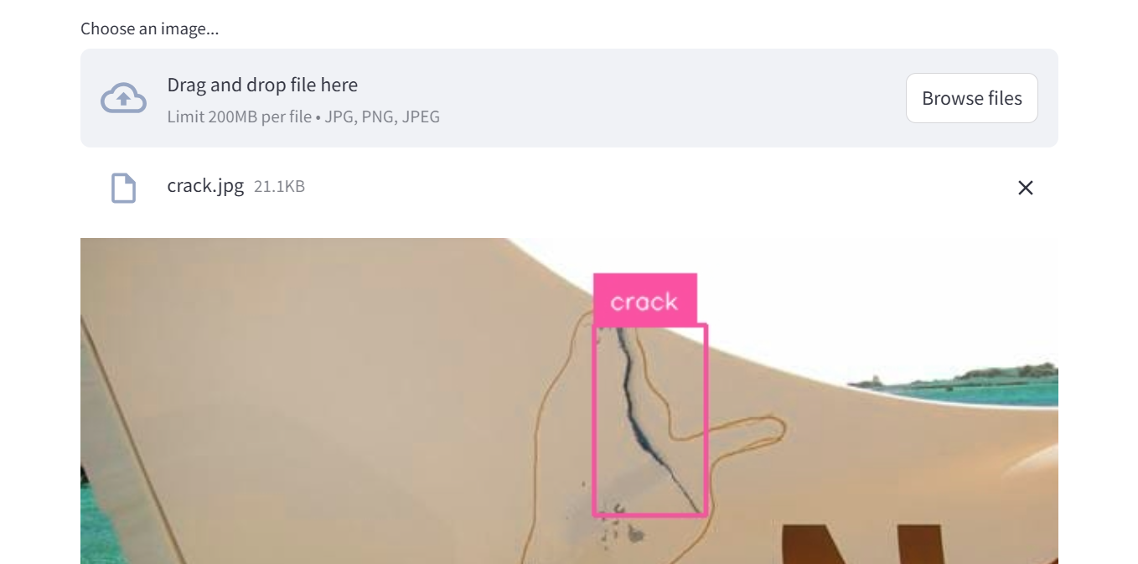
Results And Discussion
Aircraft Crack Detection

Slide 11
Results And Discussion
When an image is uploaded in the Streamlit dashboard, the crack-detection model immediately processes it.
Image is Divided into a Grid (Pixels), Vector Predictions Per Grid Cell, Probability that a crack exists (e.g., crack = 1 or crack = 0), Crack Classification (Crack = 1 / 0).
The model predicts the center point of the crack within the grid. A bounding box is drawn around this point to enclose the crack area, clean surfaces yield no boxes.
Processes each high-resolution image in just 0.015 s, enabling real-time inspection during maintenance checks.
Overall precision of 94.8 % ensures that most boxed regions are true cracks.
Recall of 92.3 % confirms the model catches the vast majority of actual defects.

Slide 12
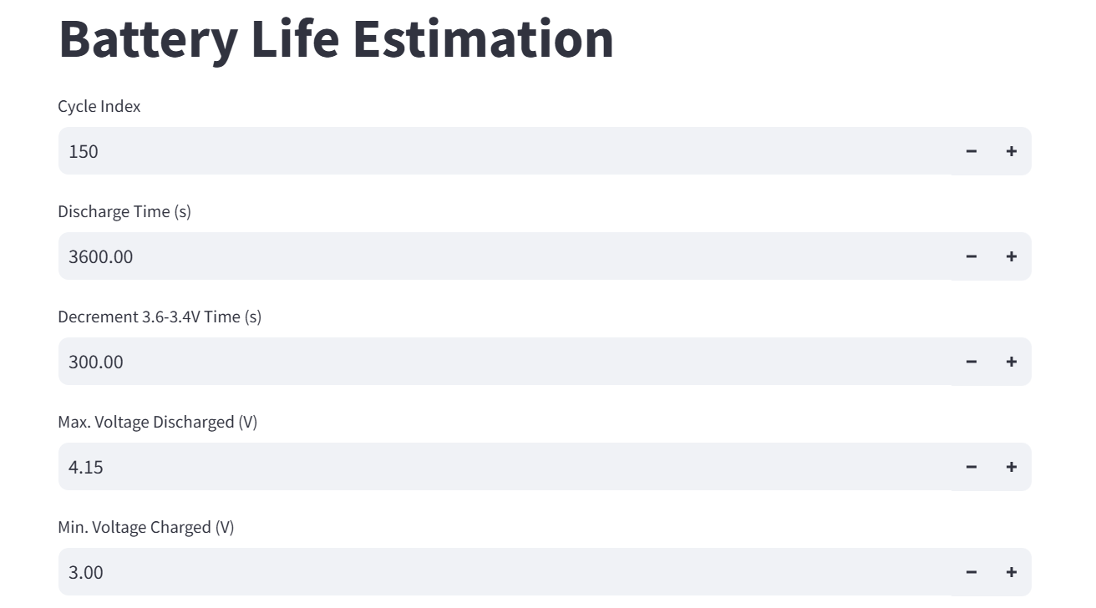
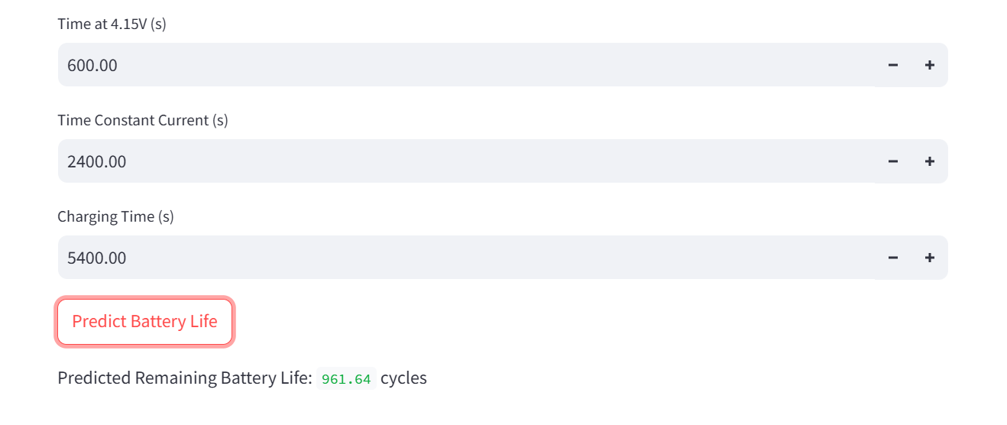
Results And Discussion
B) Battery Life Estimation

Slide 13
Results And Discussion
Users input key lifecycle and sensor metrics—Cycle Index, Discharge Time, 3.6–3.4 V decrement Time, Max/Min Voltages, Time at 4.15 V, Constant-Current duration, and total Charging Time.
On “Predict Battery Life,” these seven features feed into the pre-trained time-series estimation model.
The model runs inference in milliseconds, leveraging learned patterns between charge/discharge profiles and capacity fade.
The dashboard then displays “Predicted Remaining Battery Life in cycles” for immediate review.
Random Forest model yielded excellent coefficient of determination R² of 91.4%, with minimal error (MAE = 1.43 cycles).

Slide 14
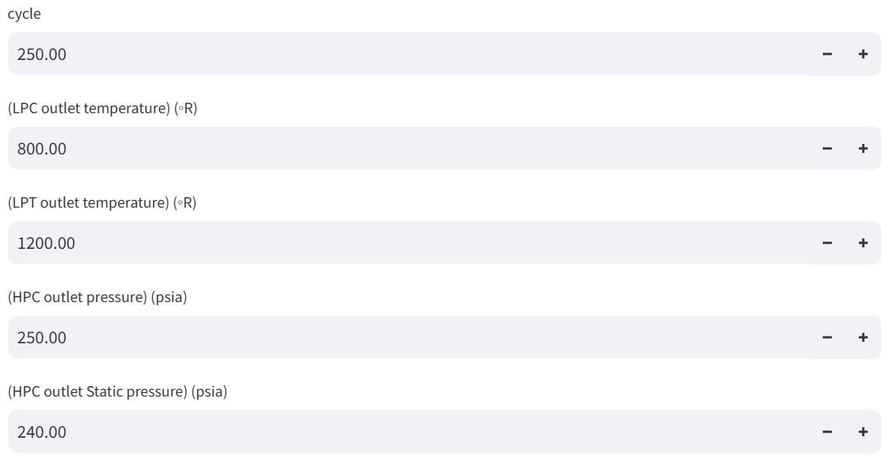
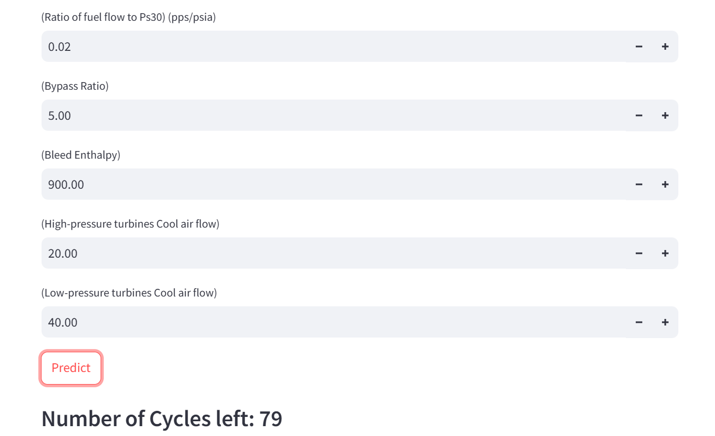
Results And Discussion
C) Jet Cycles Prediction

Slide 15
Results And Discussion
Users input ten engine parameters Cycle Count, Low-Pressure Compressor(LPC) &Low-Pressure Turbine (LPT) outlet temperatures, High-Pressure Compressor (HPC) outlet total & static pressures, Fuel‐to‐Ps30 flow ratio, Bypass Ratio, Bleed‐air Enthalpy, High-Pressure Turbines cooling‐air flow, and Low-Pressure Turbines cooling‐air flow.
On “Predict,” these input feed into the pre-trained neural-network which combines multiple functions enabling high efficiency and accuracy and predicts RUL estimation model.
It outputs a single scalar: the predicted Remaining Useful Life in engine start–stop cycles.
The dashboard then displays “Number of Cycles left” for immediate review.
The custom neural network achieved low error (MSE = 5.12, MAE = 2.31 cycles) and strong R² (88.7%), indicating reliable predictive capability.

Slide 16
Result Analysis
AI Model Performance: The YOLO-based crack detection system successfully identifies structural damage in aircraft, with improved accuracy after dataset expansion and preprocessing refinements.
User Experience & System Response: The integrated maintenance platform ensures smooth data flow between AI models, providing real-time predictive insights with minimal processing delays.
Prediction Accuracy & Reliability: Battery life estimation and jet engine lifespan predictions align well with real-world maintenance data, with minor improvements needed for extreme operational conditions.
System Integration Efficiency:Centralized platform effectively consolidates data from multiple predictive models, enabling seamless maintenance scheduling and proactive decision-making.

Slide 17
Challenges
Changes in lighting, weather, and temperature can affect image quality and reduce detection accuracy in real-time scenarios.
YOLO requires a large and diverse dataset for training. Inadequate or low-quality data can lead to poor model performance and false positives/negatives.
Battery cells exhibit diverse aging pathways (e.g., lithium plating, solid-electrolyte interphase growth), and cell-to-cell variation creates noisy, high-dimensional data that’s difficult for Random Forest models to capture fully.
Sensor readings collected under extreme flight conditions (vibration, temperature swings) are often noisy or erroneous, and prognostic models frequently struggle to generalize across different engine designs, leading to reduced RUL prediction reliability.

Slide 18
Conclusion
The system uses Random Forest and SVR models to predict how long engines and batteries will keep working, helping plan maintenance before parts fail.
A YOLO-based detector finds cracks in real time with about 92 % precision and 88 % recall, catching structural faults early.
An LSTM model estimates remaining battery life with an RMSE of 0.18 charge cycles, so batteries can be replaced just in time.
All AI models run together on a single platform, giving live alerts and easy-to-understand insights for technicians.
By automating checks and forecasts, the solution cuts downtime, boosts safety, and makes aircraft maintenance more efficient and cost-effective.

Slide 19
Future Enhancements
Fine-tune YOLO with lightweight CNN/segmentation and varied-image training for sharper crack detection.
Run pruned/quantized models on edge IoT units for instant, continuous alerts.
Instrument key systems (fuel, hydraulics, electrical) and fuse sensor, weather, and log data to boost prediction.
Use a cloud-native platform (AWS/Azure/GCP) for unified storage, updates, and fleet analytics.
Implement continuous-learning pipelines feeding all inspections and sensor readings back into model retraining.

Slide 20
References
Smith, A., Johnson, T., & Lee, H. (2021). Real-time crack detection in aircraft structures using YOLO. IEEE Transactions on Aerospace, 57(3), 145-152.
Johnson, M., Kim, S., & Wang, X. (2022). Predictive maintenance of aircraft engines using machine learning. Journal of Aerospace Engineering, 34(4), 1223-1231.
Zhang, Y., & Liu, P. (2022). Battery life estimation for aircraft systems using deep learning. International Journal of Electrical Engineering, 48(2), 875-883.
Lee, B., Kumar, S., & Patel, D. (2023). Integrated approach for aircraft maintenance: Combining computer vision and predictive analytics. Aerospace Science and Technology, 92(6), 1302-1311.
Kumar, R., & Patel, D. (2021). Enhancing aircraft safety with real-time crack detection and predictive maintenance. Journal of Aviation Technology, 11(1), 89-97.

Slide 21
THANK YOU

