Slide 1

BUSINESS INSIGHTS 360
ATLIQ HARDWARE

Slide 2

ATLIQ HARDWARE
ABOUT COMPANY
AtliQ Hardware is a leading provider of computer hardware and peripherals, specializing in:
Personal Computers (PC)
Storage Devices
Computer Peripherals
Networking Devices

Slide 3
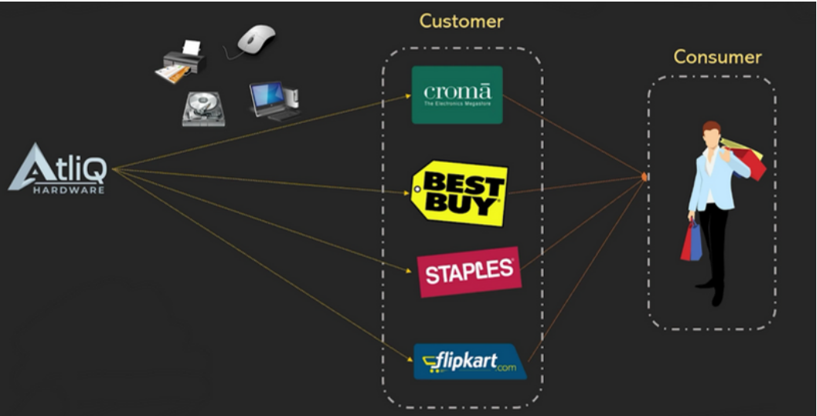
COMPANY MODEL

Slide 4
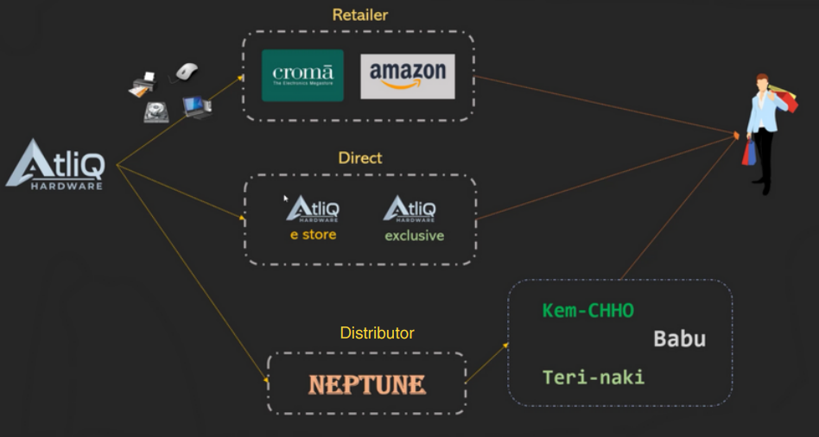
CHANNEL STRUCTURE

Slide 5

PLATFORM OVERVIEW

Slide 6
𝐏𝐫𝐨𝐛𝐥𝐞𝐦 𝐒𝐭𝐚𝐭𝐦𝐞𝐧𝐭: AtliQ Hardware, a rapidly expanding global consumer electronics company, has been grappling with unwieldy Excel files for data analytics. This outdated approach has been hindering effective decision-making and causing significant losses. In response, they urgently sought agile, data-driven decision-making. 𝐎𝐛𝐣𝐞𝐜𝐭𝐢𝐯𝐞: Develop an interactive report offering invaluable insights across finance, sales, marketing, supply chain, and executive teams, using provided mockup dashboards as a reference.

Slide 7
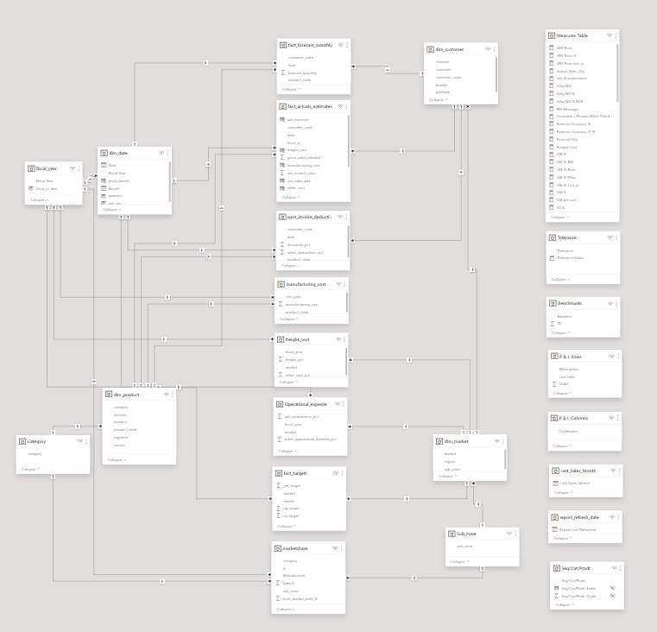
DATA MODEL
DAX - Explicit Measures
Star Schema - with fact tables in the center.
Snowflake Schema - Normalizes dimension tables.

Slide 8
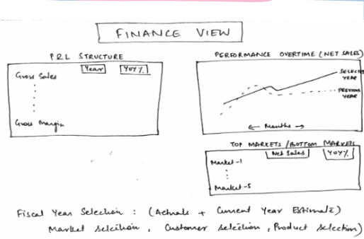
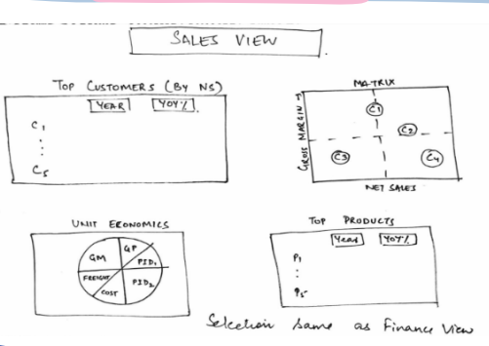
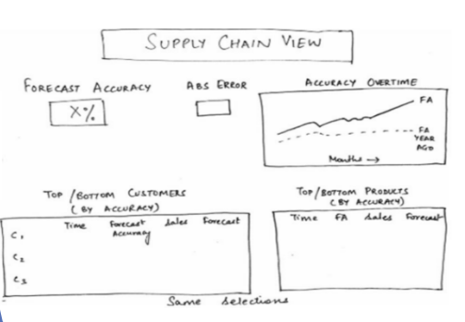
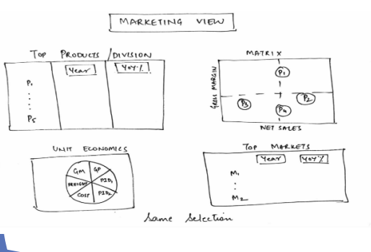
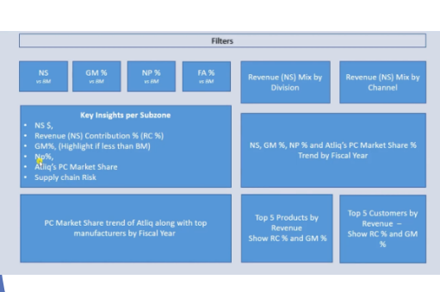
MOCK REPORTS

Slide 9


Slide 10
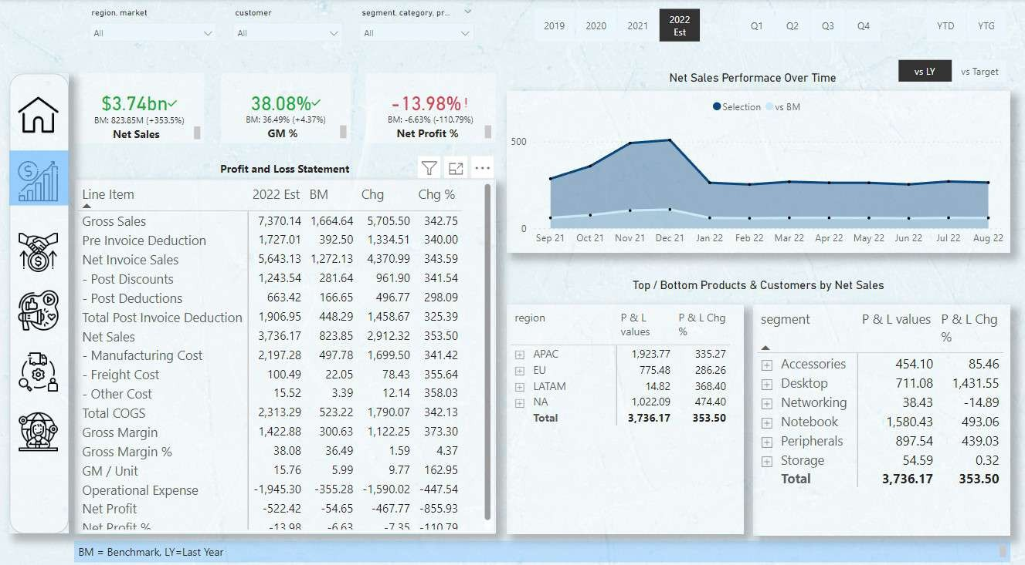

Slide 11
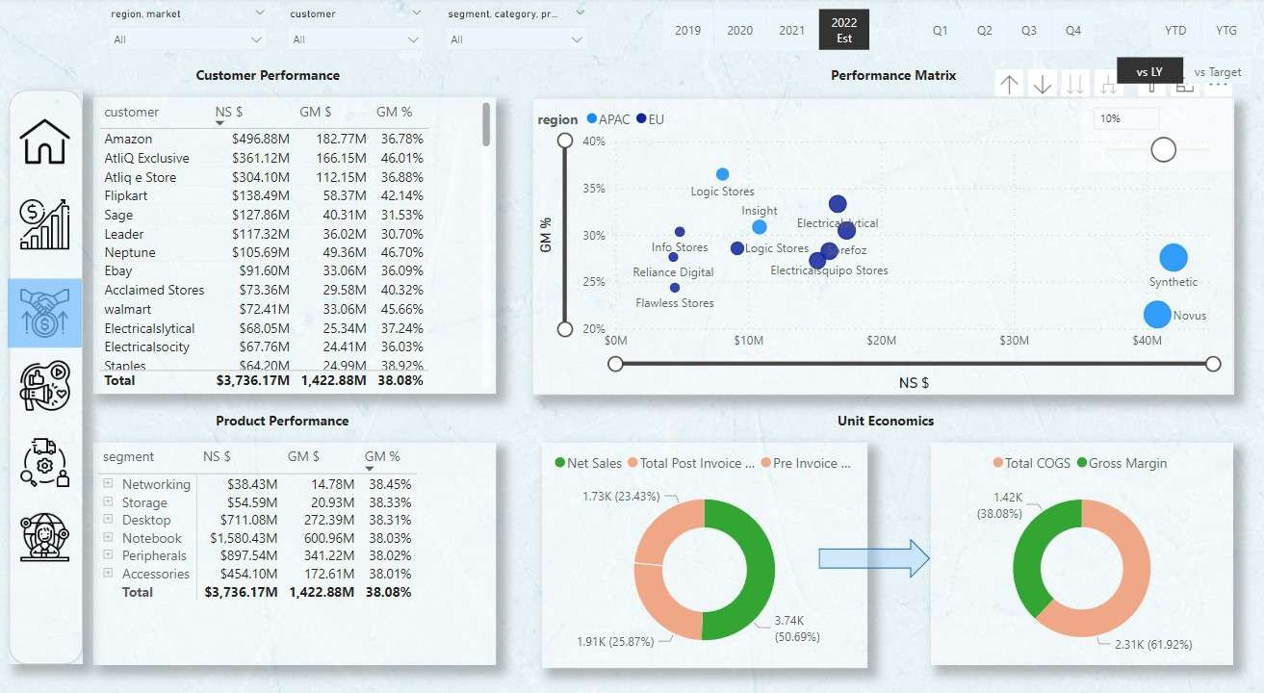

Slide 12
re glon. marke I
en stem er
se gmen t. ca deg any. pr..
2OT9
2020
20c1
Q1
Q2
Q3
Q4
YTD
YTG
Show NP 9
Performance Matrix
segment | NS S | GM S | GM ’â | Net Profit S | Net Profit ’
Accessories | 5454.10M | J72.61M | 38.019s | -63.78M | —14.0596
’ Desktop | 5711.08M | 27Z.39M | 38.3196 | -97.79M | -13.7596
Networking | 538.43M | 14.78M | 38.4596 | -5.27M | —13.7296
Notebook | $1,580.43M | 600.96M | 38.0396 | -222.16M | -14.0696
Peripherals | 5897.54M | 341.22M | 38.0296 | -125.91M | —14.0396
Storage | $54.59M | 20.93M | 38.339a | -7.SIM | -13.7696
Total | 63.736.17M | 1.422.88M | 38.089s | -522.42M | -13.9896
division 0 N @ S G P & A GPC
Desktop
36.2%
SO.0bn
S0.2bn
$0.6bn
NS $
Region / Market/ Customer performance
region | NS S | GM S | GM 96 | Net Profit S | Net Profit ’é
" APAC | $1,923.77M | 690.21M | 35.8896 | -281.16M | -14.62%
EU | $775.48M | 267.80M | 3453S | -95.52M | -12.3296
” LATAM | $14.82M | 5.19M | 35.0296 | —0.44M | —2.9596
NA | $1,022.09M | 459.68M | 44.97% | —145.31M | -14.22%
Tota\ | 63,736.17M | 1,122.88M | 38.0896 | -522.42M | -13.98%

Slide 13
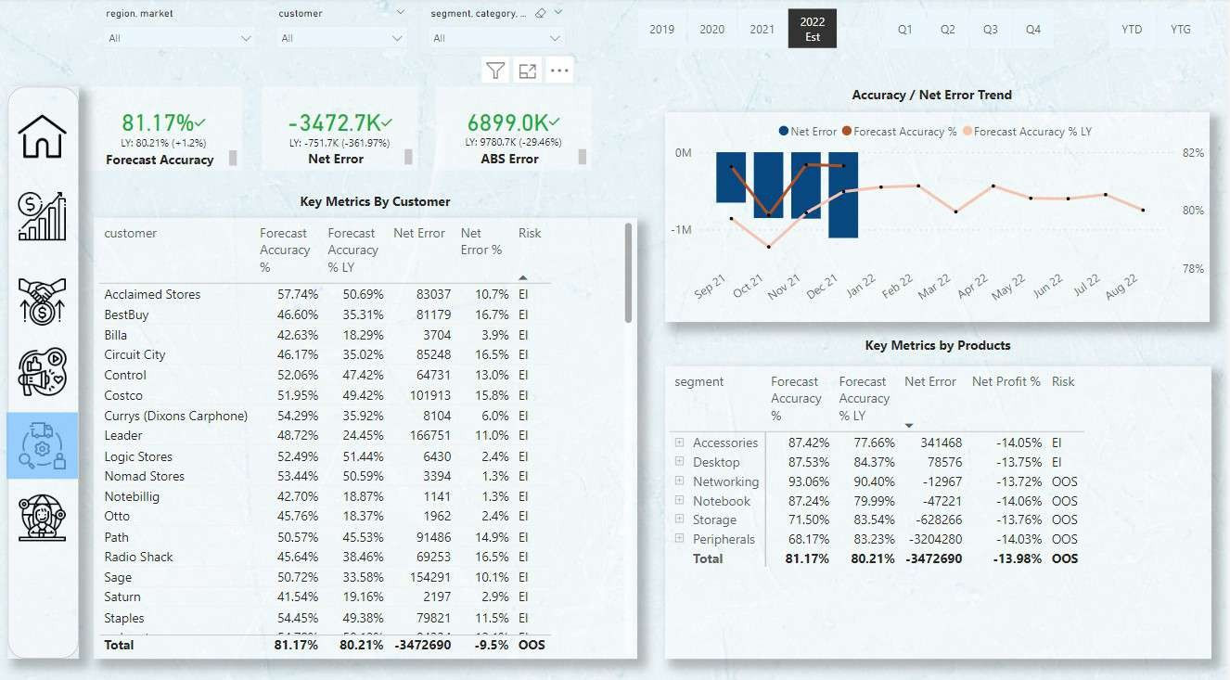

Slide 14
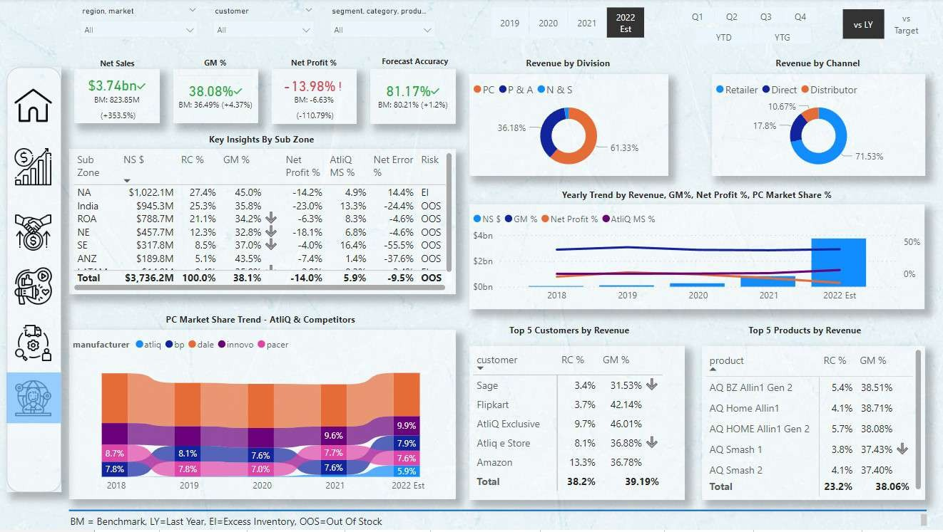

Slide 15
THANK YOU !
For Live Dashboard : CLICK HERE

