Slide 1
Image based Diabetes (Disease) detection using Retinal Images (COMP-5413 Project)
Presented by:
Vinen Patel (1140413)
Rushi Patel (1131699)
Project Guide:
Dr. Zubair Fadlullah

Slide 2
Problem Statement
Image based Diabetes (Disease) detection using Retinal Images:
Vision is the most important human sense. Retinal disease affects millions of people and it may result in loss of vision if proper treatment is not done. That's why we have decided to put some efforts on this definition.

Slide 3
Objectives
Detect the diabetic eye with maximum accuracy.
Requirements: A good amount of dataset which has quality data.
To make this system less time consuming and cost effective.

Slide 4
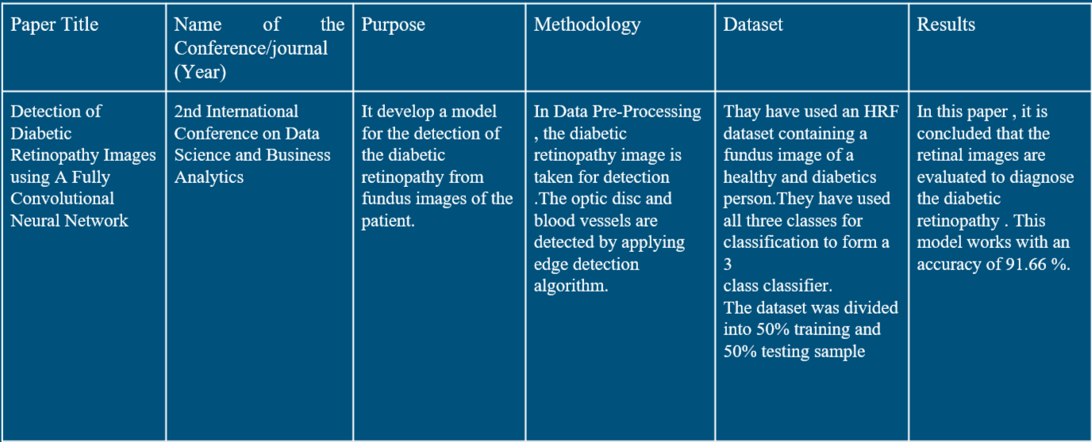
Literature Review

Slide 5
Experimental Dataset Description
We took the dataset from APTOS 2019 Blindness Detection: Detect diabetic retinopathy to stop blindness before it's too late.
APTOS is Asia Pacific Tele-Ophthalmology Society (APTOS)
A large set of retina images taken under a variety of imaging conditions.
Like any real-world data set, we have encountered noise in both the images and labels. Images may contain artifacts, be out of focus, underexposed, or overexposed. The images were gathered from multiple clinics using a variety of cameras over an extended period of time, which will introduce further variation.

Slide 6
Cont...
We have trained ResNet34 model on this dataset using the FastAI library.
We have resized the whole dataset images into 224 x 224 image size.
The 5 classes for whole dataset is saved by us. Which are Mild, moderate, proliferate, no disease and severe. So that we can get the classes of images as the output.
We have used 8 layer CNN model for the centralized approach.

Slide 7
Federated Learning
The FL architecture in its basic form consists of a curator or server that sits at its center and coordinates the training activities.
Clients are mainly edge devices. These devices communicate at least twice with the server per training iteration.
They each receive the current global model’s weights from the server, train it on each of their local data to generate updated parameters which are then uploaded back to the server for aggregation. This cycle of communication persists until a pre-set epoch number or an accuracy condition is reached.

Slide 8
Federated Averaging Algorithm
In the Federated Averaging Algorithm, aggregation simply means an averaging operation.
It can handle
Non – IID Data
Unbalanced Data
Distributed data
Limited Communication
We have discussed in next slides.

Slide 9
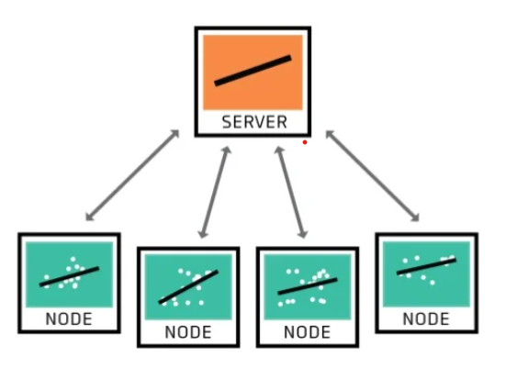

Slide 10
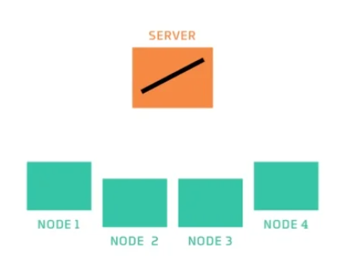

Slide 11
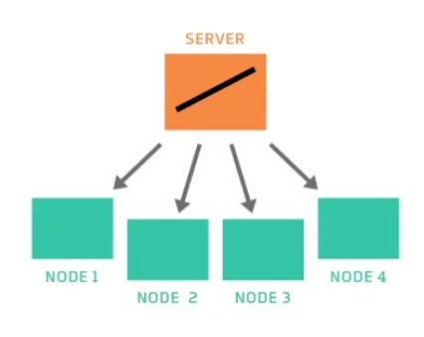

Slide 12
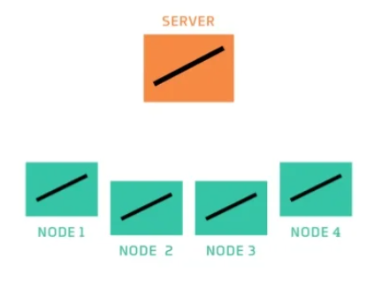

Slide 13
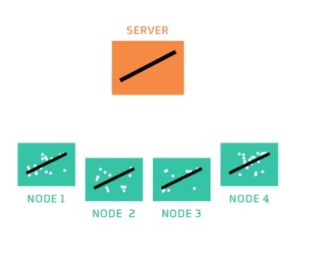

Slide 14
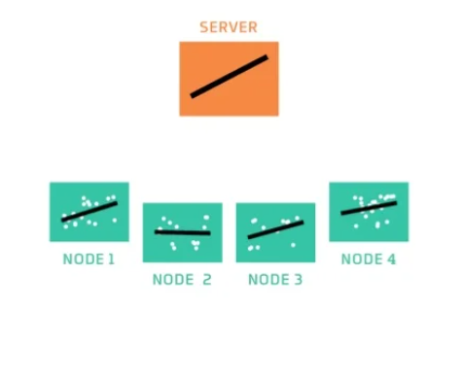

Slide 15
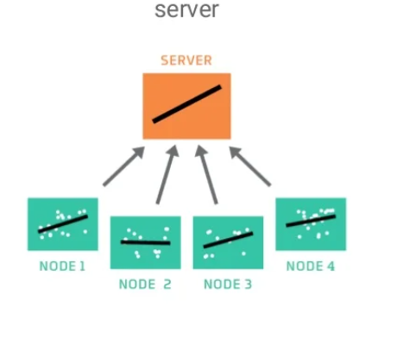

Slide 16
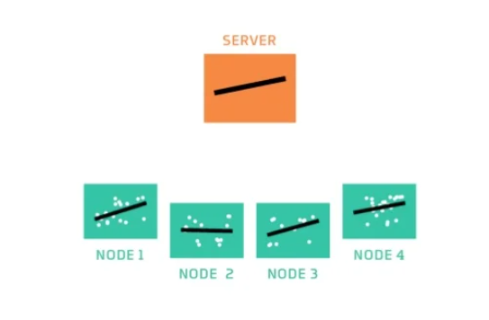

Slide 17
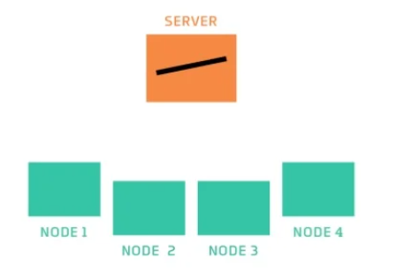

Slide 18
Cont...
Federated learning or FL (sometimes referred to as collaborative learning) is an emerging approach used to train a decentralized machine learning model (deep neural networks) across multiple edge devices.

Slide 19
Cont...
This creates an alternative to the traditional centralized approach to building machine learning models where data from different sources is collected and stored on one server, and then the model is trained on a single server too.
In simple terms, with federated learning, it is not data that moves to a model but it is a model that moves to data, meaning training is happening from user interaction with end devices.

Slide 20
What we have used
TensorFlow Federated
Developed by Google, TensorFlow Federated (TFF) is a Python-based, open-source framework for training machine learning models on decentralized data. This framework has been pioneering the experimentation with federated learning as an approach.
TFF performs in two main API layers:
Federated Learning (FL) API offers high-level interfaces that enable developers to plug existing machine learning models to TFF without the need to dive deeply into how federated learning works.
Federated Core (FC) API offers low-level interfaces that provide opportunities to build novel federated algorithms.

Slide 21
Steps for fed. Learning
Import all the necessary packages and libraries
Reading and preprocessing the dataset
Creating the test-train split
Federated members or clients as data shards
Processing and batching clients' and test data
Creating Multi layer Perceptron model:
We have created a 3 layer MLP model for classification task in federated learning program.
We have added 3 functions to create this model.

Slide 22
Cont...
The training logic has two main loops, the outer loop is for the global iteration, the inner is for iterating through client’s local training.

Slide 23
Literature Review
Federated Transfer Learning For Diabetic Retinopathy Detection Using CNN Architectures:
M. Nasajpour, M. Karakaya, S. Pouriyeh and R. M. Parizi, "Federated Transfer Learning For Diabetic Retinopathy Detection Using CNN Architectures," SoutheastCon 2022, 2022, pp. 655-660, doi: 10.1109/SoutheastCon48659.2022.9764031.
They have demonstrated their three models, including standard, FedAVG, and FedProx, were able to detect DR or non-DR images

Slide 24
Thank you for your Attention! ANY Questions?!

