Slide 1
PERI IMPLANTITIS

Slide 2
DENTAL IMPLANT
6.7 LAKH IMPLANTS – PLACED AROUND THE WORLD IN AYEAR (2021 CONSENSUS)
2.3 LAKH IMPLANTS – YEAR – INDIA
ABOUT 2/3RD OF IMPLANTS LAND UP WITH PERI-IMPLANT DISEASES

Slide 3
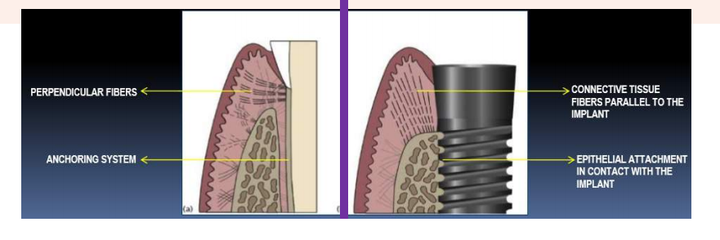

Slide 4
Peri- Implant Diseases- Terminology (European World Workshop, 1993)
Peri - Implant diseases -Collective term for inflammatory reactions in tissues surrounding an implant
Peri - Implant mucositis- Reversible inflammatory reactions in soft tissue surrounding a functioning implant
PERI-IMPLANTITIS-Term used to describe destructive inflammatory processes around osseo-integrated implants in function, leading to peri - implant pocket formation and loss of supporting bone

Slide 5
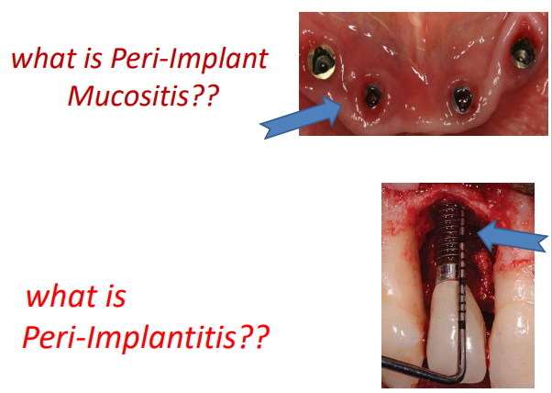

Slide 6
PERI-IMPLANT HEALTH: CASE DEFINITIONS FOR DAY-TO-DAY CLINICAL PRACTICE World workshop 2018
Visual inspection demonstrating the absence of peri-implant signs of inflammation: pink as opposed to red, no swelling as opposed to swollen tissues, firm as opposed to soft tissue consistency;
Lack of profuse (line or drop) bleeding on probing; probing pocket depths could differ depending on the height of the soft tissue at the implant location. An increase in probing depth over time, however, conflicts with peri-implant health; and
Absence of further bone loss following initial healing, which should not be ≥2 mm.

Slide 7
PERI-IMPLANTITIS: CASE DEFINITIONS FOR DAY-TO-DAY CLINICAL PRACTICE
Evidence of visual inflammatory changes in the peri-implant soft tissues combined with bleeding on probing and/or suppuration;
Increasing probing pocket depths as compared to measurements obtained at placement of the supra-structure; and
Progressive bone loss in relation to the radiographic bone level assessment at 1 year following the delivery of the implant-supported prosthetics reconstruction; and
In the absence of initial radiographs and probing depths, radiographic evidence of bone level ≥3 mm and/or probing depths ≥6 mm in conjunction with profuse bleeding represents peri-implantitis.

Slide 8
PERI-IMPLANT MUCOSITIS: CASE DEFINITIONS FOR DAY-TODAY CLINICAL PRACTICE
Visual inspection demonstrating the presence of peri-implant signs of inflammation: red as opposed to pink, swollen tissues as opposed to no swelling, soft as opposed to firm tissue consistency.
Presence of profuse (line or drop) bleeding and/or suppuration on probing.
An increase in probing depths compared to baseline and,
Absence of bone loss beyond crestal bone level changes resulting from the intial remodeling.

Slide 9
PERI-IMPLANT PATHOGENESIS- Ronald M, 1990
Traditional pathway
1. From soft tissue apically to bone
2. Dental plaque causing gingivitis
3. Progressing to peri-implantitis with resultant bone loss
Retrograde pathway
1. From bone to soft tissue
2. Bone loss occurring at crest (due to microfractures in bone from overloading, loading too soon, lateral forces or occlusal factor

Slide 10
ETIOLOGY OF PERI-IMPLANTITIS
BATERIAL INFECTION-PLAQUE THEORY
BIO MECHANICAL OVERLOAD LOADING THEORY

Slide 11
SUBGINGIVAL MIROFLORA
• HEALTH – TEETH AND IMPLANT HAVE SIMILAR FLORA – STREPTOCCI AND NONMOBILE RODS
• SAME GROUP OF MIROFLORA INVOLVED IN PERIODONTITIS AND PERIIMPLANTITIS

Slide 12
COMMONLY FOUND MIROFLORA
A.Actinomycetemcomitans
P.Gingivalis
T.Forsythia
P.Intermedia
C.Rectus
P.Aeruginosa
Enterobacteriae

Slide 13

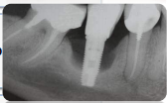
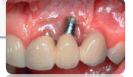
CLASSIFICATION-MEFFERT 1992
Ailing implant -Implant with soft tissue inflammation and no bone loss
Failing implant - Implant with inflammation and bone loss but no mobility
Failed implant-Implant with inflammation, bone loss and also mobility.

Slide 14
MANAGEMENT OF PERI-IMPLANTITIS
1.NON SURGICAL
MECHANICAL DEBRIDEMENT
DRUG THERAPY SYSTEMIC & LOCAL DRUG DELIVARY
PHOTODYNAMIC THERAPY
LASER THERAPY
2. SURGICAL THERAPY
RESECTIVE THERAPY
REGENERATIVE THERAPY
IMPLANT SURFACE DECONTAMINATION

Slide 15
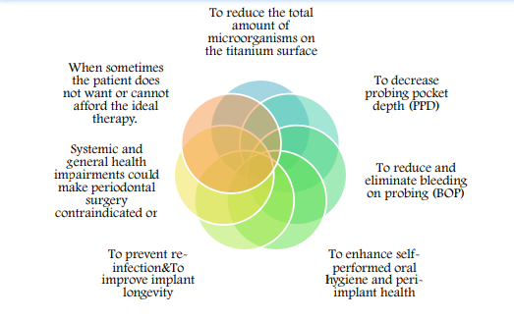
OBJECTIVES OF A NON SURGICAL APPROACH

Slide 16
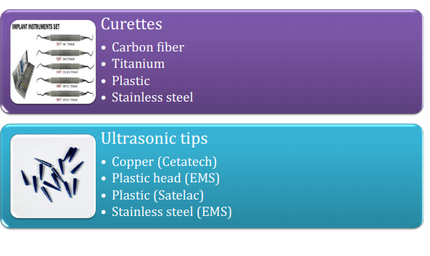
MECHANICAL DEBRIDEMENT

Slide 17
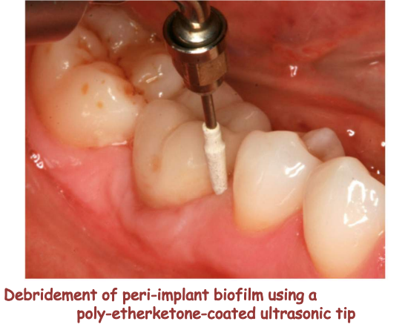
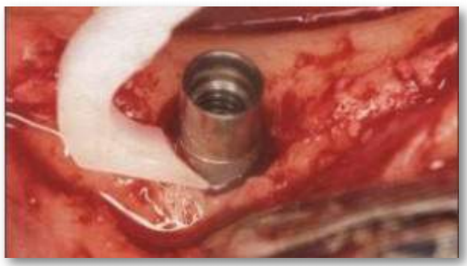

Slide 18
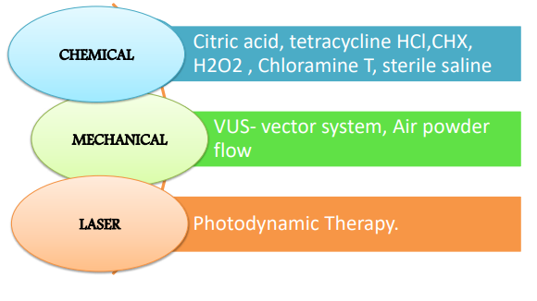
IMPLANT SURFACE DECONTAMINATION

Slide 19
Resective Therapy:
Elimination of pathological peri implant pockets in combination with implantoplasty
Regenerative procedures:
Bone augmentation.

Slide 20
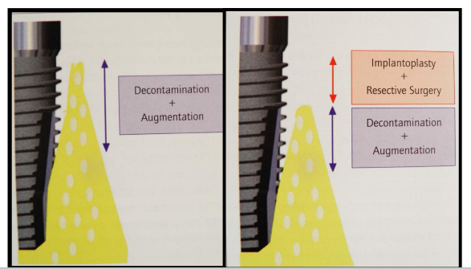

Slide 21
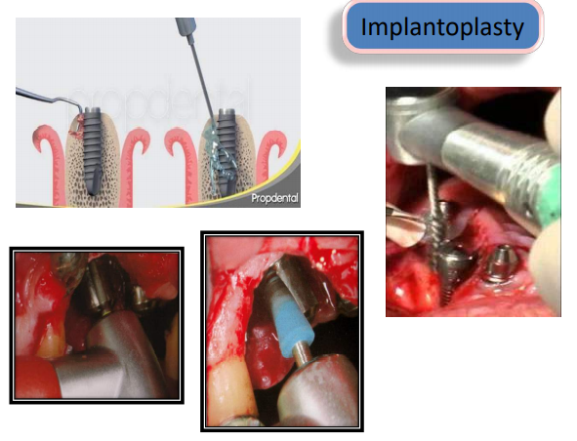

Slide 22
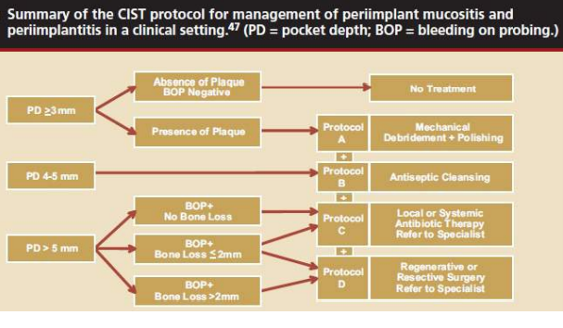
LANG ET AL., 2004

Slide 24
