Slide 1
trazo
01 / 10
trazo
A prescription reader that is honest about what
it cannot read, with measured accuracy to prove it.
Trazo means pen stroke in Spanish.
Notes:
Good morning. This is Trazo — a mini project about reading prescriptions. The one-line promise is on the slide: it is honest about what it cannot read, and the accuracy plan is built to measure that. The name means pen stroke in Spanish — the word beneath is where the reading starts.

Slide 2
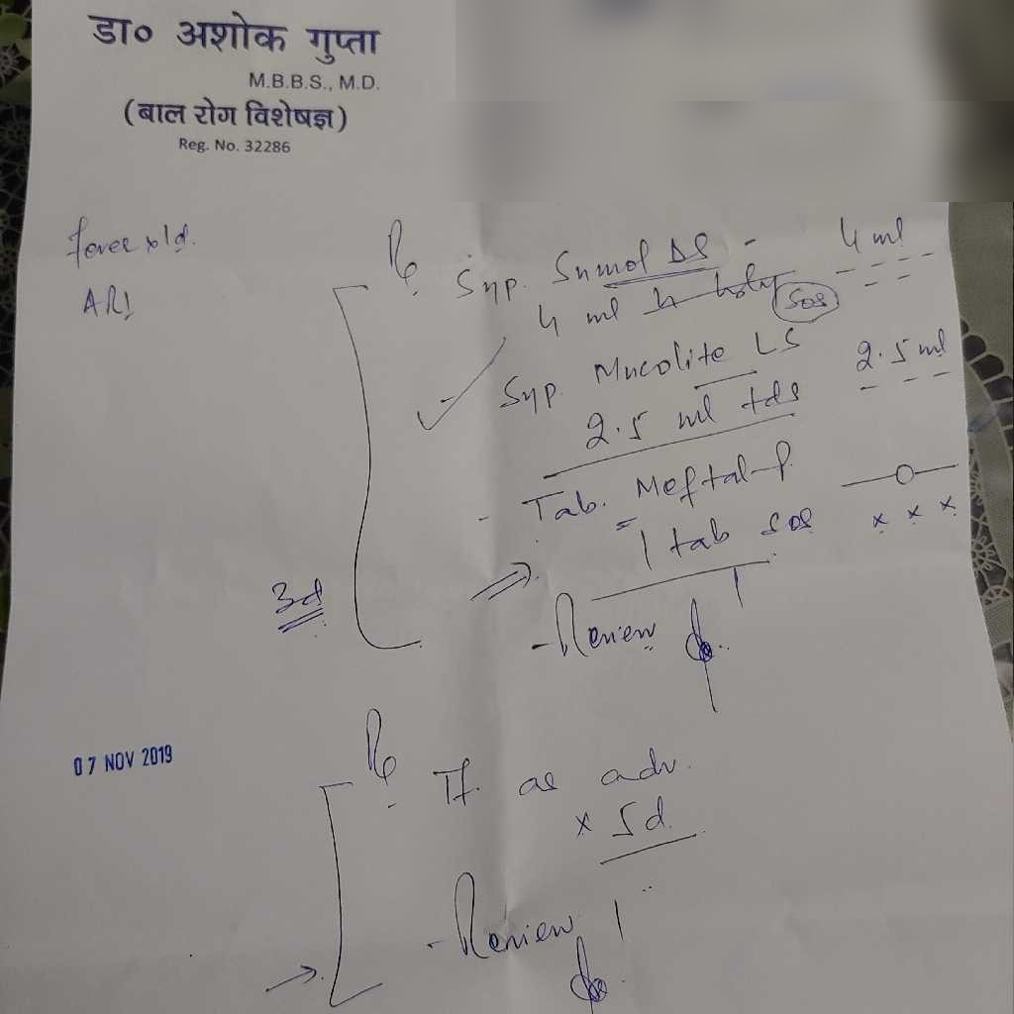
trazo
02 / 10
The problem
This is a real prescription.
Doctor handwriting and short
forms are hard to read.
A wrong dose or skipped
medicine is a real risk.
Notes:
Here is a prescription photo — an anonymized real prescription from a public collection, patient details removed. I point at the slide: this is a real prescription. Doctor handwriting and short dose forms defeat plain reading, and a wrong dose or a skipped medicine is a real risk. That risk is the reason the project exists.

Slide 3
trazo
03 / 10
Who it helps, and the gap
Who it helps
The gap
Patients and family members
Most tools show confident output
using a phone.
even when the reading is wrong.
Caregivers managing medicines
Trazo shows what
for elderly parents.
it could not read.
Not for doctors or pharmacists.
Notes:
Left side: who this is for. Patients and family members, and caregivers managing medicines for elderly parents — people holding a phone. Not for doctors or pharmacists. The gap is on the right: most tools show confident output even when the reading is wrong. Trazo does the opposite — it shows what it could not read.

Slide 4
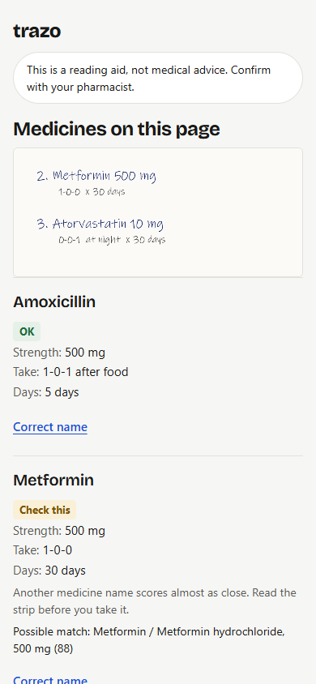
trazo
04 / 10
What Trazo does
Reads a prescription photo.
Shows medicine, strength, timing
and duration.
Marks every unclear word
instead of guessing.
This is a reading aid, not medical advice.
Confirm with your pharmacist.
Notes:
This is the real result screen from the running app. Three things happen: it reads a prescription photo, it shows medicine, strength, timing and duration, and it marks every unclear word instead of guessing. The banner text on the slide is exactly what the app shows on every result — reading aid, not medical advice, confirm with your pharmacist.

Slide 5
trazo
05 / 10
How it works
Photo
Clean,
Vision
Match to
Decode
Result
resize
model
list
timing
camera capture
rows on screen
fix tilt, size
reads the words
finds medicine
1-0-1, BD, SOS
OK
Check this
Unclear
The photo is processed in memory and deleted. It is not stored.
Notes:
Six steps, left to right, one per click, each with its job printed inside: photo from the camera, clean and resize to fix tilt and size, the vision model reads the words, match against the medicine list, decode timing codes like 1-0-1 and BD, and the result screen shows each row with its flag — OK, Check this, or Unclear. The photo itself is processed in memory and deleted — it is never stored.

Slide 6
trazo
06 / 10
Tech stack
Part
Tool
Browser
HTML, CSS, JavaScript
Server
Python, FastAPI
Image handling
OpenCV, Pillow
Name matching
RapidFuzz
Storage
SQLite
Model
Ready-made vision model, via API
Free model API, no training. The accuracy work is in the rules, not the model.
Notes:
The stack is deliberately plain — a table is meant to be read, so this slide has no animation. Browser, Python and FastAPI on the server, OpenCV and Pillow for image handling, RapidFuzz for name matching, SQLite for storage, and a ready-made vision model called through an API. Free model API, no training — the accuracy work is in the rules, not the model.

Slide 7
trazo
07 / 10
Safety and privacy design
It never fills an unreadable word - it flags it instead.
Anything it cannot confirm becomes Check this or Unclear.
Check this
Warning on every result: a reading aid, not medical advice.
No photo is stored, ever.
No dose advice or diagnosis.
Notes:
Five design decisions, one per click. It never fills an unreadable word — it flags it instead. Then the rule: anything the rules cannot confirm becomes Check this or Unclear — that is the amber tag. Whether a row earns the green OK is decided by four checks: the model did not mark it unclear, the database match is strong, the timing code is known, and no second medicine name is a close match. The warning on every result, no photo is stored, and no dose advice or diagnosis. The boundaries get their own slide at the end of the talk.

Slide 8
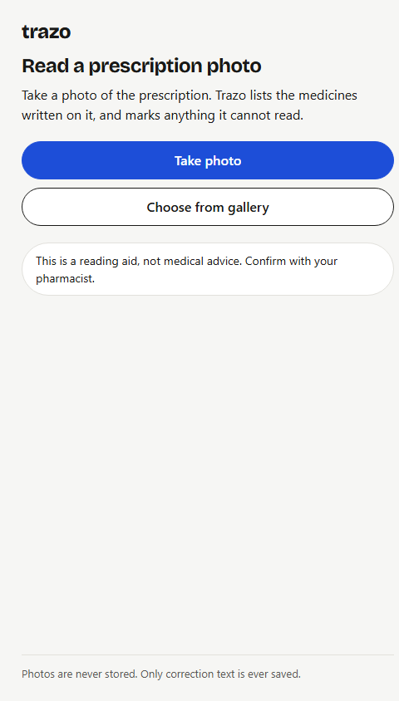
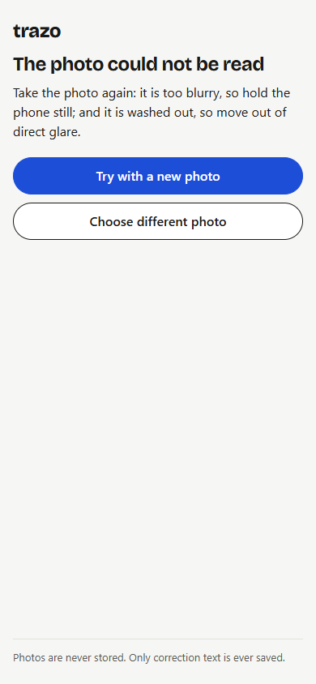
trazo
08 / 10
Live demo
Live demo on a phone, using the camera.
Could not read
Home
Result
Caught failure
Notes:
Now the demo, on a phone, using the camera. The three real screens: home, result, and a caught failure — the blank photo the app refused, with the hatched could-not-read block marked on it. I will run the live demo after this slide. The refusal screen is part of the demo, not an exception to it.

Slide 9
trazo
09 / 10
Limits
Medicine list covers only 94 medicines.
A name on the list is matched accurately; one off it stays Check this.
It reads what is written; it does not check doses.
The small list is the real limit - this is not a production system.
No clinical validation - a learning project.
Notes:
I will say the limits before anyone asks. The medicine list covers only the number shown — a name on the list is matched accurately, and a name off it stays Check this. That small list is the real limit: this is not a production system yet. It also reads what is written — it does not check doses. And no clinical validation: a learning project.

Slide 10
trazo
10 / 10
Summary
Reads a prescription photo and lists each medicine.
Flags every word it cannot read - it never guesses.
Warns on every result: a reading aid, not medical advice.
Thank you.
github.com/VineshF1/trazo
Notes:
The summary is the whole project in three lines: it reads a prescription photo and lists each medicine, it flags every word it cannot read because it never guesses, and it warns on every result that this is a reading aid, not medical advice. That closes the talk — I end on thank you and invite questions out loud rather than on the slide. The small link at the bottom is the GitHub repo, for anyone who wants to look at the code after.

