Slide 1

Rule-based CAD construction sequence synthesis from B-rep models
A frozen baseline for constrained executable reconstruction from history-free B-rep
Final B-rep
Evidence
Executable explanation
Shuo Ding
24 September 2026
Technical Briefing · 2026
https://www.unimelb.edu.au
Notes:
Good morning. Today I will present my project on rule-based CAD construction sequence synthesis from B-rep models.
The original goal is to recover executable CAD construction explanations from history-free B-rep models.
In this implementation, I focus on a constrained scope and evaluate whether final geometry and topology can support a plausible and executable construction explanation.
I will mainly introduce the pipeline, evaluation design, demonstrations, and the current limitations.

Slide 2
Research Question and Scope
OBSERVED INPUT
History-free STEP/B-rep
Can final geometry and topology constrain
an executable construction explanation?
?
TARGET OUTPUT
Plausible, executable construction explanation
TESTED CONSTRUCTION CLASSES
01
02
Base extrusion +
straight through cylindrical cut
Single extrusion
One supported planar profile
One distance extrusion
One coupled base-and-cut
construction
Input boundary: Final history-free STEP/B-rep only.
Claim boundary: Plausible construction explanation only.
Sequence uniqueness remains unresolved.
Notes:
The key research question is: given only a final history-free STEP/B-rep model, can we generate a plausible executable construction explanation?
Here, the input only contains final geometry and topology information. We do not use the original CAD history.
In this project, I tested two controlled construction classes.
The first one is single extrusion from a planar profile.
The second one is a base extrusion followed by one straight through cylindrical cut.
Importantly, the goal is not to claim unique recovery of the original designer history. The claim is only a plausible executable explanation within this defined scope.

Slide 3

Gate 0–4 Evidence Pipeline
Route-specific
validation
OBSERVED INPUT
Candidate
hypotheses
Executable
sequence
FROZEN EXECUTOR
Topology
Geometry
Adjacency
Geometry
evidence
constraints
Candidate A
Candidate B
Candidate C
Feature
Sketch
[CAD solid]
Package
History-free
STEP / B-rep
Plausible explanations
Extrude
Observed facts only
Geometry + topology only
Replayable construction
.F3D .STEP LOG
Fusion
Replay
Auditable
evidence package
Artifacts generated
Observed facts constrain hypotheses; only replay and validation close the evidence loop.
Notes:
This slide shows the overall evidence pipeline.
Starting from a history-free B-rep, we first extract observable geometric and topological facts, such as geometry, topology, and adjacency information.
These observations constrain possible construction hypotheses.
Then the candidate sequence is translated into an executable CAD sequence and replayed in Fusion.
Finally, the result is checked through route-specific validation.
The key idea is that a candidate explanation is not accepted only because it looks reasonable. It needs replay evidence and validation evidence.

Slide 4
Benchmark and Evaluation Boundary
30
curated controlled cases
Fixed benchmark roles for development and held-out evaluation
DEVELOPMENT
FROZEN HELD-OUT
15
15
Same frozen evaluation system across both splits
No post-freeze semantic tuning
EVALUATION ORDER
01
02
03
04
Freeze system
Run both splits
Seal raw evidence
Evaluate outcomes
implementation + protocols
development + held-out
formal run artifacts
expected labels used
only for statistics
Expected labels were not available to semantic inference.
27 CadQuery-generated models· 3 manually modelled in Fusion
Not a representative industrial sample.
Notes:
For evaluation, I created a small controlled benchmark with 30 cases.
It contains 15 development cases and 15 frozen held-out cases.
The important point is that the evaluation system was frozen before running both splits.
Expected labels were only used after formal runs were completed, so they were not available during semantic inference.
This benchmark is designed for controlled evaluation of the current scope, rather than representing a general industrial CAD dataset.

Slide 5
Frozen Gate 4 Observations
EVIDENCE INTEGRITY
30/30
27/27
complete result packages
✓
validated geometry passes
Package completeness is not recovery success
Among cases with trusted replay evidence
OBSERVED OUTCOMES
27/30
26/27
2/2
terminal automatic
success
supported automatic recovery
unsupported
correct rejection
✓
benchmark-level terminal outcome
supported cases only
unsupported controls
VALIDATION NOTES
25 volume-IoU results
·
2 surface-only validations
·
0 manual corrections
Surface-only cases retain volume_iou = null.
Gate 4 PASS reflects evaluation integrity, not a success-rate threshold.
Notes:
This slide summarizes the Gate 4 evaluation results.
First, all 30 cases produced complete evidence packages, meaning the evaluation process itself was reproducible.
Among the validated reconstruction cases, 27 geometry checks passed.
The final outcomes are separated into different categories.
We distinguish automatic success, supported-case recovery, unsupported rejection, and validation status.
The important point is that Gate 4 PASS means the evaluation protocol and evidence integrity passed. It is not simply a success-rate threshold.

Slide 6
Demonstration Evidence Contract
Demonstration ≠ Evaluation
Gate 5 demonstrations explain frozen capability without creating new benchmark evidence.
DEVELOPMENT DEMONSTRATIONS
READ-ONLY SEALED EVIDENCE VIEW
D-S04 · D-H01
D-S01
Delivery-layer demonstration artifacts
Sealed Gate 4 development package
Development cases only
source_mode = sealed_artifact_only
Frozen inference → Fusion replay
→ frozen validation
No fresh inference
No artifact editing
No formal result-count update
D-S04 / D-H01 DEMONSTRATION METADATA
evidence_role = demonstration_only
source_split = development
formal_evaluation = false
baseline_tag = gate0-4-frozen-baseline-v1
No algorithm changes · No threshold tuning · No benchmark updates · No result-count updates
Notes:
Before showing demonstrations, I want to clarify their role.
These demonstrations are not additional evaluation results.
D-S04 and D-H01 are development cases used to demonstrate the current capability.
D-S01 uses sealed Gate 4 evidence only.
No benchmark update, no parameter tuning, and no algorithm modification are involved.
So the purpose here is explanation of the system behavior, not improving the evaluation result.

Slide 7
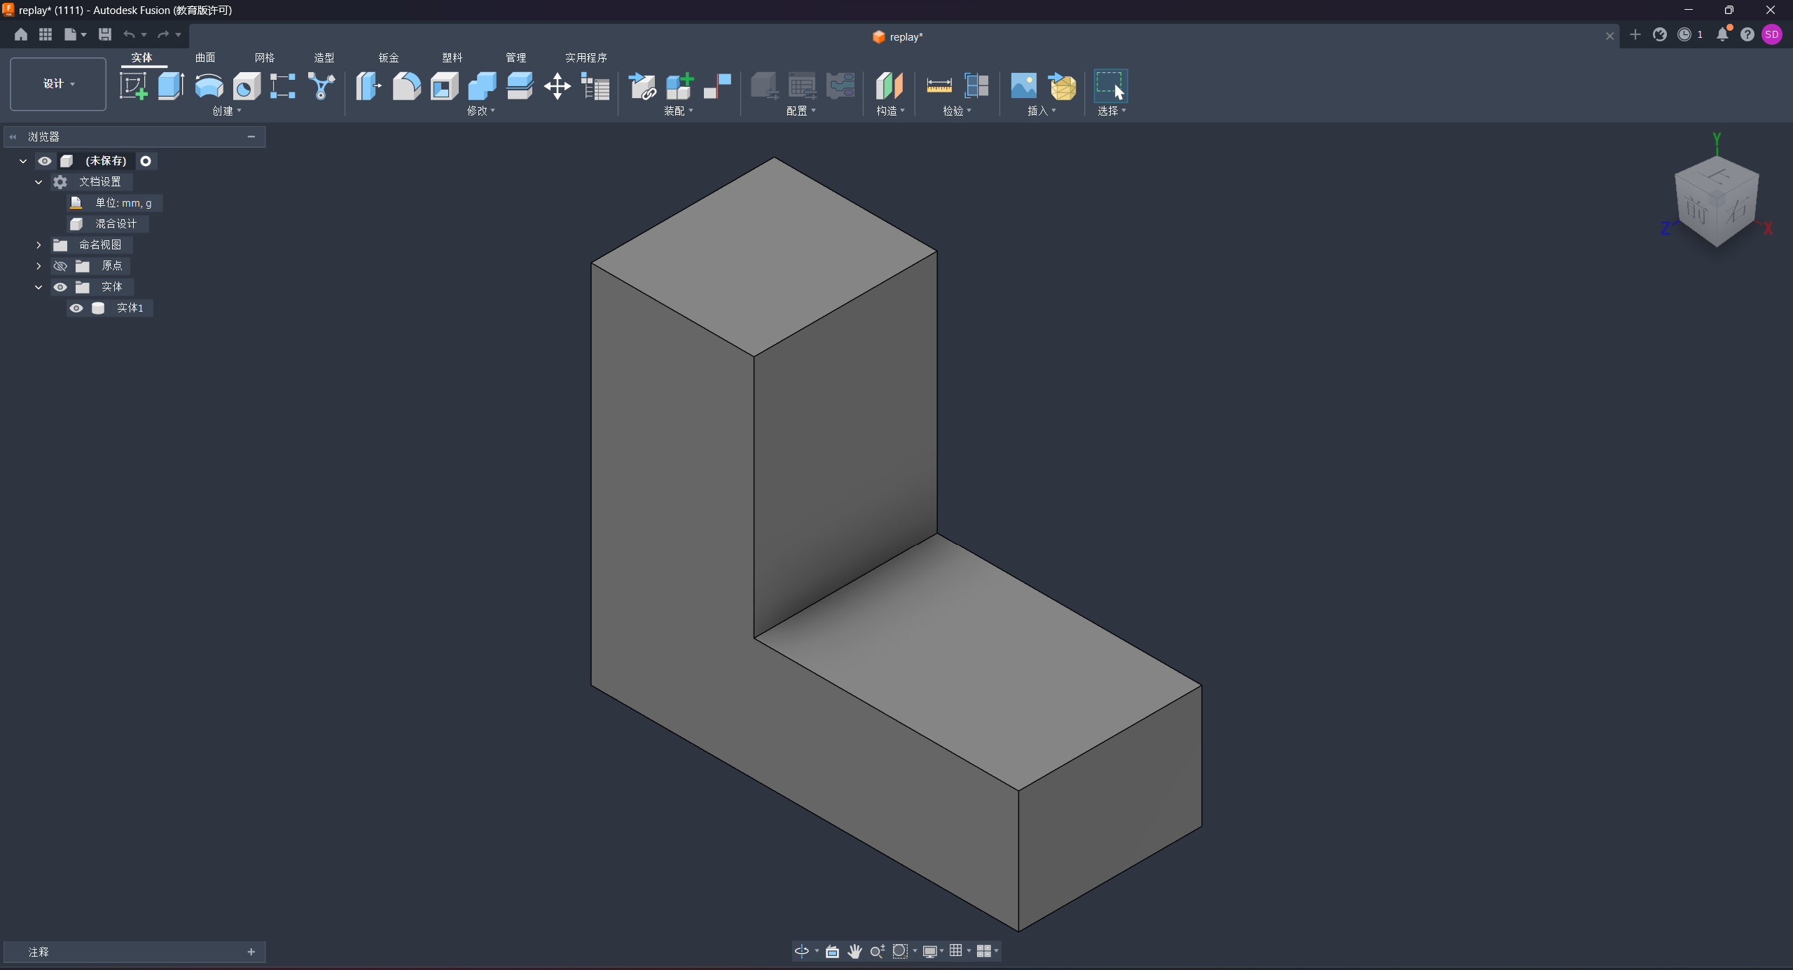
D-S04 Single Extrusion
DEVELOPMENT DEMONSTRATION
Frozen single-extrusion construction class
DEMONSTRATION PATH
01
Prepare
STEP → B-rep facts → candidate hypotheses → canonical sequence
↓
02
Fusion replay
Replay the inferred sequence
in a new Fusion document
↓
03
Finalize
Apply the frozen single-extrusion validator
↓
04
Verify
D-S04
Verified replay STEP in Fusion
Check package contract and final status
Development input: history-free STEP/B-rep
DEMONSTRATION STATUS
terminal_status
geometry_pass
automatic_success
✓
true
evidence_role
demonstration_only
formal_evaluation
false
source_split
development
Notes:
This is one demonstration of the single extrusion case.
The input is a history-free STEP/B-rep model.
The system extracts geometric constraints, generates a candidate sequence, and replays this sequence in a new Fusion document.
The final result passes the frozen single-extrusion validation route.
This demonstrates that, for this controlled case, the generated explanation is executable and geometrically consistent.
However, it does not imply that the original CAD history has been uniquely recovered.

Slide 8
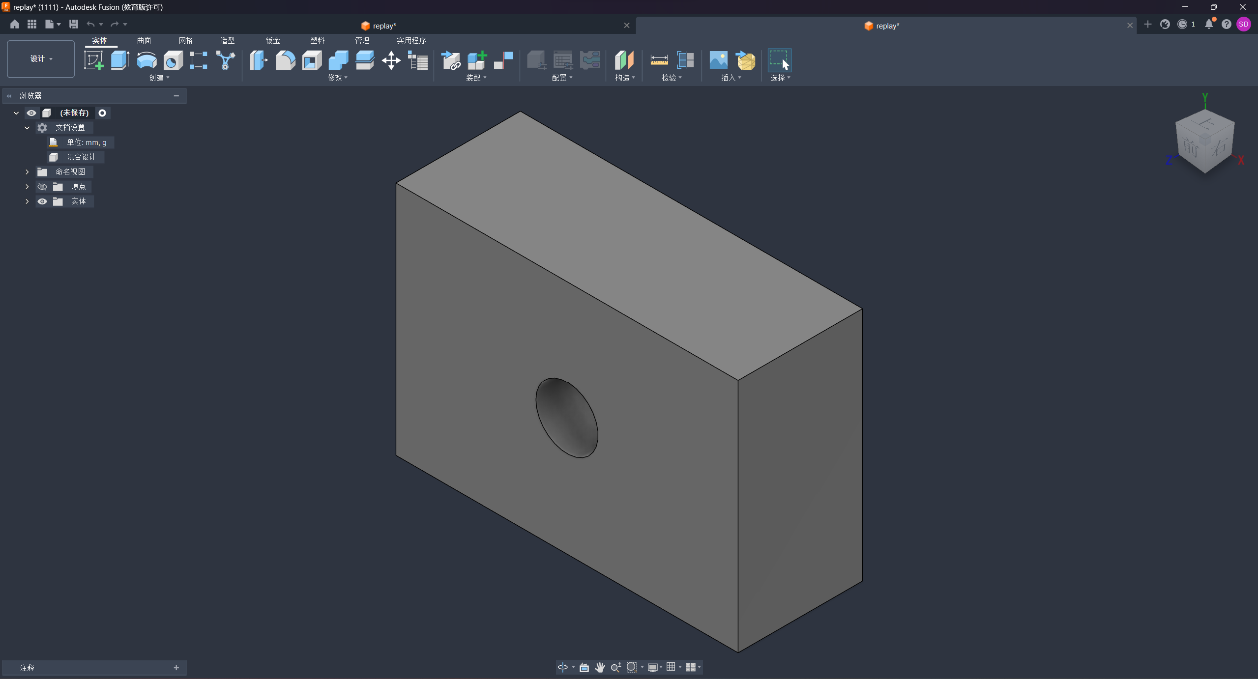
D-H01 Base and Straight Through Cut
DEVELOPMENT DEMONSTRATION
Frozen base extrusion + one straight cylindrical through-cut construction class
OBSERVED CASE
COUPLED SEQUENCE
ROUTE-SPECIFIC VALIDATION
One hypothesis explains both the base and the cut
Frozen checks for this construction route
01
Geometry
New Extrusion
✓
PASS
base construction
Base geometry
↓
coupled hypothesis
02
✓
PASS
Cut through_all
Hole feature match
straight cylindrical through cut
✓
PASS
↓
D-H01
Fusion replay
All checks use the frozen
Gate 3 validation route
Verified replay STEP in Fusion
Development input: history-free STEP/B-rep
Observed evidence: two circular openings and one connecting cylindrical face
evidence_role
demonstration_only
formal_evaluation
false
source_split
development
Scope: one straight cylindrical through cut
Not evidence for blind, stepped, tapered, multiple, intersecting,
threaded, counterbored, countersunk, or patterned holes.
Notes:
This example demonstrates the second construction class.
The explanation contains two operations:
first, a base extrusion;
second, a straight through cylindrical cut.
The important observation is that both the base geometry and the cylindrical cut can be explained by one coupled sequence.
After replay in Fusion, the geometry check, base geometry check, and feature match check all pass.
The scope is limited to this straight through cylindrical cut. It does not represent general hole recognition.

Slide 9
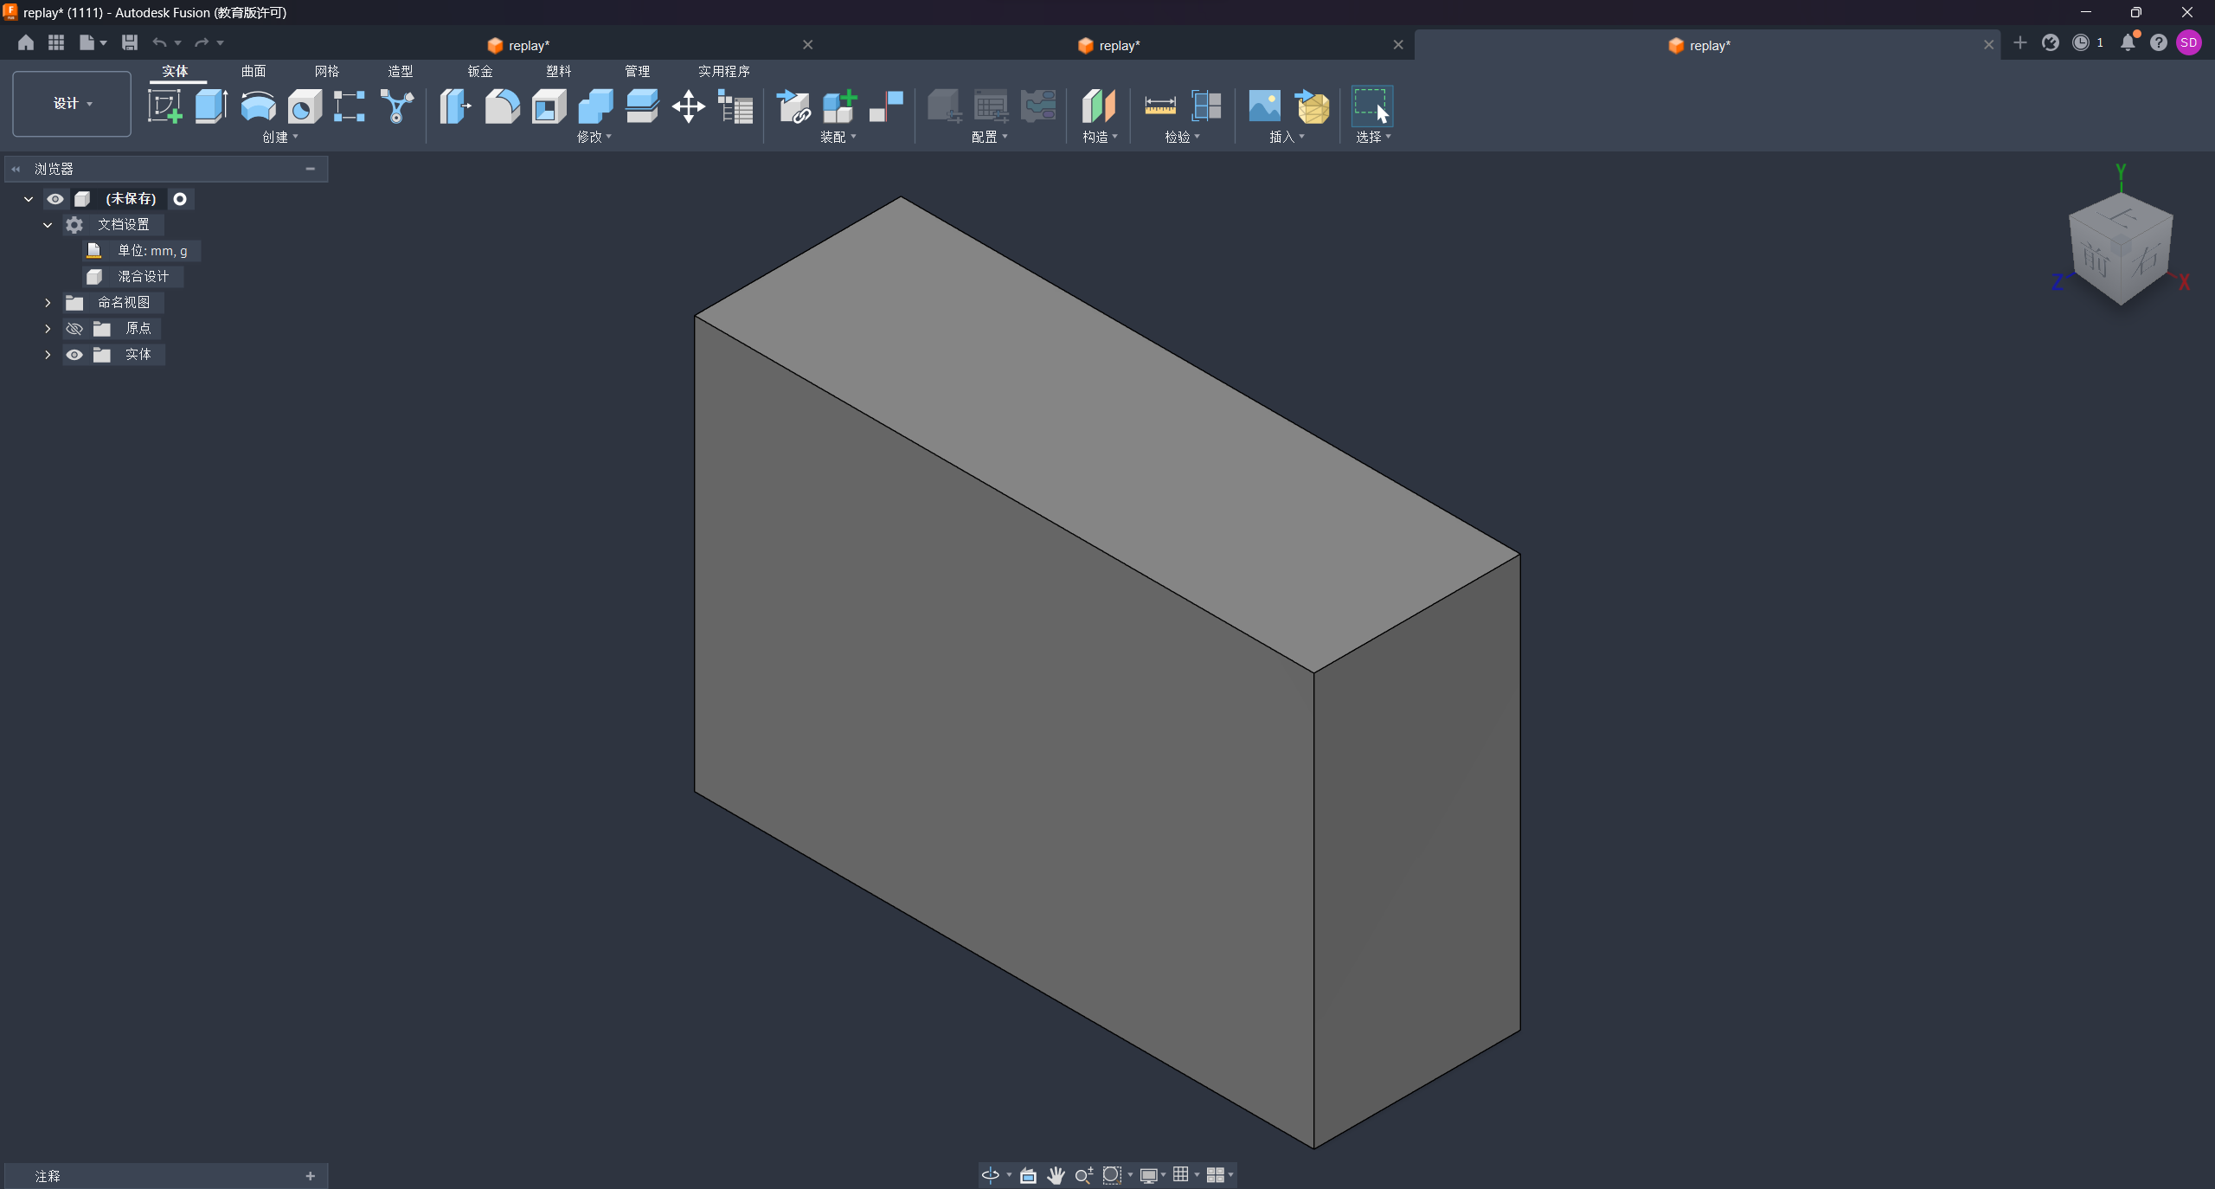
D-S01 Sealed Ambiguity Evidence
SEALED GATE 4 EVIDENCE
source_mode = sealed_artifact_only
OBSERVED CASE
PRE-FUSION CANDIDATES
CANONICAL EXECUTION PATH
Three hypotheses satisfy the frozen
pre-Fusion acceptance contract
Read-only sealed Gate 4 artifact
Canonical selection
C1
extrusion-face-000-face-001
extrusion-face-002-face-003
accepted
↓
C2
extrusion-face-002-face-003
Fusion replay
accepted
·
selected
✓
PASS
↓
C3
extrusion-face-004-face-005
Geometry validation
D-S01
Sealed canonical replay STEP in Fusion
accepted
✓
PASS
Input: history-free STEP/B-rep
Formal replay evidence exists
for the selected candidate only
●
ambiguous =
true
Candidate-space ambiguity retained
3 accepted hypotheses
≠
3 independently replayed histories
sealed_artifact_only
| no fresh inference |
no JSON correction
Notes:
This case focuses on ambiguity handling.
During candidate generation, three hypotheses satisfy the frozen pre-Fusion acceptance contract.
However, only the canonical selected candidate has replay evidence and geometry validation evidence.
Therefore, the system keeps the ambiguity flag as true.
The important distinction is that three accepted candidates do not mean three independently validated histories.
This demonstrates how ambiguity is preserved instead of being artificially removed.

Slide 10
Validated Scope and Open Question
VALIDATED SCOPE
Constrained executable reconstruction
Single extrusion
Base extrusion + one straight
through cylindrical cut
One planar profile → one extrusion
One coupled base-and-cut construction
✓
Auditable replay + route-specific validation
Evidence is limited to the tested construction classes and frozen environment.
It does not establish unique designer history, arbitrary-operation support,
industrial generalization, or universal validation thresholds.
PRESERVED EXECUTOR BOUNDARY
EXECUTOR RESULT
T-S07
Candidate reached
Fusion replay
failure_code
Preserved without
retry or relabelling
supported
held-out case
unsupported_absolute_frame
semantic inference completed
absolute-frame replay capability
No semantic retuning
Executor capability boundary — neither a semantically unsupported case
nor evidence of history ambiguity.
OPEN QUESTION
Future work will investigate controlled multi-operation ordering and history ambiguity.
Notes:
This slide summarizes what has been validated and what remains open.
Within the tested scope, the system supports constrained executable reconstruction for single extrusion and one base extrusion with one straight through cut.
The evidence supports replay and validation, but not unique designer history recovery or arbitrary operation support.
I also show T-S07 as an executor boundary case.
The semantic candidate reached replay, but the executor returned an unsupported absolute-frame error.
This is treated as an executor capability limitation, not as semantic unsupported or history ambiguity.
Future work will investigate more complex operation ordering and ambiguity.

Slide 11
Implementation Verification
APPENDIX 1
ENGINEERING VERIFICATION
Automated checks on the frozen technical baseline and Gate 5 delivery candidate
311
✓
tests passed
Full regression suite at the approved Checkpoint A verification
GATE-LEVEL CHECKS
GATE 0
GATE 1
GATE 2 / 3 / 4
22/22
8/8
PASS
environment / execution checks
forward-path verifier checks
all three gate verifiers
BASELINE AND DELIVERY CHECKS
Baseline tag verifier
Gate 5 package preflight
✓
PASS
✓
PASS
gate0-4-frozen-baseline-v1 @ c3e4485
non-PPT assets verified candidate commit: ab71dbd
Engineering verification supports reproducibility.
It does not constitute additional scientific evaluation.
Notes:
This appendix summarizes engineering verification.
The frozen technical baseline passed the regression checks, including gate-level verifiers and delivery preflight.
These tests ensure reproducibility and implementation consistency.
They are engineering verification results, not additional scientific evaluation.

Slide 12
Status and Validation Semantics
APPENDIX 2
STATUS TAXONOMY
Scope, ambiguity, execution, geometry and package completeness are reported separately.
STATUS / FIELD
MEANING / INTERPRETATION
supported
The final B-rep falls within a frozen construction class
that the semantic inference system is intended to handle.
Supported ≠ successfully reconstructed.
ambiguous = true
More than one candidate hypothesis satisfies the frozen
pre-Fusion acceptance contract.
It does not mean that multiple candidates have independent
Fusion replay evidence.
unsupported
The final B-rep falls outside the frozen supported
construction scope and is returned as a structured rejection.
Unsupported is a scope decision, not an executor failure.
executor failure
A semantic candidate reaches the replay stage, but the
frozen executor cannot complete that construction request.
This is an executor capability boundary, not semantic unsupported.
e.g. T-S07
geometry failure
Replay evidence exists, but the frozen route-specific
geometry validation does not satisfy its acceptance criteria.
Geometry failure is distinct from executor failure.
AMBIGUITY FLAG
candidate-space state
ambiguous = true / false
TERMINAL OUTCOME
execution / validation outcome
success / rejection / executor failure / geometry failure
PACKAGE COMPLETENESS
condition-dependent artifact contract
complete / incomplete
THREE INDEPENDENT DIMENSIONS
Terminal outcome ≠ ambiguity flag ≠ package completeness.
Notes:
This appendix clarifies the status definitions used in the project.
Different concepts are reported separately.
For example, ambiguous means multiple candidate hypotheses pass the pre-Fusion acceptance contract.
Executor failure means a semantic candidate reaches replay but the executor cannot complete it.
Geometry failure means replay exists but validation does not pass.
Keeping these states separate avoids mixing different failure sources.

Slide 13
Evidence References
APPENDIX 3
AUDIT REFERENCE MAP
Stable entry points for reproducing and auditing the frozen evidence
01
BASELINE ANCHOR
→
02
FORMAL EVALUATION
→
03
DELIVERY SNAPSHOT
gate0-4-frozen-baseline-v1
3d042733...
Gate 4 protocol-freeze commit
gate5-delivery-v1
Gate 4 closure report
Planned annotated delivery tag
Annotated frozen baseline tag
FROZEN
logs/gate4/gate4_closure_report.md
Demo runbook
c3e4485...
Sealed D-S01 artifact
benchmark_results/gate4-development-formal-20260905/
cases/D-S01/
docs/gate5_demo_runbook.md
baseline pack commit
Gate 4 statistics
logs/gate4/gate4_statistics.json
Media index
Baseline manifest
docs/gate5_media_index.md
config/gate0_4_baseline_manifest.json
SEALED FORMAL RUNS
Research baseline
Delivery snapshot only
docs/gate0_4_research_baseline.md
development
held-out
Not a new scientific baseline
Benchmark card
benchmark_results/gate4-development-formal-20260905/
benchmark_results/gate4-held-out-formal-20260905/
The target commit will be recorded in
submission_manifest.json after final tag creation.
docs/benchmark_v1_card.md
TRACEABLE ARTIFACTS
Manifest
Benchmark card
Closure / statistics
Formal runs
Delivery snapshot
JSON
MD
MD / JSON
sealed dirs
planned tag
Gate 5 delivery materials reference the frozen Gate 0–4 baseline. They do not redefine the scientific baseline.
Notes:
Finally, this appendix summarizes the evidence traceability structure.
All results are linked back to the frozen baseline, benchmark definition, Gate 4 evaluation records, and sealed runs.
The planned delivery snapshot is only a packaging reference and does not redefine the scientific baseline.
The purpose is to make every claim traceable and reproducible.

Slide 14
Thanks
The University of Melbourne (Australian University) PRV12150/CRICOS 00116K

