Slide 1


Sentiment In Text

Slide 2

Word Based Encodings
01
Tokenizer
02
TABLE OF CONTENTS
04
Deeper in Tokenizer
Text to Sequence
03
05
Padding
06
Practice with dataset

Slide 3
Word Based Encodings
01

Slide 4
076
073
083
084
069
078
L I S T E N

Slide 5
083
073
076
069
078
084
S I L E N T
076
073
083
084
069
078
L I S T E N

Slide 6
001
002
003
004
I love my dog

Slide 7
001
002
003
004
I love my dog
I love my cat
001
002
003
005

Slide 8
001
002
003
004
001
002
003
005

Slide 9
Using Tokenizer
02

Slide 10
Using Tokenizer
from tensorflow.keras.preprocessing.text import Tokenizer
sentences = ['I love my dog',
'I love my cat’]
tokenizer = Tokenizer()
tokenizer.fit_on_texts(sentences)
word_index = tokenizer.word_index
print(word_index)

Slide 11
Using Tokenizer
{'i': 1, 'love': 2, 'my': 3, 'dog': 4, 'cat': 5}

Slide 12
Using Tokenizer
sentences = ['I love my dog',
'I love my cat',
'You love my dog!’
]

Slide 13
Using Tokenizer
{'love': 1, 'my': 2, 'i': 3, 'dog': 4, 'cat': 5, 'you': 6}

Slide 14
TITLE
03
You can enter here the subtitle if you need it

Slide 16
TITLE
04

Slide 18
TITLE
05
You can enter here the subtitle if you need it

Slide 20
TITLE
06
You can enter here the subtitle if you need it

Slide 22
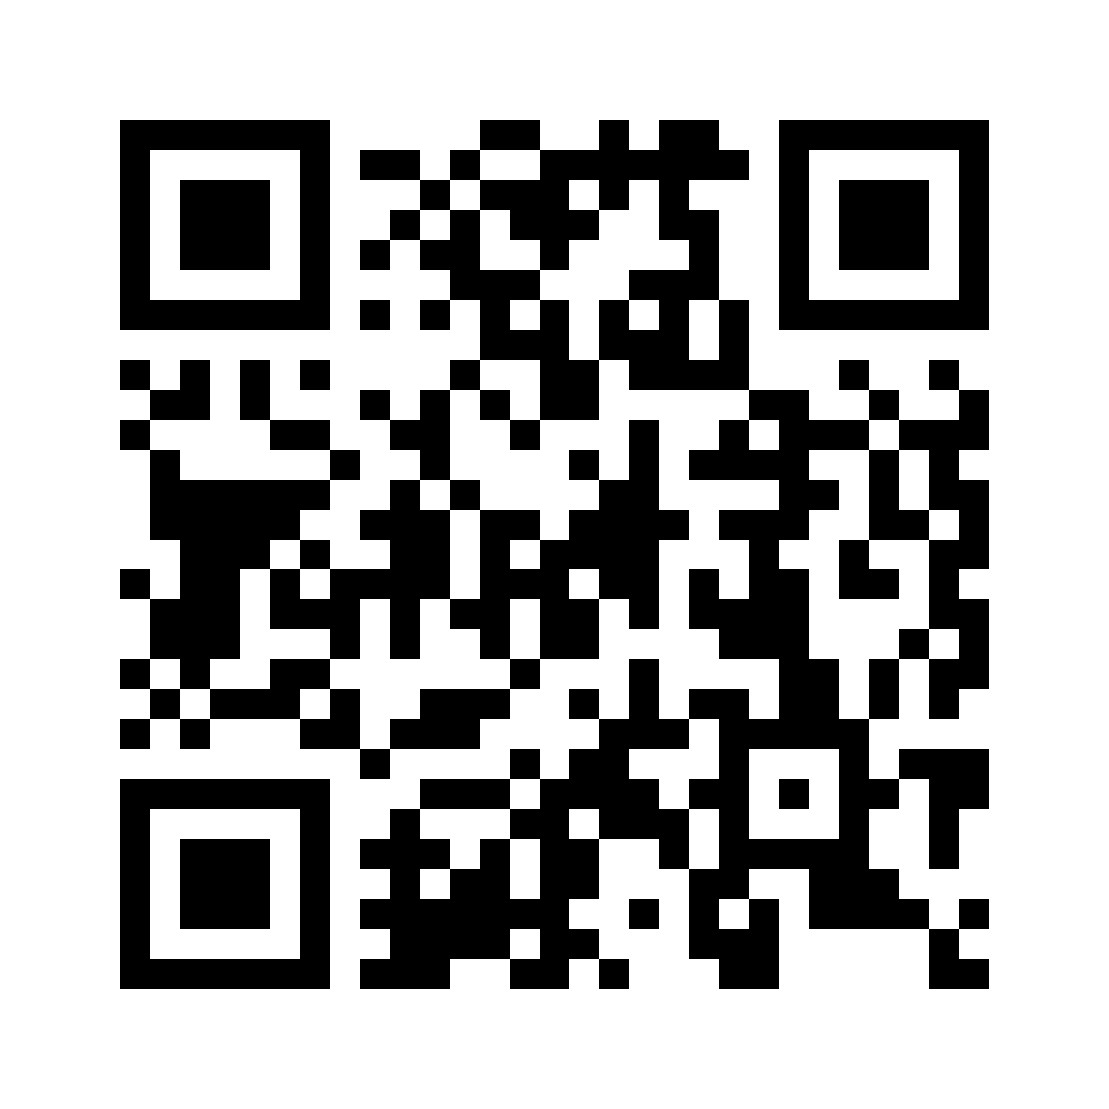
THANKS FOR LISTENING!
Does anyone have any questions?
cs.uit.ai.club@gmail.com
http://aiclub.cs.uit.edu.vn/

