Slide 1
Introduction
PROJECT NAME: PROFESSIONAL PROGRAMMING
FOR EVERYONE
Class: T1.2010.E0
Sem: 02
Supervisor: Mr. Le Thanh Nhan
Students:
1/ Mr. Nguyen Huynh Quang Vinh
2/ Mr. Vu Duc Huan
3/ Mr. Duong Dinh Phuc
Date: Sep 29th, 2021
Date… Month… Year …...

Slide 2
Agenda
Introduction
Project Overview
Project Requirement
Project Technology
Project Installation
Task Sheet
General Task List Review
Individual Presentation
Q&A

Slide 3
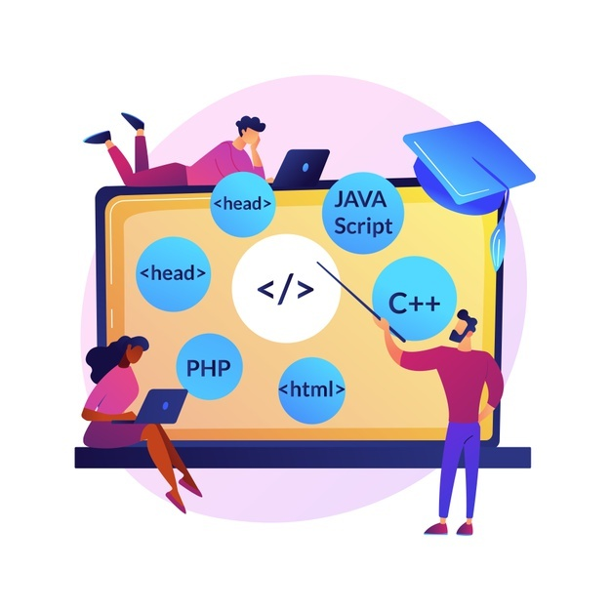



Introduction – Project Overview

Slide 4




Introduction – Project Requirement
Notes:
Non-functional (how the system works)
Functional (what the system should do)

Slide 5






Introduction – Project Technology

Slide 6



PROJECT INSTALLATION

Slide 7

TASK SHEET

Slide 8
TASK SHEET – GENERAL TASK SHEET REVIEW

Slide 9


TASK SHEET - VINH

Slide 10


TASK SHEET - HUÂN

Slide 11

Q&A

Slide 12

Thank You!

