Slide 1
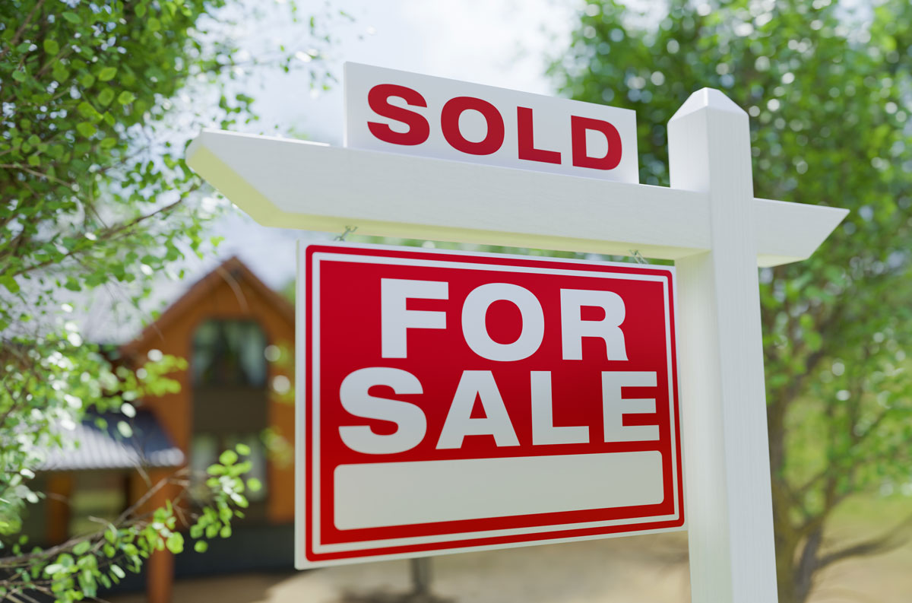
Traditional Commercial Real Estate (CRE)
Challenges in traditional CRE
Buy/sell assets in the real estate sector is often faced with many problems:
High number of third parties
Asymmetry of information and lack of transparency
Heavy paperwork and time-consuming
High upfront cost

Slide 2
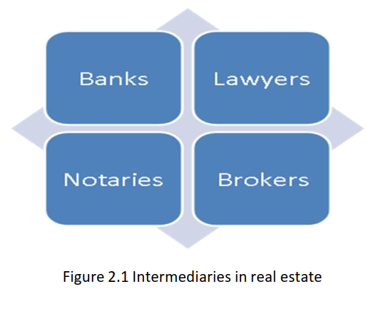
High number of third parties
Due to a high value asset and complex legal requirements, a transaction in CRE requires many third parties like:
Bank (mortgage, loan,..)
Lawyer (legal paperwork)
Notary (witness service)
Broker (navigate/guide a transaction)
House Inspection/Valuation service
Government Agency
=> Each party requires a certain amount of fee, so a final transaction cost is very high/time-consuming

Slide 3
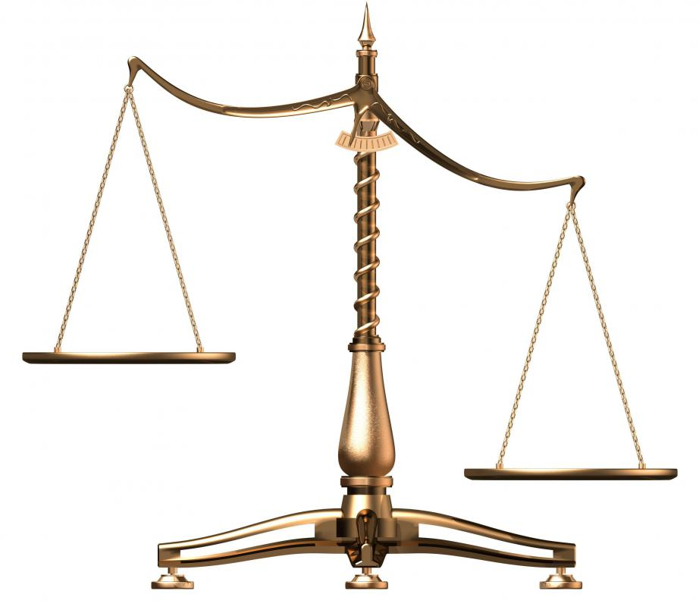
Asymmetry of information between buyer and seller
Buyer: usually a non-expert who looks for a place to live or diversify their investment, their main source of information comes from seller
Seller: a professional in the real estate market with a lot of tools and insider data like:
Knowledge of the property
Market Trends and Conditions
Inspection Reports
Seller may only show information that give them advantages
Lead to unfairness and lack of transparency between buyer and seller
Buyer
Seller

Slide 4

Heavy paperwork
In traditional real estate LLC (Limited liability company), when a transaction occurs you have to follow these steps:
Both parties have to mutually sign a purchase agreement
The company has to update the government by adding the new owner as a member in the underlying entity
The reverse is true for selling one’s ownership stake as well
=> The entire process not only takes time, but money and effort for both buyer/seller/broker

Slide 5
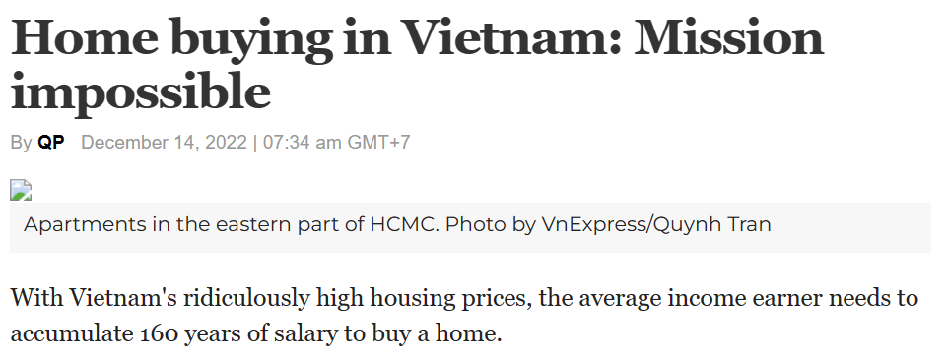
High upfront/entry cost for buyer/seller
Purchasing a house in Vietnam is an uphill battle - VnExpress International
Common fee when exchange a real estate asset
Buyer | Both | Seller
Down payment | Closing cost | Agent Commissions
Home Inspection service |  | Home Repairs and Staging
Home Valuation service |  | Transfer Taxes
Earnest Money

Slide 6
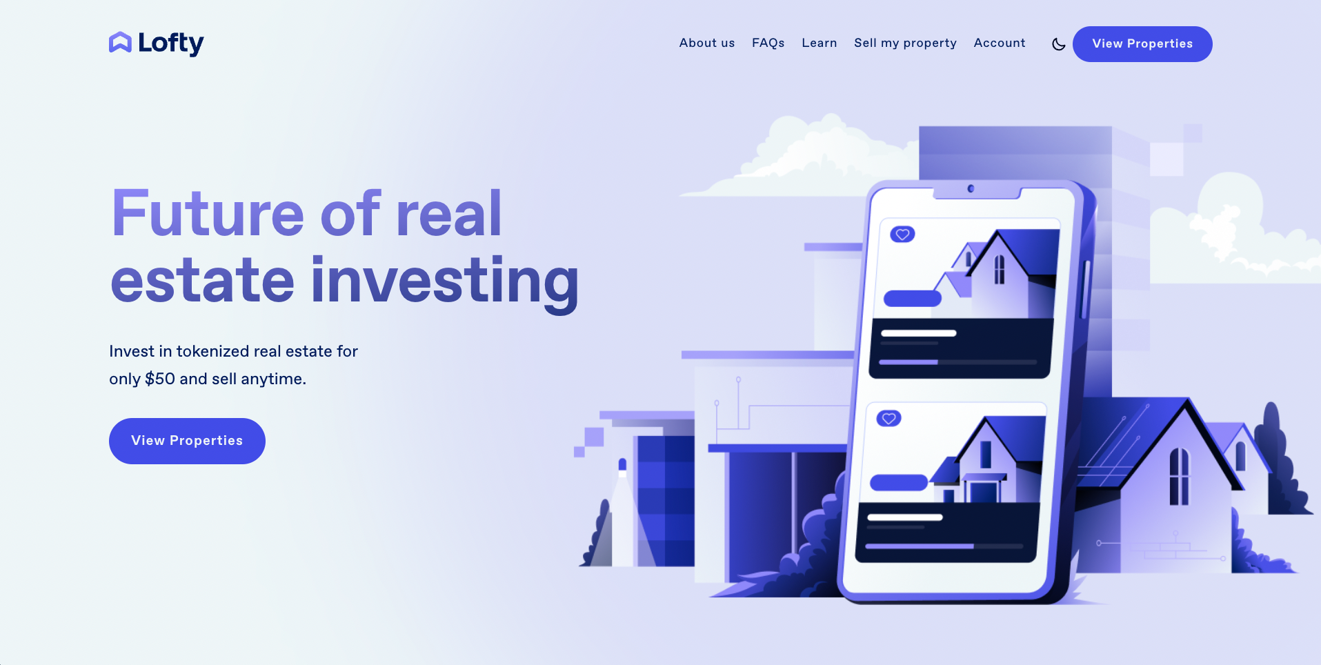
Blockchain-based CRE
Apply blockchain in CRE
As we acknowledge these problems, our team decide to propose the implementation of a blockchain-enhanced real estate system
Our system is based on Fractional Real Estate Marketplace | Lofty. The Lofty platform is introduced in 2020 using Algorand blockchain as a backbone for transactions

Slide 7
Advantages of Blockchain-based CRE
The advantages of our new system can bring to CRE is
Advantage | Tool
Low entry cost/high liquidity thanks to house tokenization | Smart Contract (created DAO LLC)
Transaction is immutable to prevent fraud | Blockchain
House Voting System | Blockchain
NO MORE PAPERWORK | Smart Contract
Daily Income based on property type | Smart Contract (residential, commercial/industrial)
All house related documents is public on website so it’s total transparency

Slide 8
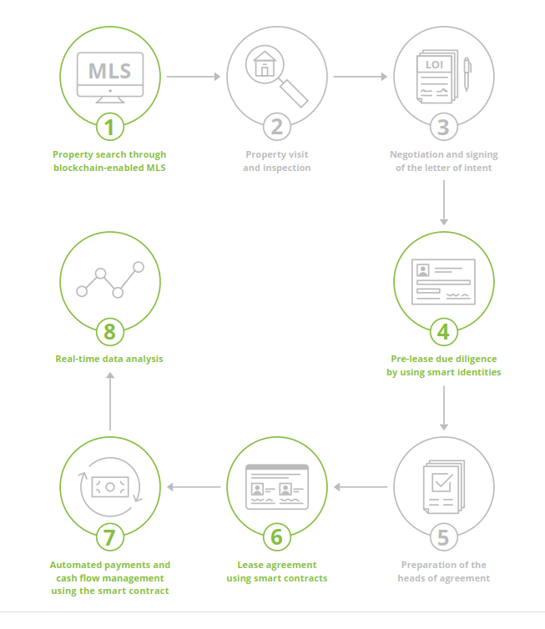
Lease transaction using Blockchain
1: A transparent MLS system enables all parties to view the available listings and documents based on their requirements.
4: All property/buyer/seller will be verified before joining marketplace
6: Lease agreement uses House Tokenization and NFT
7: Investor will earn income daily based on their own token

Slide 9
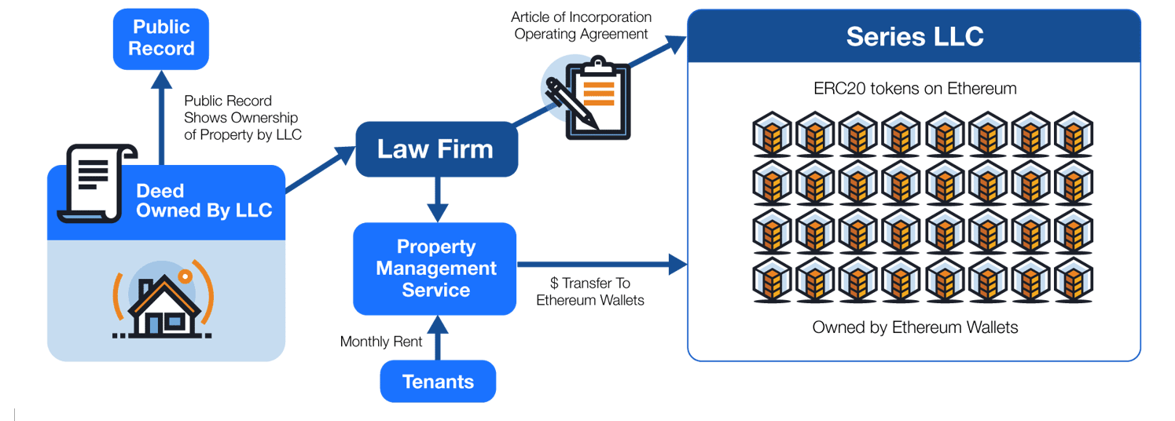
House tokenization
A method that can enable investors to own fractional ownership in a property
The process of issuing tokens may take a form of the IPO applied in the stock market
The owner of the property may issue tokens based on the market value of the property and sell them to potential investors just like shares in a company

Slide 10
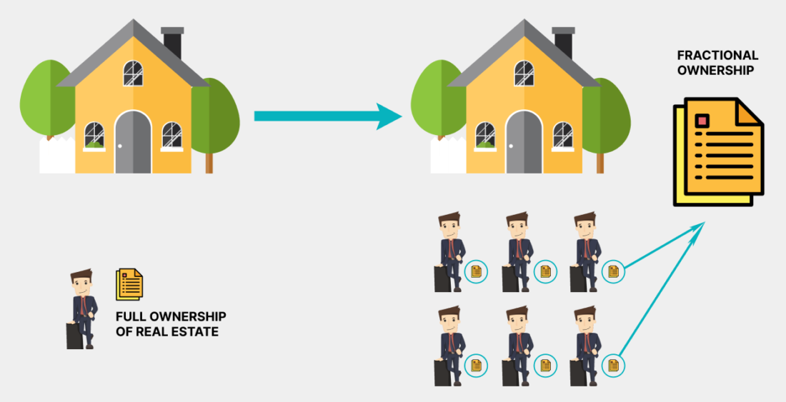
Fractional Real Esstate Investing
A method that can enable investors to own fractional ownership in a property
The process of issuing tokens may take a form of the IPO applied in the stock market
The owner of the property may issue tokens based on the market value of the property and sell them to potential investors just like shares in a company

Slide 11
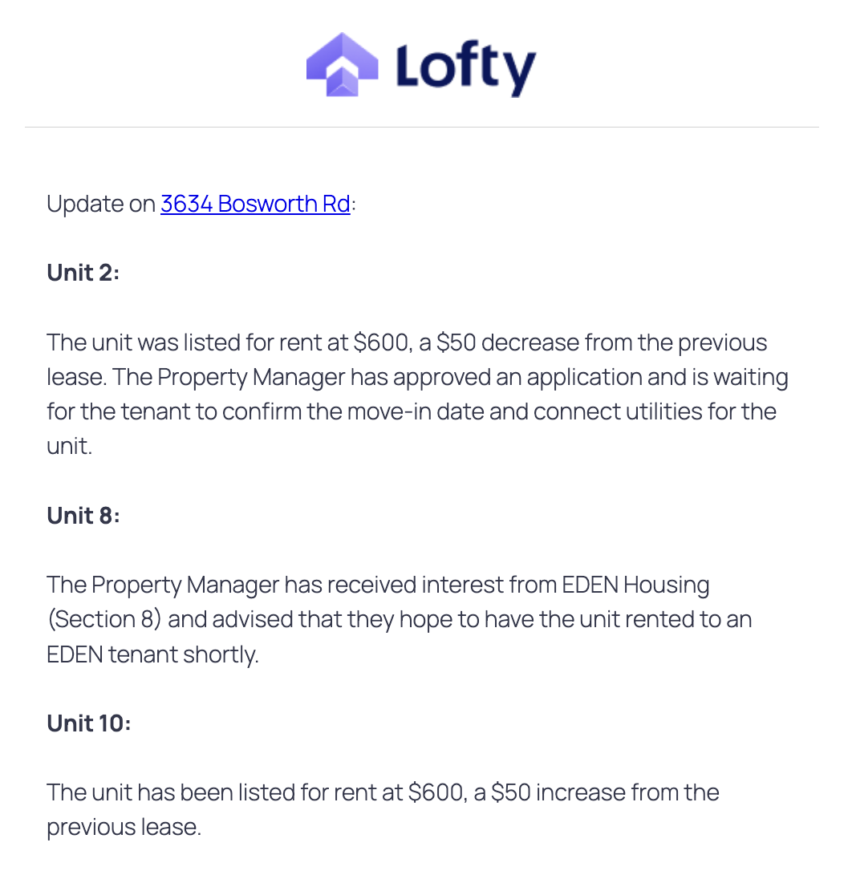
Voting system and real ownership on your own property
Once you buy a token of a listing property, you now have right to vote for that property’s decision
Vote on all key decisions such as: repair and maintenance, rent amount, eviction time for tenant,….
House changes affect on all token investors will be announced in public message board
=> Empower ownership and increase transparency

Slide 12
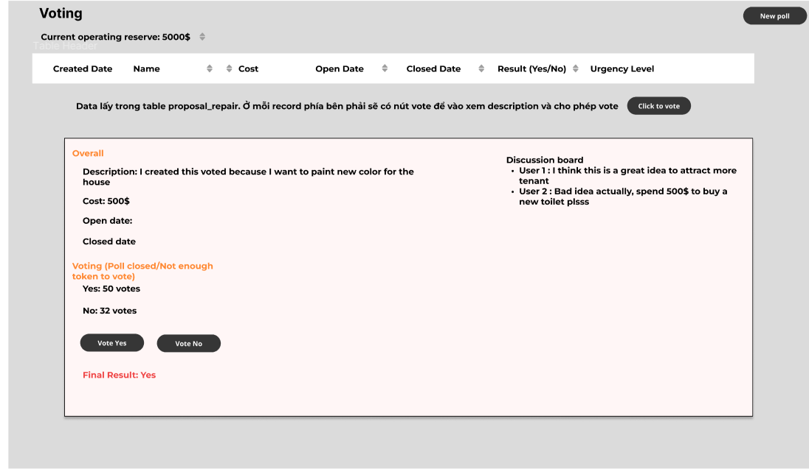
Each voting poll created by token owner will have discussion board for transparency

Slide 13

Want to know more ?
Check our folder, it will contain
Lofty_introduction_platform: a introduction to Lofty platform for you to know more. Because our system is based on it
real_estate_poc_erd: A proof of concept of system’s ERD. Our system will store all transaction tables in Hyperledger Fabric
VinhQuocTran/finalterm_real_estate_blockchain (github.com)

