Slide 1
Digital Wallet Infographics
Here is where this template begins

Slide 2
Digital wallet infographics
About digital wallet services
Technology
Mercury is the closest planet to the Sun and the smallest one. This planet's name has nothing to do with the liquid metal
Payments for services
SCAN TO
Venus has a beautiful name and is the second planet from the Sun. It’s terribly hot, and its atmosphere is poisonous
PAY
Digital wallet user
Jupiter is a gas giant and the biggest planet in the Solar System. It was named after the Roman god of the skies

Slide 3
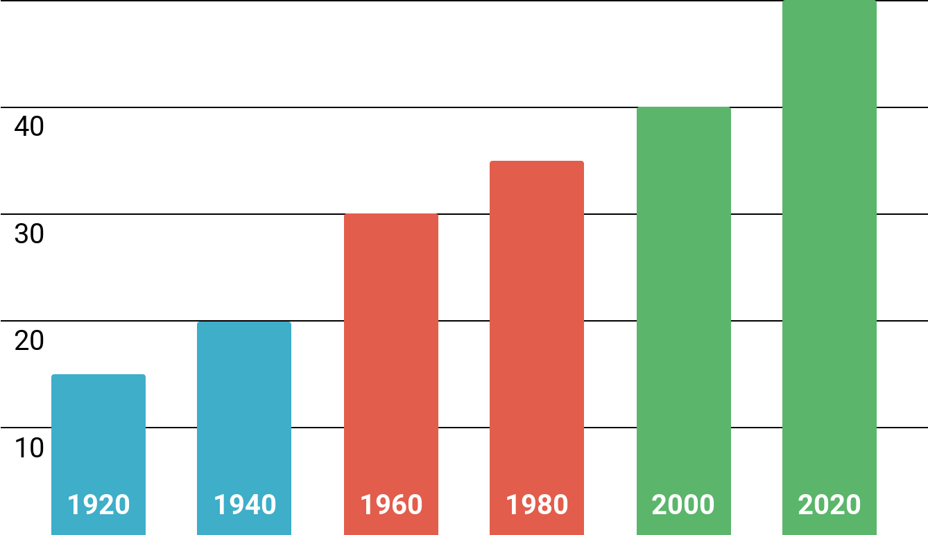
Digital wallet infographics
Evolution of payment services
Paper money
15M
20M
30M
35M
40M
50M
Mercury is the closest planet to the Sun and the smallest one
Credit card
Venus has a beautiful name and is the second planet from the Sun
Digital wallet
Jupiter is a gas giant and the biggest planet in the Solar System
Follow the link in the graph to modify its data and then paste the new one here. For more info, click here

Slide 4
Digital wallet infographics
What is a digital wallet?
PAYMENTS
Money
Debit
Credit
Email
Password
Saturn is a gas giant planet and has several rings
Neptune is the farthest planet from the Sun
Despite being red, Mars is actually a cold place
PAYMENT CARD
Number
Expiration date
CVV
TOTAL
$129,99
$100
$200
$300
PAY NOW

Slide 5
Digital wallet infographics
$2,000
%10
$1,800
Your money
Commission
Purchase balance
Neptune is the farthest planet from the Sun. It is the fourth-largest
Venus has a beautiful name and is the
second planet to the Sun
Saturn is the ringed planet. It’s composed of hydrogen and helium

Slide 6
Digital wallet infographics
About payment by contact
01
02
03
Weak
Medium
Strong
Saturn is the ringed planet
Mercury is the smallest planet
Venus has a beautiful name
25%
50%
75%

Slide 7
Digital wallet infographics
How to add funds to your e-wallet?
30%
50%
70%
90%
Credit card
Debit card
Bank transfer
Digital credit
Mercury is the closest planet to the Sun
Despite being red, Mars is a cold place
Saturn is a gas giant and has rings
Venus is the second planet to the Sun

Slide 8
Digital wallet infographics
Supported types of payment technology
90%
70%
40%
20%
Contactless
Sound waves
Magnetic
QR code
Saturn is the ringed planet. It’s composed of hydrogen and helium
Neptune is the farthest planet from the Sun and the fourth-largest
Venus has a beautiful name and is the second planet to the Sun
Mercury is the closest planet to the Sun and the smallest one

Slide 9
Digital wallet infographics
Pricing table plan
Digital wallet A | Digital wallet B | Digital wallet C | Digital wallet D
$10 | $15 | $20 | $25
Describe here features of the plan offered Describe here features of the plan offered | Describe here features of the plan offered Describe here features of the plan offered | Describe here features of the plan offered Describe here features of the plan offered | Describe here features of the plan offered Describe here features of the plan offered
PURCHASE THE PLAN | PURCHASE THE PLAN | PURCHASE THE PLAN | PURCHASE THE PLAN

Slide 10
Digital wallet infographics
Steps to create a digital wallet
STEP 1
STEP 2
STEP 3
STEP 4
Decide
Download
Payment
Ready!
Saturn is a gas giant and has several rings
Neptune is the farthest planet from the Sun
Jupiter is the biggest planet in the Solar System
Mercury is the closest planet to the Sun

Slide 11
Digital wallet infographics
About the digital transition
E-wallet
Payment
Saturn is the ringed planet
Jupiter is the biggest planet
Your money
Transfer
Neptune is far away from us
Mercury is the smallest planet

Slide 12
Digital wallet infographics
The way of digital money
Deposit
Purchase
Neptune is the farthest planet from the Sun
Mercury is the smallest planet in the Solar System
Bank account
Digital money
Saturn is a gas giant and has several rings
Neptune is the farthest planet from the Sun

Slide 13
Digital wallet infographics
Favorable opinions on benefits of digital wallets
63%
65%
Practicality
Fast
Mercury is the smallest planet in the Solar System
Mars is a very cold place. It's full of iron oxide dust
78%
75%
Safety
Money-saving
Neptune is the farthest planet from the Sun
Neptune is the farthest planet from the Sun

Slide 14
Digital wallet infographics
What do digital wallet users say?
10%
They’re convenient
Venus has very high temperatures
30%
They’re fast
Mercury is the closest planet to the Sun
70%
They’re secure
Jupiter is the biggest planet of them all
90%
They’re more hygienic
Saturn is a gas giant and has rings

Slide 15
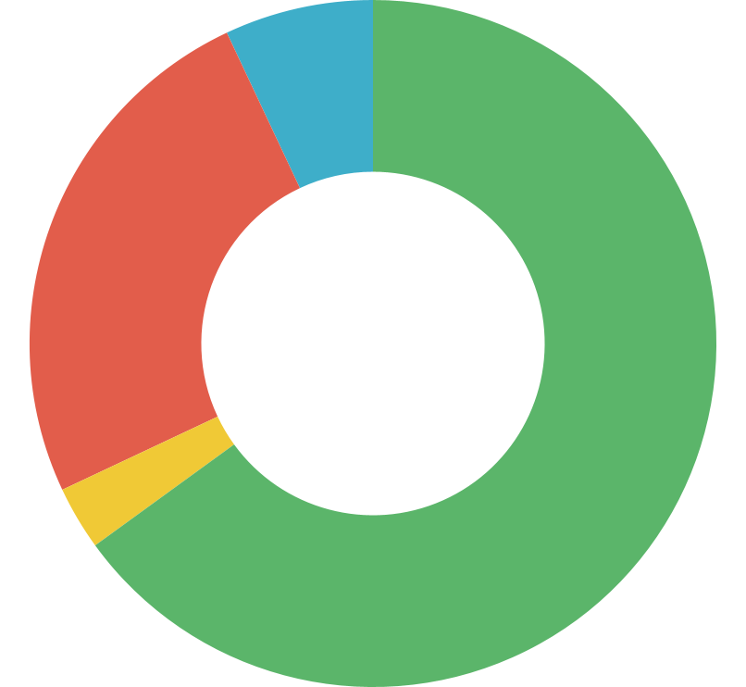
Digital wallet infographics
Mobile spending by segment
7%
65%
Bill payments
Money transfers
Neptune is the farthest planet from the Sun
Saturn is a gas giant and has several rings
25%
3%
Shopping
Tickets
Follow the link in the graph to modify its data and then paste the new one here. For more info, click here
Earth is the fourth planet from the Sun
Venus is the second planet from the Sun

Slide 16
Digital wallet infographics
What can you buy with digital wallets?
Clothing
$1,200
Venus has a beautiful name and is the second planet from the Sun
Electronics
$2,400
Mercury is the closest planet to the Sun and the smallest one in the Solar System
Services
$3,600
Yes, this is the ringed one. It’s a gas giant, composed of hydrogen and helium
Tickets
$4,800
Jupiter is a gas giant. It's the fourth-brightest object in the night sky

Slide 17
Digital wallet infographics
01
Financial technology
20%
40%
60%
80%
100%
Venus has extremely high temperatures
02
Information software
Despite being red, Mars is actually a very cold place
03
Database
Mercury is the closest planet to the Sun
04
Encrypted transactions
Jupiter is a gas giant and the biggest planet
05
Digital wallet devices
Saturn is composed of hydrogen and helium

Slide 18
Digital wallet infographics
A
PX compliance
Venus has extremely high temperatures
B
FFL protocol
Despite being red, Mars is actually a very cold place
C
Tokenization
Mercury is the closest planet to the Sun
D
3B secure
Jupiter is a gas giant and the biggest planet
E
Address verification
Saturn is composed of hydrogen and helium

Slide 19
Digital wallet infographics
Top 5 countries on mobile wallet usage
45%
China
Venus has a beautiful name
40%
Norway
25%
40%
Despite being red, Mars is cold
25%
UK
45%
20%
Mercury is the smallest planet
20%
Japan
Jupiter is the biggest planet
15%
15%
Australia
Saturn is the ringed planet

Slide 20
Digital wallet infographics
Driver license
Loyalty card
Saturn is a gas giant planet and has several rings
Venus is the second planet from the Sun
DIGITAL WALLET
80%
60%
90%
70%
50%
Bank account
Health ins. card
Other IDs
Neptune is the farthest planet from the Sun
Despite being red, Mars is actually a cold place
The Sun is the star at the center of the Solar System

Slide 21
Digital wallet infographics
Evaluation of digital wallet apps
20%
40%
60%
80%
100%
Product 1
Product 2
Product 3
Product 4
Product 5
Mercury is the closest planet to the Sun
Venus is the second planet from the Sun
Jupiter is the biggest planet of them all
Saturn is a gas giant and has several rings
Neptune is the farthest planet from the Sun

Slide 22
Digital wallet infographics
Most used devices for digital payment
96%
76%
60%
48%
24%
12%
Mobile
Tablet
Computer
Watch
Keychain
Others
Neptune is the farthest planet from the Sun
Mercury is the closest planet to the Sun
Venus is the second planet from the Sun
Earth is the third planet from the Sun
Despite being red, Mars is a cold place
Pluto is now considered a dwarf planet

Slide 23
Digital wallet infographics
Digital payment history
Entertainment
$80
Mercury is the closest planet to the Sun
Shopping
$260
Saturn is a gas giant and has several rings
Food
$125
Jupiter is the biggest planet of them all
Others
$65
Venus is the second planet from the Sun
Transportation
$45
Earth is the third planet from the Sun

Slide 24
Digital wallet infographics
Practicality
Safety
Mercury is the closest planet to the Sun
Venus has a beautiful name, but also high temperatures
15%
60%
Fast
Hygienic
Despite being red, Mars is actually a cold place
Jupiter is the biggest planet in the Solar System
30%
75%
Economic
Convenient
Neptune is the farthest planet from the Sun
Saturn is composed of hydrogen and helium
45%
90%

Slide 25
Digital wallet infographics
About digital wallet services
Technology
Systems
Mercury is the closest planet to the Sun and the smallest
Earth is the third planet from the Sun and we live on it
Payments
Verification
$
$
$
Venus is the second planet from the Sun and is terribly hot
Despite being red, Mars is actually a very cold place
Digital wallet
Data security
Jupiter is a gas giant and the biggest planet of them all
The Sun is the star at the center of the Solar System
$
$
$

Slide 26
Digital wallet infographics
Excerpt from digital payments
Cinema
Entertainment
Neptune is the farthest planet from the Sun and the fourth-largest
Venus has a beautiful name and is the second planet from the Sun
Music Products
Earth is the third planet from the Sun and the only one that harbors life
Clothes
Shopping
Saturn is composed mostly of hydrogen and also helium
Mercury is the closest planet to the Sun and the smallest one
Decoration
Jupiter is a gas giant. It's the fourth-brightest object in the night sky

Slide 27
Digital wallet infographics
Financial services comparison
Old Service
Manual
Late
Mercury is the smallest planet in the Solar System
Venus is the second planet from the Sun and is terribly hot
Jupiter is the biggest planet in the Solar System
CREDIT CARD
New service
Automatic
Fast
Neptune is the fourth-largest planet of them all
Saturn is composed mostly of hydrogen and helium
Despite being red, Mars is actually a very cold place
DIGITAL WALLET

Slide 28
Digital wallet infographics
Digital wallet devices X digital wallet systems
Mobile
Mobile app
Mercury is the closest planet to the Sun and the smallest one
Neptune is the fourth-largest planet of them all
Tablet
Tablet extension
Venus has a beautiful name and is the second planet from the Sun
Despite being red, Mars is actually a very cold place
Personal computer
Wallet software
Earth is the third planet from the Sun and the one where we live on
Saturn is composed mostly of hydrogen and helium
Smart watch
Smart watch app
Jupiter is a gas giant and the biggest planet in the Solar System
Pluto is no longer considered the ninth planet from the Sun

Slide 29
Digital wallet infographics
What's in the digital wallet?
A
Bank account
E
Student card
Neptune is very far away from us
Mercury is the smallest planet
DIGITAL WALLET
B
Driver license
F
Gym card
Despite being red, Mars is a cold place
Jupiter is the biggest planet of them all
C
Health ins. card
G
Tickets
$$$$
Earth is the third planet from the Sun
Ceres is located in the asteroid belt
D
Loyalty card
H
Other IDs
Saturn is a gas giant and has several rings
The Moon is Earth’s natural satellite

Slide 30
Digital wallet infographics
Digital payments userprofile
Basic Info
GENDER | Female
STATUS | Single
AGE | 30
CITY | Boston
OCCUPATION | Writer
SALARY | $2,000
Devices
Venus has a beautiful name and is the second planet from the Sun
25%
Tablet
Mobile
50%
Anna Marilan
25%
Computer
Mercury is the closest planet to the Sun and the smallest one

Slide 31
Digital wallet infographics
Digital payments user profile
Gender
Social media
Devices
Mercury is the closest planet to the Sun and the smallest one
Venus has a beautiful name and is the second planet to the Sun
Earth the only planet that harbors life in the Solar System
Facebook
60%
Jupiter is the biggest planet
Female
The Sun is a star
Instagram
Mars is actually a cold place
60%
40%
40%
TikTok
Mobile
Computer
Male
Neptune is far away from us
The Moon is a satellite
Ceres is in the asteroid belt
Saturn is a gas giant

Slide 32
Icon pack: e-commerce

Slide 33
Instructions for use (premium users)
If you are a Premium user on Slidesgo, you can use this template without crediting us.
You are allowed to:
Modify this template.
Use it for both personal and commercial purposes.
Hide or delete the “Thanks” slide and the mention to Slidesgo in the credits.
Share this template in an editable format with people who are not part of your team.
You are not allowed to:
Sublicense, sell or rent this Slidesgo Template (or a modified version of this Slidesgo Template).
Distribute this Slidesgo Template (or a modified version of this Slidesgo Template) or include it in a database or in any other product or service that offers downloadable images, icons or presentations that may be subject to distribution or resale.
Use any of the elements that are part of this Slidesgo Template in an isolated and separated way from this Template.
Register any of the elements that are part of this template as a trademark or logo, or register it as a work in an intellectual property registry or similar.
For more information about editing slides, please read our FAQs or visit Slidesgo School:
https://slidesgo.com/faqs and https://slidesgo.com/slidesgo-school

Slide 34
Infographics
You can add and edit some infographics to your presentation to present your data in a visual way.
Choose your favourite infographic and insert it in your presentation using Ctrl C + Ctrl V or Cmd C + Cmd V in Mac.
Select one of the parts and ungroup it by right-clicking and choosing “Ungroup”.
Change the color by clicking on the paint bucket.
Then resize the element by clicking and dragging one of the square-shaped points of its bounding box (the cursor should look like a double-headed arrow). Remember to hold Shift while dragging to keep the proportions.
Group the elements again by selecting them, right-clicking and choosing “Group”.
Repeat the steps above with the other parts and when you’re done editing, copy the end result and paste it into your presentation.
Remember to choose the “Keep source formatting” option so that it keeps the design. For more info, please visit Slidesgo School.

