Slide 1
USING DEEP REINCEFORMENT LEARNING TO RECOMMEND ITEMS
Apply a paper from Shanghai Jiao Tong University, Shanghai, China.

Slide 2


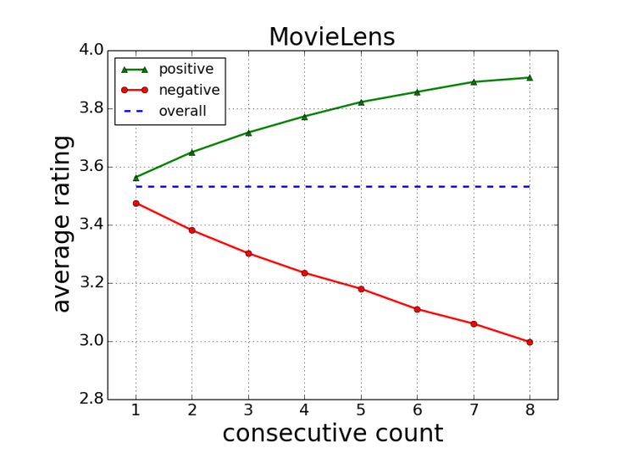

IDEA
Users tends to gives a higher rating if they has consecutively received more satisfied items

Slide 3
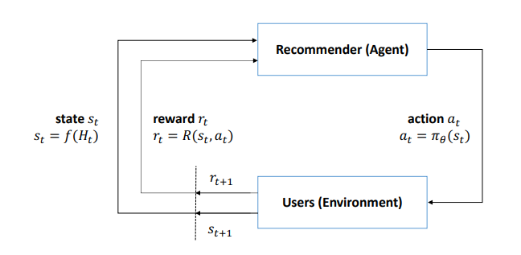
REINCEFORMENT LEARNING MODEL
Markov decision process

Slide 4
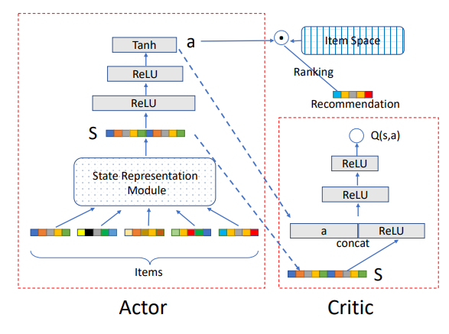
DRR framework

Slide 5
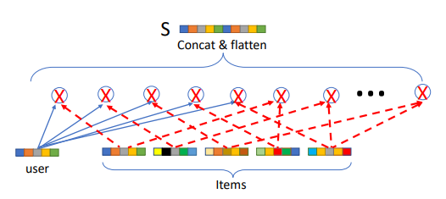
State Representation Model
S = f(H)
H = {i1, i2, i3,…,in}
I is a k-dimensional vector which was embedded of a item

Slide 6

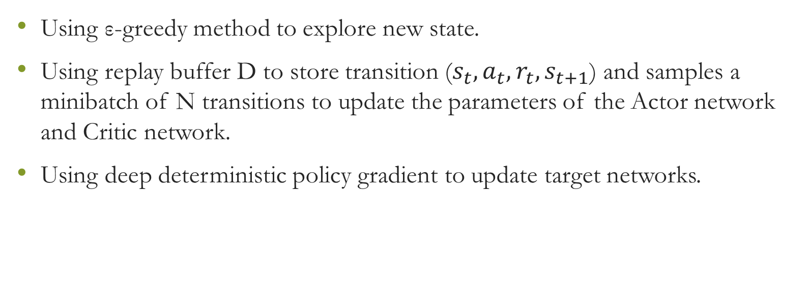
Trainning
Using ε-greedy method to explore new state.
Using replay buffer D to store transition ($s_{t}, a_{t}, r_{t}, s_{t+1}$) and samples a minibatch of N transitions to update the parameters of the Actor network and Critic network.
Using deep deterministic policy gradient to update target networks.

