Slide 1
ICS 240 Introduction to Data Structures
Jessica Maistrovich
Metropolitan State University

Slide 2
Implementing a Binary Tree
Two possibilities: Array or Nodes

Slide 3
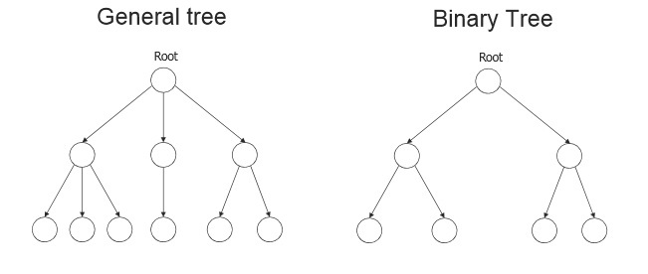
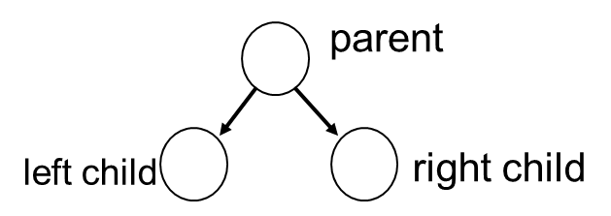
Recall Binary Trees
A binary tree is a special type of tree where each node can have two children at most
Usually called leftChild and rightChild

Slide 4
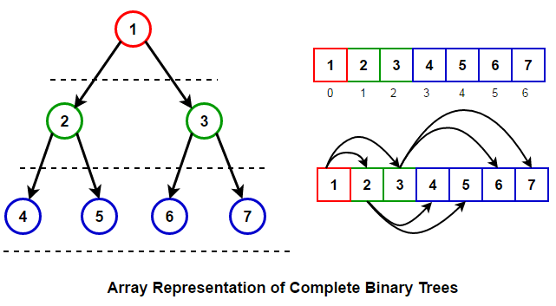
Array Representation of Complete Binary Trees
For any node at index i:
left child is at [2i+1]
Right child is at [2i+2]
parent is at [(i-1)/2]

Slide 5
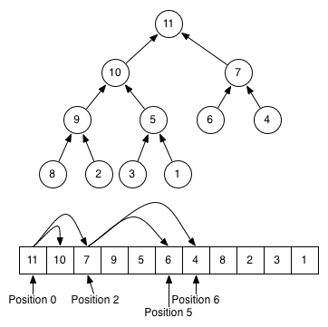
Example
Consider node with value 7:
7 is stored at array index 2
Its left child is at 2*2+1 = 5
Its right child is at 2*2+2 = 6
Its parent is at (2-1)/2 = 0

Slide 6
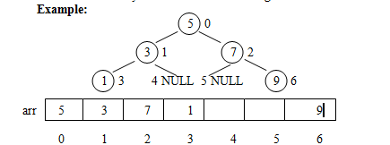
Can Arrays Be Used to Represent Incomplete Trees?
It is hard to use arrays to represent incomplete trees because there will be many empty slots

Slide 7
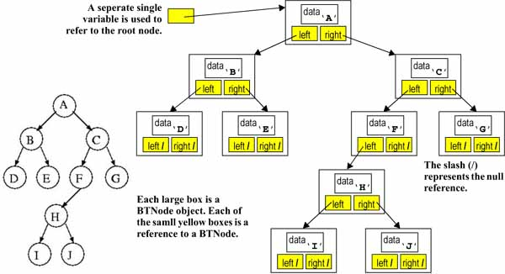
Tree Representation using Nodes

Slide 8
Binary Tree Traversals

Slide 9
Binary Tree Traversals
Tree traversal is the process of visiting each node in the tree exactly once
There are three commonly used types of tree traversals
preorder traversal ➔ root, left, right
inorder traversal ➔left, root, right
postorder traversal ➔ left, right, root

Slide 10
Preorder Traversal – node, left, right
1
F
2
B
K
5
3
D
G
6
N
7
4
C
P
8
O
9
Preorder: F B D C K G N P O

Slide 11
Inorder Traversal – left, node, right
4
F
1
B
K
6
3
D
G
5
N
7
2
C
P
9
O
8
Inorder: B C D F G K N O P

Slide 12
Postorder Traverals – left, right, node
9
F
3
B
K
8
2
D
G
4
N
7
1
C
P
6
O
5
Postorder: C D B G O P N K F

Slide 13
Tree Traversal – inorder()
public void inorder() {
inorder(root);
}
4
F
1
B
K
6
private void inorder(IntBTNode cur) {
if (cur != null) {
inorder(cur.getLeft());
System.out.println(cur.getData());
inorder(cur.getRight());
}
}
3
D
G
5
N
7
2
C
P
9
O
8
Inorder: B C D F G K N O P

Slide 14
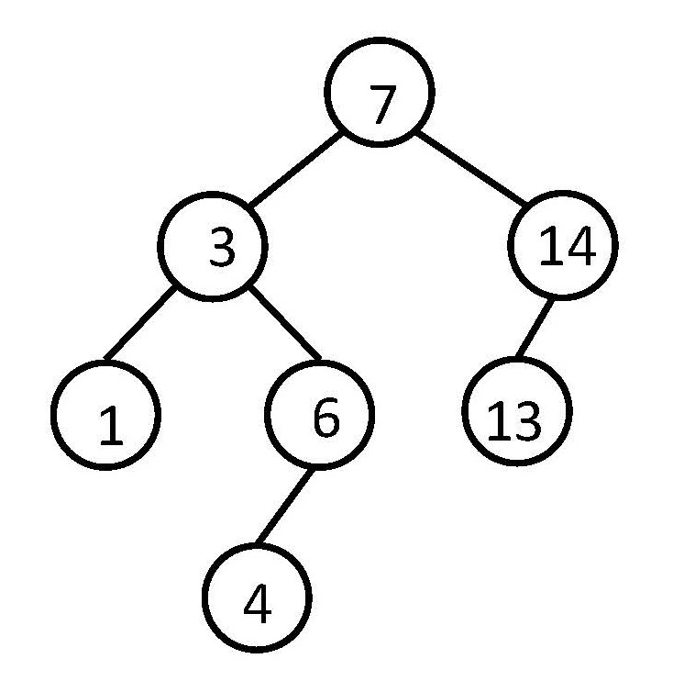
Tree Traversal – inorder()
public void inorder() {
inorder(0);
}
private void inorder(int i){
if (i < tree.length && tree[i] != null){
inorder (2*i+1);
System.out.println(tree[i]);
inorder (2*i+2);
}
}
Inorder traversal: 1 3 4 6 7 13 14
index | 0 | 1 | 2 | 3 | 4 | 5 | 6 | 7 | 8 | 9 | 10 | 11 | 12 | 13 | 14 | 15
contents | 7 | 3 | 14 | 1 | 6 | 13 | null | null | null | 4 | null | null | null | null | null | null

Slide 15
Binary Search Trees

Slide 16
Binary Search Tree (BST)
This is a BST
3
≥
≤
0
5
≤
≥
≤
A Binary Search Tree (BST) is a binary tree such that, for any given node n:
All values in n’s left subtree are less than or equal to the value in n
All values in n’s right subtree are greater than the value in n
BST’s are usually used to implement sorted lists of elements
In a BST, we can implement add(), remove() and search() in log(n)
2
4
6
≥
≤
1
≥
8
7
This is NOT a BST
3
0
2
2
4
6
1
8
7

Slide 17
Binary Search Tree Operations
BST operations
search() or countOccurrences()
add()
remove()
All BST operations are done in O(BST height)
Start at the root and then go down the tree
For a balanced tree with height = log n all operations can be performed in O(log n)
For a degenerate tree with height = n all operations are done in O(n)

Slide 18
Contrasting Various List Implementations
 | add | remove | search
Array (unordered) | O(1) | O(n) | O(n)
Sorted array | O(n) | O(n) | O(log n)
Linked list (unordered) | O(1) | O(n) | O(n)
BST | O(h) | O(h) | O(h)
root
4
2
6
1
3
5
7
Notes:
In a balanced tree, h = log N

Slide 19
Searching a BST

Slide 20
BST Search Operation
To search for a value in a BST, start from the root and scan down until the value is found or you arrive at an empty subtree
Descend using comparisons to make left/right decisions
if (search_value == node_value) return true (found)
else if (search_value < node_value)
go to the left child
else if (search_value > node_value)
go to the right child
Stop descending when move is impossible (no left or right child) and return false (or not found)
Notes:
Could return matching data or null

Slide 21
Examples of BST Search
Search for C
Search for N
F
1. N > F, go right
1. C < F, go left
F
B
K
2. N > K, go right
2. C > B, go right
B
K
3. N is found after three comparisons
D
G
N
3. C < D, go left
D
G
N
C
P
4. C is found
after 4 comparisons
P
C
O
O
The maximum number of comparisons to search a BST = tree height
Worst case O(n) when the tree is degenerate
Average and best case is O(log n) when the tree is balanced

Slide 22
Example of BST Search
Search for W
F
1. W > F, go right
B
K
2. W> K, go right
3. W > N, go right
D
G
N
C
P
4. W > P, go right – no right – Not found
O

Slide 23
Finding the Minimum Value in a BST
The minimum value is in the left-most node in the tree
To find minimum:
start at the root
while (left != null) go left
start at root, if left is not null, go left
F
B
left is null, then B is the minimum
K
D
G
N
C
P
O

Slide 24
Finding the Maximum Value in a BST
The maximum value is in the right-most node in the tree.
To find maximum:
start at the root
while (right != null)
go right
F
start at root, right is not null, go right
right is not null then go right
B
K
D
G
N
right is not null then go right
C
P
right is null then p is the maximum
O

Slide 25
Add element to BST

Slide 26
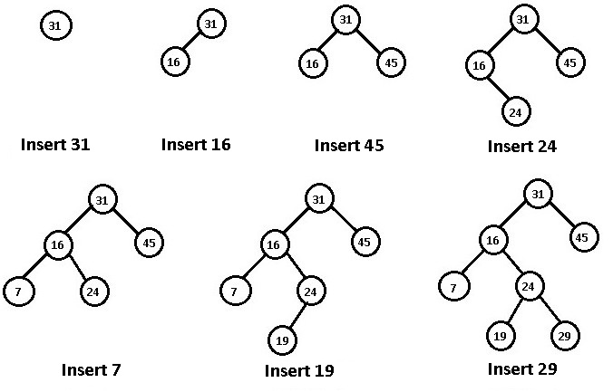
BST Add Operation
Build a BST by inserting the following values:
31,16,45,24,7,19,29

Slide 27
Will you get a different BST if you insert the values in a different order?
Assume you want to build a BST from the following values:
MN, IL, CA, TX, FL
See the resulting BSTs if the values are inserted in the following orders:
Case 1: IL,CA,TX,MN,FL
Case 2: CA, FL, IL, MN, TX
Case 3: TX,MN, IL,FL,CA
Case 4: MN, CA, FL, TX, IL

Slide 28
Case 1: IL,CA,TX,MN,FL
CA
IL
FL
CA
TX
Case 2: CA, FL, IL, MN, TX
IL
FL
MN
MN
Height = 2
TX
TX
Height = 4
Case 3: TX,MN, IL,FL,CA
Case 4: MN, CA, FL, TX, IL
MN
MN
IL
CA
TX
Height = 4
FL
FL
CA
IL
Height = 3

Slide 29
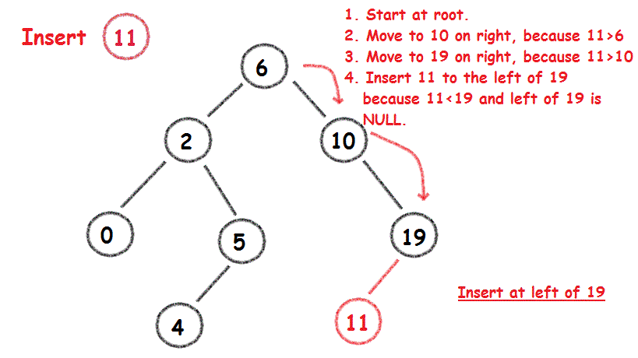
BST Add Operation

Slide 30
Delete element from BST

Slide 31
BST Delete Operation
The node to be deleted can be one of the following three types:
CASE 1: leaf node:
Just remove the node from the tree
CASE 2: has one child:
Replace the node with its child
CASE 3: has two children (left and right):
Depending on the implementation, replace the node with either:
the minimum element in its right subtree, or
the maximum element in its left subtree

Slide 32
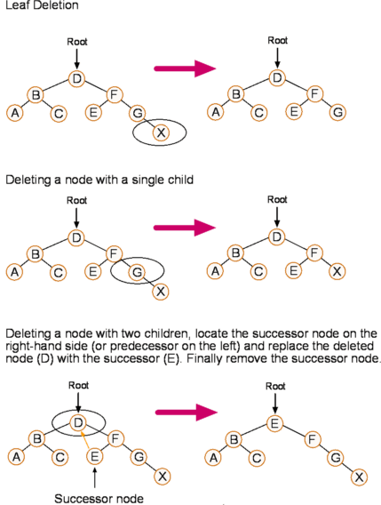

Slide 33
Extra

Slide 34
Binary Search Tree Animation
https://www.cs.usfca.edu/~galles/visualization/BST.html

