Slide 1
Indexing and Hashing

Slide 2
Disk Space Management
Query Optimization
and Execution
Lowest layer of DBMS software manages space on disk.
Higher levels call upon this layer to:
  allocate/de-allocate a page
  read/write a page
Relational Operators
Files and Access Methods
Buffer Management
Disk Space Management
Disk
Request for a sequence of pages must be satisfied by allocating the pages sequentially on disk! Higher levels don’t need to know how this is done, or how free space is managed.
Notes:
24

Slide 3

File organization: Fixed-Length Records
Simple approach:
  Store record i starting from byte n ∗ (i – 1), where n is the size of each record.
  Record access is simple but records may cross blocks
    Modification: do not allow records to cross block boundaries
Alternatives for deletion of a record:
  move records i + 1, . . ., n
  to i, . . . , n – 1
  move record n to i
  do not move records, but
  link all free records on a
  free list

Slide 4

Deletion Alternative 1:
Deleting record 3 and compacting

Slide 5

Deletion Alternative 2:
Deleting record 3 and moving last record

Slide 6
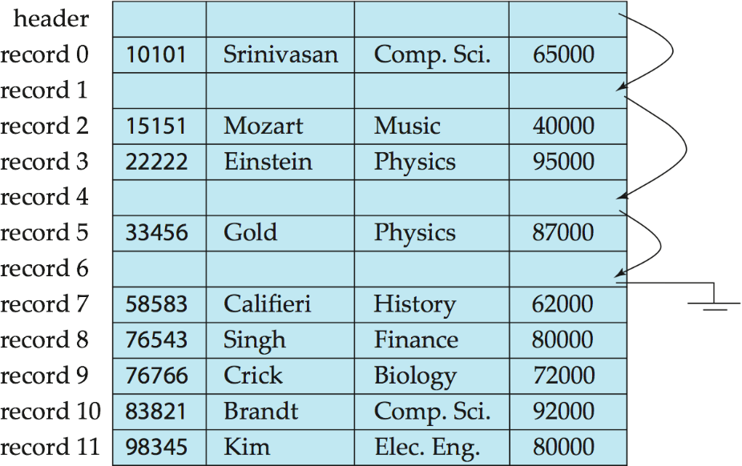
Deletion Alternative 3:
Free Lists
Store the address of the first deleted record in the file header.
Use this first record to store the address of the second deleted record, and so on
Can think of these stored addresses as pointers since they “point” to the location of a record.

Slide 7
Alternative File Organizations
Many alternatives exist, each ideal for some situations, and not so good in others:
  Heap (random order) files: Suitable when typical access is a file scan retrieving all records.
  Sorted Files: Best if records must be retrieved in some order, or only a `range’ of records is needed.
  Indexes: Data structures to organize records via trees or hashing.
    Like sorted files, they speed up searches for a subset of records, based on values in certain (“search key”) fields
    Updates are much faster than in sorted files.
Notes:
2

Slide 8
Cost of Queries
How to answer the following queries efficiently:
  Query 1: Find all instructors in Physics Department.
  Query 2: Find salary of instructor with ID 1010
The most expensive operation is disk I/O
Goal: answer queries with the minimum possible number of I/O operations.

Slide 9
Indexes
An index on a file speeds up selections on the search key fields for the index.
  Any subset of the fields of a relation can be the search key for an index on the relation.
  Search key is not the same as key (minimal set of fields that uniquely identify a record in a relation).
An index contains a collection of data entries, and supports efficient retrieval of all data entries with a given key value k.
Notes:
7

Slide 10

Index Example 1
Index on ID attribute of instructor relation
Query 1 can be answered by scanning the whole file.
Query 2 can be answered by location ID 10101 in the index and then accessing the record directly

Slide 11

Index Example 2
Index on dept_name with instructor file sorted on dept_name
Query 1 can be answered by looking up Physics department in index and then accessing only one page of the file
Query 2 can be answered by scanning the whole file

Slide 12
Choice of Indexes
What indexes should we create?
  Which relations should have indexes?
  What field(s) should be the search key?
  Should we build several indexes?
For each index, what kind of an index should it be?
  Clustered? Hash/tree?
Notes:
12

Slide 13
Index Evaluation Metrics
Access types supported efficiently. E.g.,
  Equality search: find a record with a specified value
  Range search: find all records falling in a specified range of values.
Access time
Insertion time
Deletion time
Space overhead

Slide 14
Index classifications
Dense vs. Sparse index
Clustered (primary) index vs. Unclustered (secondary)
Ordered index vs. Hash index

Slide 15
Dense vs. Sparse Index
Dense index — Index record appears for every search-key value in the file.
Sparse Index: contains index records for only some search-key values.
  Applicable when records are sequentially ordered on search-key

Slide 16
Dense Index Example 1
Dense index on ID attribute of instructor relation

Slide 17
Dense Index Example 2
Dense index on dept_name, with instructor file sorted on dept_name

Slide 18

Sparse Index Example
To locate a record with search-key value K we:
  Find index record with largest search-key value < or equal to K
  Search file sequentially starting at the record to which the index record points
Sparse index on ID attribute of instructor relation

Slide 19

Dense vs. Sparse Index
A Sparse index uses less space and less maintenance overhead for insertions and deletions.
A sparse index Generally slower than dense index for locating records.
Good tradeoff: sparse index with an index entry for every block in file, corresponding to the first search-key value in the block.

Slide 20
Clustered vs. Unclustered Index
Clustered vs. unclustered: If order of data records is the same as, or `close to’, order of data entries, then called clustered index.
  A file can be clustered on at most one search key.
Cost of retrieving data records through index varies greatly based on whether index is clustered or not!
Notes:
11

Slide 21
Clustered Index Example
Clustered index on ID attribute of instructor relation

Slide 22

Unclustered Index Example
Unclustered index on Salary attribute of instructor relation
Unclustered (Secondary) indices have to be dense

Slide 23
Multilevel Index
If the whole index fits in memory, number of disk I/O can be greatly reduced, hence improving performance.
If index is too large to fit in memory:
  Treat primary index kept on disk as a sequential file and construct a sparse index on it.
    outer index – a sparse index of primary index
    inner index – the primary index file
If even outer index is too large to fit in main memory, yet another level of index can be created, and so on.
Indices at all levels must be updated on insertion or deletion from the file.

Slide 24
Multilevel Index Example

Slide 25
B+ Tree Index
Non-leaf
Pages
Leaf
Pages
(Sorted by search key)
Leaf pages contain data entries, and are chained (prev & next)
Non-leaf pages have index entries; only used to direct searches:
index entry
P
K
P
K
P
K
P
m
0
1
1
2
2
m
Notes:
4

Slide 26
B+ Tree Example 1
Root
Note how data entries
in leaf level are sorted
17
Entries < 17
Entries >= 17
5
13
27
30
2*
3*
5*
7*
8*
14*
16*
22*
24*
27*
29*
33*
34*
38*
39*
Find 28*? 29*? All > 15* and < 30*
Insert/delete: Find data entry in leaf, then change it. Need to adjust parent sometimes.
  And change sometimes bubbles up the tree
Notes:
15

Slide 27

B⁺-Tree Example 2

Slide 28
B⁺-Tree Index Files
A B⁺-tree is a rooted tree satisfying the following properties:
Each node that is not a root or a leaf has between ⎡n/2⎤ and n children.
All paths from root to leaf are of the same length
The B⁺-tree contains a relatively small number of levels
    Level below root has at least 2* ⎡n/2⎤ values
    Next level has at least 2* ⎡n/2⎤ * ⎡n/2⎤ values
    .. etc.
  If there are K search-key values in the file, the tree height is no more than ⎡ log_{⎡n/2⎤}(K)⎤
  thus searches can be conducted efficiently.

Slide 29
Example on B+
A file with 1,000,000 records
B+ tree node size = 100
Number of levels in B+ tree: log ₅₀ 1,000,000 = 4
At most 4 I/Os are needed in order to access any record in the file

Slide 30
Why B+ trees?
B⁺-tree indices are an alternative to indexed-sequential files.
Disadvantage of indexed-sequential files
  performance degrades as file grows
  Periodic reorganization of entire file is required.
Advantage of B⁺-tree index files:
  automatically reorganizes itself with small, local, changes, in the face of insertions and deletions.
  Reorganization of entire file is not required to maintain performance.
(Minor) disadvantage of B⁺-trees:
  extra insertion and deletion overhead, space overhead.
Advantages of B⁺-trees outweigh disadvantages

Slide 31
Clustered vs. Unclustered B+Tree
  To build clustered index, first sort the Heap file (with some free space on each page for future inserts).
Efficient for range search
Index entries
UNCLUSTERED
CLUSTERED
direct search for
data entries
Data entries
Data entries
(Index File)
(Data file)
Data Records
Data Records
Notes:
12

Slide 32
Hash-Based Indexes
Good for equality selections.
Index is a collection of buckets.
  Bucket = primary page plus zero or more overflow pages.
  Buckets contain data entries.
Hashing function h: h(r) = bucket in which (data entry for) record r belongs. h looks at the search key fields of r.
  No need for “index entries” in this scheme.
Notes:
2

Slide 33
Example of Hash File Organization
Hash file organization of instructor file, using dept_name as key:
  Assume there are 8 buckets,
  The binary representation of the ith character is assumed to be the integer i.
  The hash function returns the sum of the binary representations of the characters modulo 8
  h(music) = (13+21+19+9+3) mod 8 = 65 mod 8 = 1
  h(Music) = 1 h(History) = 2
  h(Physics) = 3 h(Elec. Eng.) = 3

Slide 34
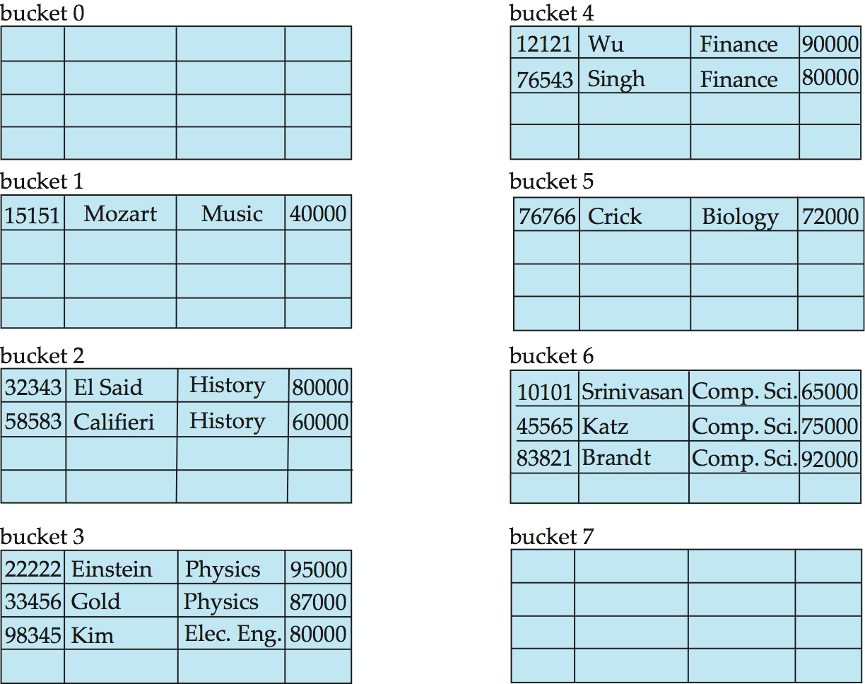
Hash File Organization Example
Hash file organization of instructor file, using dept_name as key

Slide 35
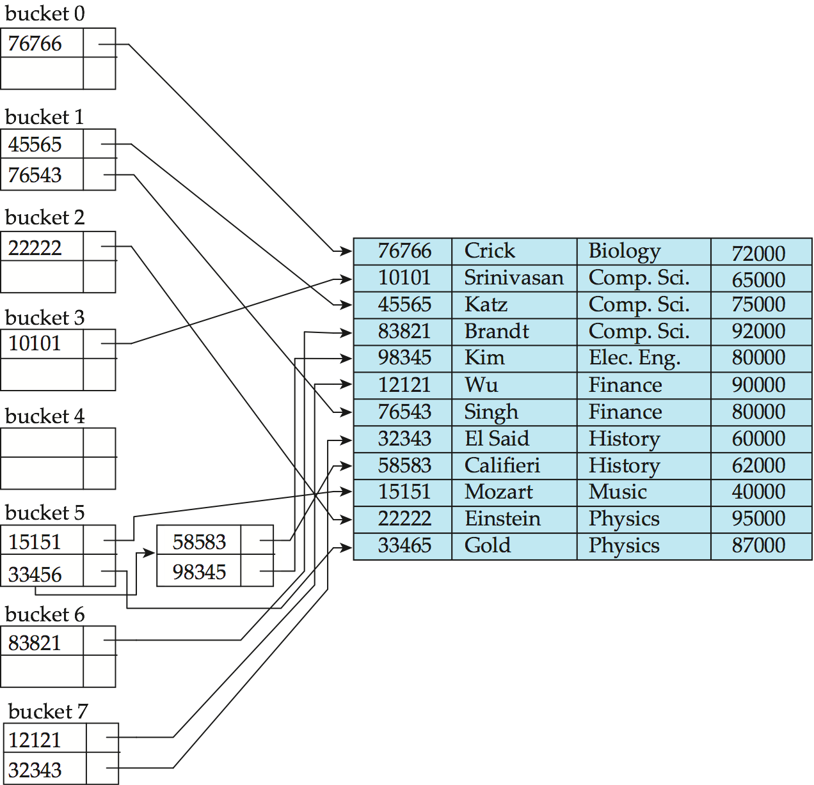
Hash Index Example
hash index on instructor, on attribute ID
h(76766) = (7+6+7+6+6) mod 8 = 0

Slide 36
Comparison between Indicies
Cost of periodic re-organization
Relative frequency of insertions and deletions
Is it desirable to optimize average access time at the expense of worst-case access time?
Expected type of queries:
  Hashing is generally better for equality search
  B+ trees (ordered indexes) are better for range queires

Slide 37
Understanding the Workload
For each query in the workload:
  Which relations does it access?
  Which attributes are retrieved?
  Which attributes are involved in selection/join conditions? How selective are these conditions likely to be?
For each update in the workload:
  Which attributes are involved in selection/join conditions? How selective are these conditions likely to be?
  The type of update (INSERT/DELETE/UPDATE), and the attributes that are affected.
  Updates to the database causes updates to indexes as well
Notes:
11

Slide 38
Choice of Indexes
What indexes should we create?
  Which relations should have indexes?
  What field(s) should be the search key?
  Should we build several indexes?
For each index, what kind of an index should it be?
  Clustered? Hash/tree?
Notes:
12

Slide 39
Choice of Indexes (continued)
One approach: Consider the most important queries in turn.
  Consider the best plan using the current indexes, and see if a better plan is possible with an additional index. If so, create it.
  Obviously, this implies that we must understand how a DBMS evaluates queries and creates query evaluation plans!
  For now, we discuss simple 1-table queries.
Before creating an index, must also consider the impact on updates in the workload!
  Trade-off: Indexes can make queries go faster, updates slower. Require disk space, too.
Notes:
13

Slide 40
Index Selection Guidelines
Attributes in WHERE clause are candidates for index keys.
  Equality conditions suggests hash index.
  Range query suggests tree index.
  Clustering is especially useful for range queries; can also help on equality queries if there are many duplicates.
Notes:
14

Slide 41
Index Selection Guidelines (continued)
Multi-attribute search keys should be considered when a WHERE clause contains several conditions.
  Order of attributes is important for range queries.
  Such indexes can sometimes enable index-only strategies for important queries.
    For index-only strategies, clustering is not important!
Try to choose indexes that benefit as many queries as possible. Since only one index can be clustered per relation, choose it based on important queries that would benefit the most from clustering.
Notes:
14

Slide 42
Examples of Clustered Indexes
B+ tree index on E.age can be used to get qualifying tuples.
  How selective is the condition?
  Is the index clustered?
Consider the GROUP BY query.
  If many tuples have E.age > 10, using E.age index
  and sorting the retrieved tuples may be costly.
  Clustered E.dno index may be better!
Equality queries and duplicates:
  Clustering on E.hobby helps!
SELECT E.dno
FROM Emp E
WHERE E.age>40
SELECT E.dno, COUNT (*)
FROM Emp E
WHERE E.age>10
GROUP BY E.dno
SELECT E.dno
FROM Emp E
WHERE E.hobby=Stamps
Notes:
18

Slide 43
Indexes with Composite Search Keys
Composite Search Keys: Search on a combination of fields.
  Equality query: Every field value is equal to a constant value.
    age=20 and sal =75
  Range query: Some field value is not a constant.
    age =20; or age=20 and sal > 10
Data entries in index sorted by search key to support range queries.
Examples of composite key
indexes using lexicographic order.
11,80
11
12,10
12
12,20
name
age
sal
12
13,75
bob
12
10
13
<age, sal>
cal
11
80
<age>
joe
12
20
10,12
sue
13
75
10
20,12
Data records
sorted by name
20
75,13
75
80,11
80
<sal, age>
<sal>
Data entries in index
sorted by <sal,age>
Data entries
sorted by <sal>
Notes:
13

Slide 44
Composite Search Keys
To retrieve Emp records with age=30 AND sal=4000, an index on <age,sal> would be better than an index on age only or an index on sal only
If condition is: 20<age<30 AND 3000<sal<5000:
  Clustered tree index on <age,sal> or <sal,age> is best.
If condition is: age=30 AND 3000<sal<5000:
  Clustered <age,sal> tree index much better than <sal,age> index!
Composite indexes are larger, updated more often.
Notes:
20

Slide 45
Index-Only Plans
A number of queries can be answered without retrieving any tuples from one or more of the relations involved if a suitable index is available.
SELECT E.dno, COUNT(*)
FROM Emp E
GROUP BY E.dno
<E.dno>
<E.dno,E.sal>
SELECT E.dno, MIN(E.sal)
FROM Emp E
GROUP BY E.dno
Tree index!
<E. age,E.sal>
or
<E.sal, E.age>
SELECT AVG(E.sal)
FROM Emp E
WHERE E.age=25 AND
E.sal BETWEEN 3000 AND 5000
Tree index!
Notes:
21

Slide 46
Summary
An index is a collection of data entries plus a way to quickly find entries with given key values.
We can have several indexes on a given file of data records, each with a different search key.
Indexes can be classified as clustered vs. unclustered. Differences have important consequences for utility/performance.
Notes:
15

Slide 47
Summary (continued)
Understanding the nature of the workload for the application, and the performance goals, is essential to developing a good design.
  What are the important queries and updates? What attributes/relations are involved?
If selection queries are frequent, sorting the file or building an index is important.
  Hash-based indexes only good for equality search.
  Sorted files and tree-based indexes best for range search; also good for equality search. (Files rarely kept sorted in practice; B+ tree index is better.)
Notes:
14

Slide 48
Summary (continued)
Indexes must be chosen to speed up important queries (and perhaps some updates!).
  Index maintenance overhead on updates to key fields.
  Choose indexes that can help many queries, if possible.
  Build indexes to support index-only strategies.
  Clustering is an important decision; only one index on a given relation can be clustered!
  Order of fields in composite index key can be important.

