Slide 1
Transactions

Slide 2
A Bird’s Eye View of DBMS
Create Tables
DB Application Programmer
DB Casual User
Enter Data
Queries: Find all students who are enrolled in CS101
SQL
SELECT StudentID
FROM Enrollement
Where CourseID = CS101
Java / C++
Course Information
Enter Course ID
DBMS
Student_Id
SName
Data Model
DB Designer
Query Parser
10032
Adam
DB Administrator
Tuning
10554
Joe
StudentID
SName
10345
Lina
Query Optimizer
  Handles security and authorization
  Data availability, crash recovery
  Database tuning as needs evolve
DB Developer
Students
Course_Id
CName
Query Operators
CS101
DB
CS122
Math
Student_Id
Course_ID
Enrollment
Index
10345
CS101
10051
CS101
Courses
Disk
CourseID
CName

Slide 3
Real-world Transactions
Examples:
  Buying a product
  Registering in a course
  Making a deposit in a checking account
One transaction consists of more than one query:
  Sales transaction:
    Updating (or adding) the customer account
    Adjusting the product inventory
    Updating the seller’s account
A transaction should be either entirely completed or entirely aborted

Slide 4
Database Transaction
Database request:
  Any action that READS from and/or WRITES to the database tables
  Each request generates several input/output (I/O) operations
A transaction may consist of:
  A series of SELECT/INSERT/UPDATE/DELETE commands/queries
  Each query requires several database READ/WRITE operations
A database transaction should be either entirely completed successfully or entirely aborted:
  NO intermediate states are accepted
  If one SQL statement fails:
    The transaction should be rolled back

Slide 5
Failure-Related Problem
Transferring money between two accounts:
  UPDTAE ACCOUNTS
  SET BALANCE = BALANCE – 1000
  WHERE ACCT_NUM = 8888
  UPDATE ACCOUNTS
  SET BALANCE = BALANCE+ 1000
  Where ACCT_NUM = 9999
If the system fails between these two updates, money may be withdrawn but not re-deposited

Slide 6
Database state
Consistent database state:
  All entity and referential integrity constraints are satisfied
To ensure database consistency:
  A transaction changes the database from one consistent state to another consistent state

Slide 7
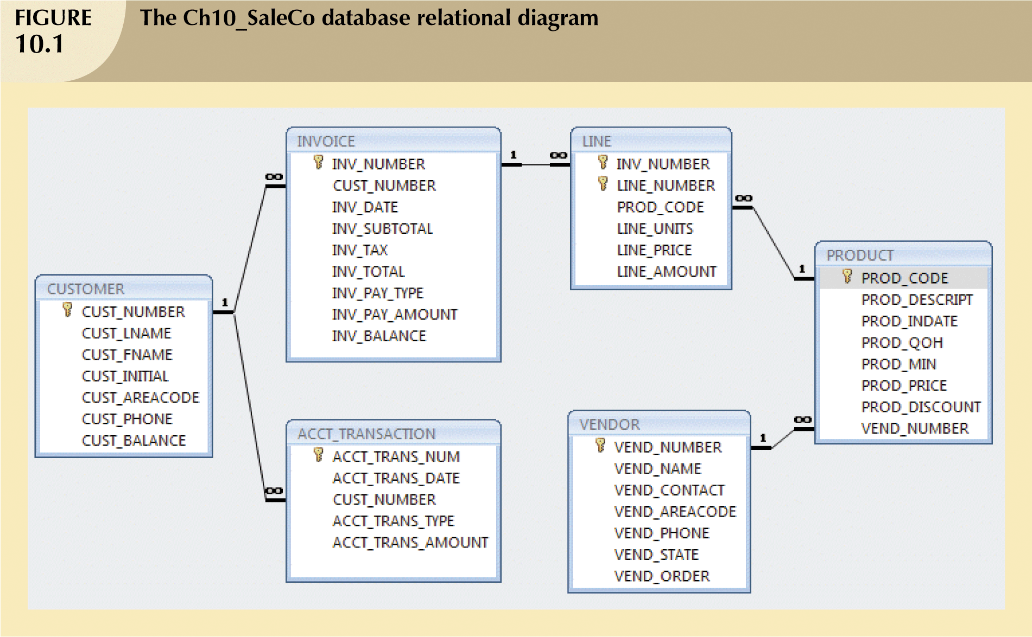

Slide 8
CUS_BALANCE increases when a customer makes a purchase
ACCT_TRANSACTION table:
  Records all customer purchases and payments

Slide 9
Customer’s Sales Transaction
When a customer makes a purchase:
  Write a new customer invoice
  Write the corresponding invoice lines
  Reduce QOH for the corresponding product
  Update CUS_BALANCE
  Update ACCT_TRANSACTION

Slide 10
1. INSERT INTO INVOICE VALUES (1009,10016,’18-Jan-2008’,256.99,20.56,277.55,’cred’,0.00,277.55)
2. INSERT INTO LINE VALUES (1009,1,’89-WRE-Q’,1,256.99,256.99)
3. UPDATE PRODUCT
SET PROD_QOH = PROD_QOH -1
WHERE PROD_CODE = ’89-WRE-Q’
4. UPDATE CUSTOMER
SET CUS_BALANCE = CUS_BALANCE + 277.5
WHERE CUS_CODE = 10016
5. INSERT INTO ACCT_TRANSACTION VALUES
(10007,’18-Jan-2008’,10016,’charge’,277.55)
6. COMMIT;

Slide 11
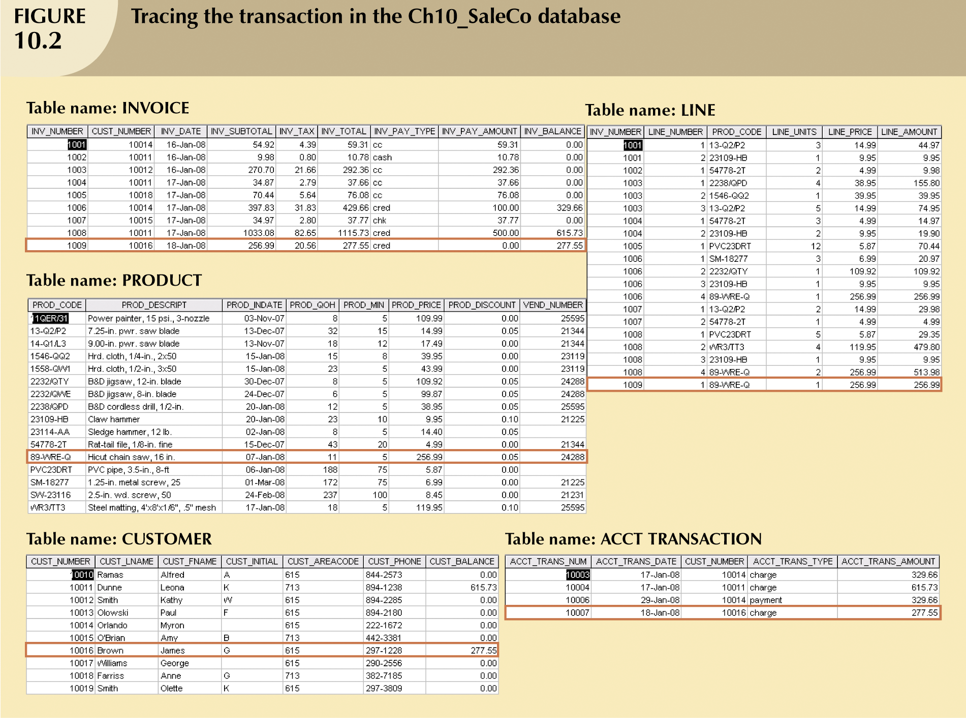

Slide 12
Failure!!
What if a computer failure takes place after step 3?
  A new invoice is added
  The product QOH is updated
  Customer is not charged!!
  The transaction is not reported in ACCT_TRANSACTION!!
  ➔ INCONSISTENT Database state

Slide 13
Solution?!!
DBMS Transaction Management:
  Module of DBMS to monitor transaction progress and performance
ROLL BACK (when there is a failure)
  Cancel the operations of the uncompleted transaction
  Return INVOICE, LINE, and PRODUCT tables to their states before the transaction
  Roll back the database to a previous consistent state

Slide 14
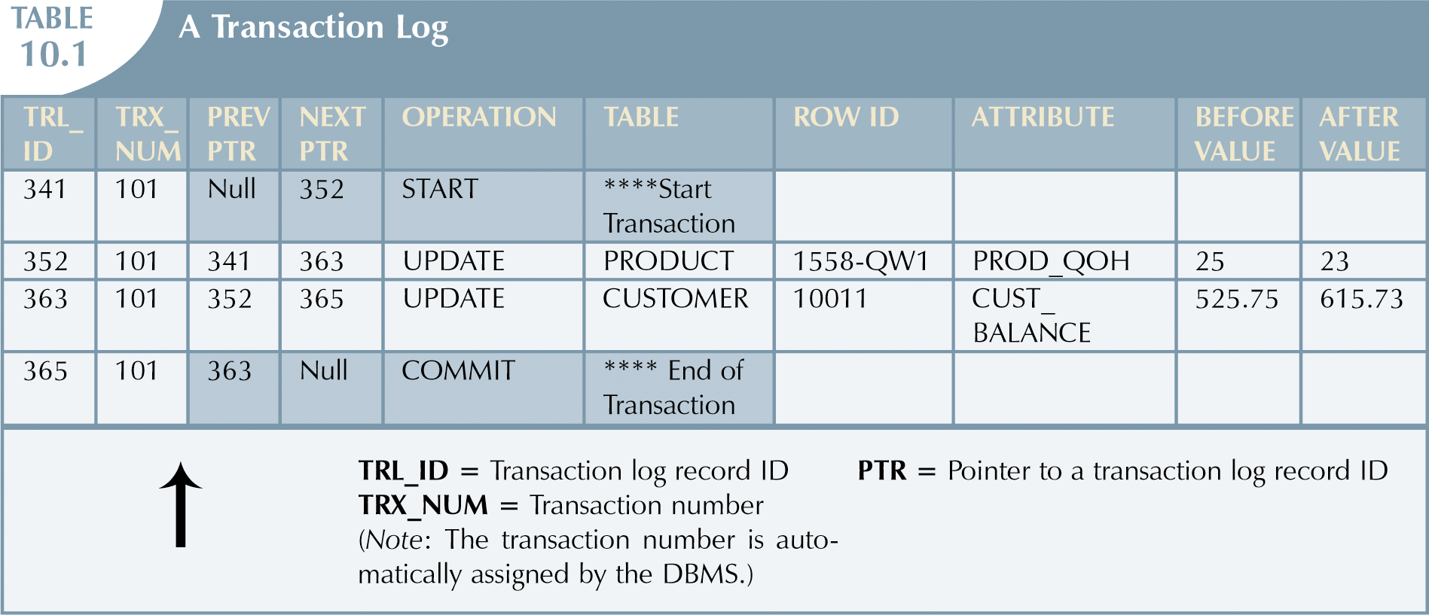
Transaction Log

Slide 15
Example of Fund Transfer
Transfer $50 from account A to account B:
  1. read(A)
  2. A := A – 50
  3. write(A)
  4. read(B)
  5. B := B + 50
  6. write(B)

Slide 16
Example of Fund Transfer (continued)
Atomicity requirement
  if the transaction fails after step 3 and before step 6, money will be “lost” leading to an inconsistent database state
    Failure could be due to software or hardware
  the system should ensure that updates of a partially executed transaction are not reflected in the database
Durability requirement — once the user has been notified that the transaction has completed (i.e., the transfer of the $50 has taken place), the updates to the database by the transaction must persist even if there are software or hardware failures.

Slide 17
Example of Fund Transfer (continued)
Consistency requirement in above example:
  the sum of A and B is unchanged by the execution of the transaction
In general, consistency requirements include
    Explicitly specified integrity constraints such as primary keys and foreign keys
    Implicit integrity constraints
      e.g. sum of balances of all accounts, minus sum of loan amounts must equal value of cash-in-hand
  A transaction must see a consistent database.
  During transaction execution the database may be temporarily inconsistent.
  When the transaction completes successfully the database must be consistent
    Erroneous transaction logic can lead to inconsistency

Slide 18
Example of Fund Transfer (continued)
Isolation requirement — if between steps 3 and 6, another transaction T2 is allowed to access the partially updated database, it will see an inconsistent database (the sum A + B will be less than it should be).
T1 T2
  1. read(A)
  2. A := A – 50
  3. write(A)
  read(A), read(B), print(A+B)
  4. read(B)
  5. B := B + 50
  6. write(B)
Isolation can be ensured trivially by running transactions serially
  that is, one after the other.
However, executing multiple transactions concurrently has significant benefits

Slide 19
ACID Properties
A transaction is a unit of program execution that accesses and possibly updates various data items.To preserve the integrity of data the database system must ensure:
Atomicity. Either all operations of the transaction are properly reflected in the database or none are.
Consistency. Execution of a transaction in isolation preserves the consistency of the database.
Isolation. Although multiple transactions may execute concurrently, each transaction must be unaware of other concurrently executing transactions. Intermediate transaction results must be hidden from other concurrently executed transactions.
  That is, for every pair of transactions T_{i} and T_{j}, it appears to T_{i} that either T_{j}, finished execution before T_{i} started, or T_{j} started execution after T_{i} finished.
Durability. After a transaction completes successfully, the changes it has made to the database persist, even if there are system failures.

Slide 20
Issues to deal with when working with Transactions
Failures of various kinds, such as hardware failures and system crashes
  Database recovery algorithms
Concurrent execution of multiple transactions
  Concurrency control algorithms
DBMS cannot guarantee the correctness of the semantic meaning of the user’s transaction

Slide 21
Transaction State
Active – the initial state; the transaction stays in this state while it is executing
Partially committed – after the final statement has been executed.
Failed -- after the discovery that normal execution can no longer proceed.
Aborted – after the transaction has been rolled back and the database restored to its state prior to the start of the transaction. Two options after it has been aborted:
  restart the transaction
    can be done only if no internal logical error
  kill the transaction
Committed – after successful completion.

Slide 22

Transaction State Diagram

Slide 23
Concurrent Executions
Advantages of Concurrent Execution:
  Increased throughput:
    Increased processor and disk utilization, leading to better transaction throughput
    one transaction can be using the CPU while another is reading from or writing to the disk
  Reduced average response time:
    short transactions need not wait behind long ones.
Concurrency control schemes – mechanisms to achieve isolation
  control the interaction among the concurrent transactions in order to prevent them from destroying the consistency of the database

Slide 24
Schedules
Schedule – a sequences of instructions that specify the chronological order in which instructions of concurrent transactions are executed
  a schedule for a set of transactions must consist of all instructions of those transactions
  must preserve the order in which the instructions appear in each individual transaction.
A transaction that successfully completes its execution will have a commit instructions as the last statement
  by default transaction assumed to execute commit instruction as its last step
A transaction that fails to successfully complete its execution will have an abort instruction as the last statement

Slide 25
Example 1
Assume the following two transactions are running concurrently in the system:
  T₁ :
    transfer $50 from A to B.
  T₂ :
    transfer 10% of the balance from A to B.

Slide 26

Example 1: Schedule 1
A serial schedule in which T₁ is followed by T₂ :

Slide 27

Example 1: Schedule 2
A serial schedule where T₂ is followed by T₁

Slide 28

Example 1: Schedule 3
Let T₁ and T₂ be the transactions defined previously. The following schedule is not a serial schedule, but it is equivalent to Schedule 1.
In Schedules 1, 2 and 3, the sum A + B is preserved.

Slide 29

Example 1: Schedule 4
The following concurrent schedule does not preserve the value of (A + B ).

Slide 30
Simplified view of transactions
  Simplified schedules consist of only read and write instructions.
  READ:
    Does not alter the database state
  SELECT CUS_CODE, CUS_BALANCE
  FROM CUSTOMER
  WHERE CUS_CODE = 1001
  WRITE:
    change the database state
UPDATE PRODUCT
SET PROD_QOH = PROD_QOH +10
WHERE PROD_CODE = ’89-WRE-Q’
  We assume that transactions may perform arbitrary computations on data in local buffers in between reads and writes.

Slide 31
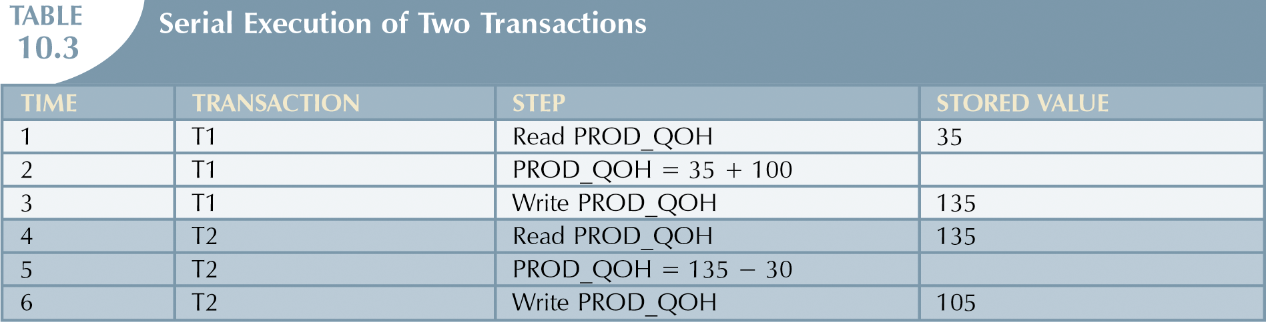
T1: R(Q) W(Q) C
T2: R(Q) W(Q)C

Slide 32
Problems of Concurrent Transactions
When two transactions are working on the database concurrently, the following problems might arise:
  Lost Update
  Dirty Read
  Unrepeatable read

Slide 33
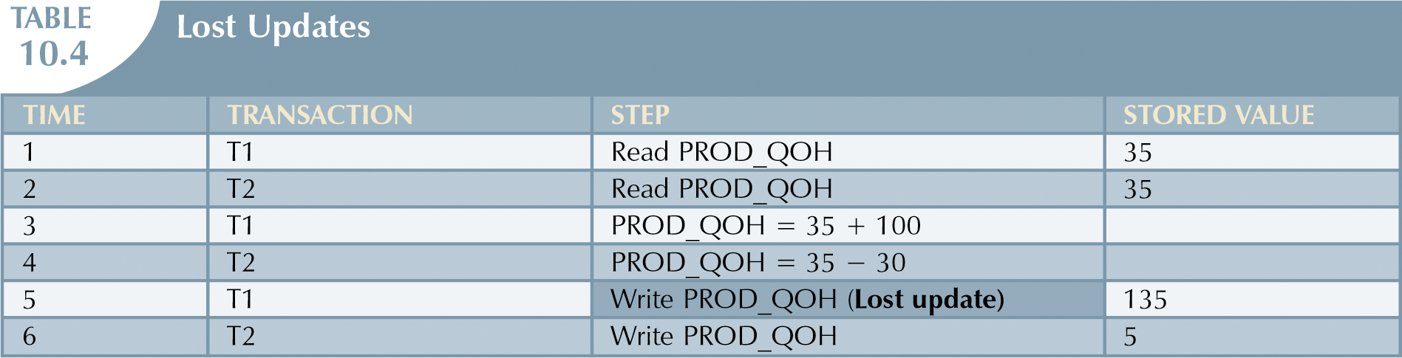
Lost Update Problem
T1: R(Q) W(Q) C
T2: R(Q) W(Q)C
Lost Update of T1

Slide 34
Lost Updates Problem (continued)
When two transactions are updating the same data element and one of the updates is lost:
  Overwritten by the other transaction

Slide 35
Example 2
T1: BEGIN A=A+100, B=B-100 END
T2: BEGIN A=1.1*A, B=1.1*B END
T1 is transferring $100 from B’s account to A’s account.
T2 is crediting both accounts with a 10% interest payment.
There is no guarantee that T1 will execute before T2 or vice-versa, if both are submitted together.
However, the net effect must be equivalent to these two transactions running serially in some order.

Slide 36
Example 2 (continued)
Consider the following schedules:
Schedule 1:
T1: R(A), A=A+100 ,W(A) R(B),B=B-100,W(B)
T2: R(A),A=1.1*A, W(A) R(B),B=1.1*B,W(B)
Schedule 2:
T1: R(A),A=A+100,W(A),R(B) B=B-100,W(B)
T2: R(A),A=1.1*A,W(A),R(B), B=1.1*B,W(B)
Schedule 2 causes the lost update problem because the value of B that was written by T2 is overwritten by T1

Slide 37
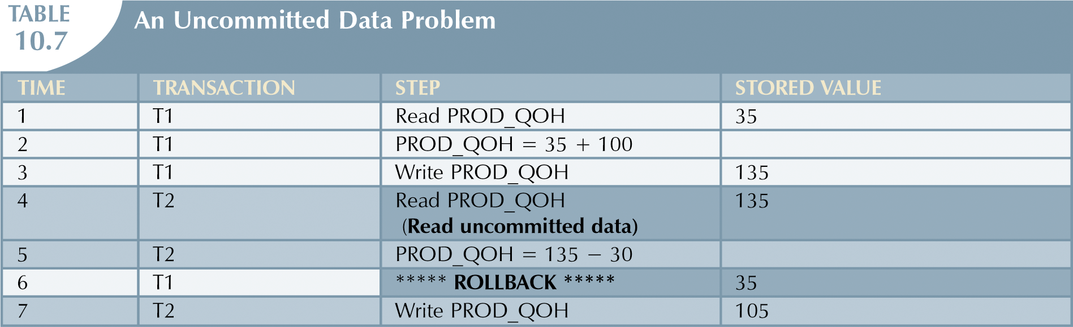
Problem 2: Reading Uncommitted Data
T1: R(Q) W(Q) Abort
T2: R(Q) W(Q) C
T2 Read Uncommitted Data (Dirty Read)

Slide 38
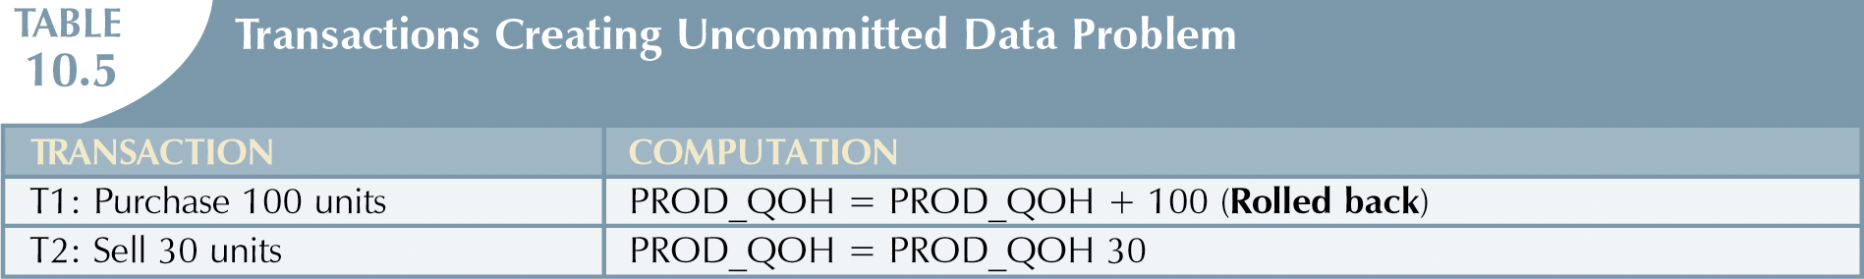
Dirty Read: Reading Uncommitted Data
When T1 and T2 are executed concurrently and T1 is rolled back after T2 has already accessed the uncommitted data

Slide 39
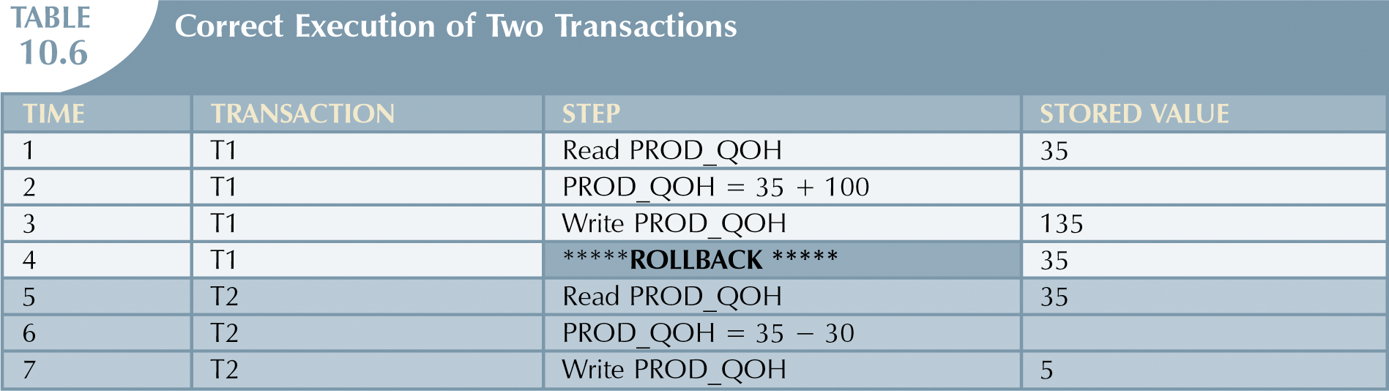
Correct sequence
T1: R(Q) W(Q) Abort
T2: R(Q) W(Q)C

