Slide 1
Lecture 2
Chapter 2: Introduction to Relational Model

Slide 2
The Relational Model
Three basic components:
  Relations (Tables):
    Logical data structures to store data
  Integrity rules:
    Rules to enforce that the data is (and remains) consistent over time
    Enforce that the database will be in a perfect condition at all times
  Operations:
    Operations to manipulate data

Slide 3
The Relational Model: Relations
A Relation is a Table (or entity set)
A Relation consists of:
  Columns ➔ attributes
  Rows ➔ entity occurrences
    Each row represents an occurrence in the entity
    Example: instructor table contains information about a group of instructors
A relation is structure-independent and data-independent

Slide 4

Example of a Relation
attributes
(or columns)
tuples
(or rows)

Slide 5
Relations (Cont’d)
A relation is made up of 2 parts:
  Relation Schema:
    Structure of the table
    Order of columns in the relation is not important
    Example:
      instructor(
        ID: string,
        name: string,
        Dept_name: string,
        salary: real).
  Relation Instance: A table filled with contents (or data)
Relation characteristics:
  Cardinality ➔ Number of Rows
  Degree ➔ Number of Attributes

Slide 6
attribute
ID
name
dept_name
salary
53666
mozart
Music
65000
53688
Smith
History
90000
53650
Smith
Math
40000
tuple
Schema:
  instructor (ID: string, name: string, dept_name: string, salary: real)
Degree = 4
Cardinality = 3
Are rows distinct?!!

Slide 7
Columns (Attributes)
Relation schema defines a set of columns
Each column has the following characteristics:
  Name:
    each column should have a distinct name
  Data type:
    all values in the column must have the same data type
      Numeric, string, date, logical
      Example:
        name ➔ string
        salary ➔ real number
  Attribute domain:
    The set of allowed values for each attribute
      Example: 30000 < salary < 150000
  Attribute values are (normally) required to be atomic; that is, indivisible

Slide 8
NULL values
NULL is a database value that is used to fill in a cell in the table that has no value:
  An unknown attribute value
  A missing attribute value
    Examples:
      salary of a certain instructor is not available at the time of data entry
      home Phone number might not exist for some people
A “not applicable” condition
A NULL value is not a zero or space

Slide 9

Relations are Unordered
Order of tuples is irrelevant (tuples may be stored in an arbitrary order)
Example: instructor relation with unordered tuples

Slide 10
Database
A database consists of multiple relations
  Example: Information about a university is broken up into three relations
    instructor, student , advisor
Bad design:
  univ (instructor_ID, name, dept_name, salary, student_Id)
  Results in:
    Repetition of information (e.g., two students have the same instructor)
    The need for null values (e.g., represent an student with no advisor)
    Normalization theory (Chapter 7) deals with how to design “good” relational schemas

Slide 11

Schema Diagram for University Database

Slide 12
Primary Key Constraint
Each relation should have a Primary Key (PK)
A PK ensures that each row in the table is uniquely identifiable
  Example: ID is the primary key for the relation instructor because each instructor must have a unique identifier
A PK determines other attributes
  A determine B (A→B)
    If you know the value of A, you can determine the value of B
  Example: ID ➔ name, dept_name, salary
  Can we use dept_name as the PK?
    If dept_name is “History”, can you determine instructor name? Can you determine salary?

Slide 13
Functional Dependency
Attribute B is functionally dependent on Attribute A if:
  Each value of A determines one and only one value in B
  Expressed as: A ➔ B
Example:
  salary is functionally dependent on ID
    Each ID value determines one and only one salary value
    An instructor has only one salary
  ID is not functionally dependent on salary
    A salary value cannot determine a single ID value
    Several instructors might have the same salary

Slide 14
Schema Diagram for University Database

Slide 15
Composite key
A composite key is a primary key that consists of more than one attribute
Example: classroom relation
  Primary key consists of two attributes:
    building
    room_no
  Can building determine capacity?
    No, because different rooms in the building differ in capacity
  Can room_no determine capacity?
    No, because two rooms with the same number but in different buildings are not the same

Slide 16
Composite Key (continued)
The PK for the relation takes consists of five attributes:
    student identifier (ID)
    course identifier (course_id)
    sec_id
    semester
    year
  ID only cannot determine a single grade value
    A student has more than one grade in more than one course
  course_id only cannot determine a single Grade value
    A course has more than one student
  (ID, course_id, sec_id, semester, year) is a Composite Key
    ID,course_id, sec_id,semester,year ➔ grade
    Pronounced: ID,course_id, sec_id, semester,and year determines grade
PK determines grade

Slide 17
Other types of keys
Super key:
  Any key that uniquely identifies each row
    Example:
      Both (ID) and (ID, name) are super keys for the instructor table
        However, name is an unnecessary attribute in the key
Candidate key:
  Minimal super key (i.e., a super key without unnecessary attributes)
  An attribute that can be a primary key but it is not selected to be a primary key
  Example: A login attribute can be a candidate key
A primary key is a super key and candidate key

Slide 18
Foreign key
A Foreign key is used to represent the relationship between two tables
student
takes
ID | name | dept_name | tot_cred
53666 | Jones | CS | 34
53688 | Smith | Music | 70
53650 | Smith | CS | 110
ID | course_id | grade
53666 | CS101 | A
53666 | CS102 | B
53650 | CS102 | A
A foreign key is an attribute whose value matches the primary key of a related table:
  ID is a foreign key in the takes table
  Only students that have ID are allowed to enroll in courses

Slide 19
Foreign key (continued)
A foreign has two parts:
  Referencing relation
  Referenced relation
Example: In the University Database
Referencing Relation | Foreign Key | Referenced Relation
takes | ID | student
instructor | dept_name | department
prereq | course_id | course

Slide 20
Keys: Summary
Primary key:
  A candidate key that is selected to uniquely identify each row in the table
  Cannot be NULL
Composite key:
  A key that consists of more than one attribute
Super key:
  An (attribute or a set of attributes) that Uniquely identifies each row in the table
Candidate key:
  A minimal super key (does not contain unnecessary attributes)
Foreign key:
  An attribute or set of attributes in one table whose value refer to an attribute in another related table

Slide 21
The Relational Model: Integrity Constraints
Integrity constraints are rules that need to be enforced by the DBMS to ensure that the data will be always in a perfect condition
Integrity constraints are divided into three categories:
  Domain Constraint:
    Specify the range of values that can be used in a column
  Entity Integrity
  Referential Integrity

Slide 22
Entity Integrity
A Primary Key uniquely identifies each row
A primary key is NOT NULL
A composite primary key cannot have NULL in any of its fields

Slide 23
Referential integrity
A foreign key must refer to the primary key of another table
Value of the foreign key attribute is either:
  Matches a value from the other table’s primary key
  NULL:
    Example:
      A course might not have an instructor assigned but can not have an invalid instructor ID

Slide 24
Checking Entity Integrity
instructor table has ID attribute as the primary key column:
  No null entries
  All entries are unique

Slide 25
Schema Diagram for University Database

Slide 26

Checking Referential Integrity
instructor table has the attribute dept_name as a foreign key:
  Represents the 1:M relationship between department and instructor
All instructors’ dept_name values are valid values from the PK attribute (dept_name) in department table

Slide 27
Summary of Integrity Constraints
Entity Integrity:
  Primary key constraint
    Unique, Not NULL
    Each row in the table has a unique identity
Referential Integrity:
  Foreign key constraint
    A foreign key on a table refers to the primary key of another table or NULL
Domain Constraint:
  Specify the range of values that can be used in a column

Slide 28
Where do ICs Come From?
Integrity constraints are extracted from Business rules
One can check a given database instance to see if an IC is violated
Example:
  We can verify that the name is not a key
  But, the assertion that ID is a key should be given to us.

Slide 29
The Relational Model: Operations
Relational Query Languages (e.g., SQL) are used for: manipulation and retrieval of data from a database.
A query is composed of one or more relational operations
There are six basic relational operators:
    Select
    Project
    Union
    Set-difference
    Cartesian Product
    Natural Join

Slide 30
Why Operations?
Operations are used to answer queries over the relational database.
Example queries:
  List names of all Physics instructors?
  List names of all instructors who has salary > 70000?
  List names of all instructors who work in “Taylor” building>?

Slide 31
Relational Query Language
RQL are Declarative:
  Users describe what they want, rather than how to compute it.
Query Languages != programming languages
  QLs are not intended to be used for complex calculations
  QLs support easy, efficient access to large data sets

Slide 32
Types of Relational Query Languages
Relational Algebra:
  Formal query language
SQL:
  Practical language used by DBMS
Relational Algebra is the formal model upon which SQL is based

Slide 33
Types of Relational Operators
Binary Op
Unary Op

Slide 34
Characteristics of Relational Operators
Closure property:
  A relational operator takes relations as input and produces a relation as output
  The schema of the result of a given query can be extracted from the query
Composition property:
  Operations can be composed:
    Output of one operation can be used as the input for another operation
Unary Op
Binary Op

Slide 35

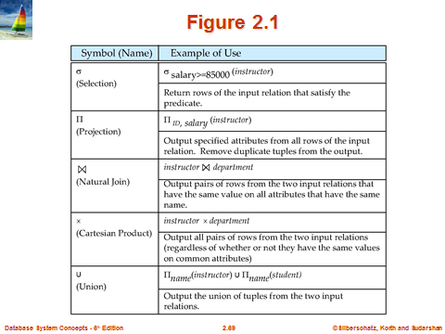

Slide 36

Figure 2.1

Slide 37
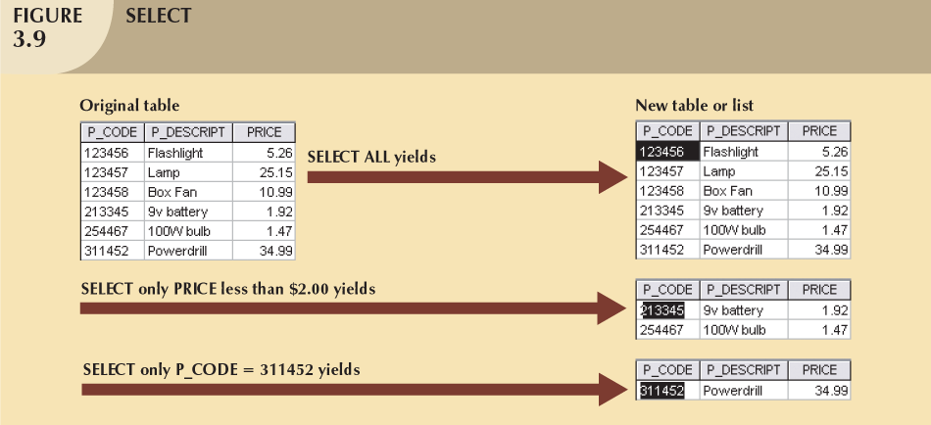
1 - Select (σ)
Unary operation σ(A)
Finds rows in a table that satisfy a given condition
  σ _{PRICE < 2}(R)
  σ _{P_CODE = 311452}(R)
Gives a horizontal subset of the table
Schema of output relation is identical to the schema of the (only) input relation.

Slide 38

Selection of tuples
Relation r
Select tuples with A=B and D > 5
σ _{A=B and D > 5} (r)

Slide 39

Select instructors with salary greater than $85000
σ _{salary > 85000}(instructor)
➔

Slide 40
Examples on Select
σ _{dept_name=“Physics”}(instructor)
σ dept_name=“Physics” ^ salary > 9000 (instructor)

Slide 41
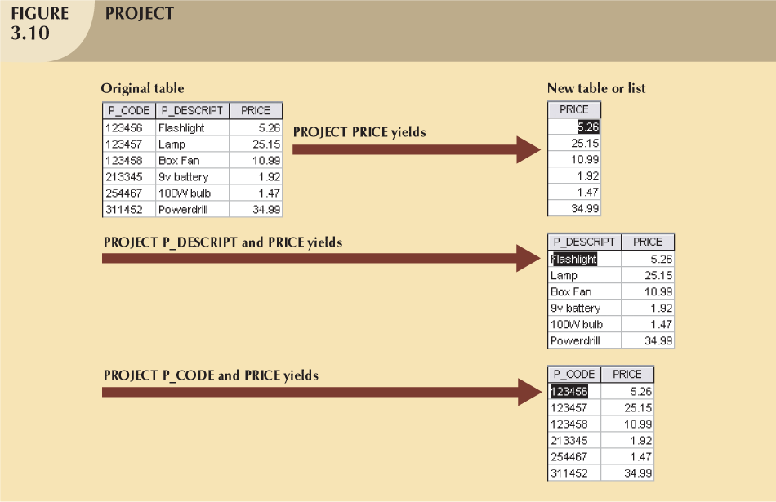
2 - Project (π)
Unary operation π (A)
Finds specific set of attributes
  π_{Price}(R)
  π_{P_CODE,PRICE}(R)
Vertical subset of the table
Schema of the output relation consists of the attributes in the projection list

Slide 42

Selection of Columns (Attributes)
Relation r:
Select A and C
  Projection
  Π _{A, C} (r)

Slide 43

Select ID and salary from table instructor
Π_{ID,salary} (instructor)
➔

Slide 44
Selection + Projection
Query: Find name and grade of students who has grade > 8.
STUDENT
ID | name | grade | age
28 | yuppy | 9 | 35
31 | lubber | 8 | 55
44 | guppy | 5 | 35
58 | rusty | 10 | 35
name | grade
yuppy | 9
rusty | 10
Input
Output
Notes:
8

Slide 45
S_name | S_grade
yuppy | 9
rusty | 10
Output
Project(name, grade)
id | name | grade | age
28 | yuppy | 9 | 35.0
58 | rusty | 10 | 35
Select (grade> 8)
id | name | grade | age
28 | yuppy | 9 | 35
31 | lubber | 8 | 55
44 | guppy | 5 | 35
58 | rusty | 10 | 35
Input

Slide 46
Example
Write the relational algebra expressions for the following query:
  Find the names of all instructors in the physics department

Slide 47
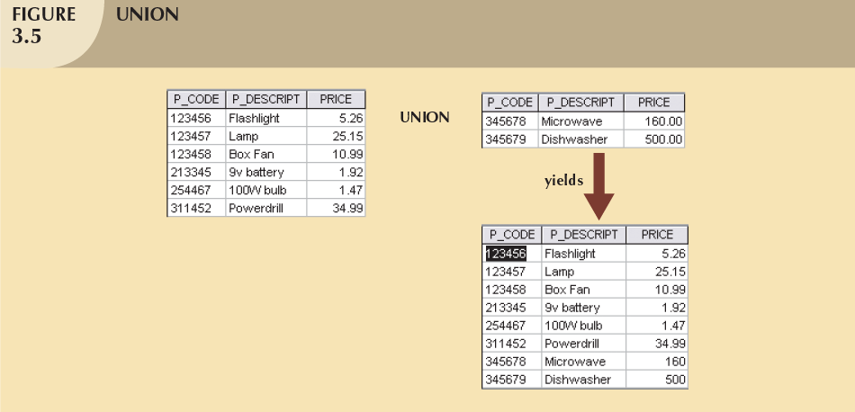
3- Union
Combines all rows from two tables
Union-compatible
  The two input tables should have the same schema
  Attributes and domains should be identical
Excludes duplicate rows

Slide 48

Union of two relations
Relations r, s:
r ∪ s:

Slide 49

Example
Given the below section table, write a query to find the set of all courses taught in Fall 2009, Spring 2010, or both.

Slide 50
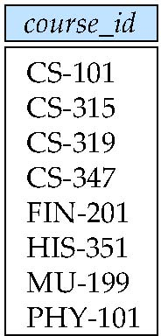
Solution
∏_{course_id} (σ _{semester=“Fall” Λ year=2009} (section))
∪
∏_{course_id} (σ _{semester=“Spring” Λ year=2010} (section))

Slide 51
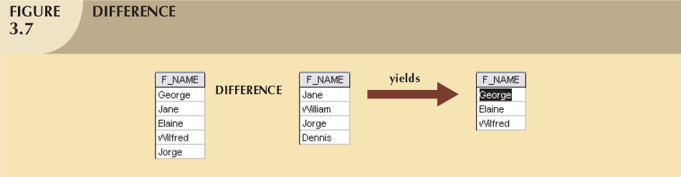
4- Set-difference
All rows in left table that are NOT in the right table
Input tables must be union-compatible

Slide 52

Set difference of two relations
Relations r, s:
r – s:

Slide 53
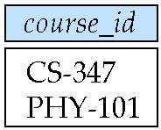
Example
Find all courses that are taught in Fall 2009 but not in Spring 2010
∏_{course_id} (σ _{semester=“Fall” Λ year=2009} (section))
-
∏_{course_id} (σ _{semester=“Spring” Λ year=2010} (section))

Slide 54
Union & Set-difference
Binary operations:
  Takes two relations as input
The input relations should be union-compatible
Schema of the output relation is the same as the input relations

Slide 55
5- Cartesian product
Allows us to combine information from any two relations
Finds all possible pairs of rows from the two tables:
  Concatenations of every possible two rows
Binary operation
If R has 6 rows, S has 3 rows:
  RXS has 18 rows
Schema of the output relation is the concatenation of the two input relations

Slide 56
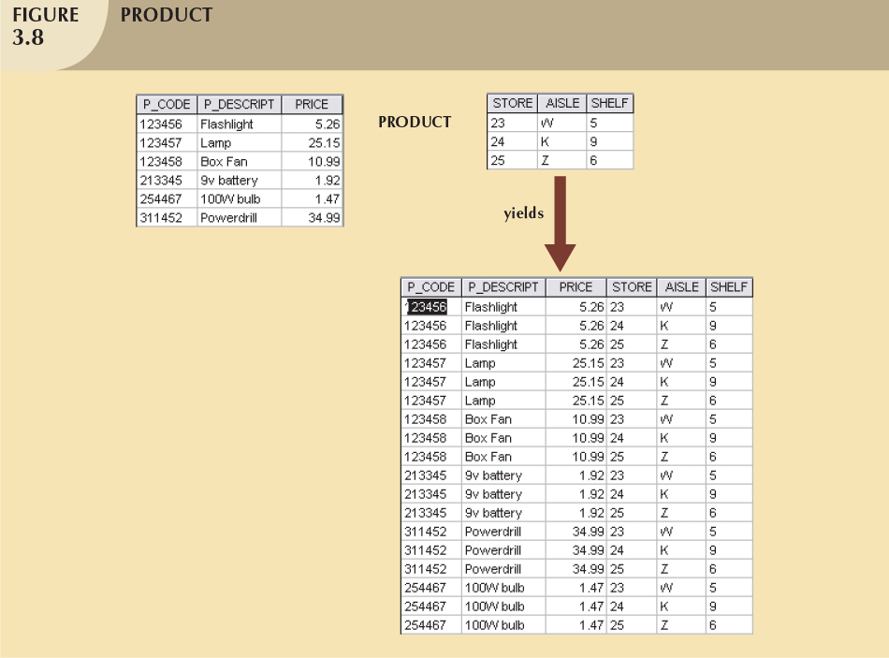

Slide 57

Cartesian Product
Relations r, s:
r x s:

Slide 58

Composition of Operations
Can build expressions using multiple operations
Example: σ_{A=C}(r x s)
r x s
σ_{A=C}(r x s)

Slide 59
Example
Find the names of all instructors in the Physics department, along with the course_id of all courses they have taught
  Solution 1:
  ∏_{instructor.ID,course_id} (σ_{dept_name=“Physics”} (σ _{instructor.ID=teaches.ID} (instructor x teaches)))
  Solution 2:
  ∏_{instructor.ID,course_id} (σ_{instructor.ID=teaches.ID} (σ _{dept_name=“Physics”} (instructor) x teaches))

Slide 60
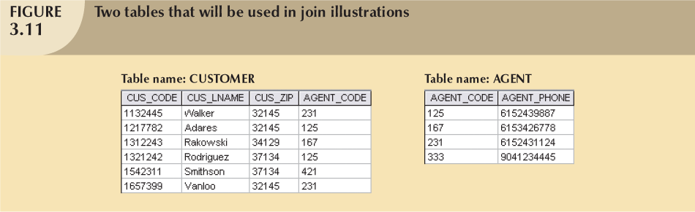
6- Join
Binary operation
Combine information from two tables
The real power behind relational databases

Slide 61
Natural Join
Natural Join:
  Links tables by selecting rows that have common values in their common attributes
Schema of the output is same as that of cross-product.
Natural Join produces fewer tuples than cross-product

Slide 62
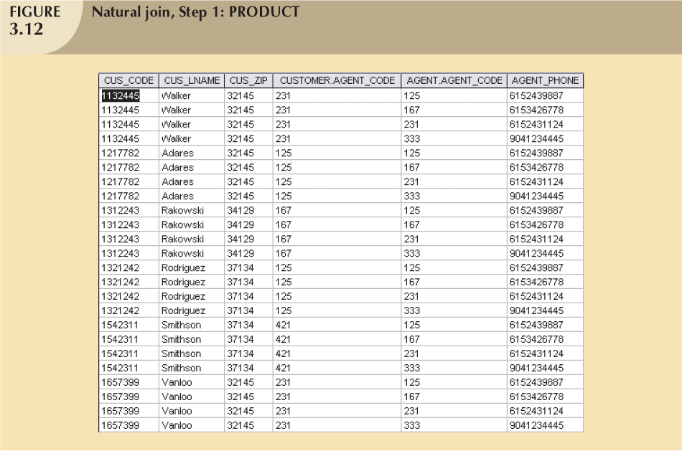
Select where
CUSTOMER.AGENT_CODE = AGENT.AGENT_CODE

Slide 63
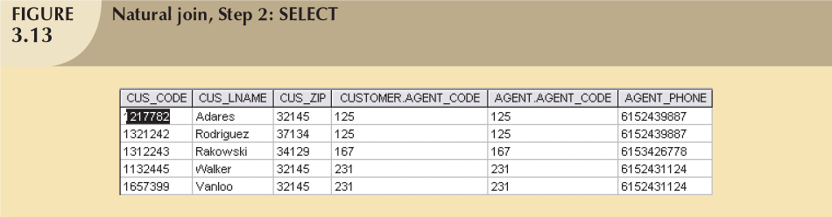
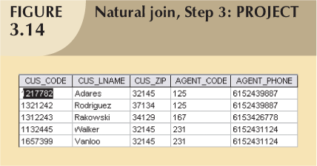

Slide 64

Natural Join Example
Relations r, s:
Natural Join
  r s

Slide 65
What is the output of the natural join of the instructor and department table
Instructor department

Slide 66

Instructor department

Slide 67
Persons
PersonID | LastName | FirstName | Address | City
1 | Hansen | Ola | Timoteivn 10 | Sandnes
2 | Svendson | Tove | Borgvn 23 | Sandnes
3 | Pettersen | Kari | Storgt 20 | Stavanger
Orders
O_Id | OrderNo | PersonID
1 | 77895 | 3
2 | 44678 | 3
3 | 22456 | 1
4 | 24562 | 1
5 | 34764 | 15
JOIN condition ( Persons.PersonID = Orders.P_ID ) OUTPUT?

Slide 68
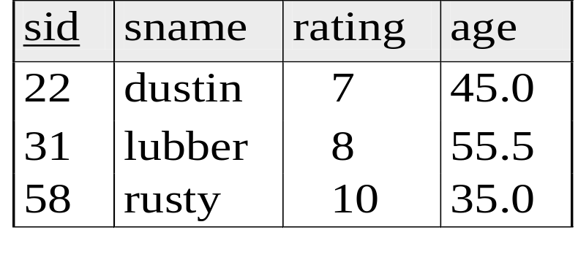
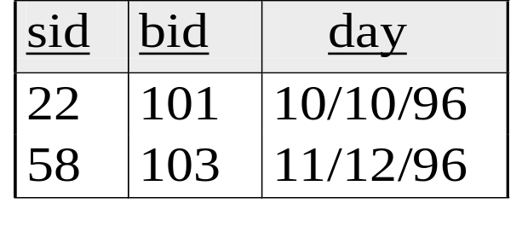
Find names of sailors who’ve reserved boat #103
sailors
reserves
boats
bid
Color
101
Red
103
Green
Notes:
16

Slide 69
sname
rusty
Solution # 1
Output
Project(sname)
sid | bid | day | sanme | rating | age
58 | 103 | 11/12/1996 | rusty | 10 | 35
Natural Join
sid | bid | day
58 | 103 | 11/12/1996
sid | sname | rating | age
22 | dustin | 7 | 45
31 | lubber | 8 | 55
58 | rusty | 10 | 35
Select (bid = 103)
sid | bid | day
22 | 101 | 10/10/1996
58 | 103 | 11/12/1996
Sailors
Reserves

Slide 70
Solution 1: Relational Algebra Expression
π_{sname}(σ_{bid=103}(reserves) sailors)

Slide 71
Find names of sailors who’ve reserved a red boat
sailors
reserves
boats
bid
Color
101
Red
103
Gree
n
Notes:
17

Slide 72
Schema Diagram for University Database

Slide 73
Reading
Chapter 2 (if you have not already)
Chapter 6 : Section 6.1 (more on relational algerbra)
Chapter 3

