Slide 1
sorting
Algorithm and programming
Shania Priccilia, S.Kom., M.Kom.

Slide 2
Learning Objectives
At the end of this session, student will be able to:
LO 2: Apply syntax and functions in C language in problem
LO 3: Construct a program using C language in problem solving
LO 5: Choose the best sorting and searching algorithm in problem solving

Slide 3
Subtopics
Bubble Sort
Selection Sort
Insertion Sort
Quick Sort
Merge Sort
Exercise

Slide 4
Sorting
definition
Sorting needs to speed up searching operation in a list.
Sorting type:
  Ascending
  Descending
Sorting algorithm, based on location of data being processed is located:
  Internal sorting → All data to be sorted are loaded to RAM
  External sorting → Sorting process using secondary storage

Slide 5
Sorting
definition
Simple:
  Bubble sort
  Selection sort
  Insertion sort
Intermediate:
  Quick Sort
  Merge Sort

Slide 6
Bubble sort
definition
Compare two neighboring values.
Compare and swap (if necessary)
Also known as exchange sort
Source Code (ascending):
void bubbleSort(int *arr, int n){
int i, j;
for(i=0; i<n-1; i++){
for(j=0; j<=n-1-i; j++){
if(arr[j] > arr[j+1]) swap(&arr[j],&arr[j+1]);
}
}
}

Slide 7
Bubble sort
algorithm
1st cycle
2nd cycle
3rd cycle

Slide 8
Bubble sort
algorithm
4th cycle
5th cycle

Slide 9
selection sort
definition
For each position in the array, find the minimum element from the remaining unsorted part and swap it with the current element.
Source Code (ascending):
void selectionSort(int *arr, int n){
int i, j, idx_smallest;
  for(i=0; i<n-1; i++){ /* n=number of data */
    idx_smallest = i;
    for(j=i+1; j<n; j++){
    if(arr[j]<arr[idx_smallest]) idx_smallest = j;
    }
    swap(&arr[i], &arr[idx_smallest]);
    }
}

Slide 10
selection sort
algorithm
1st cycle
2nd cycle
3rd cycle

Slide 11
selection sort
algorithm
4th cycle
5th cycle

Slide 12
insertion sort
definition
Insertion Sort starts with one element, then take the next element and insert it into the correct place within that sorted section, just like sorting cards in our hand.
Source Code (ascending):
void insertionSort(int arr[], int n) {
        int i, key, j;
        for (i = 1; i < n; i++) {
        key = arr[i];
        j = i - 1;
        while (j >= 0 && arr[j] > key) {
        arr[j + 1] = arr[j];
        j = j - 1;
        }
        arr[j + 1] = key;
        }
}

Slide 13
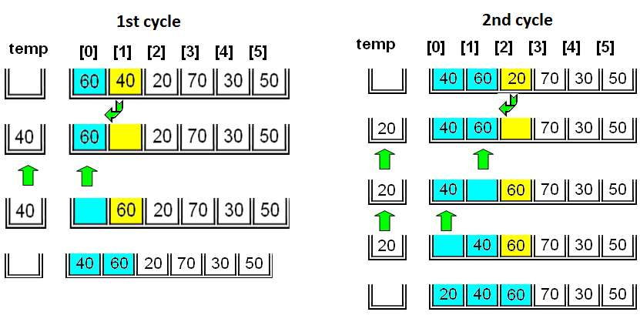
insertion sort
algorithm

Slide 14
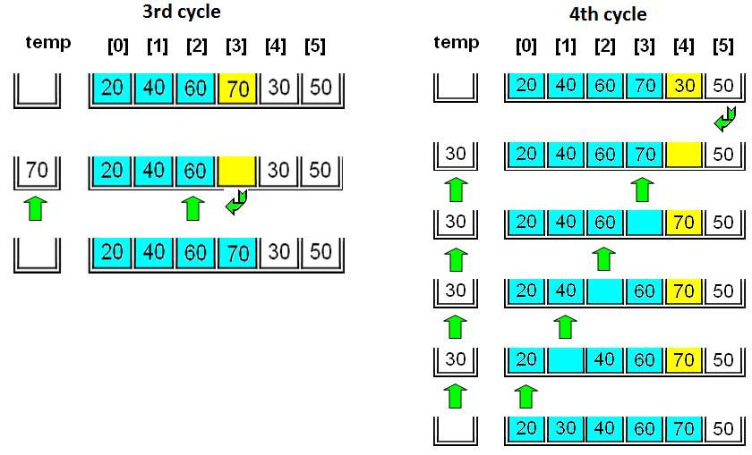
insertion sort
algorithm

Slide 15
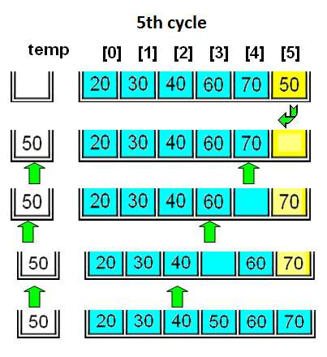
insertion sort
algorithm

Slide 16
quick sort
definition
Core idea:
  Pick a pivot, place it in its correct position, and ensure all smaller elements are on the left and larger ones on the right.
It works by:
  Choosing a pivot element from the array.
  Partitioning the array into two sub-arrays:
    Elements less than the pivot go to the left.
    Elements greater than the pivot go to the right.
  Recursively apply the same process to the left and right sub-arrays.

Slide 17
quick sort
definition
Source Code (ascending):
void quickSort(int arr[], int low, int high) {
if (low < high) {
int pi = partition(arr, low, high);
quickSort(arr, low, pi - 1);
quickSort(arr, pi + 1, high);
}
}

Slide 18
quick sort
definition
Source Code (ascending):
int partition(int arr[], int low, int high) {
int pivot = arr[low];
int i = low;
for (int j = low+1; j <= high; j++) {
if (arr[j] < pivot) {
i++;
swap(&arr[i], &arr[j]);
}
}
swap(&arr[i], &arr[low]);
return i;
}

Slide 19
quick sort
algorithm
1st partition

Slide 20
quick sort
algorithm
2nd partition (left)

Slide 21
quick sort
algorithm
3rd partition (right)

Slide 22
quick sort
algorithm
4th partition (left)
5th partition (right)

Slide 23
quick sort
algorithm
6th partition (right)

Slide 24
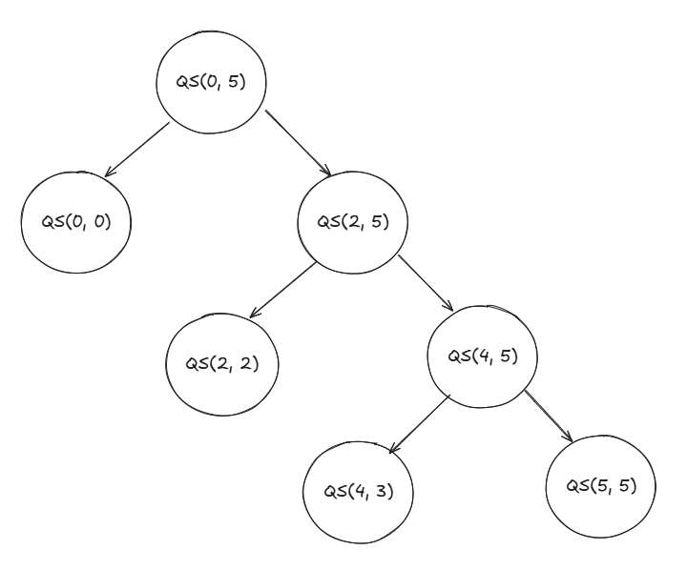
quick sort
algorithm
Quick Sort execution schema (recursive from left to right):

Slide 25
merge sort
definition
Merge Sort is also a divide-and-conquer sorting algorithm.
Core idea:
  it divides the array into halves, sorts each half recursively, and then merges the sorted halves into a single sorted array.
Divide-and-conquer is a general algorithm design paradigm
  Divide: divide the input data in two disjoint subsets
  Recur: solve the sub problems associated with subsets
  Conquer: combine the solutions for each subset into a solution

Slide 26
merge sort
definition
Source Code (ascending):
void mergeSort(int arr[], int l, int r) {
if (l < r) {
int m = (l + r) / 2;
mergeSort(arr, l, m);
mergeSort(arr, m + 1, r);
merge(arr, l, m, r);
}
}

Slide 27
merge sort
definition
Source Code (ascending):
void merge(int arr[], int l, int m, int r) {
int n1 = m - l + 1;
int n2 = r - m;
int L[n1], R[n2]; // Create temp arrays
for (int i = 0; i < n1; i++) L[i] = arr[l + i]; //Copy Data
for (int j = 0; j < n2; j++) R[j] = arr[m + 1 + j];
int i = 0, j = 0, k = l;
while (i < n1 && j < n2) { // Merge temp arrays
if (L[i] <= R[j]) arr[k++] = L[i++];
else arr[k++] = R[j++];
}
while (i < n1) arr[k++] = L[i++]; // Copy remaining elements
while (j < n2) arr[k++] = R[j++];
}

Slide 28
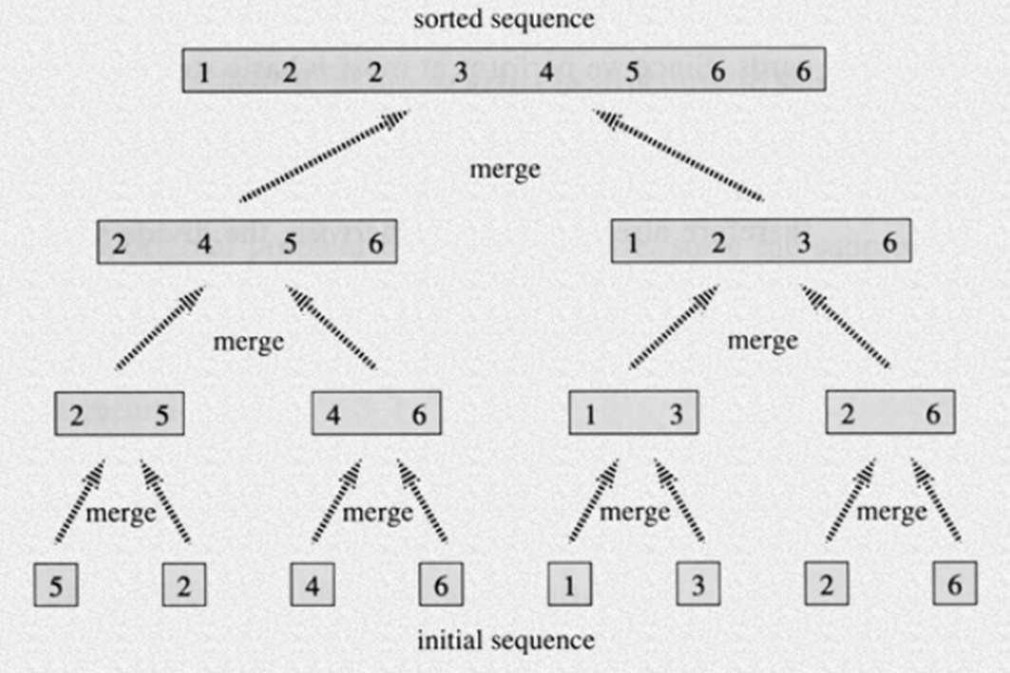
merge sort
algorithm

Slide 29
exercise
Question 1
Sort by ascending to the following data, and simulate its sequence each round using bubble, selection and insertion sort:
14 6 23 18 7 47 2 83 16 38
Question 2
By ascending, sort the question 1 data using:
Quick sort
Merge sort
Draw its execution schema

Slide 30
exercise
Question 3
Create a program/function to sort 10 data string save in an array of string (ascending), using bubble sort:
Ali Ani Tono Bayu Amir Ani Budi Tini Ucok Paijo
Question 4
Create a function/program to sort 10 data struct mhs saved in array of structure, using selection sort. Sort is based on gpa (ascending), for similar gpa then sort by name (ascending).
struct mhs{
  int nim;
  float gpa;
  char name[20];
};

Slide 31
SUMMARY
Sorting type:
  Ascending
  Descending
Simple sorting algorithm:
  Bubble sort
  Selection sort
  Insertion sort
Intermediate sorting algorithm:
  Quick Sort
  Merge Sort

Slide 32
REFRENCES
Paul Deitel & Harvey Deitel. (2021). C how to program. 09. Pearson Education. New York. ISBN: 9780137398393.
Sorting Algorithms: http://www.youtube.com/watch?v=INHF_5RIxTE
Sorting visualization: https://visualgo.net/en/sorting

