Slide 1
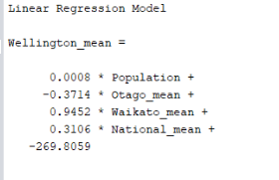
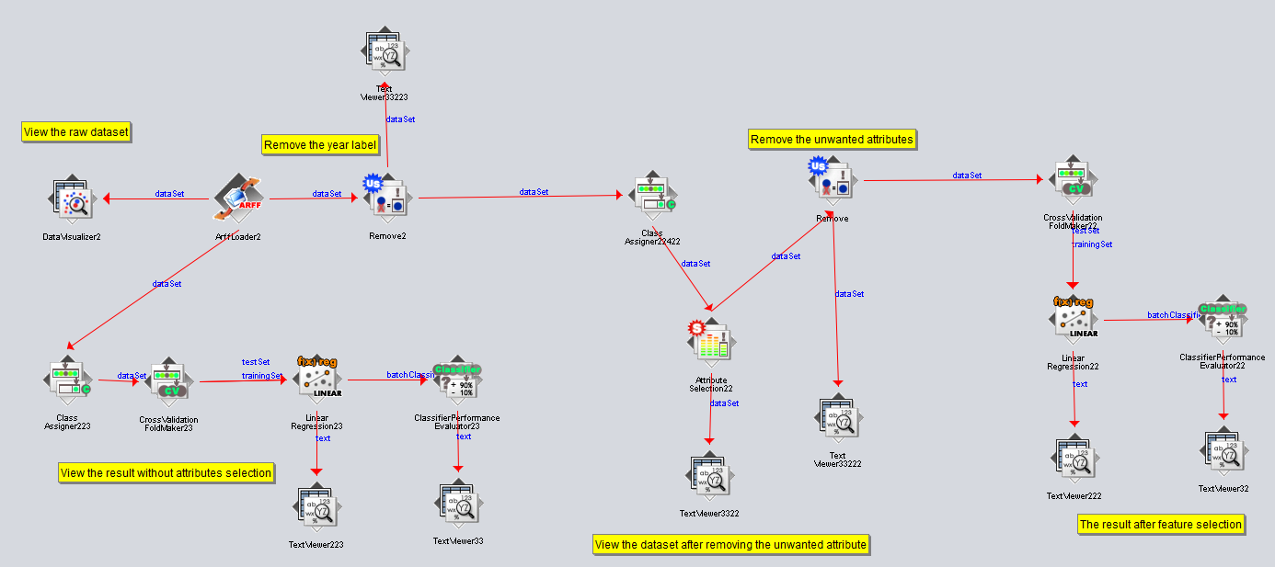
Rental Cost Of Wellington
Result:
Background:
As a citizen in Wellington, it is important to understand the rental cost and getting ahead of it. To help you do exactly that we explore the relationship with several factors to make predictions of the rent trends. The population of Wellington, GDP of New Zealand, active bonds are interesting factors which would affect the rental cost of Wellington.
Rental cost from 1993 to 2018:
As the graph shown above, we can clearly see the rental cost of Wellington keep rising from year 1993 to year 2018. But the increasement of cost is slightly different through these years, so if we can work out a formula which can predict the rental cost of next years will be very helpful to decide where to live in.
The formula was found is :
From the graph above, it illustrates these factors actually affect the rental cost of Wellington, so in this research, we aim to explore a linear relationship between the rental cost and these factors.
Methodology:
As the graph shown below, it shows the pipeline which used in this research. It can import data and pre-processing the data and find a linear formula by a technique called linear regression.
Conclusion:
The population is the most correlate data to the rental cost of Wellington,. But the mean rental cost of Waikato is the most weighted factors.
From the graph compares the model and real data, it can show the formula we get has a high quality.

