Slide 1
Tutorial 6: Scaffolding and motif grafting
Clara T. Schoeder, Rosetta Workshop, November 8th 2018
Vanderbilt University

Slide 2
Content
Introduction
Scaffolding
Overview
Setting up a scaffold database
Side chain grafting
Backbone grafting
Selection of designs
Rosetta Remodel
FunFoldDes (Fold From Loops)

Slide 3
Introduction Why Motif grafting and scaffold design?
Transplantation of the functional sites onto another protein
Immunological applications (e.g. immunogen and vaccine design)
Useful when targeting a secondary epitope
Flexible peptide can be embedded into a stable protein that will reduce the entropic penalty of binding
Can create new favorable interactions with the target

Slide 4
Introduction Grafting methods in rosetta
Rosetta method | Name | Function
Rosetta_scripts | Side chain grafting | Scaffold design
Rosetta_scripts | Backbone grafting | Scaffold design
Rosetta_scripts | FunFoldDes (Fold from loops) | Loop/Scaffold design
Rosetta application | Rosetta remodel | Scaffold design / backbone design

Slide 5
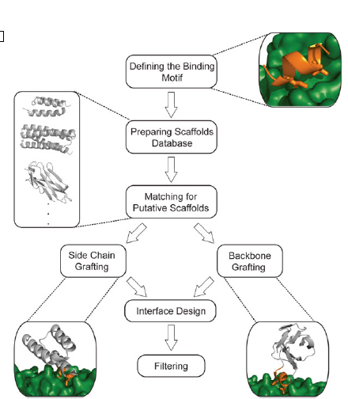
Side chain and backbone grafting – an overview
Silva, D., Correia, B.E., and Procko, E. (2016) Motif-driven Design of Protein-Protein Interactions. Methods
Mol. Biol. 1414:285-304

Slide 6
Requirements for Preparing a Scaffold Database
High-resolution diffraction data ( < 2.5 Å (better < 2.0 Å))
Protein has been reported to be expressed in E. coli
Single protein chain as an asymmetric unit
No bound ligand or modified residues
Scaffold proteins must be energy minimized using Rosetta
→ A motif-focused library may be more useful, e.g. only including helical scaffolds for a helical motif.

Slide 7
Matching putative scaffolds with Side Chain Grafting
Choose motif and scaffold backbones that superimpose with very low RMSD (<0.5 Å)
Transplant side chains from functional motif onto scaffold
Design surrounding residues on the scaffold surface
Pros | Cons
Minimal number of changes to the scaffold → Increase chances of correctly folded designs | Often motif and scaffold to the scaffold structures are too dissimilar, limiting availability of scaffolds

Slide 8
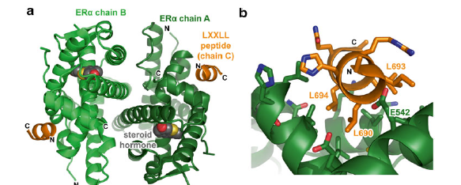
Matching putative scaffolds with Side Chain Grafting
<MotifGraft name=”motif_grafting” context_structure=”context.pdb”
motif_structure=”motif.pdb” RMSD_tolerance=”0.3” NC_points_RMSD_tolerance=”0.5”
clash_score_cutoff=”5” clash_test_residue=”GLY” hotspots=”3:7” combinatory_fragment_size_delta=”2:2” full_motif_bb_alignment=”1”
graft_only_hotspots_by_replacement=”1”
revert_graft_to_native_sequence=”1”/>
Silva, D., Correia, B.E., and Procko, E. (2016) Motif-driven Design of Protein-Protein Interactions. Methods Mol. Biol. 1414:285-304

Slide 9
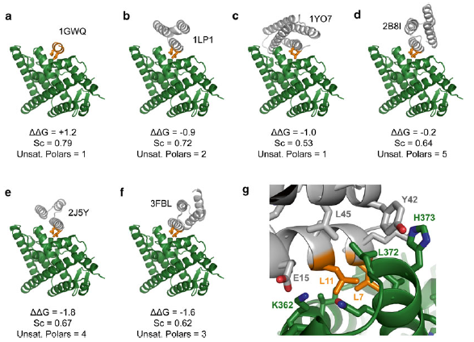
Matching putative scaffolds with Side Chain Grafting
Silva, D., Correia, B.E., and Procko, E. (2016) Motif-driven Design of Protein-Protein Interactions. Methods Mol. Biol. 1414:285-304

Slide 10
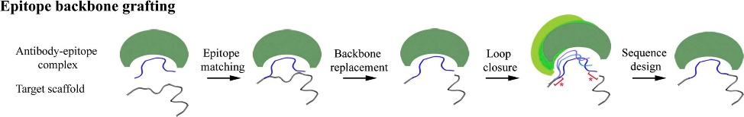
Backbone Grafting - Overview
Align to target scaffold
Remove native scaffold backbone
Model new epitope between termini
Rigid-body orientation of new epitope and antibody relative to scaffold
Azoitei, M.L., Ban, Y.A., Julien, J., Bryson, S., Schroeter, A., Kalyuzhniy, O., Porter, J.R., Adachi, Y., Baker, D., Pai, E.F., and Schief, W.R. (2012) Computational Design of High-Affinity Epitope Scaffolds by Backbone Grafting of a Linear Epitope. J. Mol. Biol. 415:175-192

Slide 11
Backbone Grafting
Search for segments of scaffolds that align closely to the termini of the motif (both N- and C- terminal sides)
The scaffold segment between these alignment points is replaced by the motif
Pros | Cons
Extremely versatile – a loop in the scaffold can be replaced by a different secondary structure or even with a different amino acid length | Can disrupt the overall fold in the scaffold
Can be used for discontinuous epitopes | Redesign of the hydrophobic core and interface introduces unfavorable mutations to the scaffold
 | Careful filtering of designs

Slide 12
Backbone Grafting XML
<MotifGraft name=”motif_grafting” context_structure=”context.pdb”
motif_structure=”motif.pdb” RMSD_tolerance=”1.0”
NC_points_RMSD_tolerance=”1.0” clash_score_cutoff=”5”
clash_test_residue=”GLY” hotspots=”3:7” combinatory_fragment_size_delta=”2:2”
max_fragment_replacement_size_delta=”-8:8” full_motif_bb_alignment=”0”
graft_only_hotspots_by_replacement=”0”/>
<PackRotamersMover name=”design_core”
task_operations=”hotspot_repack, pido_far, core”/>
<PackRotamersMover name=”design_boundary”
task_operations=”hotspot_repack, pido_med, core_and_boundary”/>

Slide 13
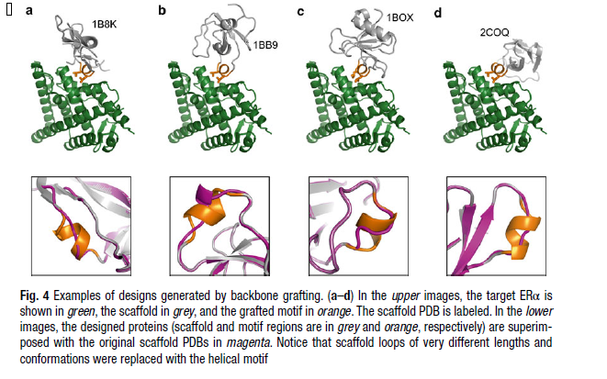
Backbone Grafting
Silva, D., Correia, B.E., and Procko, E. (2016) Motif-driven Design of Protein-Protein Interactions. Methods Mol. Biol. 1414:285-304

Slide 14
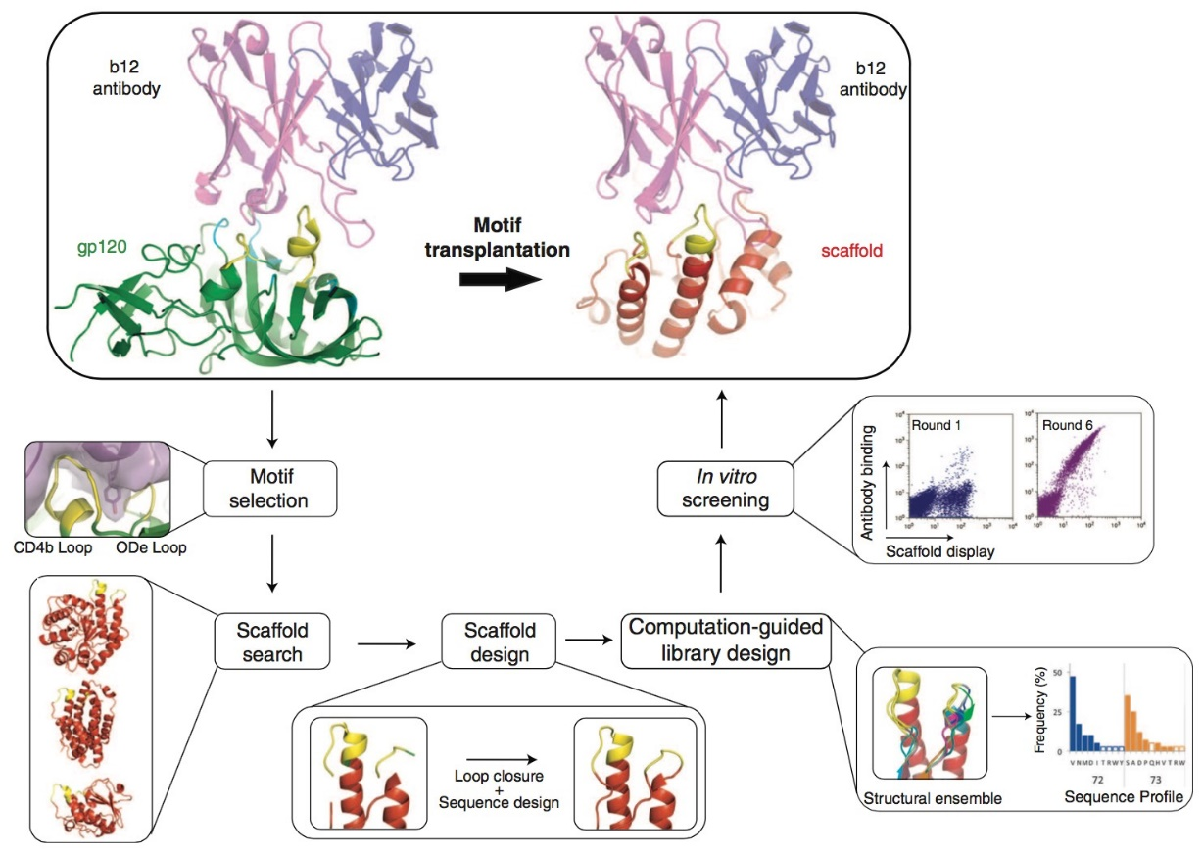
Backbone Grafting
Azoitei, M.L., Correia, B.E., Ban, Y.E., Carrico, C., Kalyuzhiy, O., Chen, L., Schroeter, A., Huang, P.S., McLellan, J.S., Kwong, P.D., Baker, D., Strong, R.K., Schief, W.R. (2011) Computation-guided backbone grafting of a discontinuous motif onto a protein scaffold. Science. 334(6054):373-6. doi: 10.1126/science.1209368

Slide 15
Selection of Designs and Optimization
Results to keep:
Favorable binding energy (ΔΔG)
High shape complementarity
Low number of buried unsatisfied H-bonding atoms
Results to cull:
Buried charged residues
Under-packed interfaces dominated by Ala residues

Slide 16
Selection of Designs and Optimization
Insert as few mutations as possible because probability of a designed sequence to properly fold is inversely correlated with the number of mutations imposed on the scaffold during the design process
Check if the design is “stable” by comparing the score vs. RMSD to the native scaffold
You may have to manually adjust designs

Slide 17
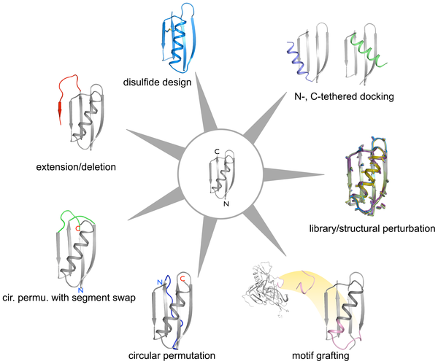
Rosetta Remodel
Huang, P.H., Ban, Y.A., Richter, F., Andre, I., Vernon, R., Schief, W.R., and Baker, D. (2011) RosettaRemodel: A generalized framework for flexible backbone protein design. PLoS One 6(8):e24109. doi:10.1371/journal.pone.0024109.g001

Slide 18
The blueprint file
Rosetta Remodel has 3 required inputs: the input PDB(s) – and also specify the chain to be remodeled, database location, and blueprint file.
1 V .
2 L .
3 E .
4 I .
5 L L PIKAA L
0 x I NATAA
0 x I NATAA
0 x I NATAA
0 x I NATAA
6 N L PIKAA L
7 G .
Example blueprint file for motif insertion

Slide 19
Motif grafting v. motif design
Motif grafting | Motif design
Requires two structures, the motif and scaffold | Requires one structure
Can be used for discontinuous epitopes | Redesign of the hydrophobic core and interface introduces unfavorable mutations to the scaffold
 | Careful filtering of designs

Slide 20
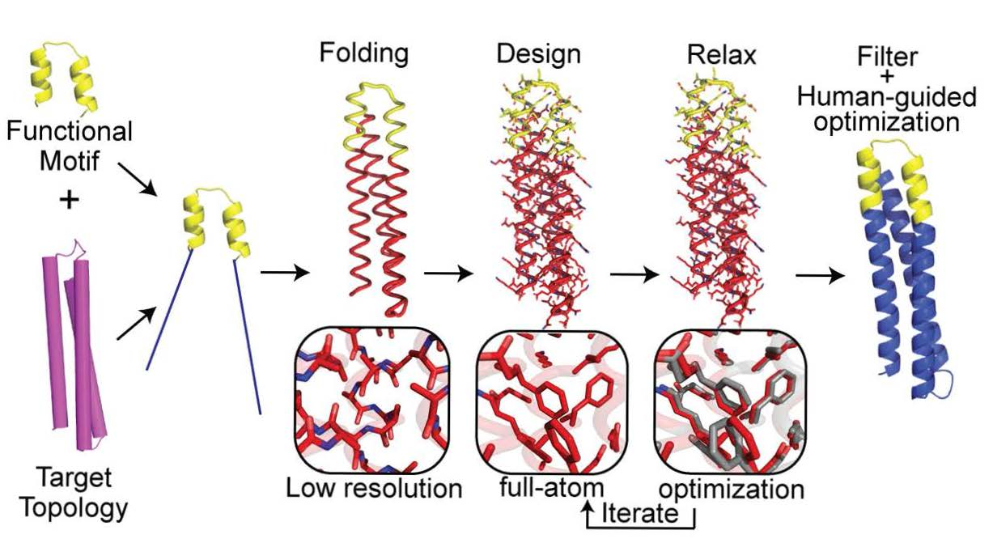
FunFolDes (FoldFromLoops)
Improvements in design capability
Design motif scaffolds in the presence of a binder/ligand.
Multi-segment or discontinous motif can be put into a scaffold using a multi-loop file.
Motif does not have to be the same length as the segment being replaced.
Can also be used in presence of a binder
Correia, B.E., Bates, J.T., Loomis, R.J., Baneyx, G., Carrico, C., Jardine, J.G., Rupert, P., Correnti, C, Kalyuzhnly, O., Vittal, V., Connell, M.J., Stevens, E., Schroeter, A., Chen, M., Macpherson, S., Serra, A.M, Adachi, Y., Holmes, M.A. Li, Y., Klevit, R.E., Graham, B.S., Wyatt, R.T., Baker, D., Strong, R.K., Crowe, J.E. Jr., Johnson, P.R., Schief, W.R. (2014) Proof of principle for epitope-focused vaccine design. Nature. Mar 13;507(7491):201-6. doi: 10.1038/nature12966.

Slide 21
FunFolDes (FoldFromLoops)
Pros | Cons
Extremely useful for loops | Can disrupt the overall fold in the scaffold
Can be used for discontinuous epitopes | Redesign of the hydrophobic core and interface introduces unfavorable mutations to the scaffold
 | Careful filtering of designs

Slide 22
Questions?
Contact: clara.t.schoeder@vanderbilt.edu

