Slide 1
DS4001:Databases Final Project
Group 03:
DB System for Sports Leagues
Students: Ernest Jorba Calafell, Lucca Coutinho Heineck and Vinicius Eduardo Beuther

Slide 2
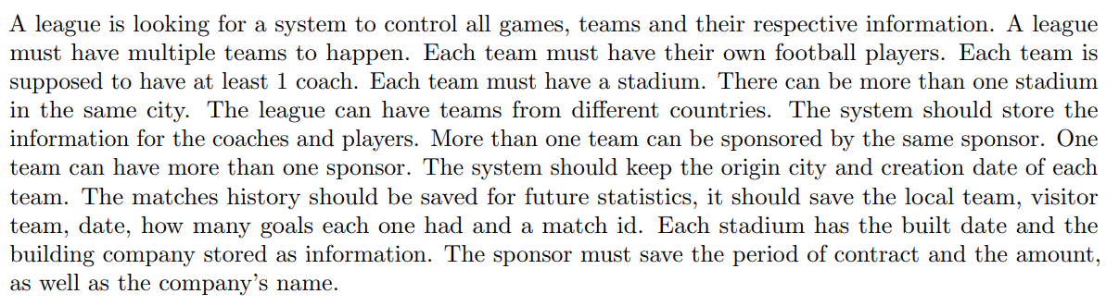
Domain Description
Handle leagues
Matches
Players information
Locations
Historical Data
Contracts

Slide 3
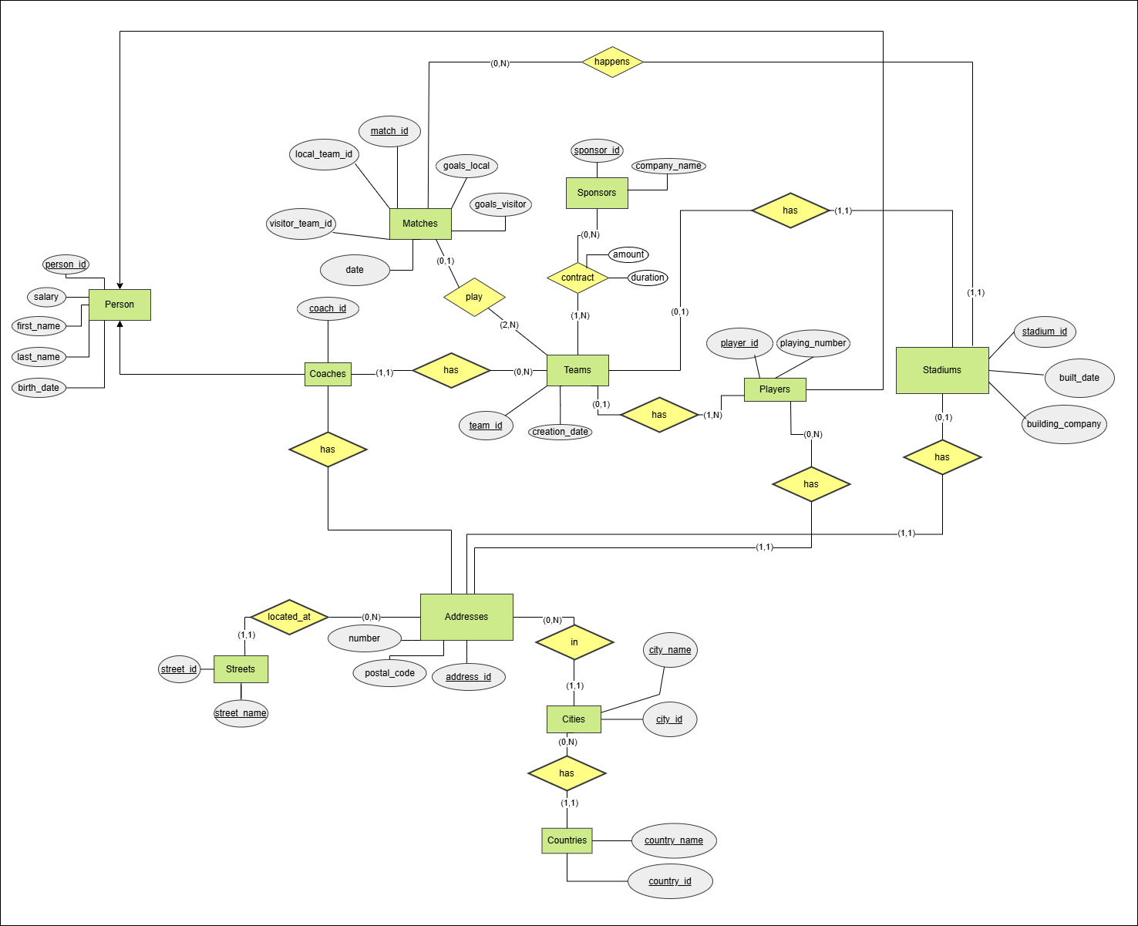
Entity-Relationship Diagram

Slide 4
Thank you for your attention.
Please let us know if you have any questions!

