Slide 1

ML Constructive - Thesis
Bloise / Umberto Mele

Slide 2
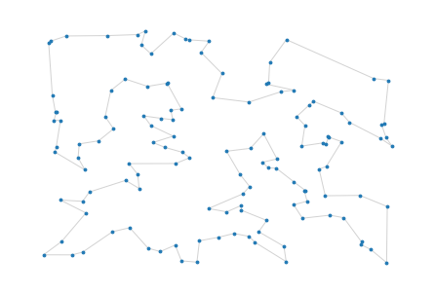
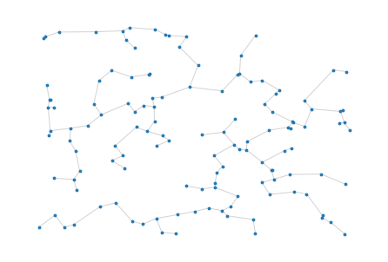
Optimal Tour and Minimum Spanning Tree

Slide 3
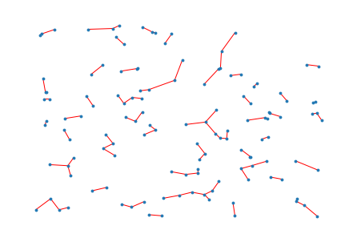
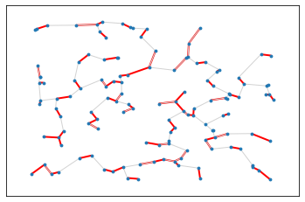
Shortest local edges & intersection SL Edges (red) ∩ MST Edges (yellow)

Slide 4
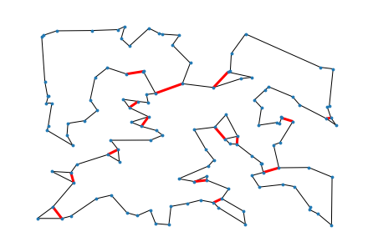
Optimum Tour & error nodes (as ∩(mst&local.min))

