Slide 1
Identifying the best location to open a coffee shop in Toronto

Slide 2


Hello!
I am Jayden Smith
I am here because I love to give presentations.
You can find me at:
@username

Slide 3
1.
Transition headline
Let’s start with the first set of slides

Slide 4
Quotations are commonly printed as a means of inspiration and to invoke philosophical thoughts from the reader.

Slide 5
Business Problem
Choosing a place to open a coffee shop takes many factors into consideration.
The neighborhood should have venues commonly visited in the morning;
There shouldn’t be heavy competition
Location Data can be used to identify the neighborhood that best fits these needs.

Slide 6
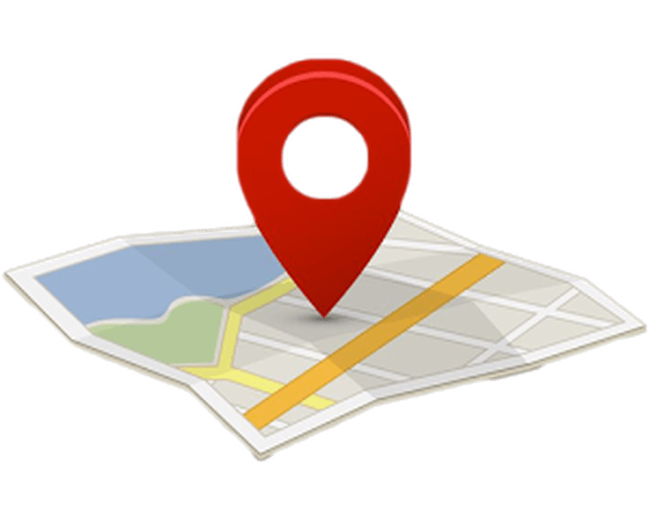
What is Location Data?
Full address
Category
Geospatial coordinates
Location Data is used to describe places and venues, containing many of the place’s attributes

Slide 7
Data acquisition and cleaning
Canada’s neighborhoods’ postal code and borough scraped from https://en.wikipedia.org/w/index.php?title=List_of_postal_codes_of_Canada:_M&direction=prev&oldid=1012023397.
Data from venues around the neighborhoods acquired from Foursquare API.
Variable ‘Postal Code’ was standardized in both datasets.
The final dataset was reduced to only Toronto neighborhoods.

Slide 8



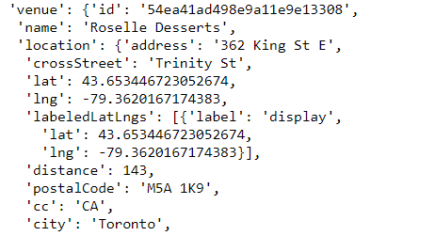


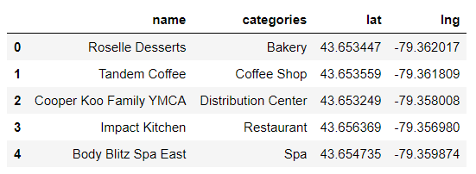
Accessing the Foursquare API
The program sent a GET request to the Foursquare API and got a JSON file as a response
The JSON format was converted to a dataframe to make visualization easier
GET
JSON

Slide 9
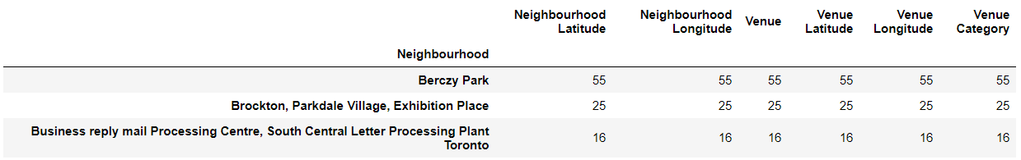
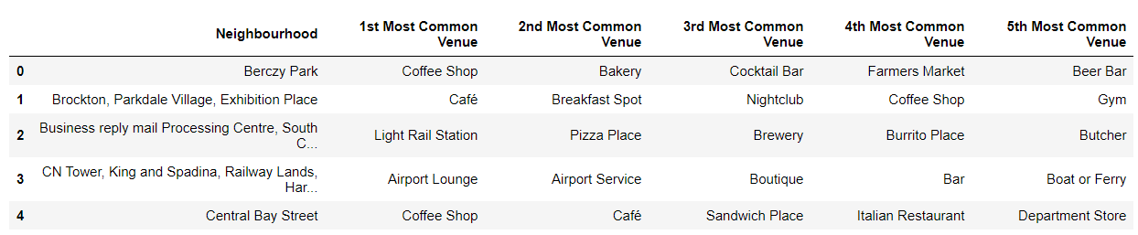
Exploring Toronto neighborhoods
The data acquired from the venues was merged with the previously obtained data from the neighborhoods in Toronto
The dataframe generated was grouped in a way to visualize the most common venues to each neighborhood

Slide 10
Clustering the neighborhoods
For the purpose of grouping neighborhoods based on their similarities and differences, a clustering algorithm named K-Means was selected as the best choice.

Slide 11
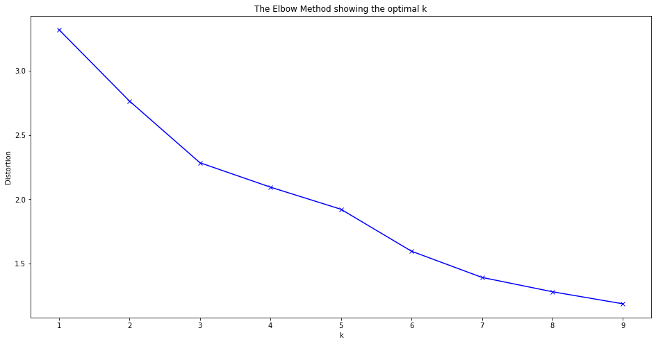
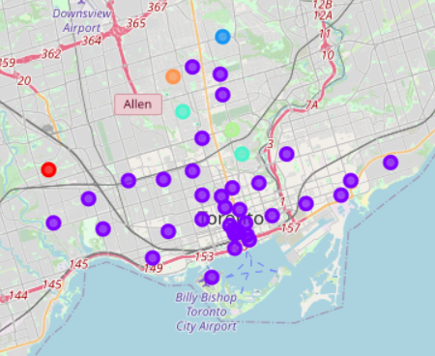
Using the elbow method, 6 was elected the optimal number of clusters to the algorithm.
A Folium Map was generated to visualize those clusters organized by K-Means.

Slide 12
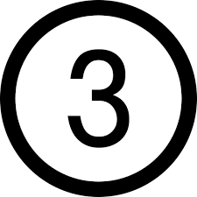
Smaller clusters, if possible, were assigned to larger ones manually, as there were some similarities in their most common venues that the algorithm did not recognize.
Cluster 2
Cluster 3
Final Cluster 2
Trails
Parks
Food Venues
Yoga Studios
Cluster 4

Slide 13
Most common venues for the final clusters
Final Cluster 0
Garden
Diner
Event Space
Final Cluster 1
Coffee shops
Restaurants
Final Cluster 2
Parks
Trails
Playgrounds
Yoga Studios
Morning entertainment

Slide 14
Conclusion
Final Cluster 0 had more evening and night venues.
Final Cluster 1 already had too many coffee shops, which means more competition.
Final Cluster 2 consisted mainly of morning entertainment venues , which makes it more likely to draw people to a coffee shop. Also, there isn’t much competition.
Therefore, the neighbourhoods in Final Cluster 2 - Lawrence Park; Forest Hill North & West, Forest Hill Road Park; Moore Park, Summerhill East and Rosedale - are the best places to open a coffee shop.

