Slide 1
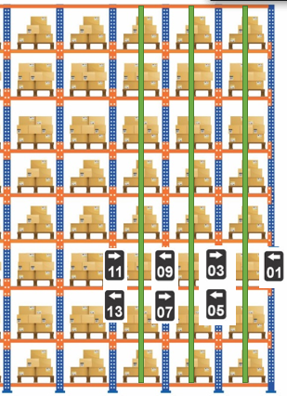



}
Nivel 8

Slide 2
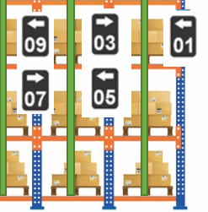



}
APT 3-2-1
APT 3-2-1
AND 2
Nivel 1
APT 3-2-1
APT 3-2-1
AND 1

Slide 3
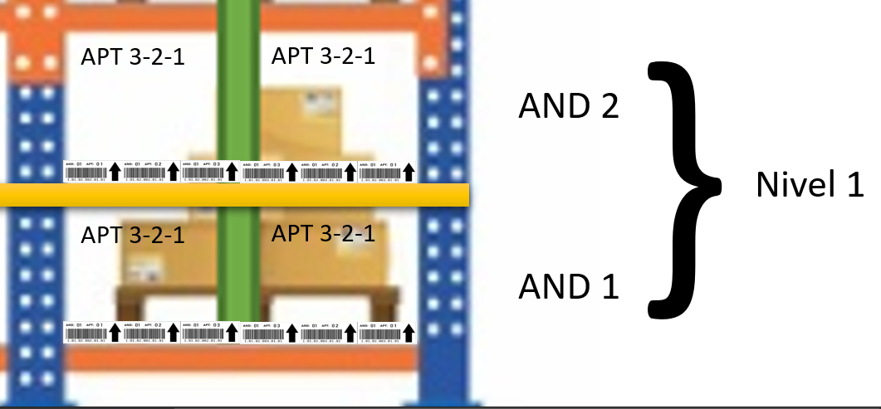

Slide 4
