Slide 1

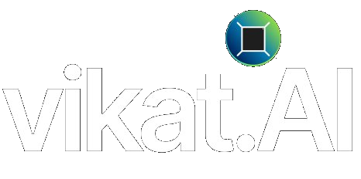
THE AGENT SEMANTICS COMPANY
PERSONALIZED AND PREEMPTIVE CYBERSEC AND SRE
Powered by Semantic Context; to give enterprises the best-in-class personalized and preemptive Sec Ops and SRE outcomes
Early Preempting not faster resolution | Personalized Solution not generic product | Pay for Outcomes not licenses
Solutions : SecSemantic for SecOps | DevSemantic for SRE | ProSemantic for Forward Deployed Services
COMPANY AND OFFERING OVERVIEW · 2026
vikat.ai · info@vikat.ai
© 2026 Vikat.AI. All rights reserved. Vikat, SecSemantic, DevSemantic, ProSemantic, VShield, VCommand, VSentinel, and VInsight are trademarks of Vikat.AI. Confidential.

Slide 2

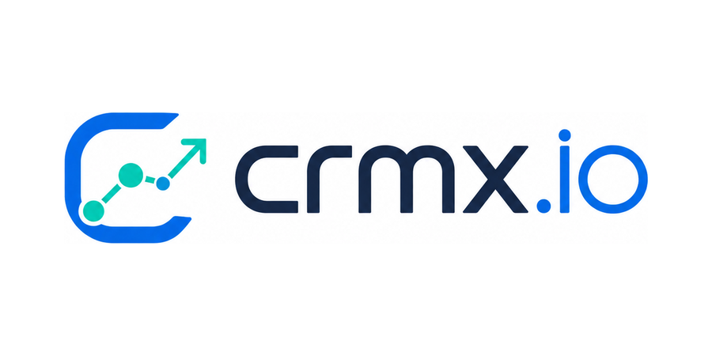
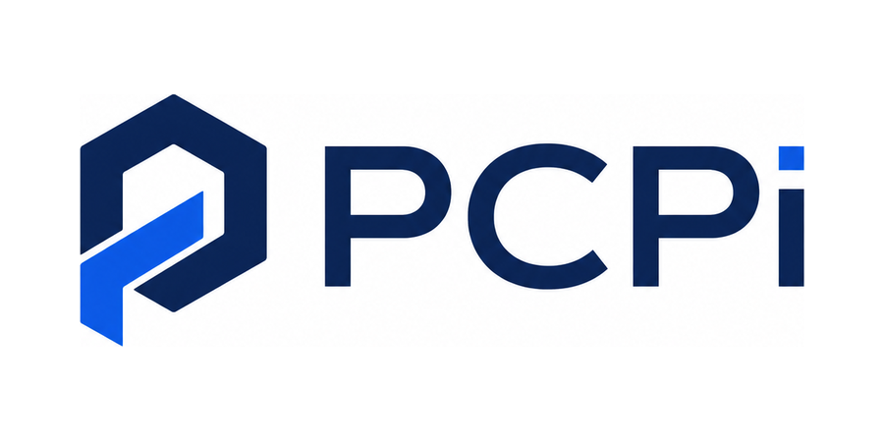
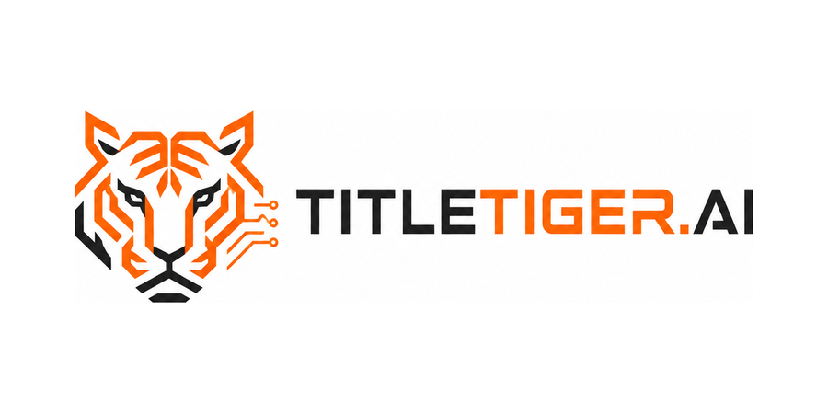
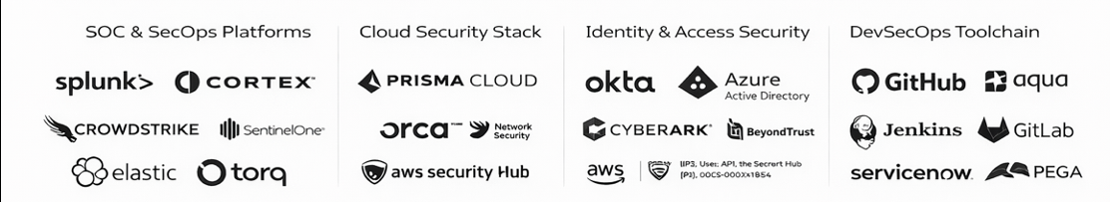
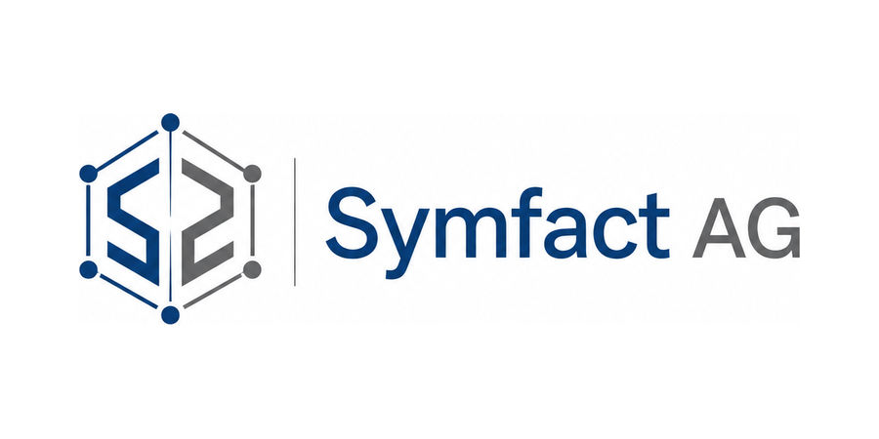
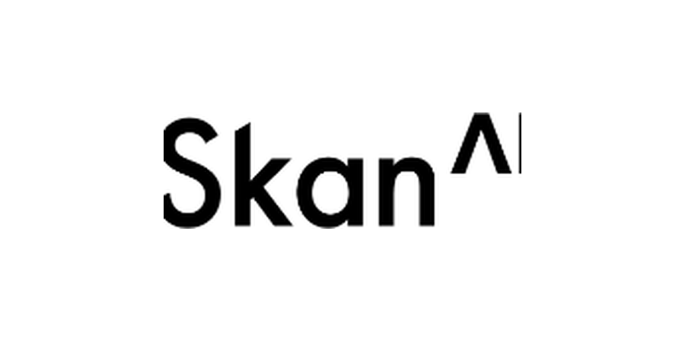

WHO WE ARE
Vikat at a glance.
The team, certifications, and customers behind personalized and preemptive operations.
PERSONALIZED AND PREEMPTIVE - CyberSec and SRE solution, delivered on committed outcomes
80+
100+
4
50+
5
Certified Agentic CyberSec & SRE consultants
Years combined security experience, IIT alumni leadership
Patents pending on the Semantic Context Plane and the Semantic Context Loop
Integrations across enterprise security toolsets
Industry certifications: SOC 2 Type 2, ISO 27001, HIPAA, GDPR, ISO 9001
TRUSTED BY
50+ INTEGRATIONS ACROSS YOUR TOOLSETS
We layer alongside EDR, SIEM, IAM, SCM, cloud, and DevSecOps toolchains. No replacement required.
HEADQUARTERS AND LOCATIOS
San Jose, California · HQ
Dallas, Texas · Ontario, Canada · Hyderabad, India
© 2026 Vikat.AI. All rights reserved. Vikat, SecSemantic, DevSemantic, ProSemantic, VShield, VCommand, VSentinel, and VInsight are trademarks of Vikat.AI. Confidential.
VIKAT CYBERSEC

Slide 3
WHAT WE DO · SEMANTIC CONTEXT
Personalized to your business. Preemptive by design.
Attacks and outages are shaped by “your” business operations. Generic tools don’t know your business ops. Vikat enriches your telemetry with Semantic Context so agents predict and preempt security events and IT incidents, and we commit to preemptive KPIs, not resolution KPIs.
YOUR SYSTEMS – EVENTS & INCIDENTS
SEMANTIC CONTEXT GRAPH
PERSONALIZED SEC & SRE OPS
Alerts, events, logs, and tickets from the systems you already run: SIEM, EDR, cloud, identity, repos, pipelines.
Every alert and event is correlated and enriched in the Semantic Context Graph: crown jewels, dependencies, ownership, business processes, blast radius.
Ranked by consequence to your business, so agents predict and preempt attacks and incidents before impact.
SecSemantic
DevSemantic
AGENTIC CYBERSEC · PERSONALIZED AND PREEMPTIVE
AGENTIC SRE OPS · PERSONALIZED AND PREEMPTIVE
Every alert ranked by business consequence, not generic severity. Threats stopped before they become incidents.
Incidents predicted and resolved before they page a human. Changes ship with blast radius known.
MTTK Credentials dead before first use MTTC Contained in minutes
MTTP Predicted before the page RPR Same cause never repeats
THE SEMANTIC LOOP
Named Vikat forward deployed engineers work inside your team and feed every incident, change, and decision back into the graph.
Your context never goes stale, so predictions get earlier every month.
© 2026 Vikat.AI. All rights reserved. Vikat, SecSemantic, DevSemantic, ProSemantic, VShield, VCommand, VSentinel, and VInsight are trademarks of Vikat.AI. Confidential.
VIKAT CYBERSEC

Slide 4
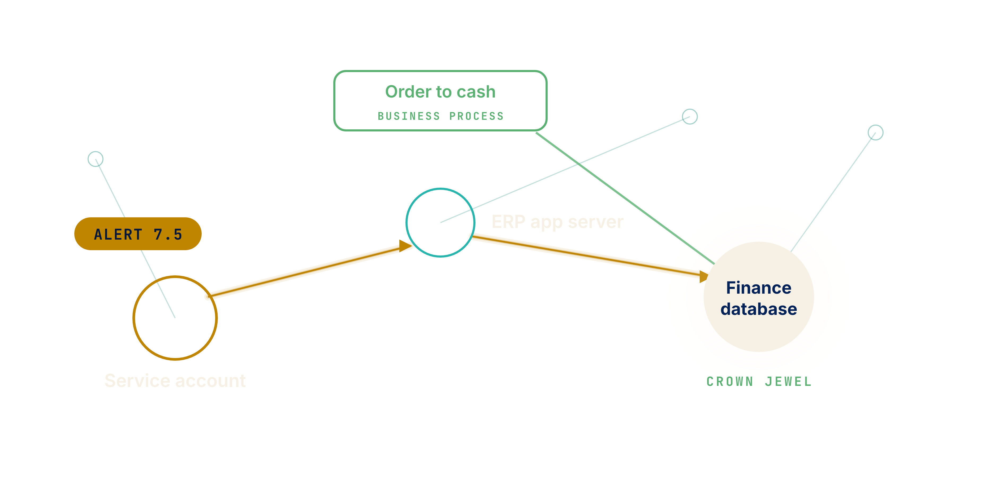
AGENTIC CYBERSEC · SECSEMANTIC
Stop attacks before they become incidents.
SecSemantic grounds security agents in the Security Context Plane.
Attacks are personalized to your business. Generic defense is not. SecSemantic grounds agents in your context: what matters most, what it costs, and what they may touch.
THE 90 DAY KPI SCORECARD
Mean time to contain
Minutes, not the 42 day sector average
Stolen credential kill time
Revoked before first use
Coverage
100% of domains and LLM calls governed
Alert priority
Ranked by business consequence
Runs private in your network. A human approves every action. Full audit trail.
A 7.5 alert, two hops from order to cash. First priority, contained before it lands.
© 2026 Vikat.AI. All rights reserved. Vikat, SecSemantic, DevSemantic, ProSemantic, VShield, VCommand, VSentinel, and VInsight are trademarks of Vikat.AI. Confidential.
VIKAT SECSEMANTIC

Slide 5
PERSONALIZED AND PREEMPTIVE AI-NATIVE SECURITY OPS SOLUTION
Security operations, personalized to your business.
Vikat analyzes your company's threat landscape, live telemetry, detection rules, and SOC workflows to identify real threats before they become incidents.
YOUR EXISTING SECURITY STACK
SIEM
Endpoint
Cloud
Identity
Threat intel
Data stack
Splunk · Sentinel
QRadar · Elastic
CrowdStrike · SentinelOne
Defender
AWS · Google Cloud
Accounts · Access
Privilege
Feeds · Advisories
Warehouses · Pipelines
TELEMETRY IN
APPROVED ACTIONS OUT
ATT&CK Matrix
Attack Paths
Investigate
SecSemantic
AI-NATIVE SECURITY OPS
Response
Business Context
Ask
Private in your network
Human approval on every action
Forward Deployed Engineers keep it current
THE SECURITY CONTEXT PLANE
COST
EXPOSURE
PRIORITY
AGENT REACH
What does this incident cost the business?
Which assets are most exposed right now?
Which alert matters most this week?
What is this AI agent allowed to touch?
© 2026 Vikat.AI. All rights reserved. Vikat, SecSemantic, DevSemantic, ProSemantic, VShield, VCommand, VSentinel, and VInsight are trademarks of Vikat.AI. Confidential.

Slide 6
THE IMPACT
Preempt security events before they escalate.
Aggregate impact modeled across five mid market U.S. companies.
Across five mid market enterprises, roughly 70,000 security events are analyzed each month, and about 700 actionable events are proactively preempted or resolved. That is approximately 8,400 security events a year that never escalate.
EVERY MONTH, ACROSS 5 COMPANIES AND 5,750 EMPLOYEES
70,000
security events analyzed
5,050
Security approach
Automated detection, correlation, prioritization, and remediation.
requiring investigation
700
preempted or resolved
Operational impact
Reduced analyst workload and alert fatigue.
Security impact
Faster response and earlier containment of actionable threats.
8,400
Business outcome
Scalable, proactive security operations with reduced risk of escalation.
security events preempted or resolved
Data note: illustrative modeled estimates. Not actual customer production results unless independently validated.
© 2026 Vikat.AI. All rights reserved. Vikat, SecSemantic, DevSemantic, ProSemantic, VShield, VCommand, VSentinel, and VInsight are trademarks of Vikat.AI. Confidential.
VIKAT CYBERSEC

Slide 7
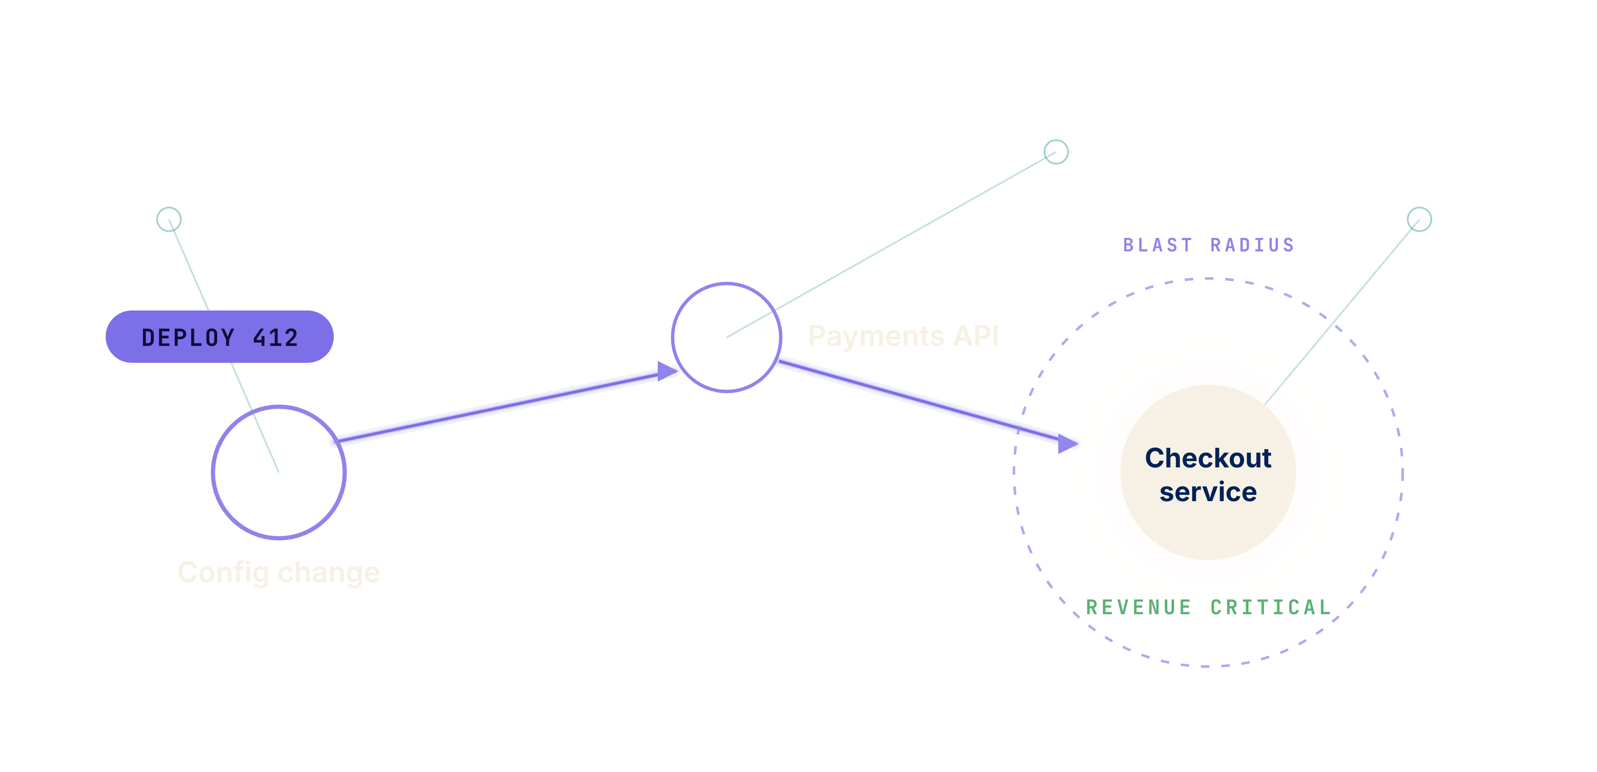
AGENTIC SRE · DEVSEMANTIC
Resolve incidents before they page your team.
DevSemantic grounds coding and operations agents in the Development Context Plane.
Incidents are personal to your stack. Generic runbooks are not. DevSemantic grounds agents in your context: what depends on what, who owns it, and what breaks if it fails.
THE 90 DAY KPI SCORECARD · BONUS AT RISK
Mean time to resolve
Committed reduction vs your baseline
Autonomous resolution share
Measured monthly, targets set at the 30 day diagnostic
Change failure rate
Held or improved while agents ship
Toil hours returned
Quantified per sprint for the CTO
Customized to your stack. Context maintained by named engineers. A fraction of the cost of alternatives.
One change, traced to the checkout service. Blast radius known before it ships.
© 2026 Vikat.AI. All rights reserved. Vikat, SecSemantic, DevSemantic, ProSemantic, VShield, VCommand, VSentinel, and VInsight are trademarks of Vikat.AI. Confidential.
VIKAT DEVSEMANTIC

Slide 8
PERSONALIZED AND PREEMPTIVE AI-NATIVE SRE SOLUTION
Site reliability, grounded in your systems.
Vikat analyzes your systems, telemetry, runbooks, and dependencies to resolve operational cases before they page your team.
YOUR EXISTING OPS STACK
Observability
Incident mgmt
CI CD
Repos
Cloud
Runbooks
Metrics · Logs
Traces
Pages · Tickets
Pipelines · Deploys
Code · Config · IaC
AWS · Google Cloud
Docs · Wikis
TELEMETRY IN
APPROVED ACTIONS OUT
Incidents
Root Cause
Change Safety
DevSemantic
AI-NATIVE SRE
Runbooks
Toil Automation
Ask
Private in your network
Human approval on every action
Forward Deployed Engineers keep it current
THE DEVELOPMENT CONTEXT PLANE
COST
BLAST RADIUS
PRIORITY
AGENT REACH
What does this outage cost the business?
What breaks if this change ships?
Which incident matters most right now?
What is this agent allowed to change?
© 2026 Vikat.AI. All rights reserved. Vikat, SecSemantic, DevSemantic, ProSemantic, VShield, VCommand, VSentinel, and VInsight are trademarks of Vikat.AI. Confidential.

Slide 9
THE IMPACT · AGENTIC SRE
More than half the queue, handled by agents.
Aggregate SRE operations modeled across the same five mid market U.S. companies.
SRE teams at five mid market enterprises handle roughly 5,750 operational cases and tickets each month. About 3,220 are automated, preempted, or resolved by agents. That is approximately 38,640 cases a year that never page a human.
EVERY MONTH, ACROSS THE SAME 5 COMPANIES
5,750
operational cases and tickets
3,220
L1 · 70% of volume
Alert triage, health checks, restarts, standard runbooks, ticket routing. Automation potential high.
automated, preempted, or resolved
L1 2,600 · L2 575 · L3 45
L2 · 25% of volume
Log analysis, config fixes, deployments, capacity and performance, dependency failures. Medium to high.
38,640
L3 · 5% of volume
Complex incidents, architecture issues, code defects, RCA. Agents assist, humans lead.
cases automated, preempted, or resolved
Human involvement
Low at L1, medium at L2, high at L3. Approval gates on every risky action.
More than half the monthly queue never needs a human. L3 stays human led, agent assisted.
Data note: illustrative modeled estimates. Not actual customer production results unless independently validated.
© 2026 Vikat.AI. All rights reserved. Vikat, SecSemantic, DevSemantic, ProSemantic, VShield, VCommand, VSentinel, and VInsight are trademarks of Vikat.AI. Confidential.
VIKAT DEVSEMANTIC

Slide 10
OFFERING OVERVIEW
Platforms. Solutions. Services.
Three semantic platforms, outcome committed solutions, and senior services that run them.
PLATFORMS
SOLUTIONS
SERVICES
SecSemantic SCP
O1 · Agentic CyberSec Threat Management
Forward Deployed Engineering
The CyberSec suite. Defense personalized to your business. Both threat surfaces mapped, scored, and continuously updated.
KPI Stolen credential kill time: before first use
VCommand · VShield · VSentinel
Applied AI, built inside your business. Named engineers run the Semantic Loop.
O2 · Agentic Workforce Security
SecSemantic · DevSemantic
VShield · VCommand · VSentinel · VInsight
KPI LLM calls governed: 100%, audit: per agent
VShield AI Gateway · VCommand
AI and Cybersecurity Consulting
Advisory and delivery for leaders across the business.
DevSemantic DCP
O3 · External Surface Defense
The Agentic SRE suite. Incidents preempted and resolved by agents grounded in your systems.
KPI Domain monitoring coverage: 100%
VShield Domain Security
Chief AI Officer as a Service
Senior AI leadership, installed.
O4 · Cloud Security Foundation + FinOps
Managed AI Governance
Development Context Plane
KPI Tag coverage: 85%+, savings: in dollars
VShield CSPM + FinOps · VInsight
Shadow AI discovery, observability, data protection, cost controls, compliance. Run for you.
ProSemantic PCP
O5 · AppSec and Supply Chain
VShield AI Gateway · Agents Inventory
The process intelligence suite. Process context where business agents create real value. Powered with Skan.
KPI SBOM coverage: 100%, fixes: PRs merged
VShield Soter · VInsight
Continuous Threat Exposure Management
O6 · SecOps Modernization
Penetration testing as a standing program.
Process Context Plane
KPI Mean time to contain: minutes, not 42 days
VCommand · VSentinel · VInsight
VShield · VSentinel
EVIDENCE 7.5x greater risk reduction when priorities follow consequence. McKinsey.
ACCOUNTABILITY Every pod carries a KPI scorecard, committed at 90 days.
SKIN IN THE GAME Outcome bonus tied to the 90 day KPI scorecard.
© 2026 Vikat.AI. All rights reserved. Vikat, SecSemantic, DevSemantic, ProSemantic, VShield, VCommand, VSentinel, and VInsight are trademarks of Vikat.AI. Confidential.
VIKAT CYBERSEC

Slide 11
THE CATALOG · CYBERSEC
CyberSec offerings.
Each delivered as an Atomic Pod: platform plus two senior engineers plus a fractional CISO advisor. Mix and scale.
O1
O2
O3
DETECTION AND RESPONSE
AI AGENT GOVERNANCE
EXTERNAL SURFACE
Agentic CyberSec Threat Management
Agentic Workforce Security
External Surface Defense
Detection, response, and continuous testing against AI augmented attack chains, deepfakes, vishing, and stealer log credential abuse.
Visibility and control over every AI agent you deploy. AI Gateway guardrails, agent inventory, audit log, policy enforcement.
Continuous monitoring of every domain, certificate, DNS record, and email security control you own. Defensive only.
90 DAY KPIs · BONUS AT RISK
90 DAY KPIs · BONUS AT RISK
90 DAY KPIs · BONUS AT RISK
Credential kill time: before first use · Attack chain playbooks: live · Attack sims: quarterly
LLM calls governed: 100% · Agent audit coverage: 100% · Budget controls: live
Domain coverage: 100% · Shadow subdomains: inventoried · Email security: graded and fixed
O4
O5
O6
CLOUD SECURITY
APPLICATION SECURITY
SOC OPERATIONS
Cloud Security Foundation + FinOps
AppSec and Supply Chain
SecOps Modernization
Cloud posture management with risk weighted prioritization and shipped fixes. FinOps waste detection on the same connectors.
ASPM, source code, and software supply chain security. The pod lands remediation pull requests with your developers.
SOC re engineering for machine speed response. Pre authorized SOAR autonomy, identity threat detection, zero trust roadmap.
90 DAY KPIs · BONUS AT RISK
90 DAY KPIs · BONUS AT RISK
90 DAY KPIs · BONUS AT RISK
Critical findings: down vs baseline · Tag coverage: 85%+ · Cloud savings: in dollars
SBOM coverage: 100% of repos · Remediation: PRs merged, not reported
Mean time to contain: minutes vs 42 day sector average · Standing privileges: pruned
© 2026 Vikat.AI. All rights reserved. Vikat, SecSemantic, DevSemantic, ProSemantic, VShield, VCommand, VSentinel, and VInsight are trademarks of Vikat.AI. Confidential.
VIKAT CYBERSEC

Slide 12
OUTCOME DIFFERENTIATED · CYBERSEC
We measure how early, not how fast.
A new class of Personalized and Preemptive metrics: scientific, measurable, and committed with an outcome bonus at risk.
THE INDUSTRY MEASURES REACTION Detect and respond, after the fact.
VIKAT MEASURES PREEMPTION Predict, prevent, and kill before impact, tuned to your business.
THE METRIC
WHAT IT REPLACES
THE 90 DAY COMMITMENT
MTTK
Mean Time to Kill a stolen credential
Breach notification lag
Dead before first use
AGC
Agent Governance Coverage
After the fact AI audits
100% checked before execution
MTTD
Mean Time to Discover an exposure
The annual pen test
Found before attackers, 100% of your surface
MTTP
Mean Time to Prevent exploitation
Patch SLA aging reports
Critical exposures closed pre exploit, tags 85%+
PSC
Pre Ship Closure
Vulnerability backlog counts
Fixes merged before code ships, 100% of repos
MTTC
Mean Time to Contain an attack
The 42 day dwell average
Minutes
SKIN IN THE GAME Fixed retainer. The outcome bonus is paid only against these metrics. Baselines set in a 30 day diagnostic at no cost.
© 2026 Vikat.AI. All rights reserved. Vikat, SecSemantic, DevSemantic, ProSemantic, VShield, VCommand, VSentinel, and VInsight are trademarks of Vikat.AI. Confidential.
VIKAT CYBERSEC

Slide 13
THE CATALOG · SRE
SRE offerings.
Each delivered as an Atomic Pod: platform plus two senior engineers, run as managed support. Mix and scale.
D1
D2
D3
INCIDENT RESPONSE
ROOT CAUSE ANALYSIS
CHANGE SAFETY
Agentic Incident Response
Root Cause and Reliability
Change and Release Safety
Agents triage, diagnose, and resolve incidents with runbooks grounded in your context. Human approval on every risky action.
Correlated analysis across logs, metrics, deploys, and dependencies in the Development Context Plane.
Blast radius known before a change ships. Risk scored deploys with pre approved rollback paths.
90 DAY KPIs · BONUS AT RISK
90 DAY KPIs · BONUS AT RISK
90 DAY KPIs · BONUS AT RISK
Mean time to resolve: reduced vs baseline · Autonomous resolution share: tracked monthly
RCA turnaround: reduced vs baseline · Repeat incidents: tracked and down
Change failure rate: held or improved · Blast radius: mapped for every release
D4
D5
D6
RUNBOOKS
OBSERVABILITY
OPERATING MODEL
Runbook Automation
Observability Foundation
SRE Modernization
Your runbooks operationalized into agent playbooks, kept continuously current by Forward Deployed Engineers.
Metrics, logs, and traces unified into the Development Context Plane. Alert noise cut, signals ranked by consequence.
On call and operations re engineered around agents. Targets set from the 30 day diagnostic baseline.
90 DAY KPIs · BONUS AT RISK
90 DAY KPIs · BONUS AT RISK
90 DAY KPIs · BONUS AT RISK
Runbook coverage: top scenarios automated · Toil hours returned: quantified per sprint
Alert noise: reduced vs baseline · Signal to page ratio: tracked monthly
Pages per engineer: down vs baseline · Autonomous share: targets set at diagnostic
© 2026 Vikat.AI. All rights reserved. Vikat, SecSemantic, DevSemantic, ProSemantic, VShield, VCommand, VSentinel, and VInsight are trademarks of Vikat.AI. Confidential.
VIKAT CYBERSEC

Slide 14
OUTCOME DIFFERENTIATED · SRE
We measure how early, not how fast.
A new class of Personalized and Preemptive metrics: scientific, measurable, and committed with an outcome bonus at risk.
THE INDUSTRY MEASURES REACTION Detect and respond, after the fact.
VIKAT MEASURES PREEMPTION Predict, prevent, and kill before impact, tuned to your business.
THE METRIC
WHAT IT REPLACES
THE 90 DAY COMMITMENT
MTTP
Mean Time to Predict an incident
Mean time to respond
Caught and resolved before it pages a human
RPR
Repeat Prevention Rate
Raw incident counts
The same cause never repeats, vs baseline
BRC
Blast Radius Coverage
Change advisory boards
Known before deploy, failure rate held
THR
Toil Hours Returned
Ticket closure counts
Quantified every sprint for the CTO
SNR
Signal to Noise Ratio
Raw alert volume
False pages down, real issues seen sooner
PPE
Pages Per Engineer
On call heroics
Down vs your baseline, reviewed quarterly
SKIN IN THE GAME Fixed retainer. The outcome bonus is paid only against these metrics. Baselines set in a 30 day diagnostic at no cost.
© 2026 Vikat.AI. All rights reserved. Vikat, SecSemantic, DevSemantic, ProSemantic, VShield, VCommand, VSentinel, and VInsight are trademarks of Vikat.AI. Confidential.
VIKAT CYBERSEC

Slide 15
Thank you.
PERSONALIZED AND PREEMPTIVE CYBERSEC AND SRE
TRADEMARKS
Vikat, Vikat.AI, SecSemantic, DevSemantic, ProSemantic, SCP, DCP, PCP, VShield, VCommand, VSentinel, VInsight, and the tagline Intelligence you can rely on are trademarks or service marks of Vikat.AI. Registration applied for or pending in applicable jurisdictions.
PATENTS
Patents pending, including on the Semantic Context Plane and the Semantic Context Loop.
DATA
Figures identified as modeled are illustrative estimates, not actual customer production results unless independently validated. Third party names and logos are property of their respective owners, used for identification only; no endorsement is implied.
CONFIDENTIALITY
© 2026 Vikat.AI. All rights reserved. Prepared for the named recipient. Not for reproduction or redistribution without written permission from Vikat.AI.
LET US RUN THE 30 DAY DIAGNOSTIC
vikat.ai · info@vikat.ai

