Slide 1

CSE312 Software Architecture: Principles and Practices
Dr. Athira B
Asst.Professor
IIIT Kottayam

Slide 2
Course Details
Code: CSE312
Title: Software Architecture: Principles and Practices
L-T-P-C: 3-0-2-4
Faculty: Dr. Athira B
Office: BB 213
Email: athirab@iiitkottayam.ac.in

Slide 3
Syllabus
Introduction to software engineering
Software life cycle model
Requirement analysis and specification
Architecture and Design
System Design
Software testing
Software Project Management

Slide 4
Evaluation Mode
Theory
  Assignment-1 Weightage: 10
  Quiz-1 Weightage: 10
  Midsemester Examination Weightage: 20
  Quiz-2 Weightage: 10
  Assignment-2: Weightage: 10
  End-semester Exam Weightage: 40
  Total Weightage: 70
Lab (Project Based)
  Project Presentation 15
  Progress 10
  Viva 5
  Weightage 30

Slide 5
Organization of this Lecture:
What is Software Engineering?
Programs vs. Software Products
Evolution of Software Engineering
Notable Changes In Software Development Practices
Summary
R. Mall, “Fundamentals of Software Engineering,” Prentice-Hall of India, 1999, CHAPTER 1.

Slide 6
Introduction to software engineering
Software is more than just a program code.
A program is an executable code, which serves some computational purpose.
Software is considered to be collection of executable programming code, associated libraries and documentations.
Software, when made for a specific requirement is called software product.
Software Engineering provides a standard procedure to design and develop a software.

Slide 7
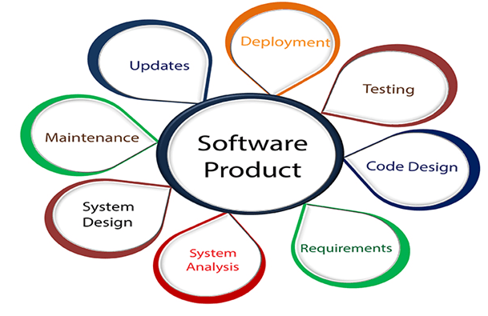
Software Engineering is an engineering branch related to the evolution of software product using well-defined scientific principles, techniques, and procedures.

Slide 8


What is Software Engineering?
Engineering approach to develop software.
  Building Construction Analogy.
Systematic collection of past experience:
  techniques,
  methodologies,
  guidelines.

Slide 9
Why Study Software Engineering? (1)
To acquire skills to develop large programs.
  Exponential growth in complexity and difficulty level with size.

Slide 10
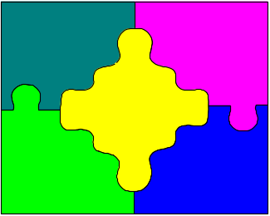
Why Study Software Engineering? (2)
Ability to solve complex programming problems:
  How to break large projects into smaller and manageable parts?
Learn techniques of:
  specification, design, interface development, testing, project management, etc.

Slide 11
Why Study Software Engineering? (3)
To acquire skills to be a better programmer:
    Higher Productivity
    Better Quality Programs

Slide 12
Programs versus Software Products
Usually small in size
Author himself is sole user
Single developer
Lacks proper user interface
Lacks proper documentation
Ad hoc development.
Large
Large number of users
Team of developers
Well-designed interface
Well documented & user-manual prepared
Systematic development

Slide 13
Software Crisis
Software products:
  fail to meet user requirements.
  frequently crash.
  expensive.
  difficult to alter, debug, and enhance.
  often delivered late.
  use resources non-optimally.

Slide 14
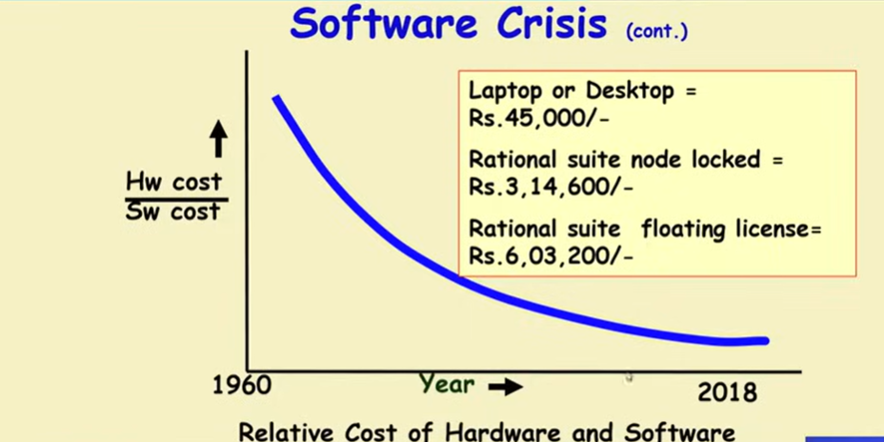
Software Crisis (cont.)

Slide 15
Factors contributing to the software crisis
Larger problems,
Lack of adequate training in software engineering,
Increasing skill shortage,
Low productivity improvements.

Slide 16
Human Cognitive limitation
Complexity and cost increases exponentially if SE principles are not used.

Slide 17
Two important Principles
Abstraction
Decomposition
These are the two fundamental techniques to carry out the complexity
They effectively handle complexity as the program size increases

Slide 18
What is abstraction?
Focus attention on one aspect of the problem and ignore irrelevant details.
Also known as model building.
Simplify a problem by omitting unnecessary details.
Eg-To develop overall understanding of a country.
Will refer various types of maps.

Slide 19
A map is an abstract representation of a country.
Different types of maps(abstractions) are possible.
Several abstraction to the same problem can be created.

Slide 20
Does every problem have a single Abstraction?
Different types of models help to understand different aspects of the problem.
For Complex problems
A single level of abstraction may be inadequate.
A hierarchy of abstractions may have to be constructed

Slide 21
Abstraction of Complex forms-An Example
Qstn- Understand all life forms in Earth
Solution – Try to built abstraction hierarchy

Slide 22
Decomposition
Decompose a problem into many small independent parts.
The smaller parts are taken up one by one and solved separately.
Idea- Each small part would be easy to grasp and therefore can be easily solved.
The full problem is solved when all the parts are solved.

Slide 23
Example- Decomposition
Try to break a bunch of sticks tied together versus breaking them individually.
An arbitrary decomposition may not help.

Slide 24
Example
You understand a book easier when the contents are organized into independent chapters.

Slide 25
Computer Systems Engineering
Computer systems engineering:
  encompasses software engineering.
Many products require development of software as well as specific hardware to run it:
  a coffee vending machine,
  a mobile communication product, etc.

Slide 26
Computer Systems Engineering
The high-level problem:
  deciding which tasks are to be solved by software
  which ones by hardware.

Slide 27
Computer Systems Engineering (CONT.)
Often, hardware and software are developed together:
  Hardware simulator is used during software development.
Integration of hardware and software.
Final system testing

Slide 28
Computer Systems Engineering (CONT.)
Feasibility
Study
Requirements Analysis and Specification
Hardware Development
Hardware Software Partitioning
Software Development
Integration
and Testing
Project Management

Slide 29
Evolution

Slide 30
Emergence of Software Engineering
Early Computer Programming (1950s):
  Programs were being written in assembly language.
  Programs were limited to about a few hundreds of lines of assembly code.

Slide 31
Early Computer Programming (50s)
Every programmer developed his own style of writing programs:
  according to his intuition (exploratory programming).

Slide 32
High-Level Language Programming (Early 60s)
High-level languages such as FORTRAN, ALGOL, and COBOL were introduced:
  This reduced software development efforts greatly.

Slide 33
High-Level Language Programming (Early 60s)
Software development style was still exploratory.
  Typical program sizes were limited to a few thousands of lines of source code.

Slide 34
Control Flow-Based Design (late 60s)
Size and complexity of programs increased further:
  exploratory programming style proved to be insufficient.
Programmers found:
  very difficult to write cost-effective and correct programs.

Slide 35
Control Flow-Based Design (late 60s)
Programmers found:
  programs written by others very difficult to understand and maintain.
To cope up with this problem, experienced programmers advised: ``Pay particular attention to the design of the program's control structure.'’

Slide 36
Control Flow-Based Design (late 60s)
A program's control structure indicates:
  the sequence in which the program's instructions are executed.
To help design programs having good control structure:
  flow charting technique was developed.

Slide 37
Control Flow-Based Design (late 60s)
Using flow charting technique:
  one can represent and design a program's control structure.
  Usually one understands a program:
    by mentally simulating the program's execution sequence.

Slide 38
Control Flow-Based Design
(Late 60s)
A program having a messy flow chart representation:
  difficult to understand and debug.
111

Slide 39
Control Flow-Based Design (Late 60s)
It was found:
  GO TO statements makes control structure of a program messy
  GO TO statements alter the flow of control arbitrarily.
  The need to restrict use of GO TO statements was recognized.

Slide 40
Control Flow-Based Design (Late 60s)
Many programmers had extensively used assembly languages.
  JUMP instructions are frequently used for program branching in assembly languages,
  programmers considered use of GO TO statements inevitable.

Slide 41
Control-flow Based Design (Late 60s)
At that time, Dijkstra published his article:
  “Goto Statement Considered Harmful” Comm. of ACM, 1969.
Many programmers were unhappy to read his article.

Slide 42
Control Flow-Based Design (Late 60s)
They published several counter articles:
  highlighting the advantages and inevitability of GO TO statements.

Slide 43
Control Flow-Based Design (Late 60s)
But, soon it was conclusively proved:
  only three programming constructs are sufficient to express any programming logic:
    sequence (e.g. a=0;b=5;)
    selection (e.g.if(c=true) k=5 else m=5;)
    iteration (e.g. while(k>0) k=j-k;)

Slide 44
Control-flow Based Design (Late 60s)
Everyone accepted:
  it is possible to solve any programming problem without using GO TO statements.
  This formed the basis of Structured Programming methodology.

Slide 45
Structured Programming
A program is called structured
  when it uses only the following types of constructs:
    sequence,
    selection,
    iteration

Slide 46
Structured programs
Unstructured control flows are avoided.
Consist of a neat set of modules.
Use single-entry, single-exit program constructs.

Slide 47
Structured programs
However, violations to this feature are permitted:
  due to practical considerations such as:
    premature loop exit to support exception handling.

Slide 48
Structured programs
Structured programs are:
  Easier to read and understand,
  easier to maintain,
  require less effort and time for development.

Slide 49
Structured Programming
Research experience shows:
  programmers commit less number of errors
    while using structured if-then-else and do-while statements
    compared to test-and-branch constructs.

Slide 50
Data Structure-Oriented Design (Early 70s)
Soon it was discovered:
  it is important to pay more attention to the design of data structures of a program
    than to the design of its control structure.

Slide 51
Data Structure-Oriented Design (Early 70s)
Techniques which emphasize designing the data structure:
  derive program structure from it:
    are called data structure-oriented design techniques.

Slide 52
Data Structure Oriented Design (Early 70s)
Example of data structure-oriented design technique:
  Jackson's Structured Programming(JSP) methodology
    developed by Michael Jackson in 1970s.

Slide 53
Data Structure Oriented Design (Early 70s)
JSP technique:
  program code structure should correspond to the data structure.

Slide 54
Data Structure Oriented Design (Early 70s)
In JSP methodology:
  a program's data structures are first designed using notations for
    sequence, selection, and iteration.
  Then data structure design is used :
    to derive the program structure.

Slide 55
Data Structure Oriented Design (Early 70s)
Several other data structure-oriented Methodologies also exist:
  e.g., Warnier-Orr Methodology.

Slide 56
Data Flow-Oriented Design (Late 70s)
Data flow-oriented techniques advocate:
  the data items input to a system must first be identified,
  processing required on the data items to produce the required outputs should be determined.

Slide 57
Data Flow-Oriented Design (Late 70s)
Data flow technique identifies:
  different processing stations (functions) in a system
  the items (data) that flow between processing stations.

Slide 58
Data Flow-Oriented Design (Late 70s)
Data flow technique is a generic technique:
  can be used to model the working of any system
    not just software systems.
A major advantage of the data flow technique is its simplicity.

Slide 59

Data Flow Model of a Car Assembly Unit
Engine Store
Door Store
Chassis with Engine
Partly Assembled Car
Fit
Engine
Fit
Doors
Fit
Wheels
Paint and
Test
Car
Assembled Car
Chassis Store
Wheel Store

Slide 60
Object-Oriented Design (80s)
Object-oriented technique:
  an intuitively appealing design approach:
  natural objects (such as employees, pay-roll-register, etc.) occurring in a problem are first identified.

Slide 61
Object-Oriented Design (80s)
Relationships among objects:
  such as composition, reference, and inheritance are determined.
Each object essentially acts as
  a data hiding (or data abstraction) entity.

Slide 62
Object-Oriented Design (80s)
Object-Oriented Techniques have gained wide acceptance:
  Simplicity
  Reuse possibilities
  Lower development time and cost
  More robust code
  Easy maintenance

Slide 63
Evolution of Design Techniques
Object-Oriented
Data flow-based
Data structure-based
Control flow-based
Ad hoc

Slide 64
Evolution of Other Software Engineering Techniques
The improvements to the software design methodologies
  are indeed very conspicuous.
In additions to the software design techniques:
  several other techniques evolved.

Slide 65
Evolution of Other Software Engineering Techniques
  life cycle models,
  specification techniques,
  project management techniques,
  testing techniques,
  debugging techniques,
  quality assurance techniques,
  software measurement techniques,
  CASE tools, etc.

Slide 66
Differences between the exploratory style and modern software development practices
Use of Life Cycle Models
Software is developed through several well-defined stages:
  requirements analysis and specification,
  design,
  coding,
  testing, etc.

Slide 67
Differences between the exploratory style and modern software development practices
Emphasis has shifted
  from error correction to error prevention.
Modern practices emphasize:
  detection of errors as close to their point of introduction as possible.

Slide 68
Differences between the exploratory style and modern software development practices (CONT.)
In exploratory style,
  errors are detected only during testing,
Now,
  focus is on detecting as many errors as possible in each phase of development.

Slide 69
Differences between the exploratory style and modern software development practices (CONT.)
In exploratory style,
  coding is synonymous with program development.
Now,
  coding is considered only a small part of program development effort.

Slide 70
Differences between the exploratory style and modern software development practices (CONT.)
A lot of effort and attention is now being paid to:
  requirements specification.
Also, now there is a distinct design phase:
  standard design techniques are being used.

Slide 71
Differences between the exploratory style and modern software development practices (CONT.)
During all stages of development process:
  Periodic reviews are being carried out
Software testing has become systematic:
  standard testing techniques are available.

Slide 72
Differences between the exploratory style and modern software development practices (CONT.)
There is better visibility of design and code:
  visibility means production of good quality, consistent and standard documents.
  In the past, very little attention was being given to producing good quality and consistent documents.
  We will see later that increased visibility makes software project management easier.

Slide 73
Differences between the exploratory style and modern software development practices (CONT.)
Because of good documentation:
  fault diagnosis and maintenance are smoother now.
Several metrics are being used:
  help in software project management, quality assurance, etc.

Slide 74
Differences between the exploratory style and modern software development practices (CONT.)
Projects are being thoroughly planned:
  estimation,
  scheduling,
  monitoring mechanisms.
Use of CASE tools.

