Slide 1

A
Project Report on
E-commerce Platform for Shoes
In partial Fulfillment of
Bachelor of Computer Application (B.C.A) Gujarat University (2023-2024)
Gujarat University
Submitted By
Vinit Jumani (2021122100163) Dhruvil Kadiya (2021122100165)
Navgujarat College of Computer Application
1

Slide 2
Acknowledgement
We would like to express our special thanks of gratitude to our project guide Prof. Ankita Gondaliya as well as our vice-principal incharge, Who gave us the golden opportunity to do this wonderful project on the topic E-commerce platform for shoes, Which also helped us in doing a lotof research and We came to know about so many new things We are really thankful to them.
Secondly, We should also like to thank our parents and friends who helped us a lot in finalizing this project within the limited time frame.
Date: 25/11/2023 | Students Name: 1. Vinit Jumani 2. Dhruvil Kadiya
Place: Ahmedabad | BCA(6th Sem)
Navgujarat College of Computer Application
2

Slide 3
INDEX
S.NO | TITLE | P.NO
1. | COMPANY PROFILE | 2
2. | PROJECT PROFILE | 4
3. | HARDWARE AND SOFTWARE REQUIREMENTS | 5
4. | HARDWARE AND SOFTWARE REQUIREMENTS | 7
5. | ADMIN SIDE SCREEN SHOTS | 8
6. | USER SIDE SCREEN SHOTS | 18
7. | VENDOR SIDE SCREEN SHOTS | 36
8. | REPORT LAYOUT | 47
9. | SAMPLE CODING | 52
10. | FUTURE ENHANCEMENTS | 55
11. | CONCLUSION | 56
12. | BIBLIOGRAPHY | 57
13. | LOG SHEET OF REPORTING | 58
Navgujarat College of Computer Application
3

Slide 4
NAVGUJARAT COLLEGE OF COMPUTER APPLICATION
1

Slide 5

COMPANY PROFILE
Company Name Director Name Contact No. Email Id Address
Website
INFOLABZ IT SERVICES PVT. LTD. Mr. Chintan Nagrecha 8866662662 info@infolabz.in
Vraj Avenue, 405, above SAM'S Pizza, nr. Commerce Six Road, Navrangpura, Ahmedabad, Gujarat 380009
www.infolabz.in
NAVGUJARAT COLLEGE OF COMPUTER APPLICATION
2

Slide 6
Established in 2011, we are a distinguished entity within the IT industry, operating as a subsidiary of a prominent parent IT corporation. Our enduring presence in the market attests to our solid reputation and unwavering commitment to excellence.
Our core strength lies in our highly qualified and experienced team, meticulously prepared to confront and conquer any challenges that may arise.
Our dedicated team comprises seasoned experts proficient in a wide array of cutting-edge technologies. Additionally, we maintain specialized teams for UI/UX and graphic design. Our clientele spans the globe, with hundreds of satisfied clients benefiting from our comprehensive services.
In this segment, we maintain dedicated teams specifically tasked with API and web service management, as well as crafting contemporary material designs. Our unyielding dedication to innovation is evident in every app we create, as we continually seek to expand our horizons and knowledge with each project.
InfoLabz proudly offers industry-oriented live project training, catering to students pursuing CE/IT (BE/B.TECH & DIPLOMA ENGINEERING), BCA/MCA, BSc IT/MSc IT degrees. Our training programs provide students with invaluable hands-on experience, bridging the divide between theoretical knowledge and real-world application. This immersive experience empowers students to gain a deeper understanding of engineering principles and apply their acquired skills to develop practical software and live websites.
NAVGUJARAT COLLEGE OF COMPUTER APPLICATION
3

Slide 7
PROJECT PROFILE :-
> Project Title :
> Internal guide :
> External guide :
> Project Duration : -
> Developed In :
> Group No : -
> Group Members : -
> Presented TO : -
- E-COMMERCE PLATFORM FOR SHOES
- Prof. Ankita Gondaliya
Ms. Twinkle Shah
1-Year
Python Django
43
KADIYA DHRUVIL UMESHKUMAR (5026) JUMANI VINIT HARESHKUMAR (5116)
Navgujarat College Of Computer Application Ashram Road, Ahmedabad.
NAVGUJARAT COLLEGE OF COMPUTER APPLICATION
4

Slide 8
TECHNOLOGIES
• The project is developed using technologies mentioned below ■ FRONTEND o HTML
• Hypertext Markup Language (HTML) is the standard Markup language for creating web pages and web applications. With Cascading Style Sheets (CSS) and JavaScript. It forms a triad of cornerstone technologies for the World Wide Web browsers receive HTML documents from a web server or from local storage and render them into multimedia web pages.HTML describes the structure of web Page semantically and originally included cues for the appearance of the document.
o CSS
• CSS is the language for describing the presentation of web pages, including colours, layout and fonts. It allows one to adapt the presentation to different types of devices, such as large screens, small screens, or printers. CSS is independent of HTML and can be used with any XML-based mark-up language.
o JAVASCRIPT
• JavaScript is a client-side scripting language developed by Brendan Each JavaScript can be run on any operating systems and almost all web browsers. The programs in this language are called scripts. They can be written right in a web page’s HTML and run automatically as the page loads. Scripts are provided and executed as plain text. They don’t need special preparation or compilation to run. In this aspect, JavaScript is very different from another language called Java.
NAVGUJARAT COLLEGE OF COMPUTER APPLICATION
5

Slide 9
BACKEND
o PYTHON WITH DJANGO FRAMEWORK
• Python is a high-level, general-purpose programming language. Its design philosophy emphasizes code readability with the use of significant indentation. Python is dynamically typed and garbage-collected. It supports multiple programming paradigms, including structured, object-oriented and functional programming.
■ BACKEND
o SQLite : SQLite is one of the most popular and easy-to-use relational database systems. It possesses many features over other relational databases.
NAVGUJARAT COLLEGE OF COMPUTER APPLICATION
6

Slide 10
HARDWARE AND SOFTWARE REQUIREMENTS
• Hardware
o Desktop/laptop: windows 8 or above o Storage: 512GB SSD/HDD o Processor: i3 or above
• Software
o Python - 3.11 o Pycharm -IDE o Web Browser o Db Browser
NAVGUJARAT COLLEGE OF COMPUTER APPLICATION
7

Slide 11
Admin Layout
NAVGUJARAT COLLEGE OF COMPUTER APPLICATION
8

Slide 12
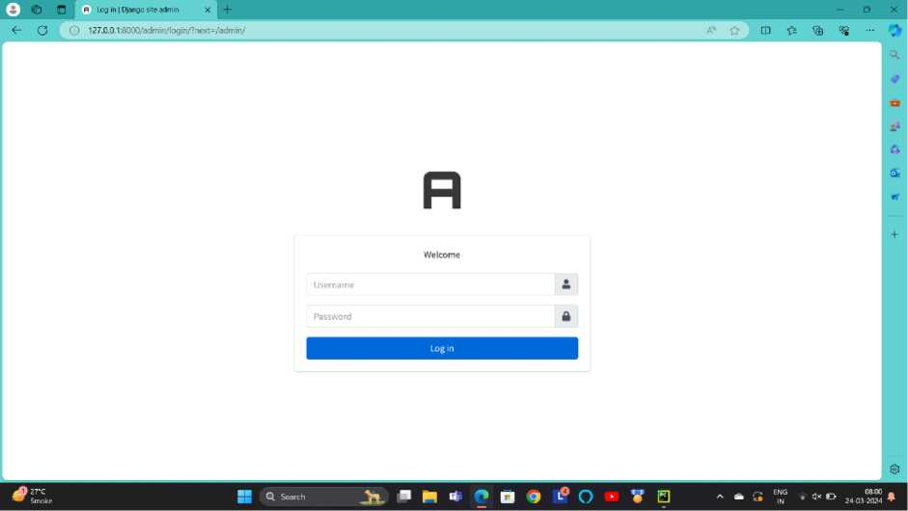
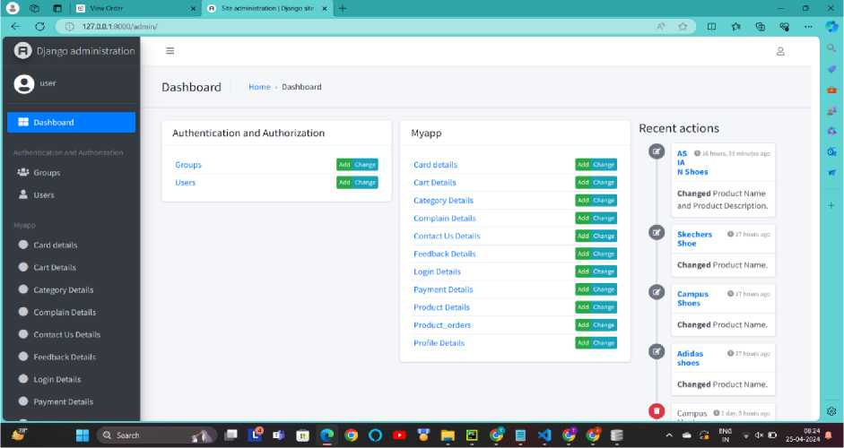
Admin Login Page:
Description :- This screen-shot is about admin login. Admin can login from here and manage all the things from here (only use for admin).
Dashboard :-
Description :- This screen-shot is about admin dashboard page. In this page admin can access all the functions and manage admin and users.
NAVGUJARAT COLLEGE OF COMPUTER APPLICATION
9

Slide 13
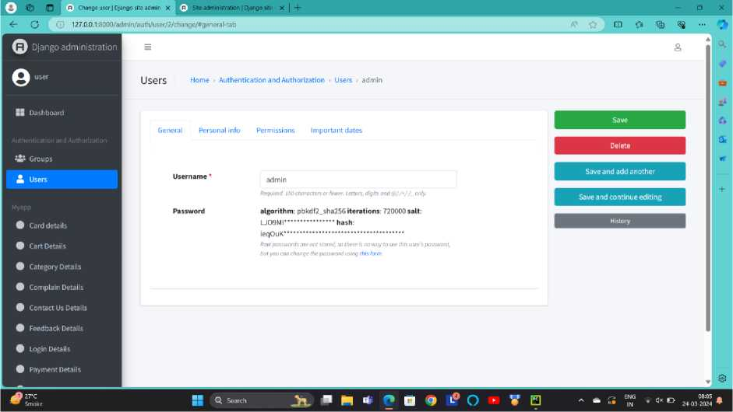

Admin Page :-
General :
Description :- This screen-shot is about admin general page. There is a detail about admin name and password.
Personal information :
Description :- This screen-shot is about admin personal information. In this page there is a personal details of admin like first name, last name and email address.
NAVGUJARAT COLLEGE OF COMPUTER APPLICATION 10

Slide 14
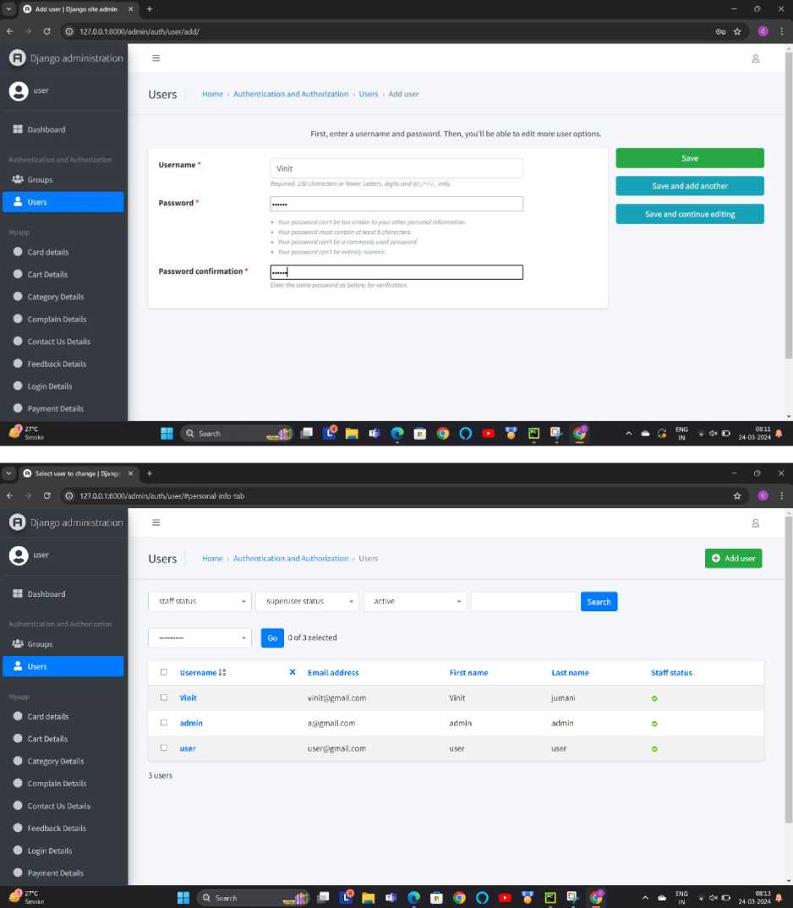
Add Admin :-
Description :- This screen-shot is about add admin page. With the use of this page admin can add another admin and manage this page.
NAVGUJARAT COLLEGE OF COMPUTER APPLICATION
11

Slide 15
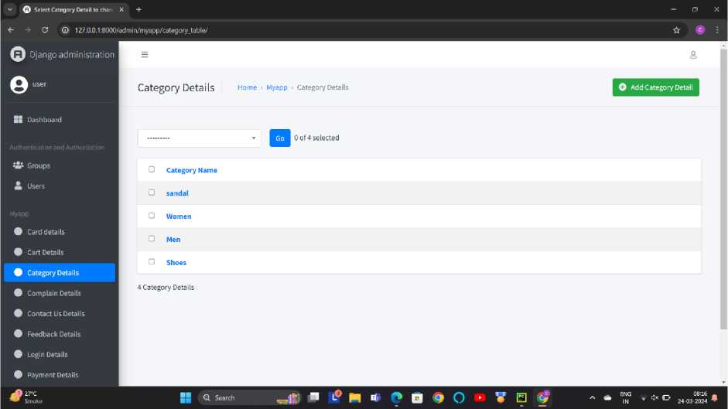
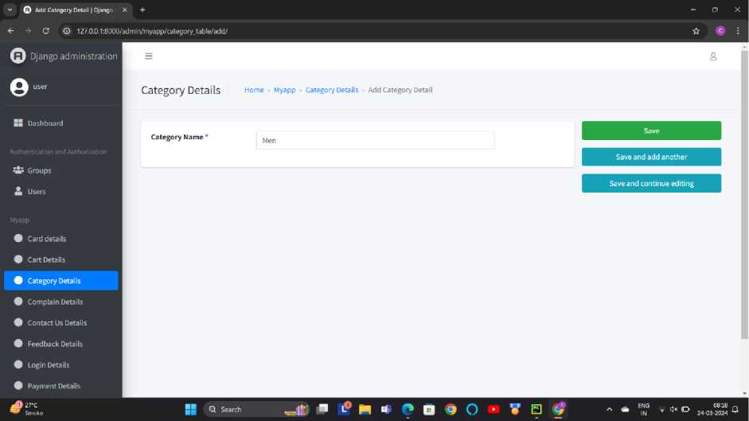
Manage Product Category :-
Description This screen-shot is about manage product category. In this page admin can add product and manage it.
Add Product Category :-
Description :- This screen-shot is about add product category. That means admin can add product from this page.
NAVGUJARAT COLLEGE OF COMPUTER APPLICATION
12

Slide 16
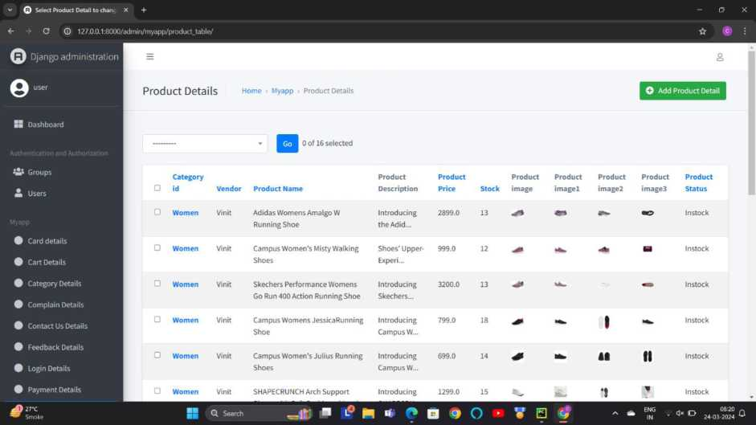
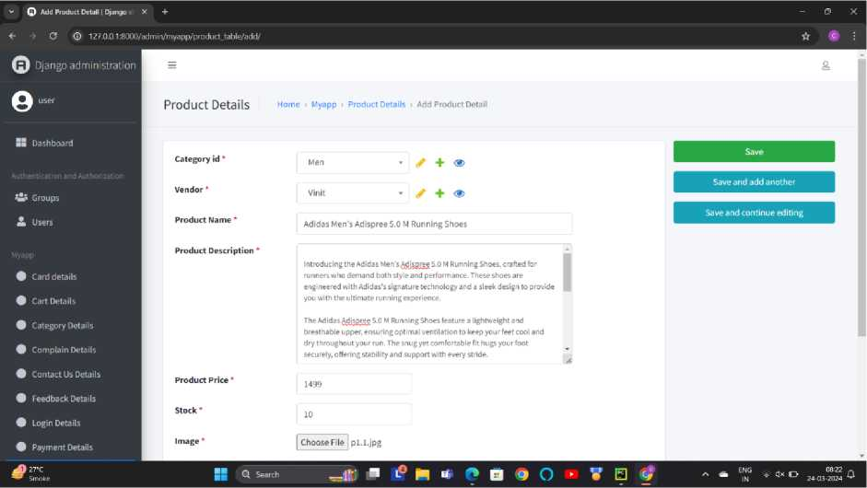
Manage Product Details
Description:-This screen-shot is about manage product details. In this page admin can manage the details of every product.
Add Product :
NAVGUJARAT COLLEGE OF COMPUTER APPLICATION
13

Slide 17

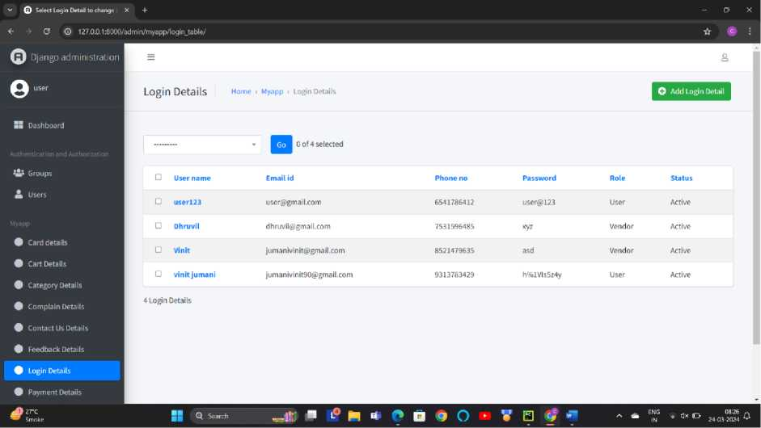
Description :- This screen-shot is about add product page. Admin can add the new product from here and manage all the products.
User Login details :-
Description :- This screen-shot is about user/customer details page. Admin can see all the details from this page and manage all the users and customers from here.
NAVGUJARAT COLLEGE OF COMPUTER APPLICATION 14

Slide 18
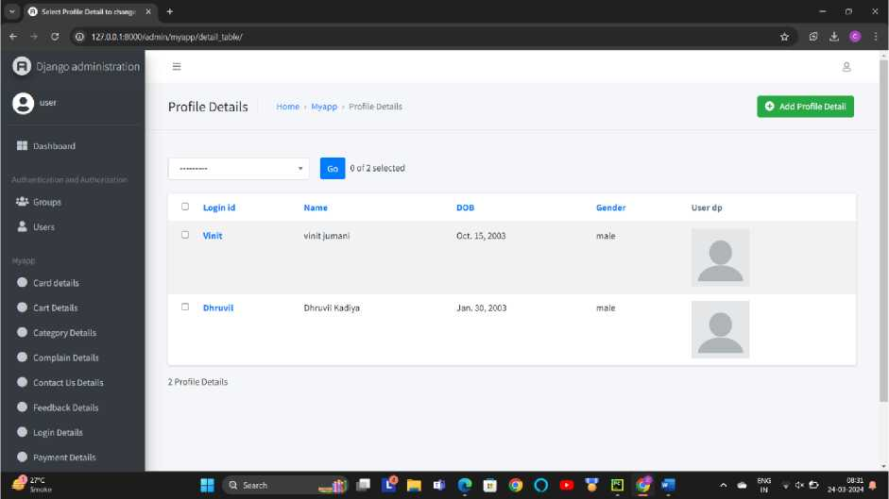
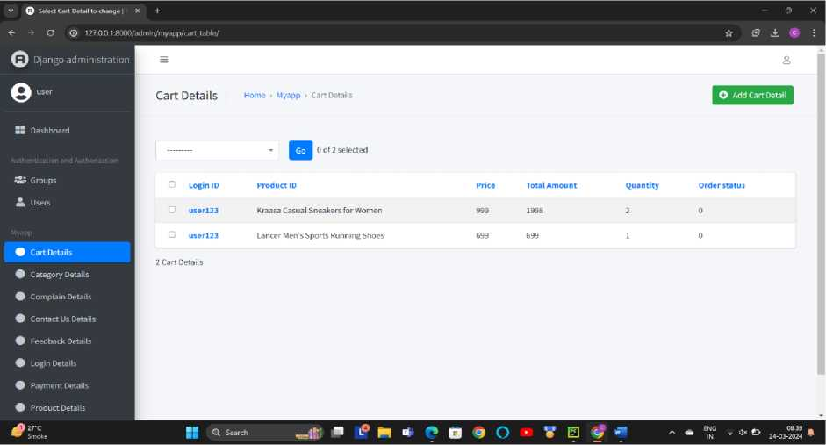
User / Customer Details :-
Description :- This screen-shot is about manage user/customer details page. Admin can see all the details from this page and manage all the users and customers from here.
Manage Product Cart :-
Description :- This screen-shot is about manage product cart. Admin can manage product cart from this page.
NAVGUJARAT COLLEGE OF COMPUTER APPLICATION
15

Slide 19
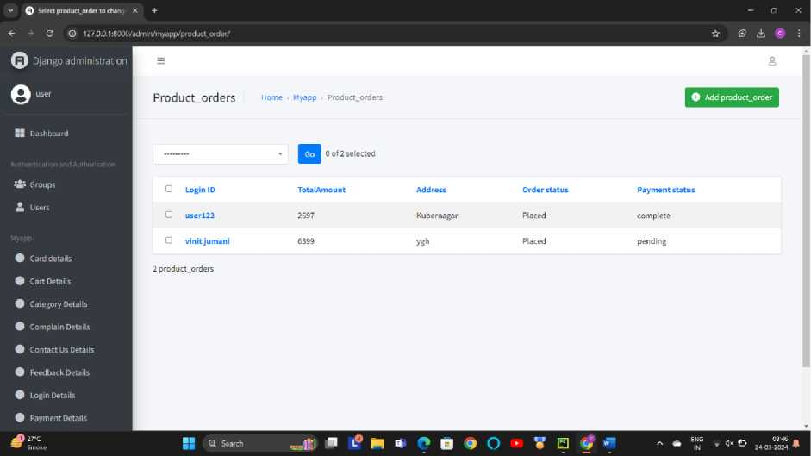
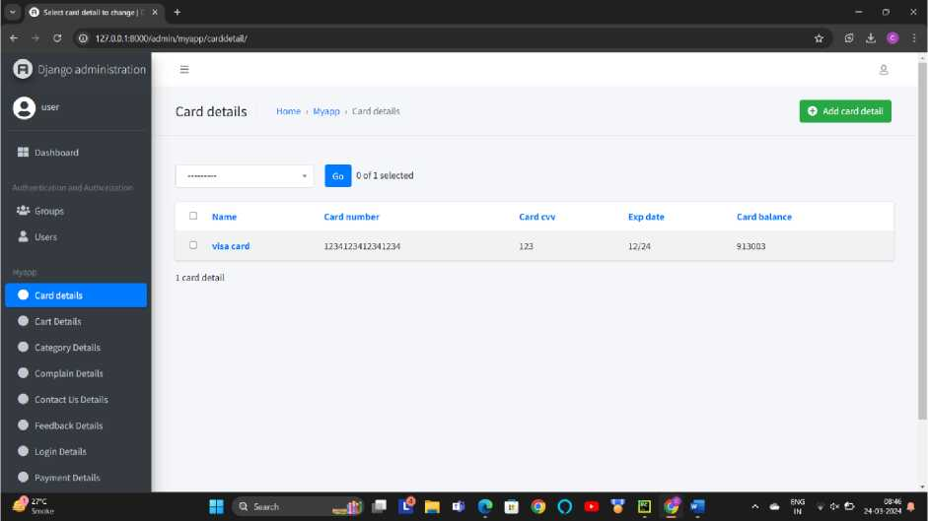
Manage Product Orders :-
Description :- This screen-shot is about manage product orders. Admin can manage product orders from this page.
Manage Card Detail :-
Description :- This screen-shot is about manage card details. In this page there is all the details of user card.
NAVGUJARAT COLLEGE OF COMPUTER APPLICATION
16

Slide 20
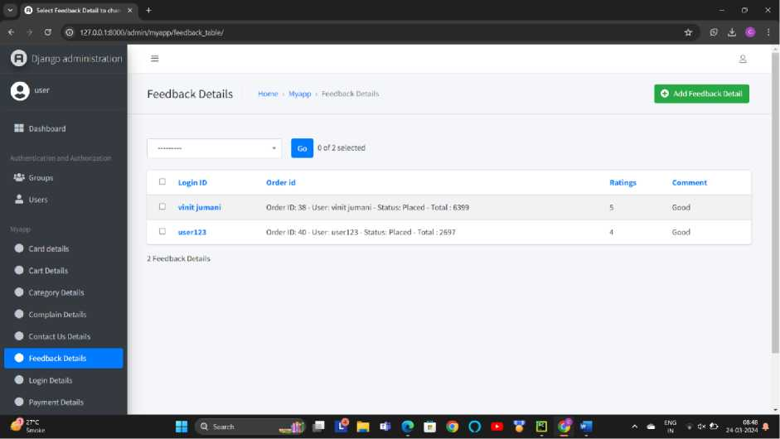
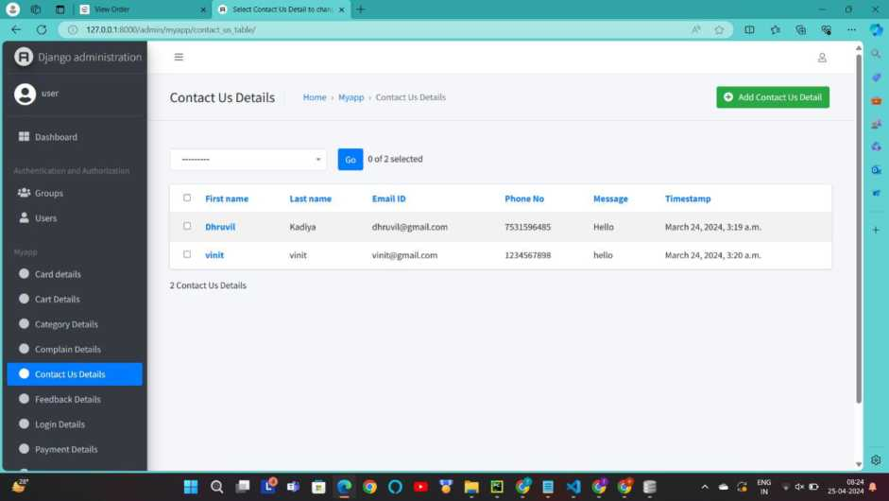
View Feedback :-
Description :-This screen-shot is about feedback table. Users can give feedback and admin can manage this feedbacks and also can delete feedbacks.
View Contact Us :-
NAVGUJARAT COLLEGE OF COMPUTER APPLICATION
17

Slide 21
USER LAYOUT
NAVGUJARAT COLLEGE OF COMPUTER APPLICATION
18

Slide 22
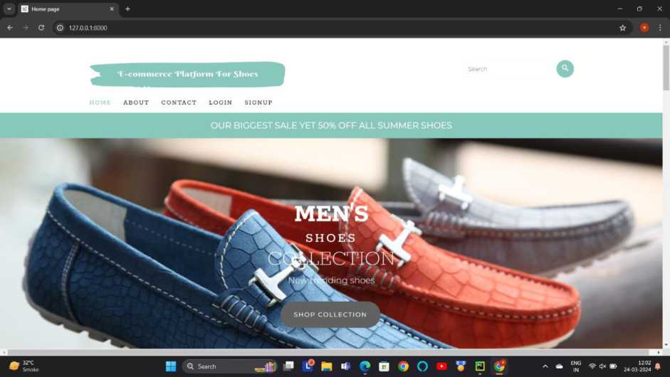
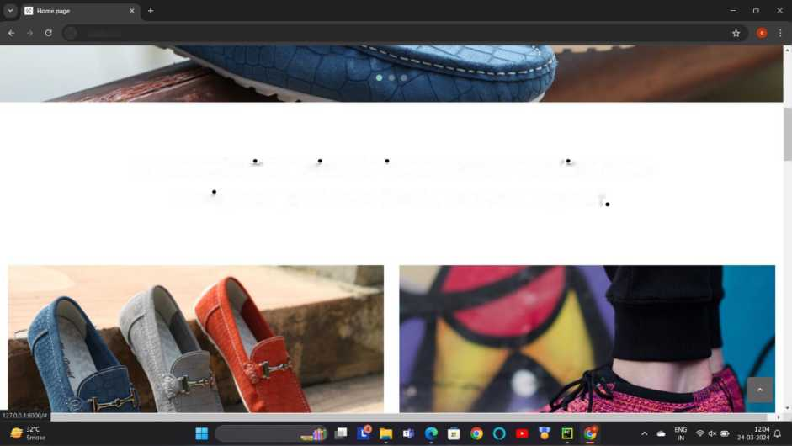
Home Page :-
© 127.0.0.1:8000
It started with a simple idea: Create quality, well-
designed products that I wanted myself
Q Search
NAVGUJARAT COLLEGE OF COMPUTER APPLICATION
19

Slide 23
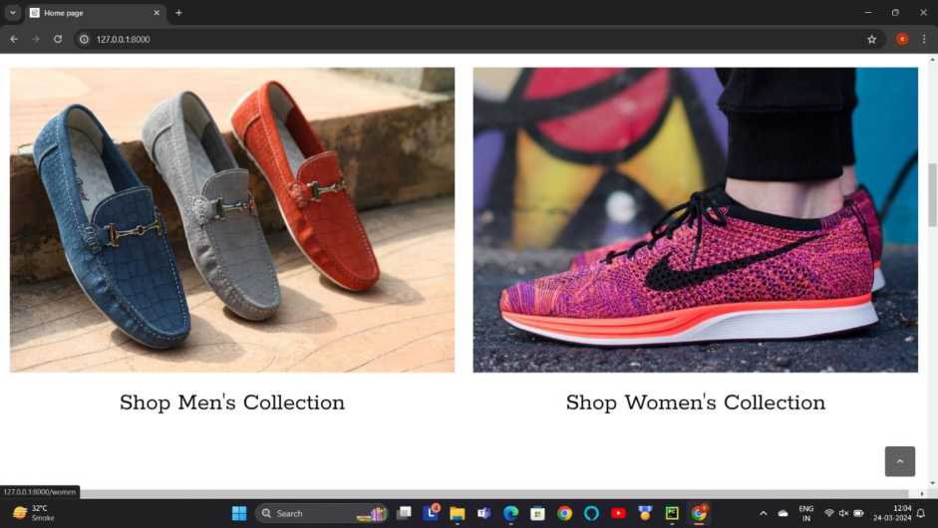
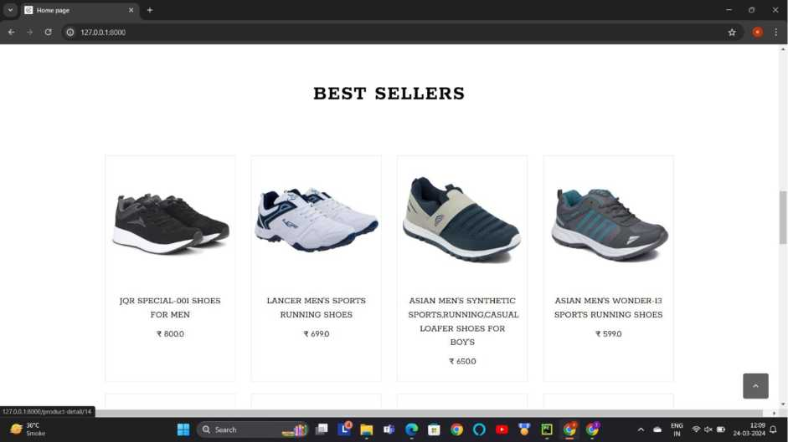
NAVGUJARAT COLLEGE OF COMPUTER APPLICATION
20

Slide 24
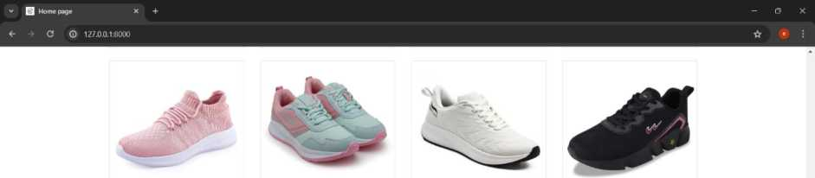
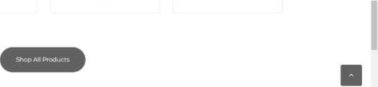
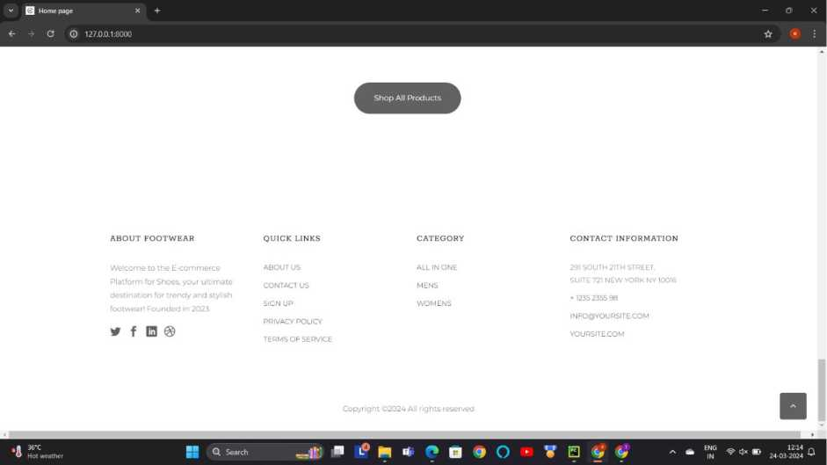
KRAASA CASUAL SNEAKERS FOR WOMEN
^ 999.0
ASIAN WOMEN'S CUTE | SHAPECRUNCH ARCH | CAMPUS WOMEN'S
SPORTS RUNNING | SUPPORT SHOES WITH | JULIUS RUNNING SHOES
SHOES.WALKING, GYM | SOFT CUSHIONED | ^ 699.0
CASUAL SNEAKER LACE- | INSOLES FOR WOMEN
UP SHOES FOR GIRL S | FOR WALKING AND
t 6990 | RUNNING
^ 12990
fi n * © D • O • W 0 <*i V
Description :-This screen-shots are about home page. In this users can visit this website and check the products and if they want to purchase then they can purchase ant product according to their choices.
NAVGUJARAT COLLEGE OF COMPUTER APPLICATION
21

Slide 25
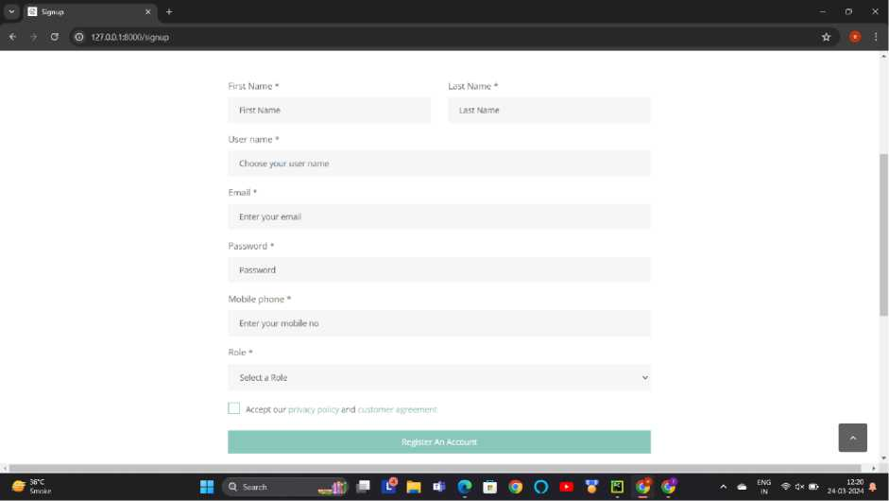
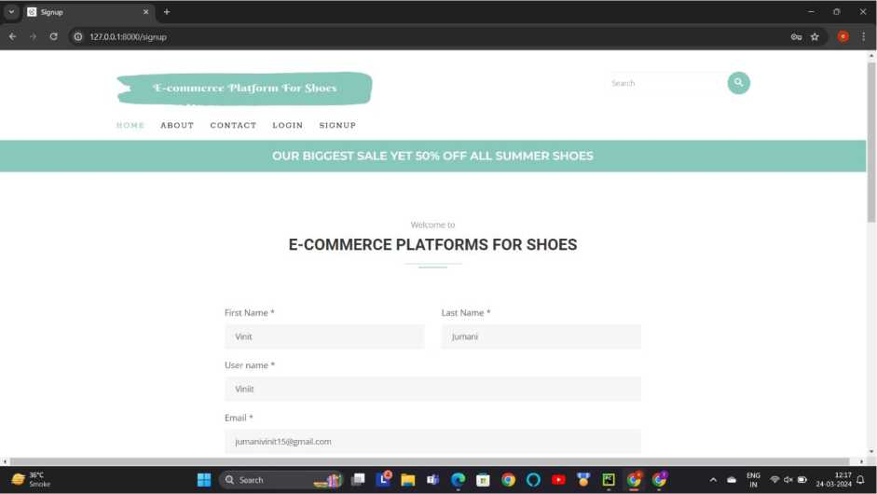
Registration Page:-
NAVGUJARAT COLLEGE OF COMPUTER APPLICATION
22

Slide 26
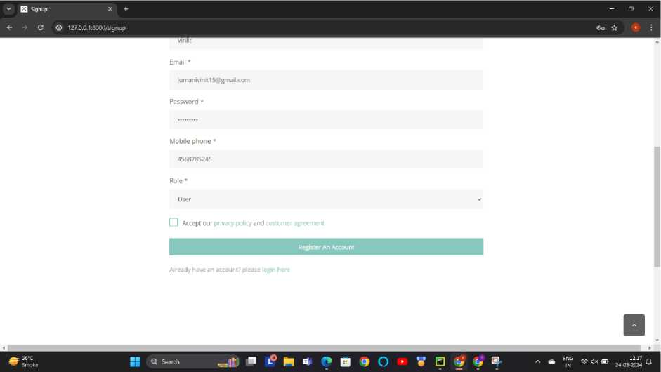
Description :- This screen-shot is about registration page. User can register their self for purchasing any product.
v (^1 Login X +
4- X © 127.0.01:8000/insert
 | 127,0.0.1:8000 says REGISTERATION SUCCESSFUL!. •
■? N i* f*
Description :- This screen-shot show when user is successfully registered. After registering users have to login.
NAVGUJARAT COLLEGE OF COMPUTER APPLICATION
23

Slide 27
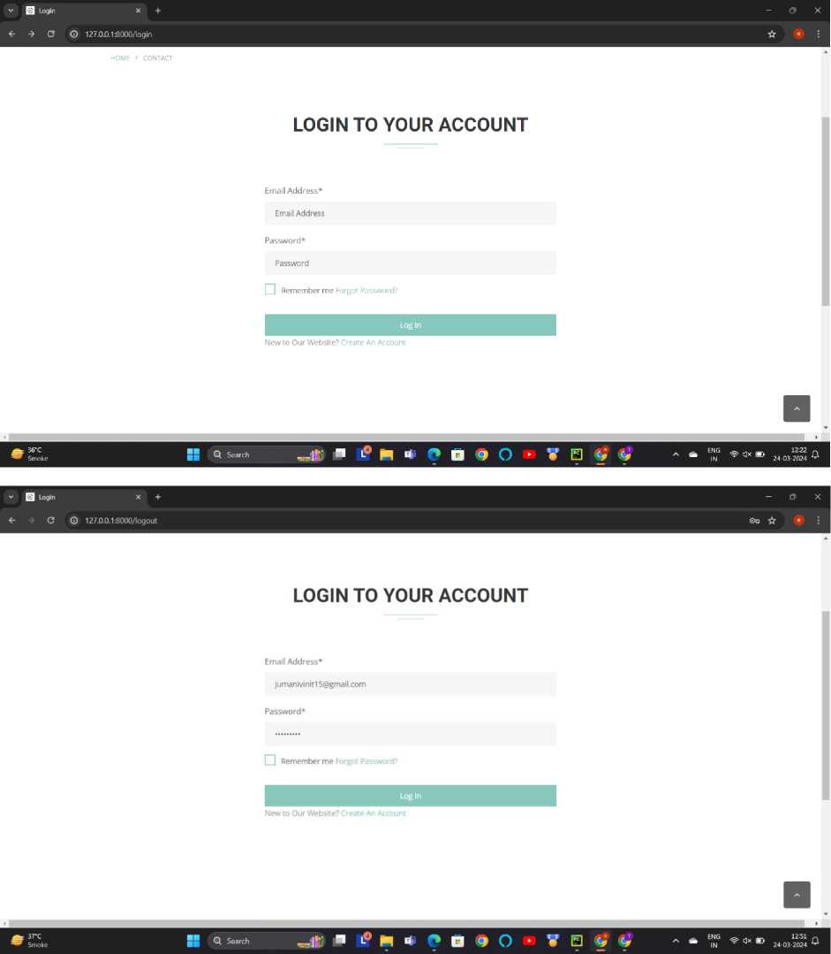
Login Page :-
Description This screen-shot is about login page. User can login from here with their email id and password.
NAVGUJARAT COLLEGE OF COMPUTER APPLICATION
24

Slide 28
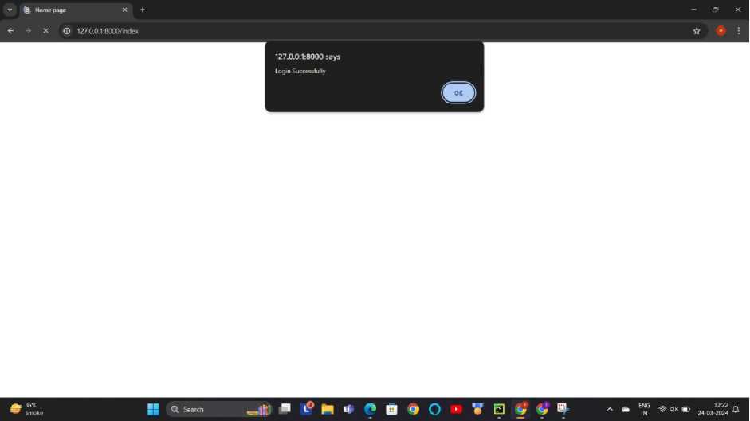
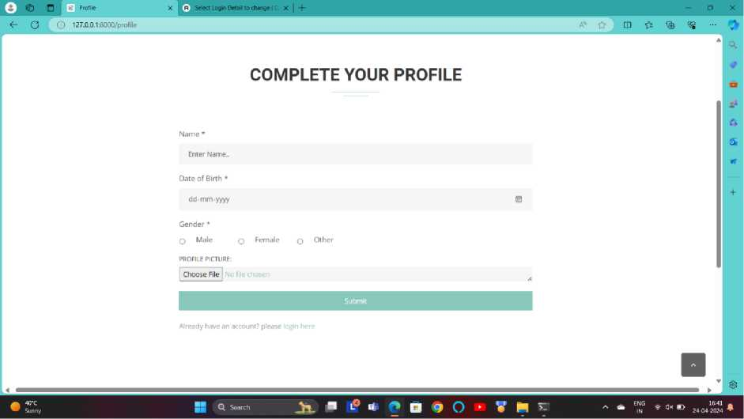
Description :- This screen-shot is after user is logged. User can access their dashboard from here.
Complete your Profile:-
Description:-This screen-shot is about user profile page. User can complete their profile by this page.
NAVGUJARAT COLLEGE OF COMPUTER APPLICATION
25

Slide 29

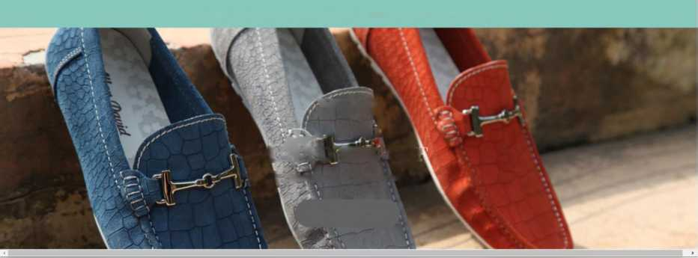
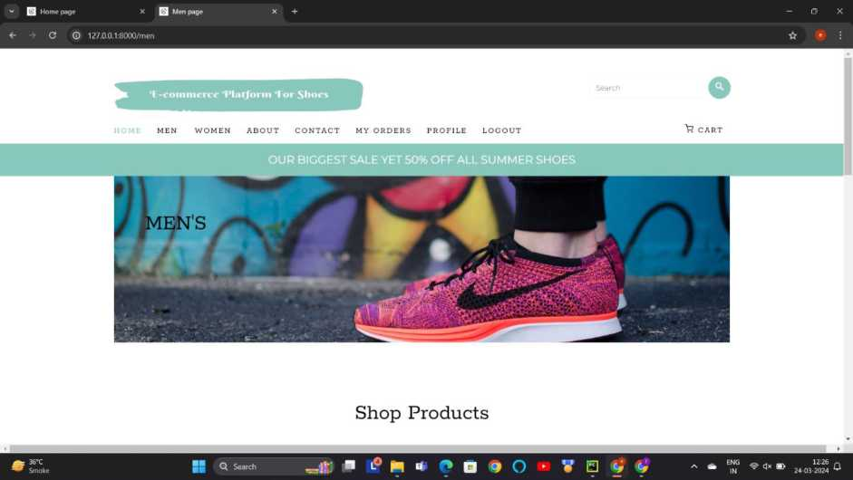
Choose Categories :-
v Q Home page X Q Home page | x + | -OX
<- -» G O 127.0.0.1:8000/index |  | ©o ☆ ^{e} :
25% OFF (ALMOST) EVERYTHING! USE CODE: SUMMER SALE
NEW
. , ARRIVAL
ufeo 30% OFI
^i^ew stylish shoes for men
SHOP COLLECTION
Description :-This screen-shot is about all categories. User can choose a category according to their choices.
Mens:-
NAVGUJARAT COLLEGE OF COMPUTER APPLICATION
26

Slide 30
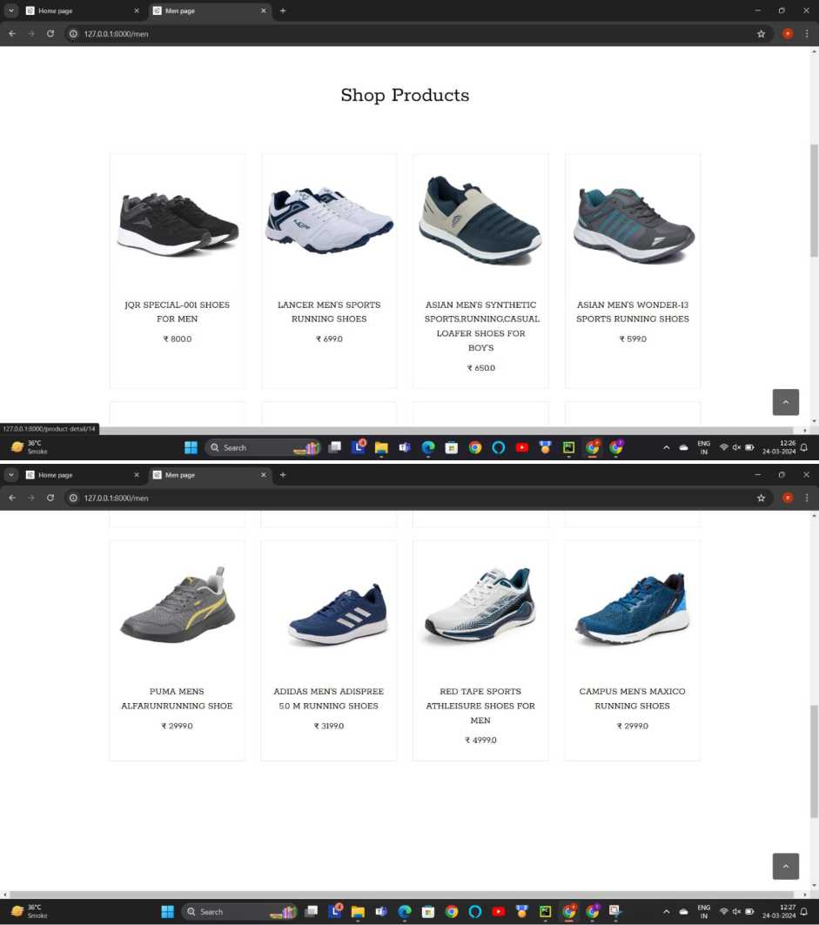
Description :- This screenshot displays products categorized under men's fashion. Users can browse through various products available in the men's category.
NAVGUJARAT COLLEGE OF COMPUTER APPLICATION
27

Slide 31
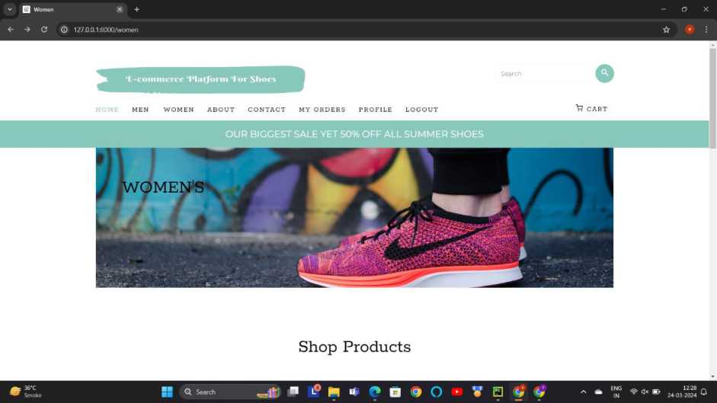
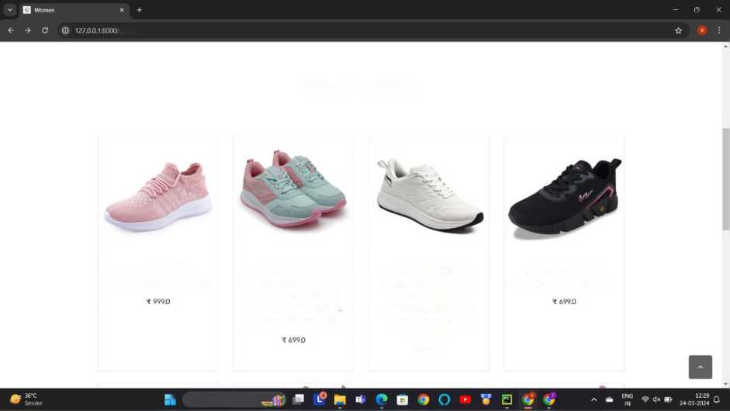
Womens:-
''women
Shop Products
KRAASA CASUAL
ASIAN WOMEN'S CUTE
SHAPECRUNCH ARCH
CAMPUS WOMEN'S JULIUS RUNNING SHOES
SNEAKERS FOR WOMEN
SPORTS RUNNING
SUPPORT SHOES WITH
SHOESWALKING. GYM
SOFT CUSHIONED
CASUAL SNEAKER LACE
INSOLES FOR WOMEN
UP SHOES FOR GIRLS
FOR WALKING AND
RUNNING
* 1299.0
* Q Search
Description This screenshot displays products categorized under men's fashion. Users can browse through various products available in the men's category.
NAVGUJARAT COLLEGE OF COMPUTER APPLICATION
28

Slide 32
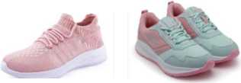
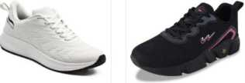
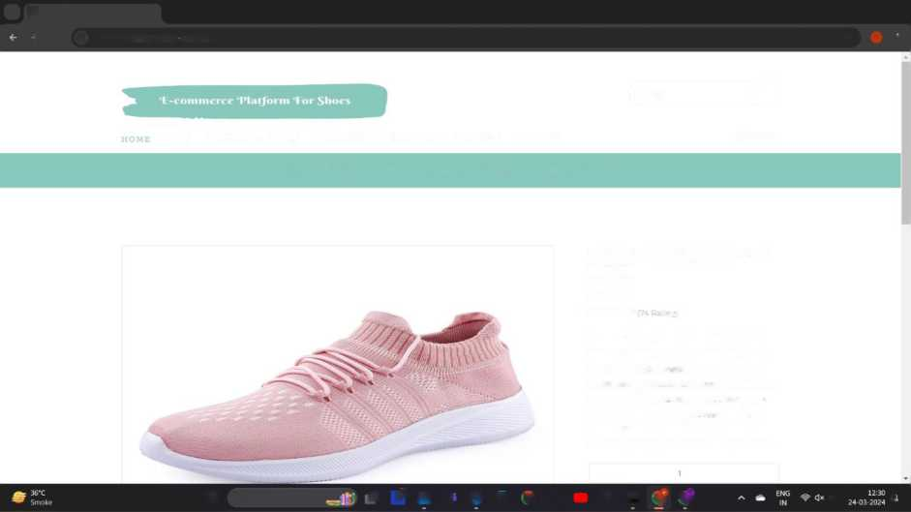
Buy Product:-
Shop Products
KRAASA CASUAL SNEAKERS FOR WOMEN
^ 999.0
ASIAN WOMEN'S CUTE SPORTS RUNNING SHOESWALKING. GYM CASUAL SNEAKER LACE UP SHOES FOR GIRLS ^ 699.0
SHAPECRUNCH ARCH SUPPORT SHOES WITH SOFT CUSHIONED INSOLES FOR WOMEN FOR WALKING AND RUNNING
CAMPUS WOMEN'S JULIUS RUNNING SHOES
t 699.0
M * c B • o • v s 9
Description :- This screen-shot is about purchased product. Users can buy product according to their choices.
View Product Details :
^{v} Q Product Detail page X + |  |  | -OX
A C © 127.0.0.1:8000/productdetail/23 |  |  | ☆ • :
 | Search | o
MEN WOMEN ABOUT CONTACT MY ORDERS PROFILE LOGOUT |  | P. CART
OUR BIGGEST SALE YET 50% OFF ALL SUMMER SHOES
KRAASA CASUAL SNEAKERS FOR WOMEN
^ 999.0
* * * * * |7« Rating)
Introducing the Kraasa Casual Sneakers for Women, where comfort meets style in every step. Crafted with meticulous attention to detail, these sneakers are designed to elevate your casual footwear collection. Featuring a sleek and modern design, these sneakers boast a timeless appeal that effortlessly complements any outfit. Whether you're run..,
SS Q Search ■f>k*f*Q?0 ‘ V E <* 9 ■> C
NAVGUJARAT COLLEGE OF COMPUTER APPLICATION
29

Slide 33
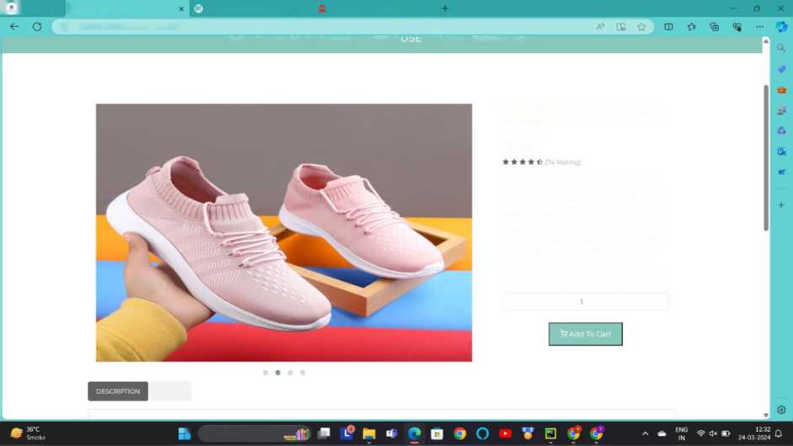
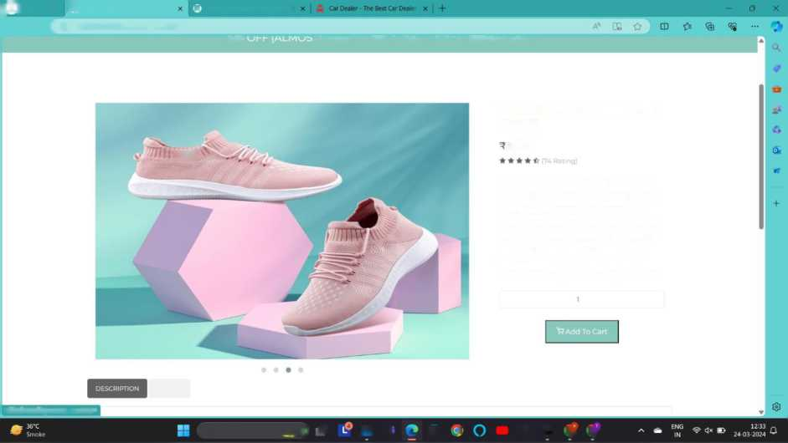
K-Wi! o H
Product Detail page
p Select Login Detail to change | C x | Car Dealer - The Best Car Dealer X |
© 127.0.0.1:8000/product-detail/23
ZSTb CJI-I- IMLMkJS I) CvCKl I nilNCj! L.UUC. 5UMMCK 5MLC
KRAASA CASUAL SNEAKERS FOR
WOMEN
T 999.0
Introducing the Kraasa Casual Sneakers for Women, where comfort meets style in every step. Crafted with meticulous attention to detail, these sneakers are designed to elevate your casual footwear collection. Featuring a sleek and modern design, these sneakers boast a timeless appeal that effortlessly complements any outfit. Whether you’re run...
REVIEW
" Q Search
jTw® o n
Product Detail page
p Select Login Detail to change |!
<T G [ 0 127.0.0.1:8000/product-detail/23
ZOTO | J LVLKT I niINCj! Uit L.UUL. SUMMtK OHLC
KRAASA CASUAL SNEAKERS FOR
WOMEN
ivv\\\
999.0
Introducing the Kraasa Casual Sneakers for Women, where comfort meets style in every step. Crafted with meticulous attention to detail, these sneakers are designed to elevate your casual footwear collection. Featuring a sleek and modern design, these sneakers boast a timeless appeal that effortlessly complements any outfit. Whether you're run...
127.0.0.1:8000/product-detail/23#
REVIEW
Q S»rch —IK ■ m * D > • VB <* <<
NAVGUJARAT COLLEGE OF COMPUTER APPLICATION

Slide 34
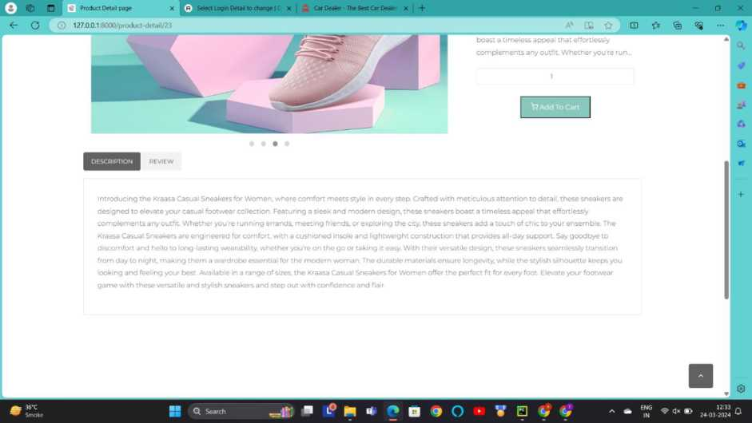
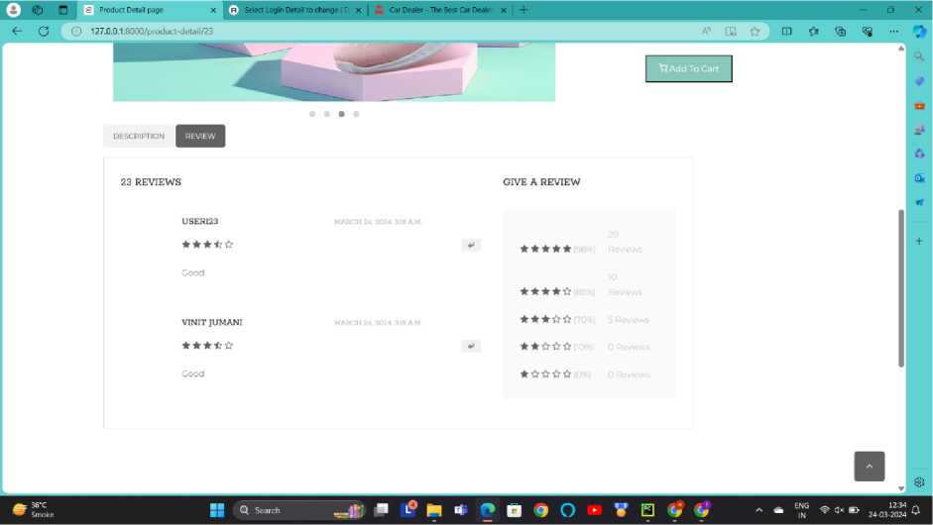
Description :-This screen-shot is about view product details. While user want to purchase any product they can see all the details from here.
NAVGUJARAT COLLEGE OF COMPUTER APPLICATION
31

Slide 35
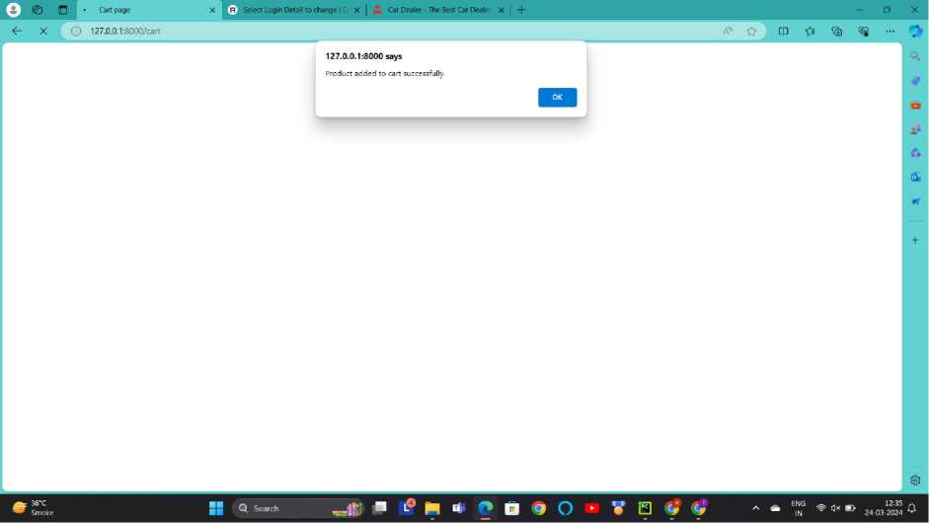
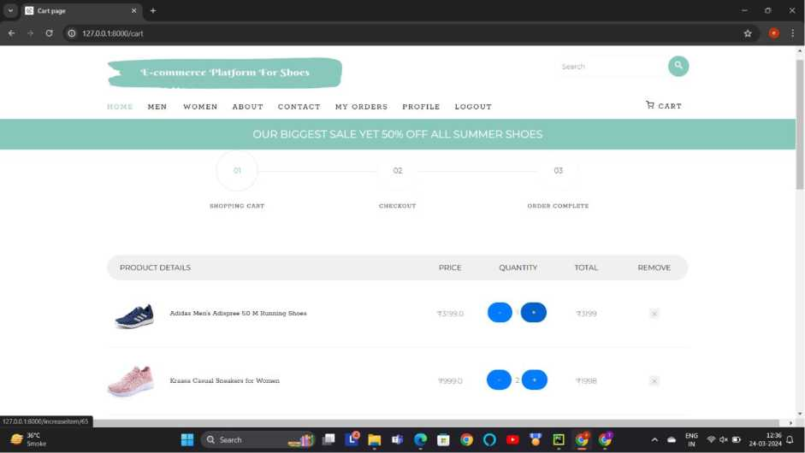
Add To Cart :-
Description :- This screen-shot is about add to cart. While user do add to cart this page will be shown at user side and user can check details.
NAVGUJARAT COLLEGE OF COMPUTER APPLICATION
32

Slide 36
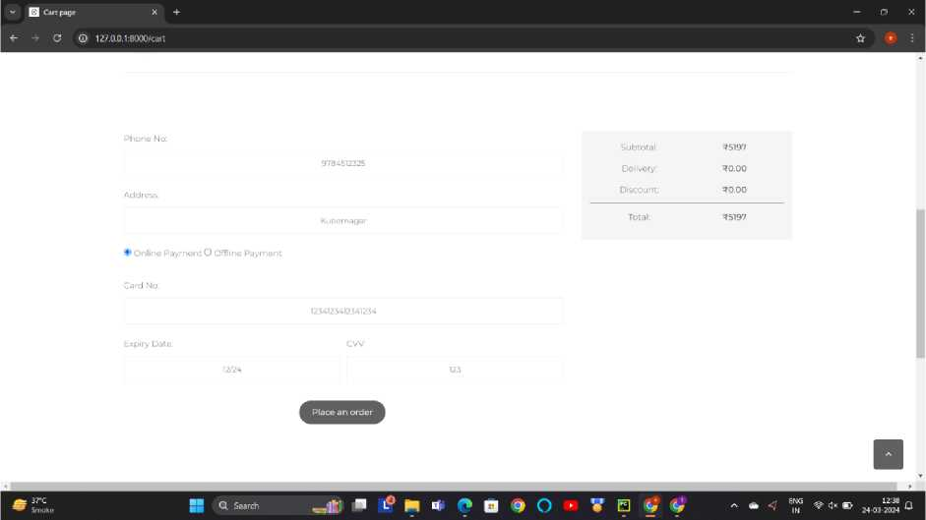
Remove Product From Cart :-
^{v} (g, Cart page X Q Manage Product X +
<r A X © 127.0.0.1:8000/cart
 | 127.0.0.1:8000 says Product successfully removed from cart •
M 4 f* □ *9 O
Add Details And Add Payment :-
Description This screen-shot is about add details. In this page user have to put details of name, address and also have to mention the method of payment.
NAVGUJARAT COLLEGE OF COMPUTER APPLICATION
33

Slide 37
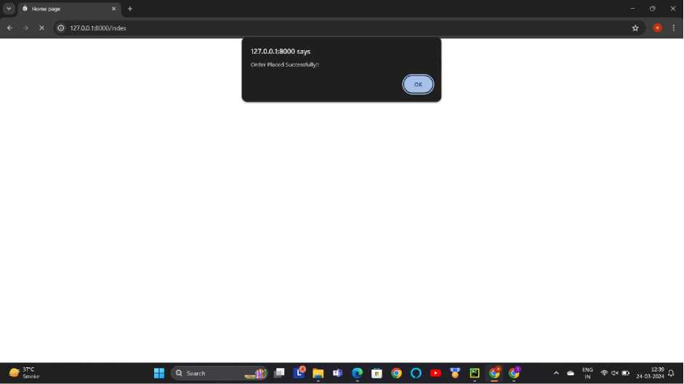
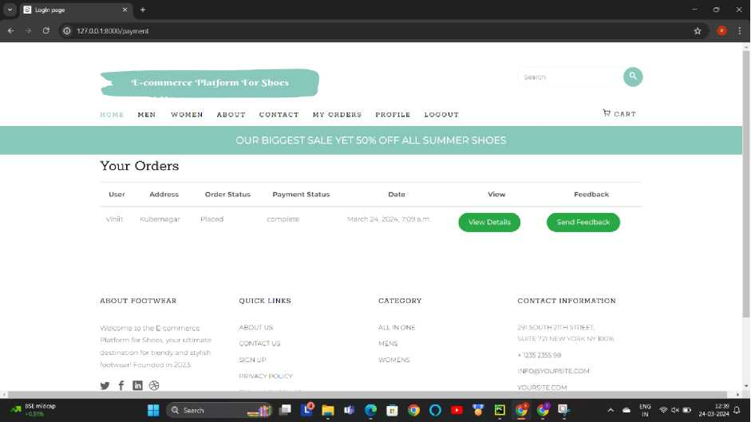
Order Placed :-
Description This screen-shot is about order placed. User can see a message order placed successfully.
My Order:
Description :- This screen-shot show the detail of all order of user
NAVGUJARAT COLLEGE OF COMPUTER APPLICATION
34

Slide 38
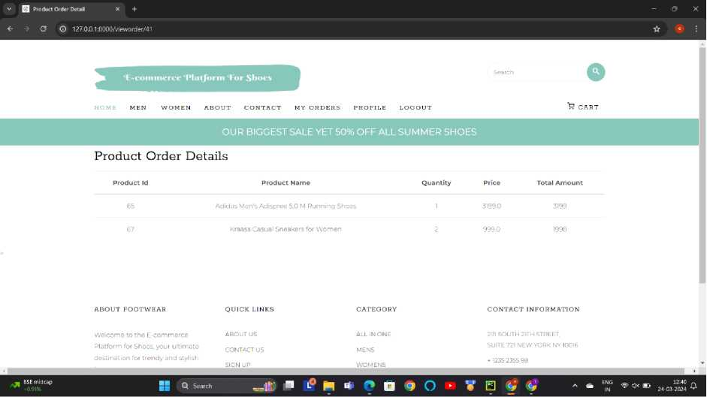
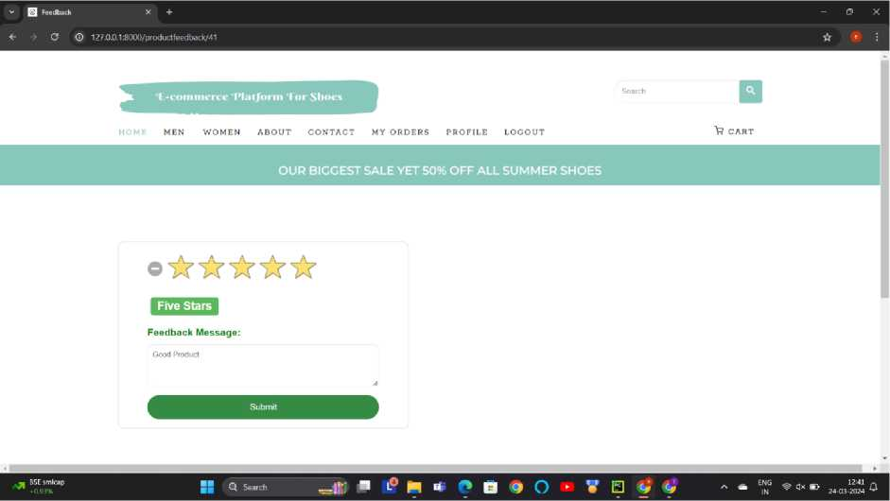
View Detail of order:
Description :- This screen-shot show the detail information of order.
Feedback:
Description :- This screen-shot is about feedback. User can give a feedback according to their choices.
NAVGUJARAT COLLEGE OF COMPUTER APPLICATION
35

Slide 39
VENDOR LAYOUT
NAVGUJARAT COLLEGE OF COMPUTER APPLICATION
36

Slide 40
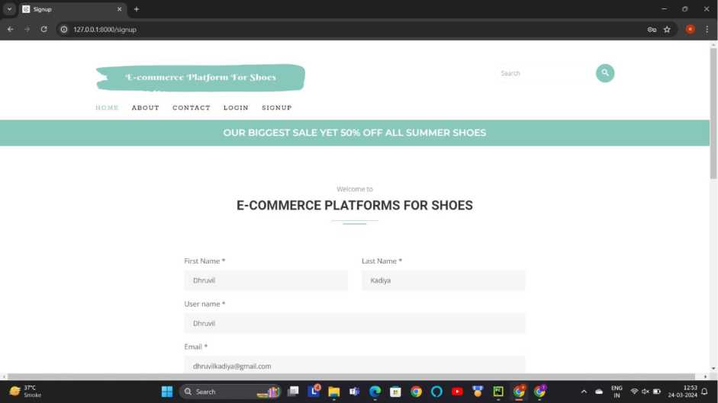
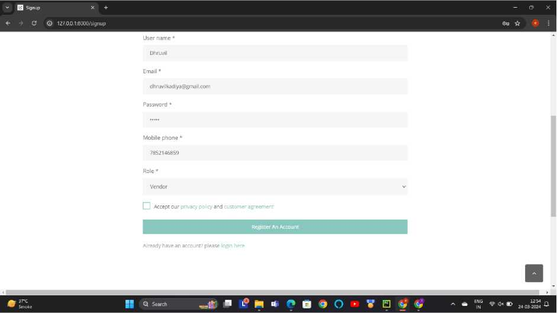
Registration Page:-
Description This screen-shot is about registration page.Vendor can register their self for purchasing any product.
NAVGUJARAT COLLEGE OF COMPUTER APPLICATION
37

Slide 41
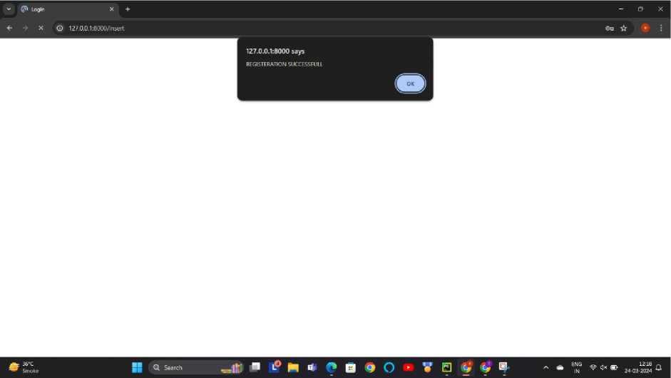

Description :- This screen-shot show when vendor is successfully registered. After registering vendor have to login.
Login Page :-
NAVGUJARAT COLLEGE OF COMPUTER APPLICATION
38

Slide 42

Description :- This screen-shot is about login page. Vendor can login from here with their email id and password.
v (j?) Login X +
4- X © 127.0.01:8000/insert
 | 127,0.0.1:8000 says REGISTERATION SUCCESSFULL •
■? N i* f*
V B V
NAVGUJARAT COLLEGE OF COMPUTER APPLICATION
39

Slide 43


© 127.0.0.1:8000/index
ABOUT CONTACT ADD PRODUCT MANACE PRODUCT VIEW ORDERS PROFILE LOGOUT
25% OFF (ALMOST) EVERYTHING! USE CODE: SUMMER SALE
SHOP COLLECTION
Q Search
Description :- This screen-shot is after user is logged. User can access their dashboard from here.
Complete your Profile:-
Description:-This screen-shot is about user profile page. User can complete their profile by this page.
NAVGUJARAT COLLEGE OF COMPUTER APPLICATION
40

Slide 44


Add Product :-
NAVGUJARAT COLLEGE OF COMPUTER APPLICATION
41

Slide 45


NAVGUJARAT COLLEGE OF COMPUTER APPLICATION
42

Slide 46


Description :- This screen-shot is about add product page.Vendor can add the new product from here.
Manage Product :-
Description :- This screen-shot is about manage product page. Vendor can add the edit product from here and manage all the products.
NAVGUJARAT COLLEGE OF COMPUTER APPLICATION
43

Slide 47


Edit/Update Product Data:-
NAVGUJARAT COLLEGE OF COMPUTER APPLICATION
44

Slide 48


Description :- This screen-shot is about Edit product page. Vendor can edit product from here.
Description :- This screen-shot is about manage product page. Vendor can delete product from here.
NAVGUJARAT COLLEGE OF COMPUTER APPLICATION
45

Slide 49
^{v} g) Manage Pmduct X § Manage Product X +
x © 127.0.0.l:8QQQ/manageproduct
 | 127.0.0.1:8000 says Product successfully deleted. •
* « f» a <? o
Description :- This screen-shot is about delete product page.
NAVGUJARAT COLLEGE OF COMPUTER APPLICATION
46

Slide 50
REPORT LAYOUT
NAVGUJARAT COLLEGE OF COMPUTER APPLICATION
47

Slide 51


Product Detail Report Before Generating:
After generating as pdf form:-
NAVGUJARAT COLLEGE OF COMPUTER APPLICATION
48

Slide 52


Product Order Report Before Generating:
After generating as pdf form:-
NAVGUJARAT COLLEGE OF COMPUTER APPLICATION
49

Slide 53


Payment Detail Report Before Generating:
After generating as pdf form:-
NAVGUJARAT COLLEGE OF COMPUTER APPLICATION
50

Slide 54


Login Report Before Generating:
After generating as pdf form:-
NAVGUJARAT COLLEGE OF COMPUTER APPLICATION
51

Slide 55


Sample Coding
Views.py:-
NAVGUJARAT COLLEGE OF COMPUTER APPLICATION
52

Slide 56

Models.py:
0 | = 1 E occmmercel ^{v} Version control ^{v} |  | Current File v |> Q ■ | a a © - | 3 | X
CD | Project - | ■Sf models.py ^{x} |  |  |  | a
□□ | Qecommercel jecommerce' > C3 ecommerce | from django.db import models from django.utils.safestring import mark_safe |  | A 9 A 40 «J1 | ~ V
p | > CDvenv library root > iQj External Libraries i? Scratches and Consoles | STATUS = [ ("Inactive”, "Inactive"}, ("Active", "Active"),
 |  | PRCDUCT_STATUS = [ (“B'V'Qiit of stock"), |  |  | -
10 C*i","instock"). I
]
u Create your models here.
class Login_Table(nK>dels.Model):
First_name = models .CharFleldCmax.lengthsSB, null=True) Last.name = models.CharField(max_length=3G, null=True) User.name = models.CharField(max_lervgth=30, null=True) £mall_ld = models.EmailFieldO Phone_no = models.BiglntegerFieldO
 | Password = models,CherFieldCmax. | .length=39) |  | _
■- | ROLE = (
© | ("Vendor", "Vendor"), ("User", "User"), |  |  | -
& | ) Role = models.CharFieldCmax.lent | |th=30, defaul | t=")
© | Status = models.CharField(max_l4 | ingth=3G_{A}choic | es=STATUS)
0 | 27 ©r def _str (self):
© | return self.User_name
oecommercel > ecommerce > ecommerce > myapp > %»models.py 10:21 CRLF UTF-8 4 spaces Python 3.12 (ecommercel) of
• s: a*-* JK ■ L© o, f* Q c, o ► 7 « * c n s - - a ^{EN}_{N}^{S} ♦ »■*> *
NAVGUJARAT COLLEGE OF COMPUTER APPLICATION
53

Slide 57
urls.py:
• Decommercel
v CD ecommerce > CD idea ^{v} CD ecommerce
> D.idea
> CD media ^ ED myapp
> ED migrations
> CD static
> CD templates
if_init__py
from django.urls import path from .import views
urlpatterns = [
pathC ¹, views, index.name=¹¹index”), pathC’ index ■ .views. index.name="index"), path (* about ’ . views. about_{JL}name="about"), pathCaboutus¹. views.aboutus, names*'aboutus").
path('add-to-wishlist' .views.add_to_wishlist,namf>s"add-to-wishlist"),
pathC 'cart¹ . views.cart./•; - ->="cart"),
path(¹ checkout¹.views.checkout.name="checkout"),
pathC contact * . views, contact, > a n-?s"contact"),
path(' men', views. men ,nanie="men"),
path C' allproduct' .views. allproduct. i • .="allproduct"),
path(¹ order-complete'.views.order_complete, ia m="order-complete”),
pathCproduct-detail/<int:pid>⁻,views.product.detail,name="product-detail"),
pathC women' .views .women.name=”wowen¹¹),
pathC¹ signup'.views.signup.name="slgnup"),
pathC'login', views.login, name="login"),
pathC insert' .views. insertdata.name=”insert"),
pathC' checklogin' .views. checklogin, n ^{i}>me="checklogin"),
pathC logout* .views. logout.name="logout" ),
pathC'yoursinqleorder/<int:id>‘.views.yoursingleorder, = "yoursingleorder").
pathC'profile¹.views.profile.na ^"profile"),
pathC showorders',views.showorders, nam-="showorders"),
pathCfeedback¹.views.feedback.name=“feedback"),
^ pathC'addtocart'.views.addtocart. ="addtocart"). pathC'addproduct'.views.addproduct, ^"addproduct") ,| pathC'insertproduct', views.insertproduct. v ^"insertproduct").
pathC'insertprofiledetall'. views.insertprofiledetail, ="insertprofiledetall"). pathC'manageproduct*.views.manageproduct, ami^''manageproduct").
if views.py ■ IS myproject D static ¹ D venv
0 ecommerce.zip
> CD venv i! ary ro< i Qi External Libraries Scratches and Consoles
.="voursinqleorder"),
□ ecommerce! > ecommerce )
Q Search
L°*f*O9>0 • ? ^ ’ir N B
28:59 CRLF UTF-8 4 spaces Python 3.12 (ecom
> CD idea ^{v} Cl ecommerce
> D.idea
> D media ^{v} ED myapp
> ED migrations
> D static
> D templates
C'addtocart'.views.addtocart. ■="addtocart").
C¹addproduct'.views.addproduct.' ="addproduct"),
Oinsertproduct’.views.insertproduct. jme="insertproduct").
C'insertprofiledetail'. views.Insertprofiledetall, . ;-="lnsertproflledetall").
C'manageproduct'.views.manageproduct. n ="manaqeproduct").
C'insertcontact'. views■ insertcontact. I T ="insertcontact").
C'deleteproduct/<int:did>'.views.deleteproduct,r r ^"delete"),
C'removeproduct/<int:rld>'.views.removeproduct.i arae=”remove"),
( ' editproduct/<int:eid>'.views.editproduct, i.-in.:-="editproduct") ■ C'updateproduct/<int:uid>'.views.updateproduct. n -"updateproduct").
C'placeorder’.views.placeorder,i mi ="placeorder").
C'lncreaseltem/<lnt:ld>'.views.lncreaseltem, ; ="lncreaseltem"). C'decreaseitem/<int:id>'. views.decreaseitem, -="decreaseitem").
C'forgotpassword'. views.forgotpassword, r ^'forgotpassword').
0vleworder/<lnt:ld>', views.vieworder, nes'vleworder¹).
C'productfeedback/<lnt:order_ld>'. views.productfeedback, nor ='productfeedback').
Cstorefeedback'. views.storefeedback, ■ ='storefeedback').
C'vendorvieworder', views. vendorvieworder, names' vendorvieworder ‘) .
C' ai^nugne*',^{v}l«ws.algnupn8«, Typo: In word Worvteworder'
C'loqlnnew'. views .loglnnew. ■ =''loqlnnew") .
C' f indproduct'. views, findproduct, »«»findproduct"). Save'vendorvieworder¹ to dictionary > C' prof ile2 ', views.profile2.n ane="prof ile2"),
C'edltproduct2/<lnt:eld>'.views.edltproduct2. -="edltproduct"),
C 'myorder' .views, myorder,n ="myorder'‘)
if views.py ¹ ED myproject D static
Typo: In word 'vendorvieworder¹
52:1 CRLF UTF-8 4 spaces Python 3.12 (ecommercel) cf
NAVGUJARAT COLLEGE OF COMPUTER APPLICATION
54

Slide 58
Future Enhancements
> Social Integration: Integrate social media features to allow users to share their favorite shoe finds, reviews, and purchases with friends and followers. This enhances engagement and word-of-mouth marketing for the platform.
> Customization Options: Offer customization features that allow users to personalize their shoes with different colors, materials, or designs. This adds a unique selling point and increases customer satisfaction by providing tailored products.
> Real-Time Inventory Management: Implement realtime inventory management to ensure accurate stock availability information. This prevents disappointment due to out-of-stock items and improves overall customer experience.
> Virtual Styling Consultations: Provide virtual styling consultations with professional stylists to help users choose the perfect shoes for their outfits or occasions. This adds value to the shopping experience and builds customer loyalty.
> Gamification Elements: Incorporate gamification elements such as loyalty programs, challenges, or rewards for completing certain actions on the platform. This encourages user engagement, repeat visits, and brand loyalty.
NAVGUJARAT COLLEGE OF COMPUTER APPLICATION
55

Slide 59
BIBLIOGRAPHY
> | https://www.google.com/
> | https: //youtube.com/
> | https: //www.w3 school s .com/
> | https: //www.iavatpoint.com/
NAVGUJARAT COLLEGE OF COMPUTER APPLICATION
56

Slide 60
CONCLUSION
> It was wonderful and learning experience for me while working on this project.
> This project took me through various aspects of project and taught me about research and findings. It also give me real insight into this project. This project was full of thrill and joy.
> We learned a lot about problem-solving and how to deal with challenges.
NAVGUJARAT COLLEGE OF COMPUTER APPLICATION
57

Slide 61
NAVGUJARAT COLLEGE OF COMPUTER APPLICATION
58

