Slide 1

Swami Keshvanand Institute of Technology,
Management & Gramothan, Jaipur
Department of Information Technology
Project Name:
Real Time Air Quality Monitoring & Weather Forecasting System
Mentor:
Ms. Shalini Singhal
Assistant Professor
Submitted by:
Rishabh Dev Singh (19ESKIT077)
Sakshi Agarwal (19ESKIT083)
Vinit Kumar Shah (19ESKIT098)
Yashwardhan Gaur (19ESKIT099)
Submitted to:
Ms. Sanju Choudhary
Associate Professor

Slide 2
Introduction
Real time air quality monitoring and weather forecasting system.
Combines the factor of air quality into weather forecasting to give more accurate information.
It uses Android SDK, Android API , JAVA and other latest technologies.
It uses Open weather & AQI APIs to get the data.

Slide 3
Purpose of the Project
To provide information that can be use by people and organizations.
To reduce weather related losses and enhance social benefits.
To provide real time information on an easy to use UI.
To provide an ad free, privacy oriented experience.

Slide 4
Existing System
Filled with adware, floating ads and popups.
Not so easy to use interface for general public.
Does not integrate air quality and weather forecasting together on one platform.
No UV data of your location.

Slide 5
Proposed System
Light weight app with no ads or pop ups.
Easy to use interface.
Realtime UV data of your location.
Real time suggestion and feedback system to further increase accuracy in weather forecasting.

Slide 6
Scope
Great for travel & tourism industry.
Great for business industry.
Good scope for general public looking for an all in one solution.
Good scope in public sector area for preservation of life and property, promotion of public health and safety.

Slide 7
Technology & Tools used
Technology: Android SDK, Android API 22 (Android v5.1 and sooner), JAVA
APIs: Open weather map & AQI APIs and webhooks
Tools: Android Studio

Slide 8
Modules
Activities: For interactions on a page.
Adapters: For linking views with activities.
Fragments: For dialogues on UI.
Models: For structure of weather data.
Notification: For displaying notifications.
Utilities: For reusable structures across the app.
Weather API: For fetching weather data based upon request
Widgets: For UI widgets.

Slide 9
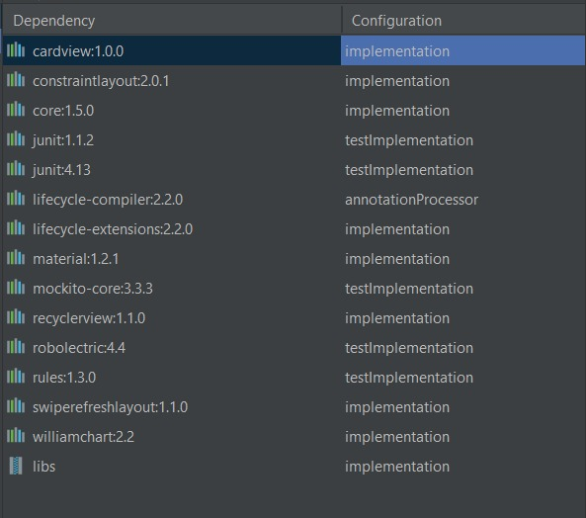
Dependencies

Slide 10
Weather Forecasting Process
The Dataset/Dataset Exploration
Pre processing, Advanced Visualization, Stationarity
Machine Learning Algorithms
Forecasting

Slide 11
Calculation of AQI
The air quality index is calculated based on averages of all pollutant concentrations measured in a full hour, a full 8 hours, or a full day. To calculate an hourly air quality index, we average at least 90 measured data points of pollution concentration from a full hour (e.g. between 09:00 AM and 10:00 AM).

Slide 12
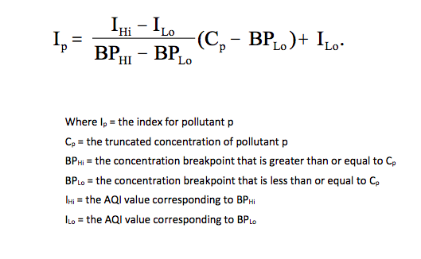
Calculation of AQI
Further considerations for individual pollutants: -
Carbon Monoxide
Nitric Oxide
Particulate matter

Slide 13
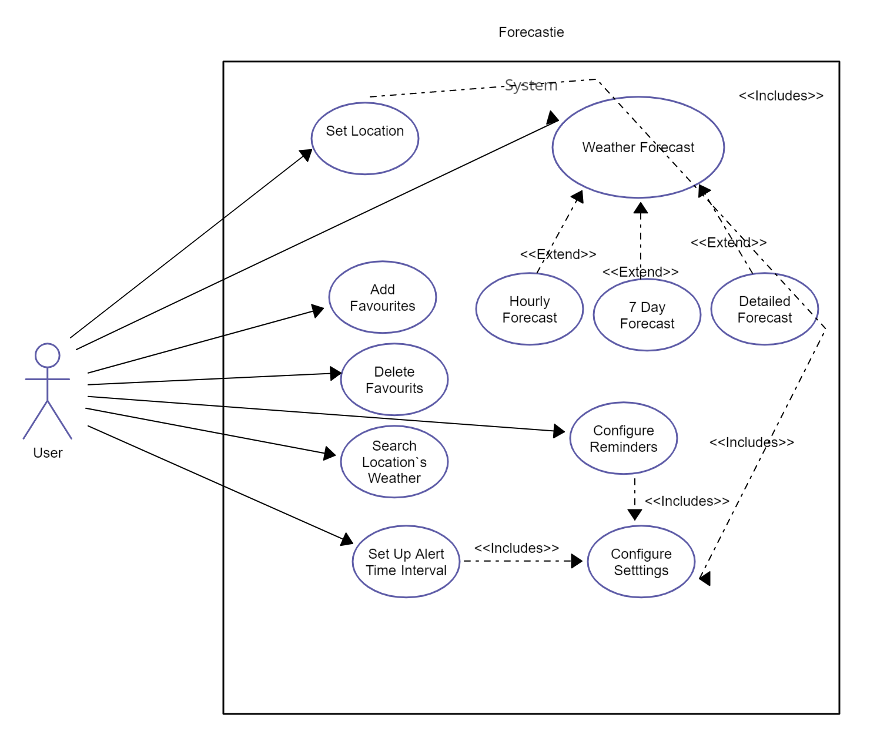
Use case

Slide 14
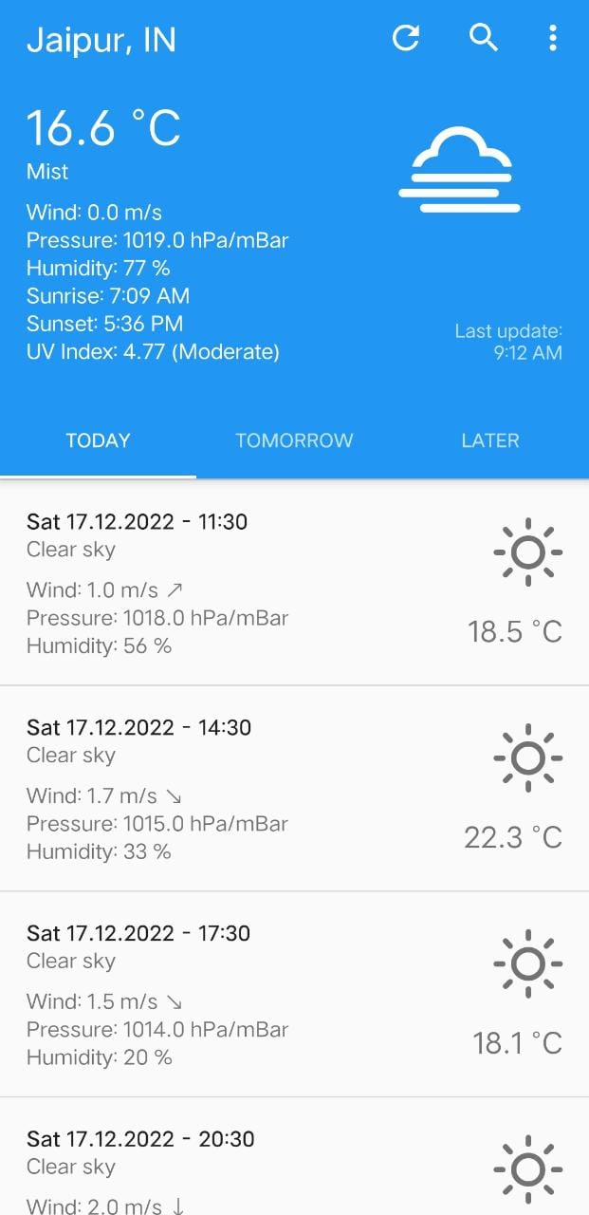
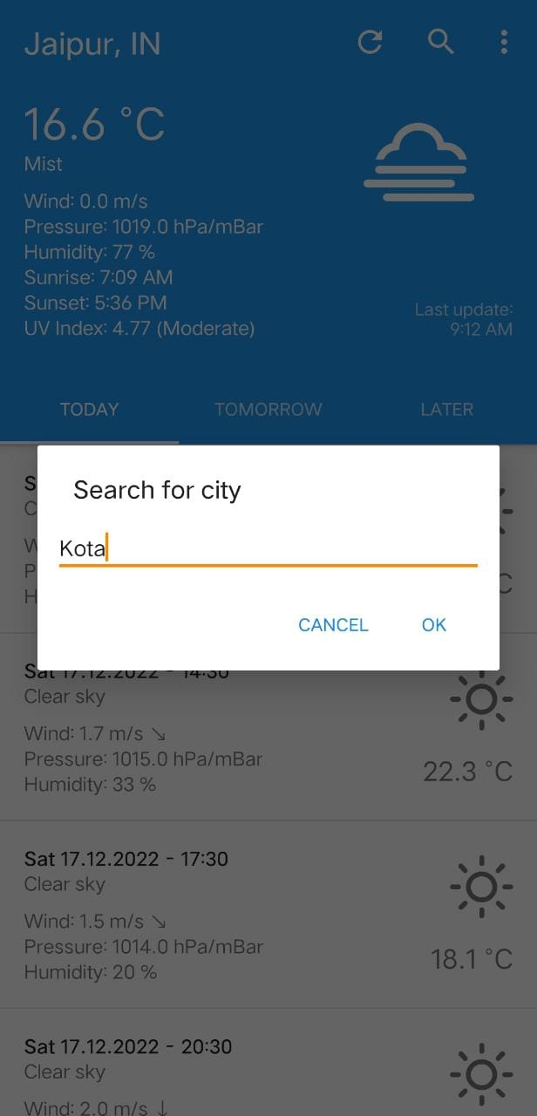
User Interface

Slide 15
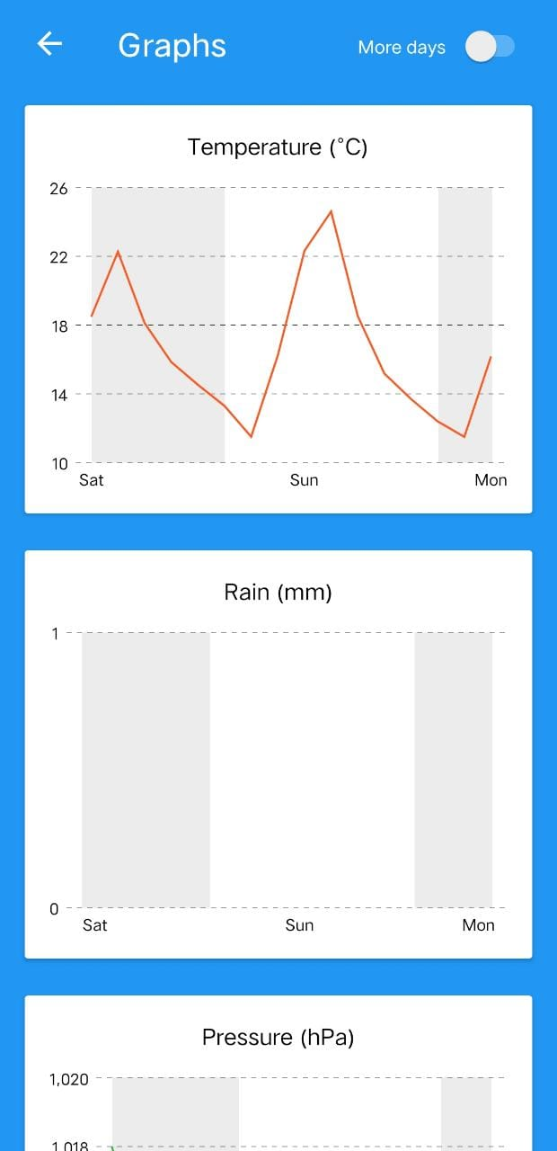
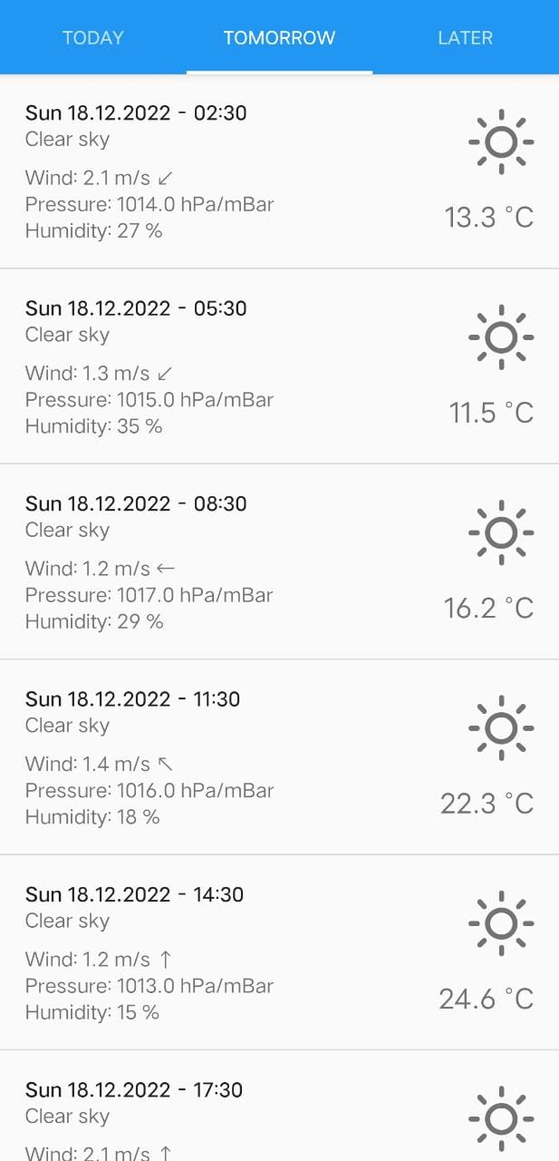
User Interface

Slide 16
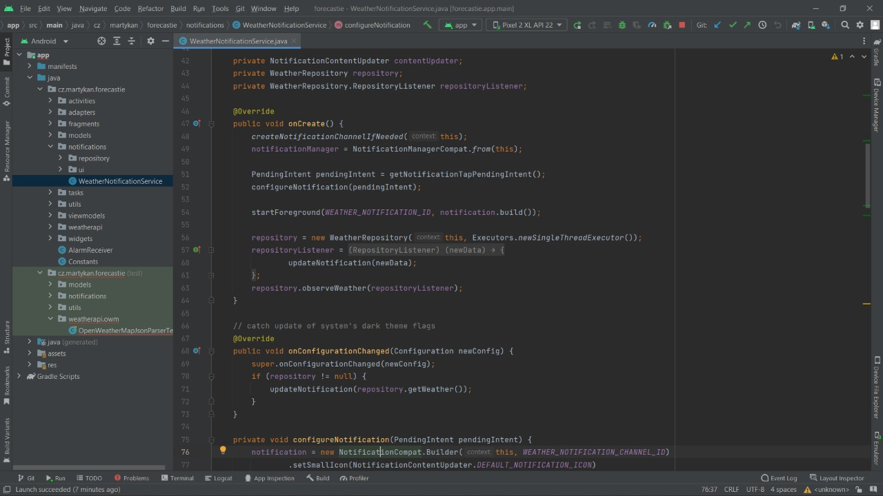
Code Snapshot

Slide 17
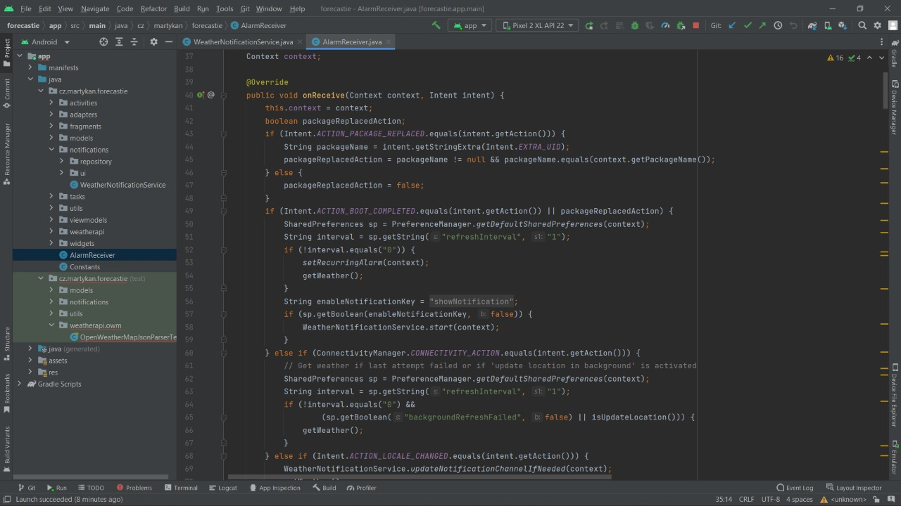
Code Snapshot

Slide 18
Conclusion
Real time monitoring of hourly, daily, weekly weather.
Real time Air Quality Index monitoring.
Simple and easy to use.

Slide 19
Future scope
Real time satellite imaging based weather prediction.
Real time cloud movement tracking.

