Slide 1

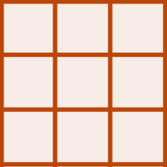


Raster A
Raster A*
L
L*
Upscaling
terra::aggregate
Raster A
L_{A}
Fine Coarse
L*= axL
Raster B
Raster B*
L
L*
Raster B
Downscaling
terra::disagg
L_{B}
Coarse Fine
L*=L/a
Raster A
Raster A*
L_{B} = 2xL_{A}
L
L_{A}*
Resampling
terra::resample
Res A Res B
L_{A}* = L_{B}= 2xL_{A}

Slide 2
Raster A
Raster A*
L
L_{A}*
Resampling
Raster A
terra::resample
L_{A}
Res A Res B
L_{A}* = L_{B}= 2xL_{A}
Raster A
Raster A*
L
L*
Raster B
Upscaling
terra::aggregate
L_{B}
Fine Coarse
L*= axL
Raster B
Raster B*
L_{B} = 2xL_{A}
L
L*
Downscaling
terra::disagg
Coarse Fine
L*=L/a

Slide 3
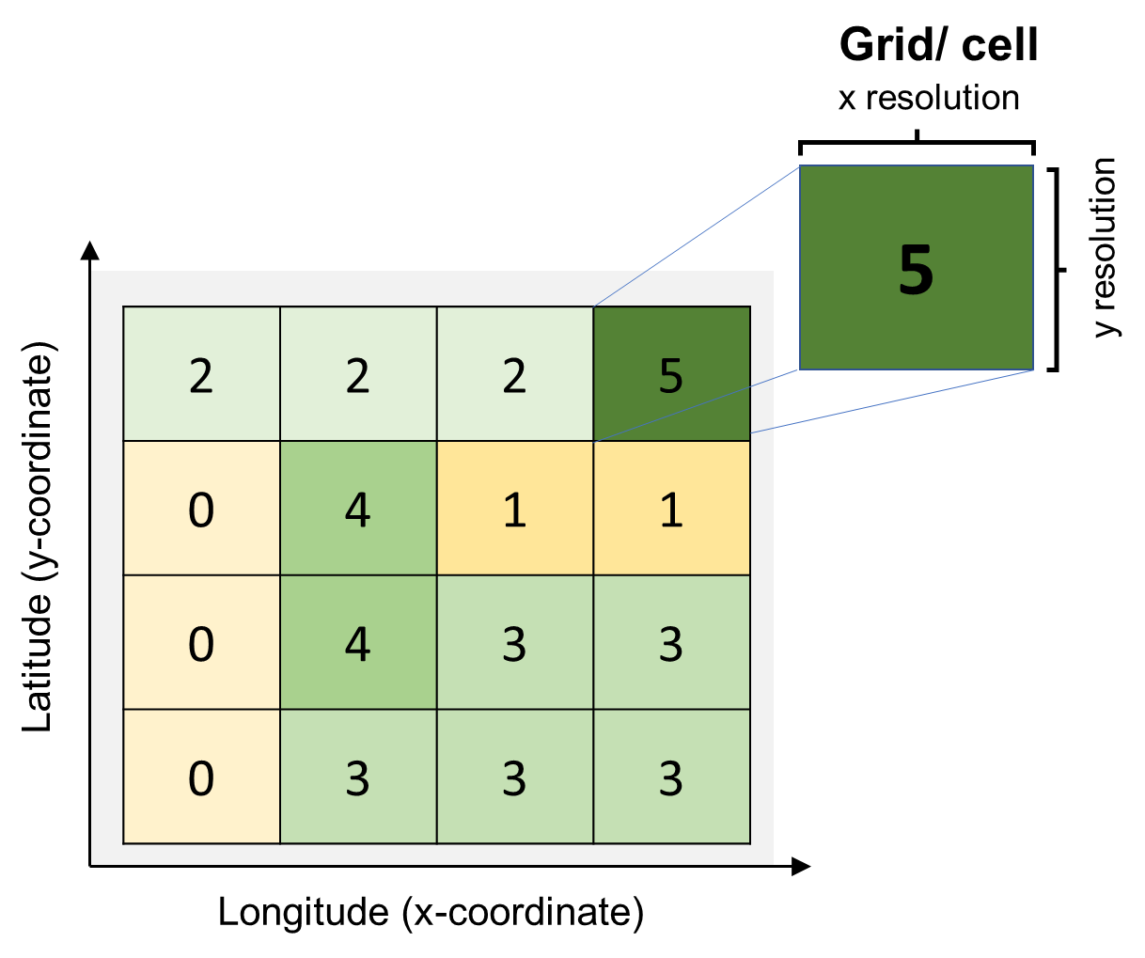
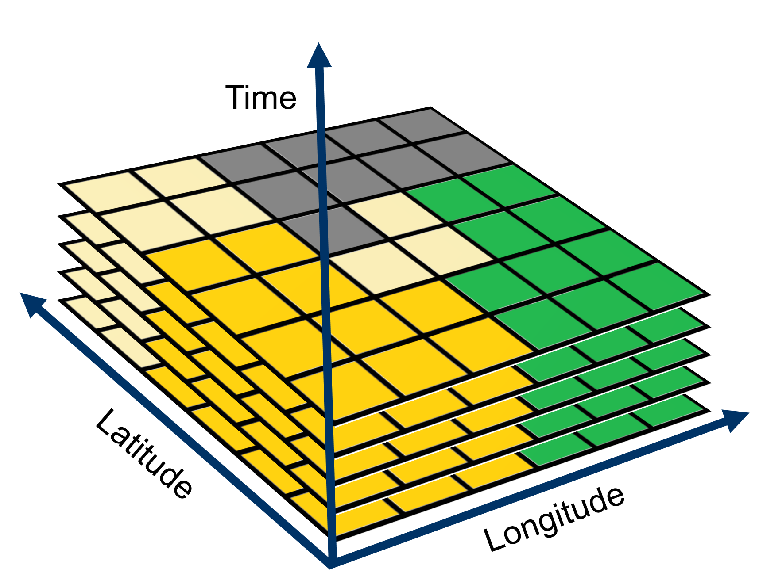
Raster
netCDF
t
t-1
t-2
…

Slide 4
Raster Arithmetic
Arithmetic operation on a raster (*,/, ^^, +, -)
Histogram, boxplot, etc.
Inter-raster operations (diff, average SM for n days, etc.)
Multivariate plots of rasters
Raster Statistics
Applying user defined function
Value extraction
Aggregation, disaggregation and resampling

Slide 5
How to define a function:
function_name= function (variable, argument) {
Execute line 1
Execute line 2
…
value=statement
return (value)
}
How to call a function:
function_name (variable, argument)
Name of the function
Instructions to be executed
Stores the value of the function output
Returns value as function output

Slide 6
FLASH CARD (Raster Arithmetic & Stats)
terra::rast Import raster
terra:: global Apply function on raster layer terra::values Generate array of raster cells
A [A < value] = new_value Replace raster cell values based on logical operator

Slide 7
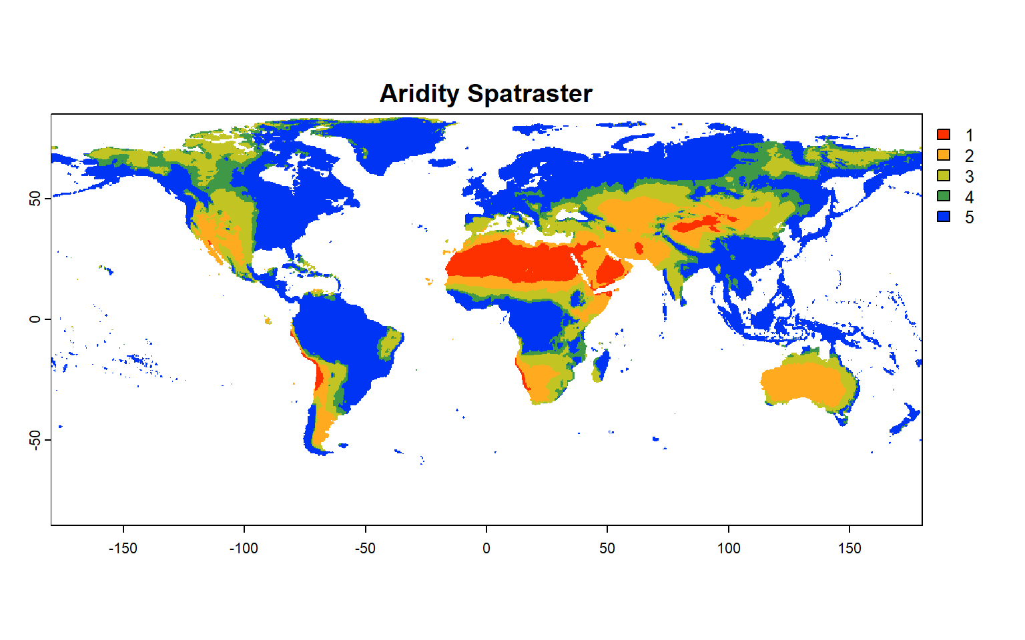
Hyper arid
Arid
Semi arid
Sub humid
Humid
Global Climate Classification

Slide 8
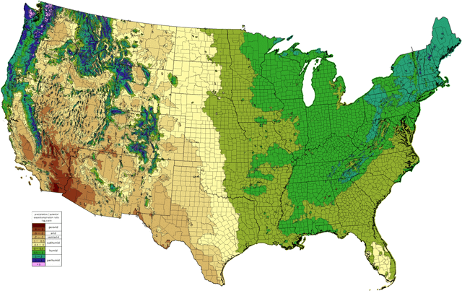
US Moisture Index Map

Slide 9
FLASH CARD (Raster Resampling, RATification and Zonal Statistics)
terra::resample Resample raster to target resolution
terra:: aggregate Aggregate (coarse) a raster layer terra::disagg Disaggregate (fine) a raster layer
terra::crop Cut out raster/vector to the match extent
terra::mask Cut out raster/vector to the match shape
base::cut Assign discrete class to continuous values
terra:: as.polygons Create polygon from raster
terra:: extract Zone-wise extract raster cells using polygon
exactextractr:: exact_extract Same as above, but faster

Slide 10
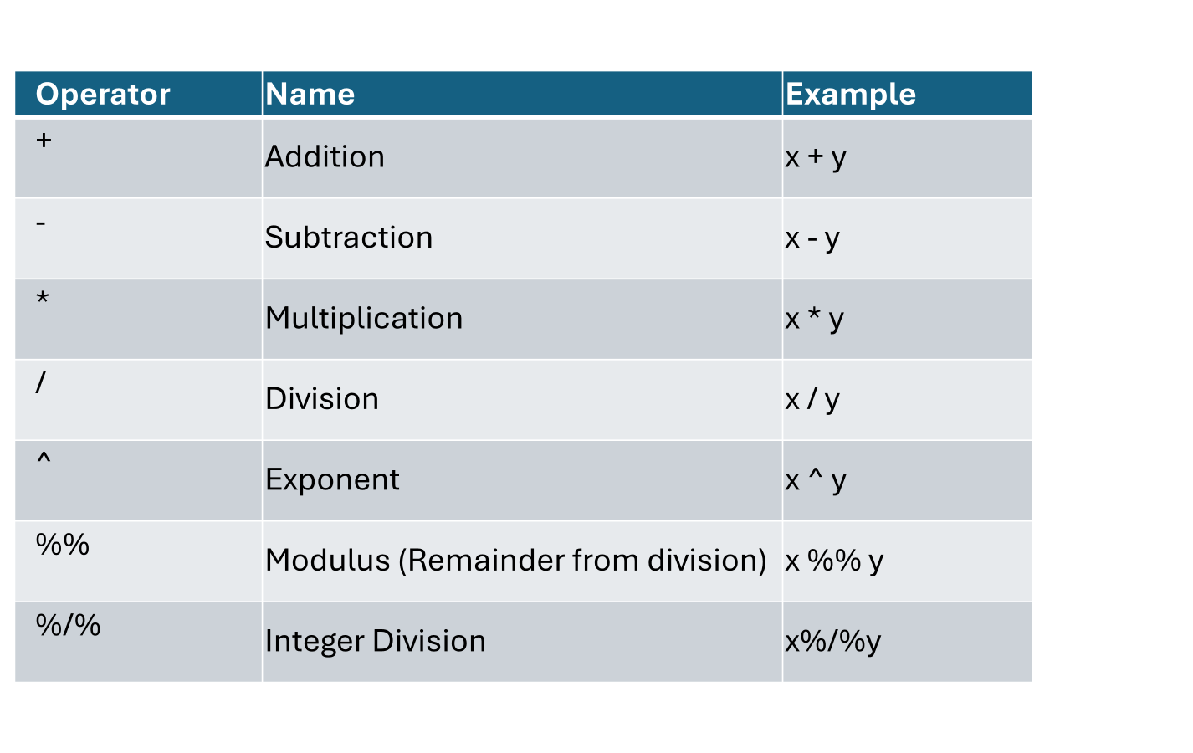
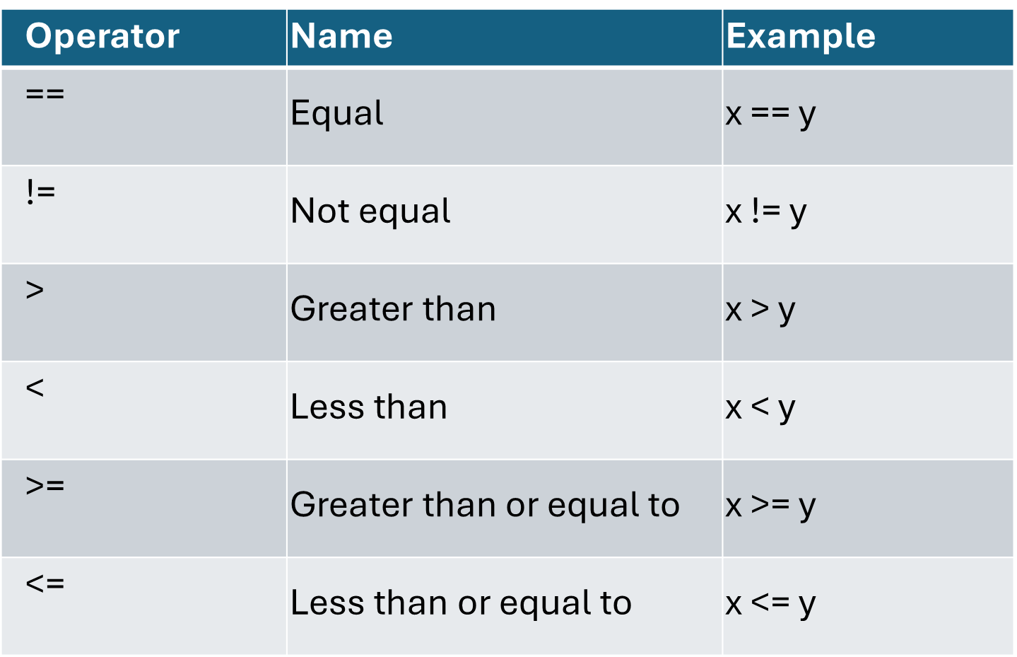
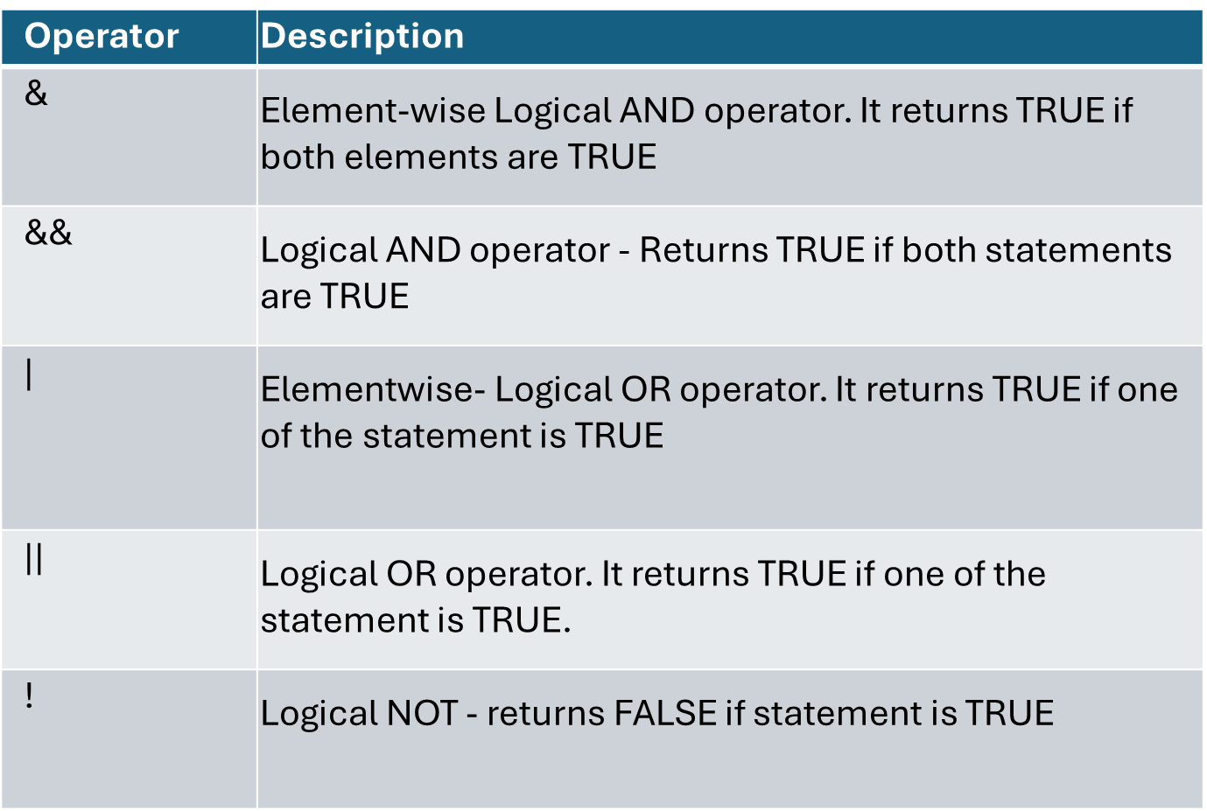

Slide 11
Operator | Name | Example
+ | Addition | x + y
- | Subtraction | x - y
* | Multiplication | x * y
/ | Division | x / y
^ | Exponent | x ^ y
%% | Modulus (Remainder from division) | x %% y
%/% | Integer Division | x%/%y

Slide 12
Operator | Name | Example
== | Equal | x == y
!= | Not equal | x != y
> | Greater than | x > y
< | Less than | x < y
>= | Greater than or equal to | x >= y
<= | Less than or equal to | x <= y

Slide 13
Operator | Description
& | Element-wise Logical AND operator. It returns TRUE if both elements are TRUE
&& | Logical AND operator - Returns TRUE if both statements are TRUE
| | Elementwise- Logical OR operator. It returns TRUE if one of the statement is TRUE
|| | Logical OR operator. It returns TRUE if one of the statement is TRUE.
! | Logical NOT - returns FALSE if statement is TRUE

Slide 14
Operator | Description | Example
: | Creates a series of numbers in a sequence | x <- 1:10
%in% | Find out if an element belongs to a vector | x %in% y
%*% | Matrix Multiplication | x <- Matrix1 %*% Matrix2

Slide 15
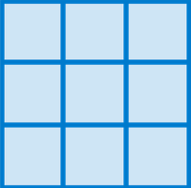
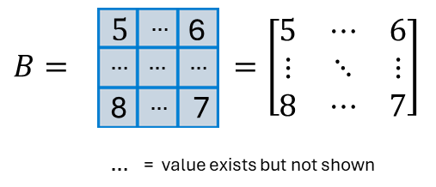


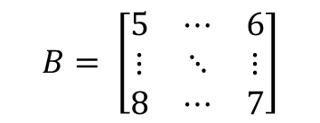

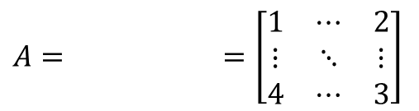



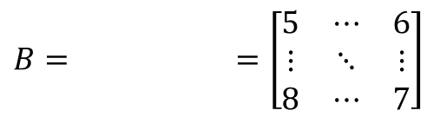


$$1$$
$$…$$
2
$$A= =\left[\begin{matrix}1 & ⋯ & 2 \\ ⋮ & ⋱ & ⋮ \\ 4 & ⋯ & 3\end{matrix}\right]$$
$$…$$
$$…$$
$$…$$
4
$$…$$
3
$…$ = value exists but not shown
$$B= \left[\begin{matrix}5 & ⋯ & 6 \\ ⋮ & ⋱ & ⋮ \\ 8 & ⋯ & 7\end{matrix}\right]$$
$$5$$
$$…$$
6
$$B= =\left[\begin{matrix}5 & ⋯ & 6 \\ ⋮ & ⋱ & ⋮ \\ 8 & ⋯ & 7\end{matrix}\right]$$
$$…$$
$$…$$
$$…$$
8
$$…$$
7
$…$ = value exists but not shown

Slide 16
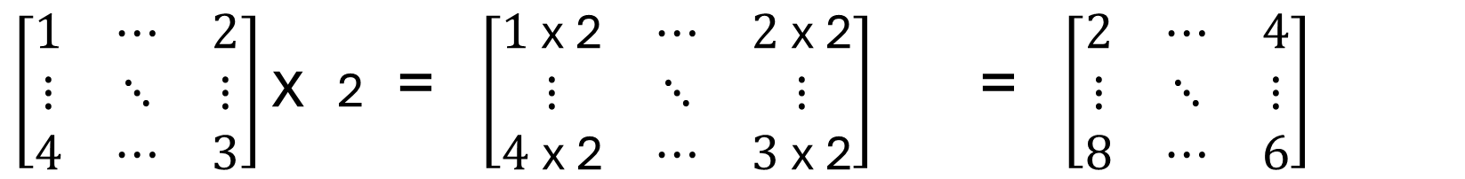
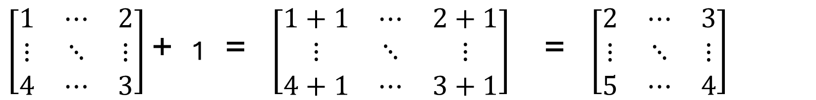
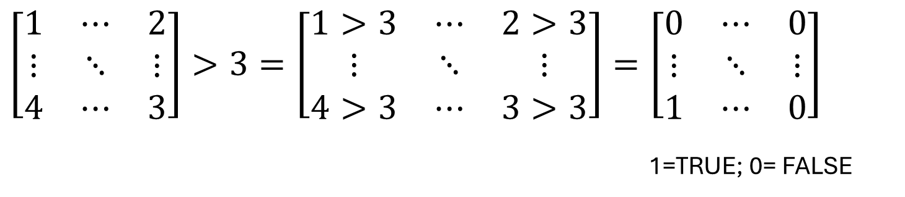
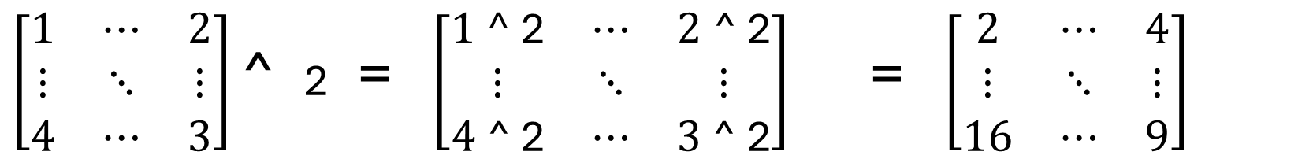
All operations are executed at grid level
$\left[\begin{matrix}1 & ⋯ & 2 \\ ⋮ & ⋱ & ⋮ \\ 4 & ⋯ & 3\end{matrix}\right]$ + 1 = $\left[\begin{matrix}1+1 & ⋯ & 2+1 \\ ⋮ & ⋱ & ⋮ \\ 4+1 & ⋯ & 3+1\end{matrix}\right]$ = $\left[\begin{matrix}2 & ⋯ & 3 \\ ⋮ & ⋱ & ⋮ \\ 5 & ⋯ & 4\end{matrix}\right]$
$\left[\begin{matrix}1 & ⋯ & 2 \\ ⋮ & ⋱ & ⋮ \\ 4 & ⋯ & 3\end{matrix}\right]$ x 2 = $\left[\begin{matrix}1 \text{x}\text{ 2} & ⋯ & 2 \text{x}\text{ 2} \\ ⋮ & ⋱ & ⋮ \\ 4 \text{x}\text{ 2} & ⋯ & 3 \text{x}\text{ 2}\end{matrix}\right]$ = $\left[\begin{matrix}2 & ⋯ & 4 \\ ⋮ & ⋱ & ⋮ \\ 8 & ⋯ & 6\end{matrix}\right]$
$\left[\begin{matrix}1 & ⋯ & 2 \\ ⋮ & ⋱ & ⋮ \\ 4 & ⋯ & 3\end{matrix}\right]$ ^ 2 = $\left[\begin{matrix}1\text{ ^}\text{ 2} & ⋯ & 2 \text{^}\text{ 2} \\ ⋮ & ⋱ & ⋮ \\ 4 \text{^}\text{ 2} & ⋯ & 3 \text{^}\text{ 2}\end{matrix}\right]$ = $\left[\begin{matrix}2 & ⋯ & 4 \\ ⋮ & ⋱ & ⋮ \\ 16 & ⋯ & 9\end{matrix}\right]$
$$\left[\begin{matrix}1 & ⋯ & 2 \\ ⋮ & ⋱ & ⋮ \\ 4 & ⋯ & 3\end{matrix}\right]>3=\left[\begin{matrix}1>3 & ⋯ & 2>3 \\ ⋮ & ⋱ & ⋮ \\ 4>3 & ⋯ & 3>3\end{matrix}\right]=\left[\begin{matrix}0 & ⋯ & 0 \\ ⋮ & ⋱ & ⋮ \\ 1 & ⋯ & 0\end{matrix}\right]$$
1=TRUE; 0= FALSE

Slide 17
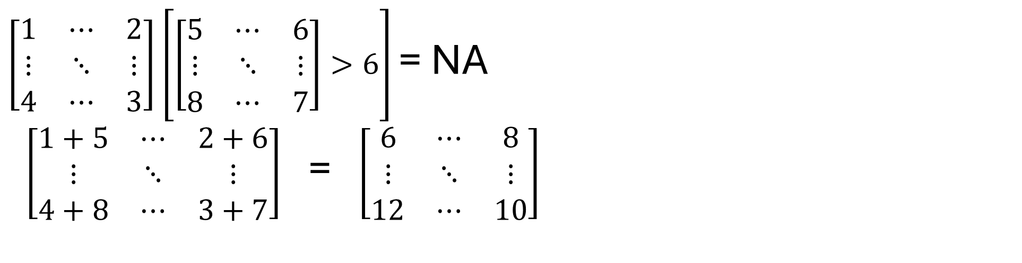
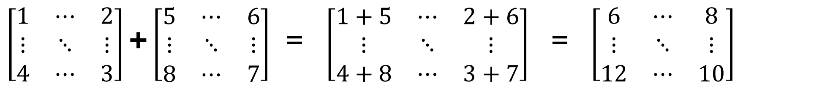
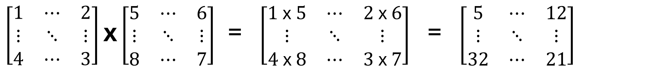
$\left[\begin{matrix}1 & ⋯ & 2 \\ ⋮ & ⋱ & ⋮ \\ 4 & ⋯ & 3\end{matrix}\right]$ + $\left[\begin{matrix}5 & ⋯ & 6 \\ ⋮ & ⋱ & ⋮ \\ 8 & ⋯ & 7\end{matrix}\right]$ = $\left[\begin{matrix}1+5 & ⋯ & 2+6 \\ ⋮ & ⋱ & ⋮ \\ 4+8 & ⋯ & 3+7\end{matrix}\right]$ = $\left[\begin{matrix}6 & ⋯ & 8 \\ ⋮ & ⋱ & ⋮ \\ 12 & ⋯ & 10\end{matrix}\right]$
$\left[\begin{matrix}1 & ⋯ & 2 \\ ⋮ & ⋱ & ⋮ \\ 4 & ⋯ & 3\end{matrix}\right]$ x $\left[\begin{matrix}5 & ⋯ & 6 \\ ⋮ & ⋱ & ⋮ \\ 8 & ⋯ & 7\end{matrix}\right]$ = $\left[\begin{matrix}1 \text{x} 5 & ⋯ & 2 \text{x} 6 \\ ⋮ & ⋱ & ⋮ \\ 4 \text{x} 8 & ⋯ & 3 \text{x} 7\end{matrix}\right]$ = $\left[\begin{matrix}5 & ⋯ & 12 \\ ⋮ & ⋱ & ⋮ \\ 32 & ⋯ & 21\end{matrix}\right]$
$\left[\begin{matrix}1 & ⋯ & 2 \\ ⋮ & ⋱ & ⋮ \\ 4 & ⋯ & 3\end{matrix}\right]$ $\left[\left[\begin{matrix}5 & ⋯ & 6 \\ ⋮ & ⋱ & ⋮ \\ 8 & ⋯ & 7\end{matrix}\right]>6\right]$ = NA
$\left[\begin{matrix}1+5 & ⋯ & 2+6 \\ ⋮ & ⋱ & ⋮ \\ 4+8 & ⋯ & 3+7\end{matrix}\right]$ = $\left[\begin{matrix}6 & ⋯ & 8 \\ ⋮ & ⋱ & ⋮ \\ 12 & ⋯ & 10\end{matrix}\right]$

Slide 18
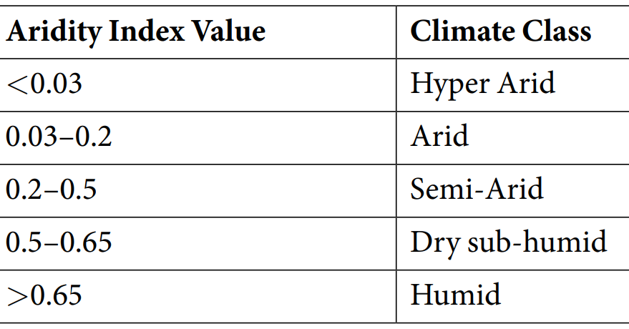

Slide 19
