Slide 1

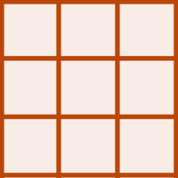

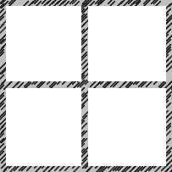
Raster A
Raster A*
L
L*
Upscaling
terra::aggregate
Raster A
L_{A}
Fine Coarse
L*= axL
Raster B
Raster B*
L
L*
Raster B
Downscaling
terra::disagg
L_{B}
Coarse Fine
L*=L/a
Raster A
Raster A*
L_{B} = 2xL_{A}
L
L_{A}*
Resampling
terra::resample
Res A Res B
L_{A}* = L_{B}= 2xL_{A}

Slide 2
Raster A
Raster A*
L
L_{A}*
Resampling
Raster A
terra::resample
L_{A}
Res A Res B
L_{A}* = L_{B}= 2xL_{A}
Raster A
Raster A*
L
L*
Raster B
Upscaling
terra::aggregate
L_{B}
Fine Coarse
L*= axL
Raster B
Raster B*
L_{B} = 2xL_{A}
L
L*
Downscaling
terra::disagg
Coarse Fine
L*=L/a

Slide 3
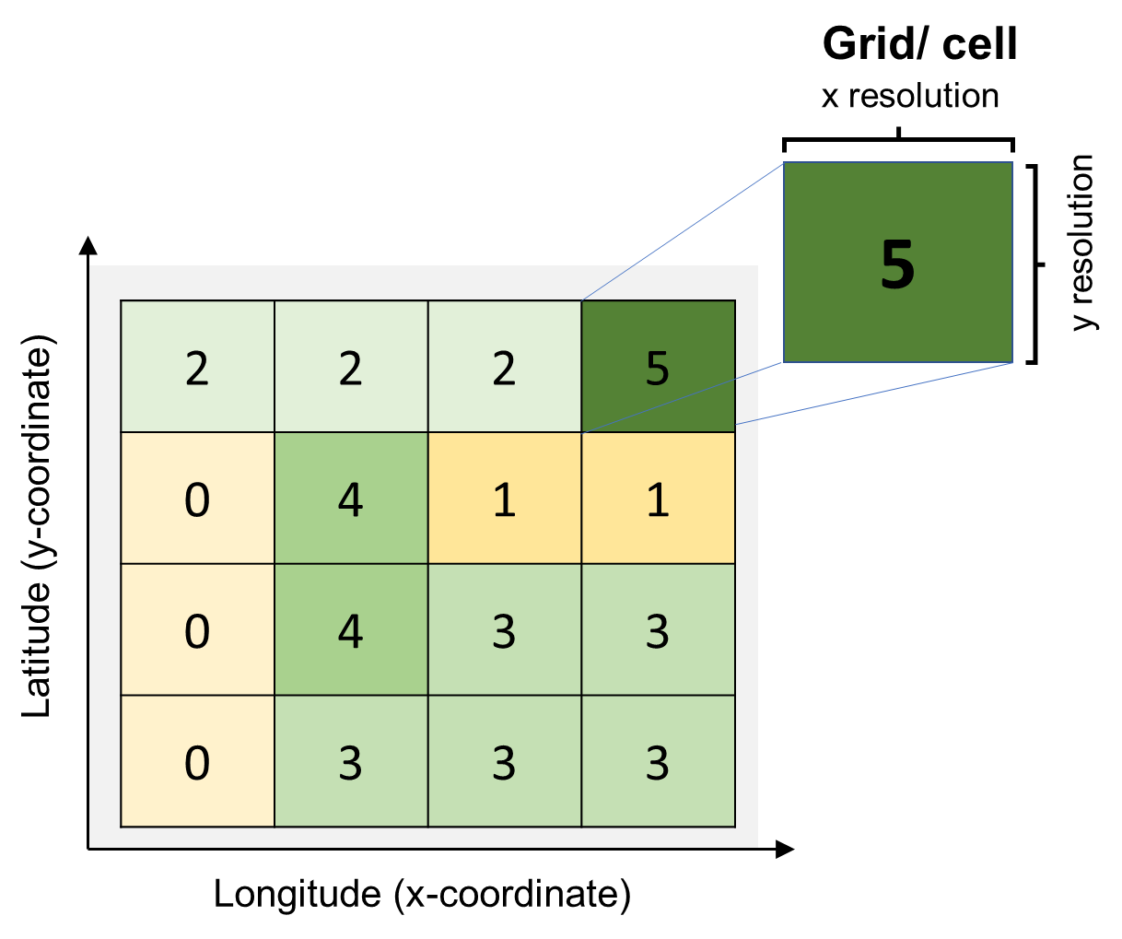
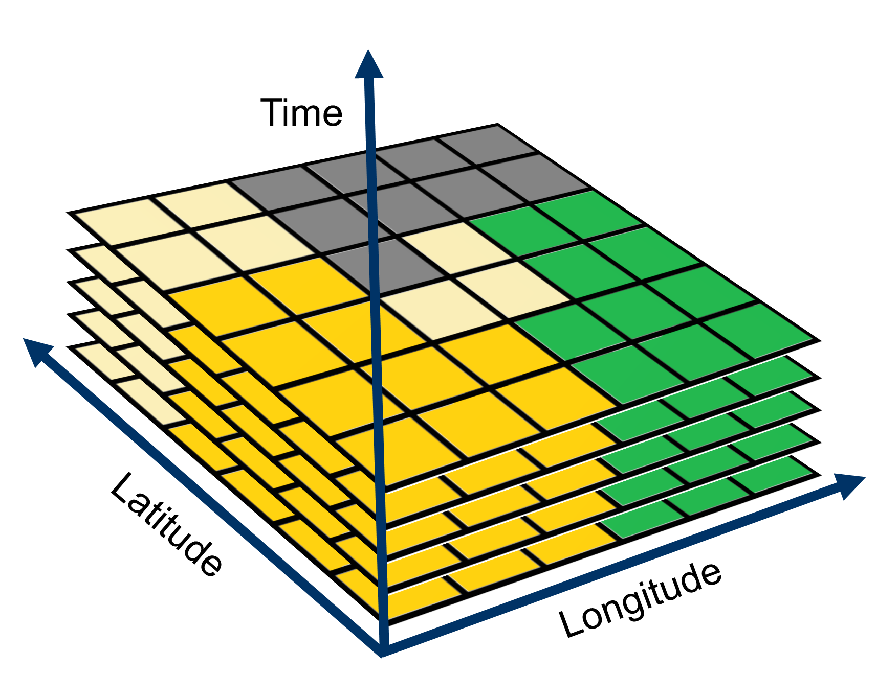
Raster
netCDF
t
t-1
t-2
…

Slide 4
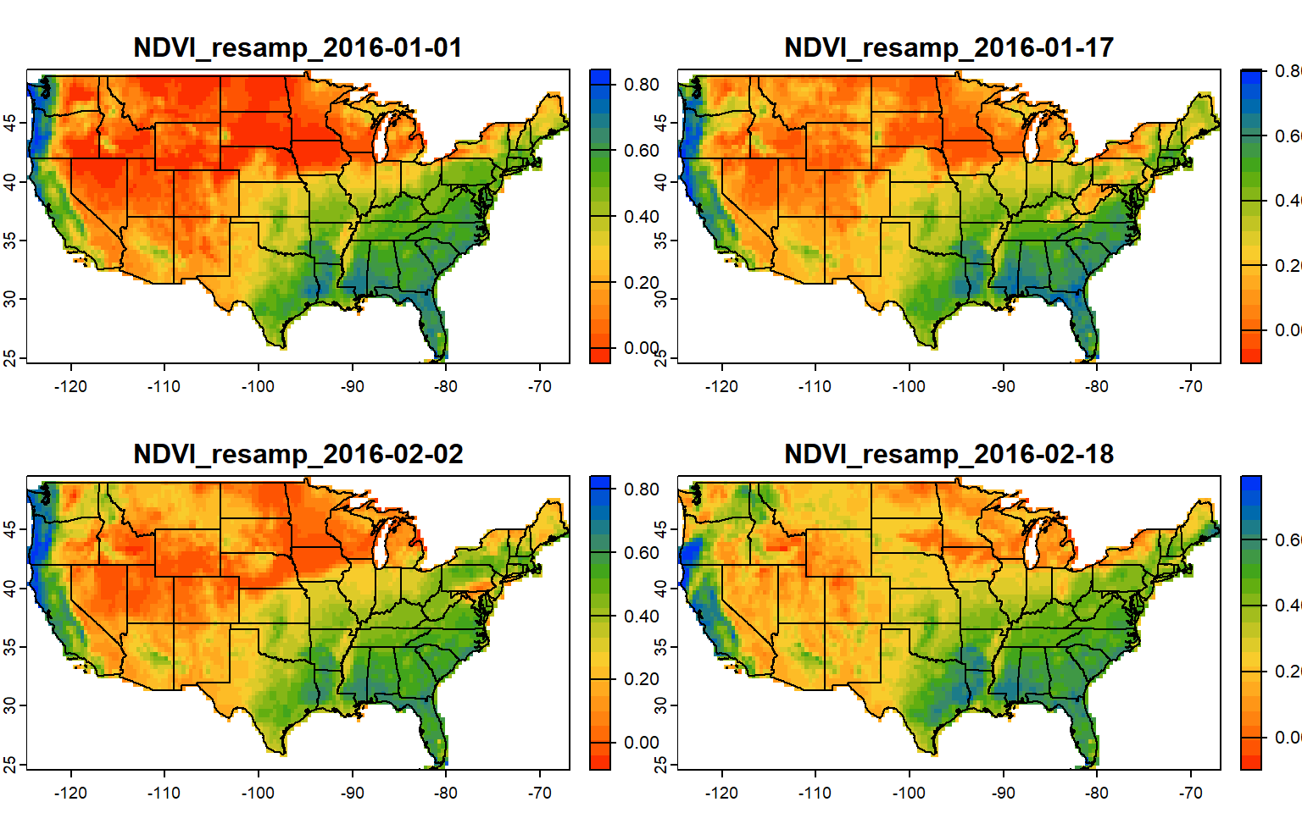


Slide 5

rast 6
rast 5
rast 4
rast 3
rast 2
rast 1

Slide 6
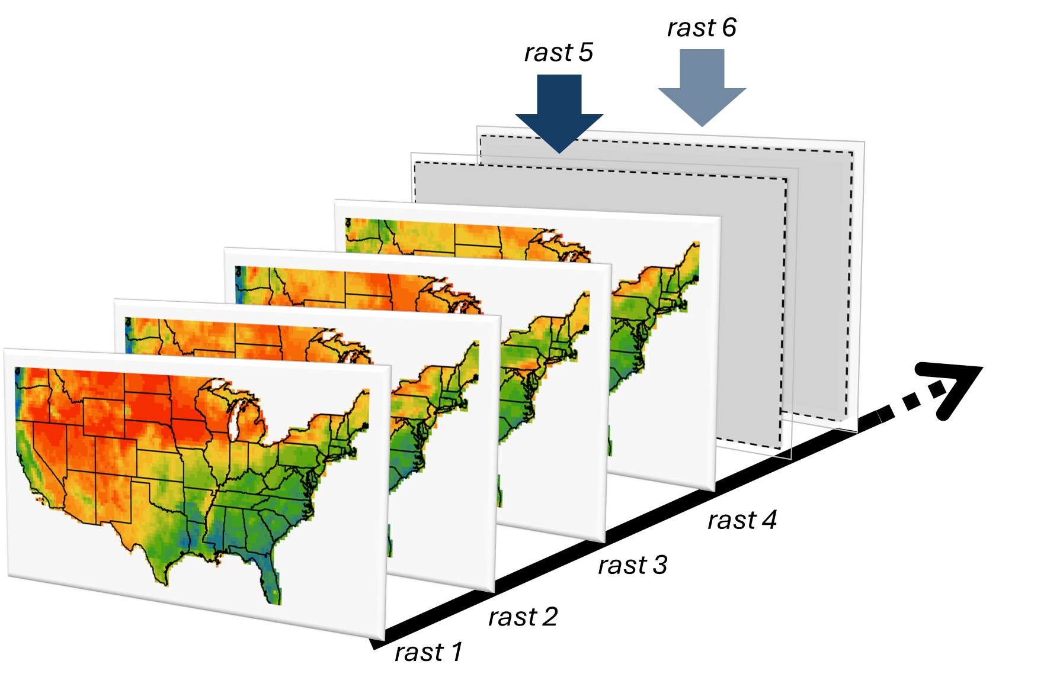

Slide 8
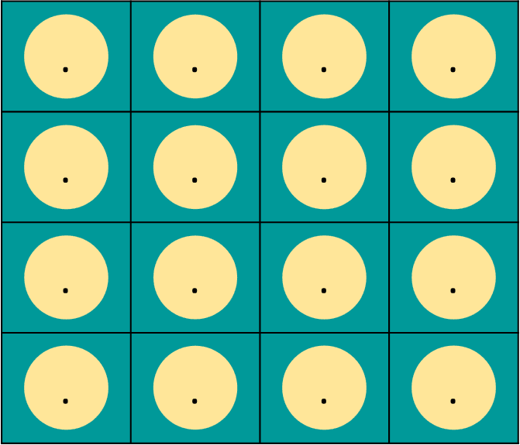

$$f(.)$$
User function
CORE
CORE
CORE
Computing cores over shared memory
Multilayer raster
Sequential grid data
Output

Slide 9
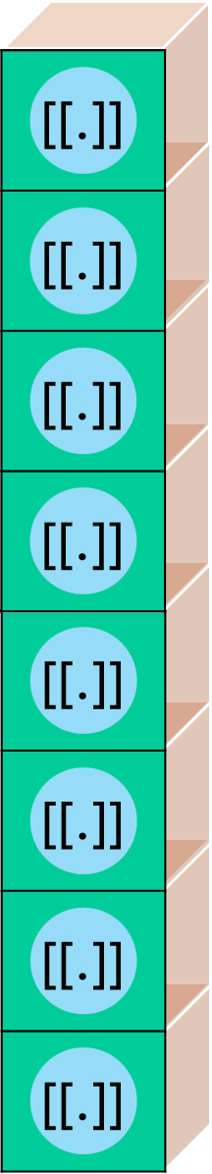

Computing cores over shared memory
Multilayer raster
Output
CORE
User function
$$f(.)$$
CORE
CORE

Slide 10
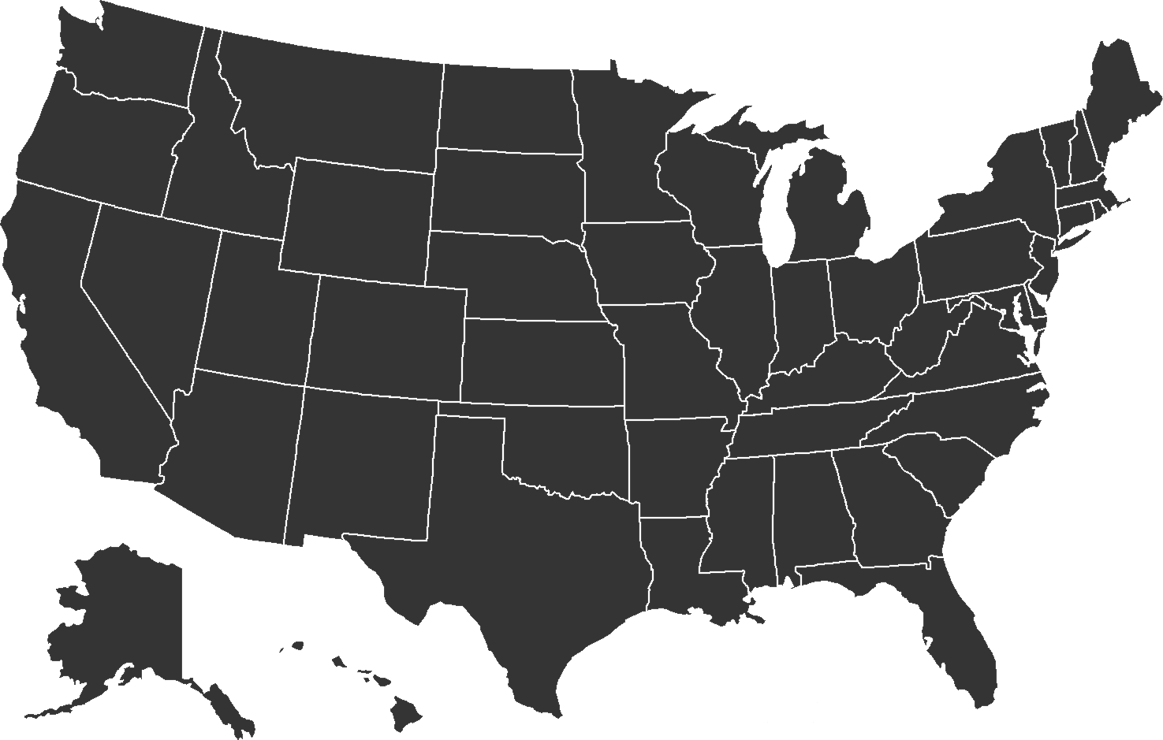

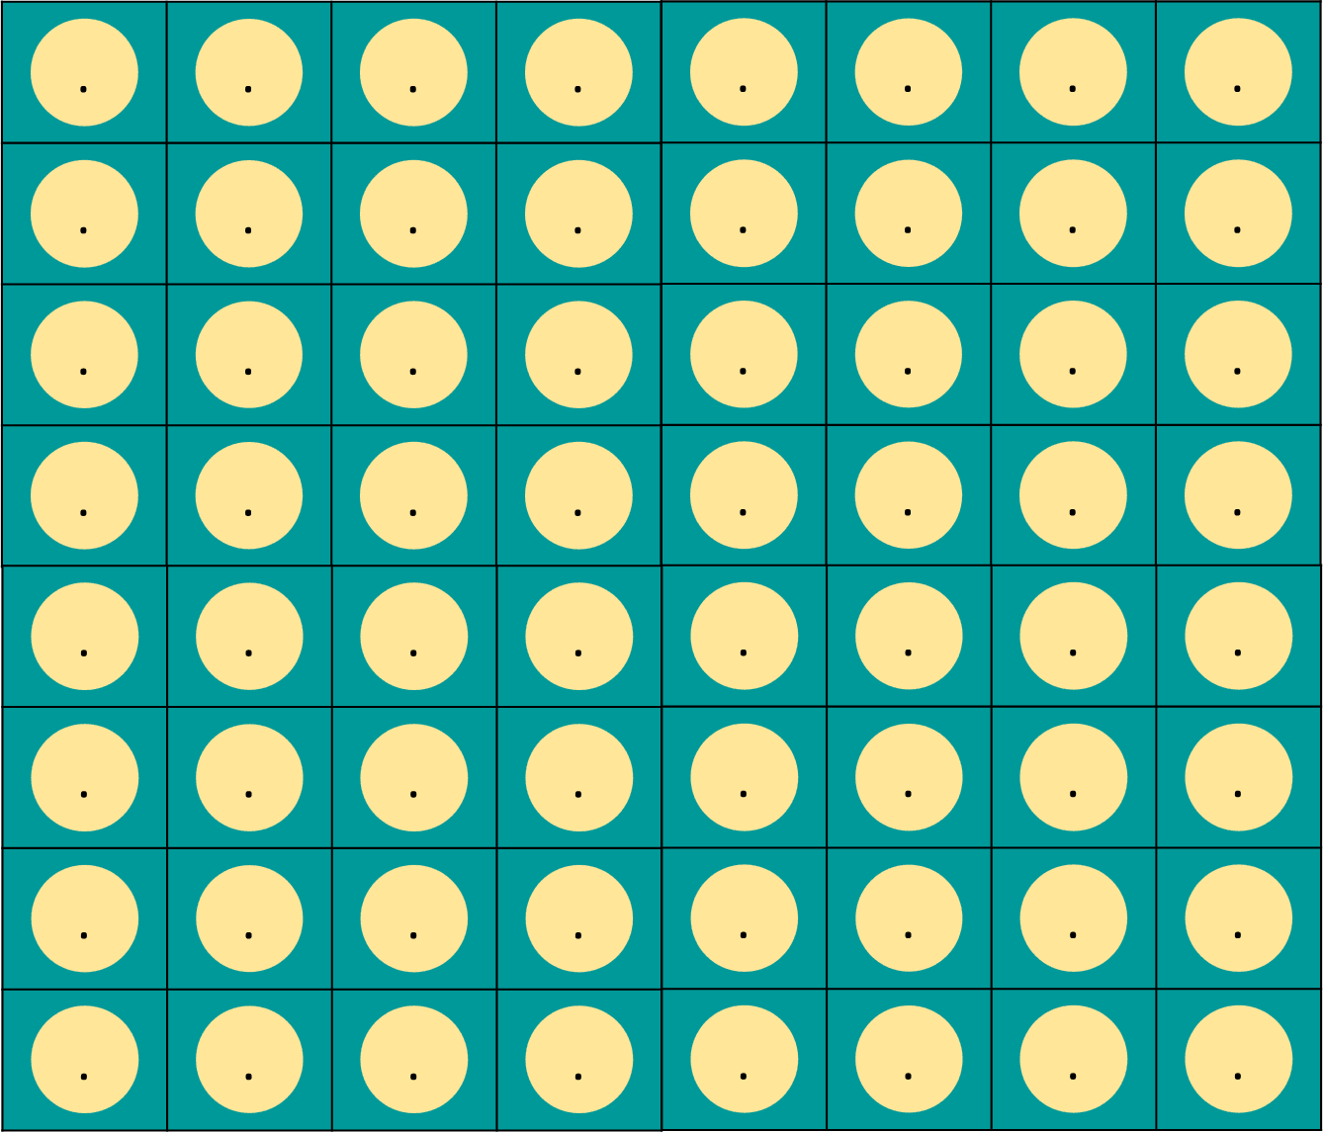




Block-wise operations on feature extracted data
Extracted pixel values for:
all layers
each feature
Output of f(x) for each feature
Shapefile
[[.]]
[[.]]
[[.]]
[[.]]
[[.]]
[[.]]
[[.]]
[[.]]
$$f(.)$$
Multilayer raster
All features

Slide 11
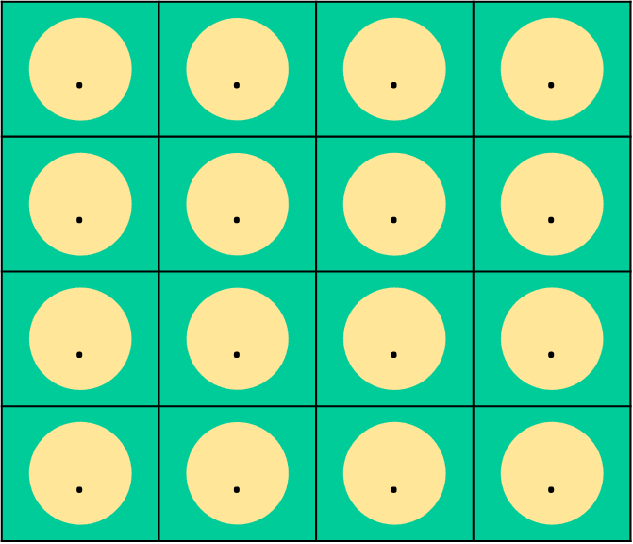
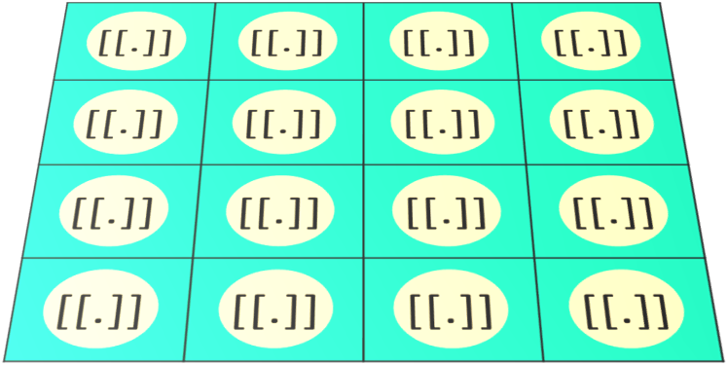


Layer-wise operations on RasterStack/Brick
Cell-wise operations on RasterStack/Brick
$$f(.)$$
$$f(.)$$
Time series/ sequential data
raster::cellStats
raster::stackApply
raster::calc

Slide 12



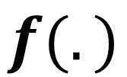
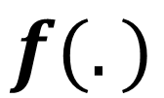


$$Y$$
$$Y$$
$$z$$
$$z$$
[[.]]
[[.]]
[[.]]
[[.]]
[[.]]
[[.]]
[[.]]
[[.]]
[[.]]
[[.]]
[[.]]
[[.]]
[[.]]
[[.]]
[[.]]
[[.]]
[[.]]
[[.]]
[[.]]
[[.]]
$$f(.)$$
$$f(.)$$
$$X$$

Slide 13

Block-wise operations on feature extracted data
Extracted pixel values for:
all layers
each feature
Output of f(x) for each feature
Shapefile
[[.]]
[[.]]
[[.]]
[[.]]
[[.]]
[[.]]
[[.]]
[[.]]
$$f(.)$$
RasterBrick/ RasterStack
All features

Slide 14
Raster Arithmetic
Arithmetic operation on a raster (*,/, ^^, +, -)
Histogram, boxplot, etc.
Inter-raster operations (diff, average SM for n days, etc.)
Multivariate plots of rasters
Raster Statistics
Applying user defined function
Value extraction
Aggregation, disaggregation and resampling

Slide 15
How to define a function:
function_name= function (variable, argument) {
Execute line 1
Execute line 2
…
value=statement
return (value)
}
How to call a function:
function_name (variable, argument)
Name of the function
Instructions to be executed
Stores the value of the function output
Returns value as function output

Slide 16
FLASH CARD (Raster Arithmetic & Stats)
terra::rast Import raster
terra:: global Apply function on raster layer terra::values Generate array of raster cells
A [A < value] = new_value Replace raster cell values based on logical operator

Slide 17
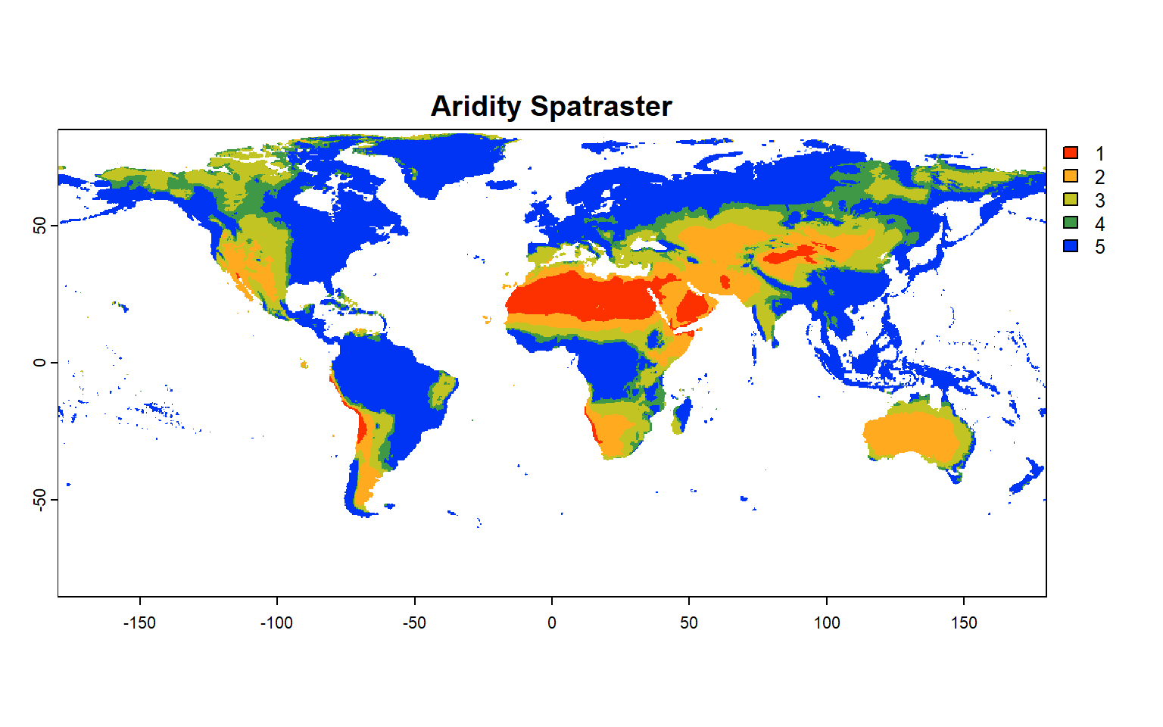
Hyper arid
Arid
Semi arid
Sub humid
Humid
Global Climate Classification

Slide 18
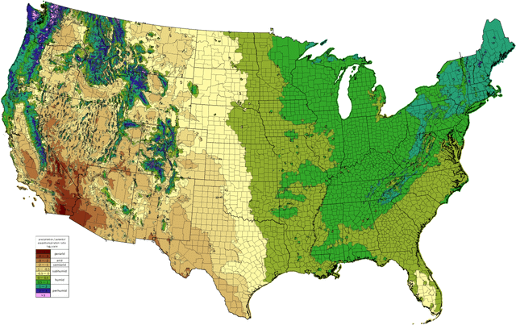
US Moisture Index Map

Slide 19
FLASH CARD (Raster Resampling, RATification and Zonal Statistics)
terra::resample Resample raster to target resolution
terra:: aggregate Aggregate (coarse) a raster layer terra::disagg Disaggregate (fine) a raster layer
terra::crop Cut out raster/vector to the match extent
terra::mask Cut out raster/vector to the match shape
base::cut Assign discrete class to continuous values
terra:: as.polygons Create polygon from raster
terra:: extract Zone-wise extract raster cells using polygon
exactextractr:: exact_extract Same as above, but faster

Slide 20
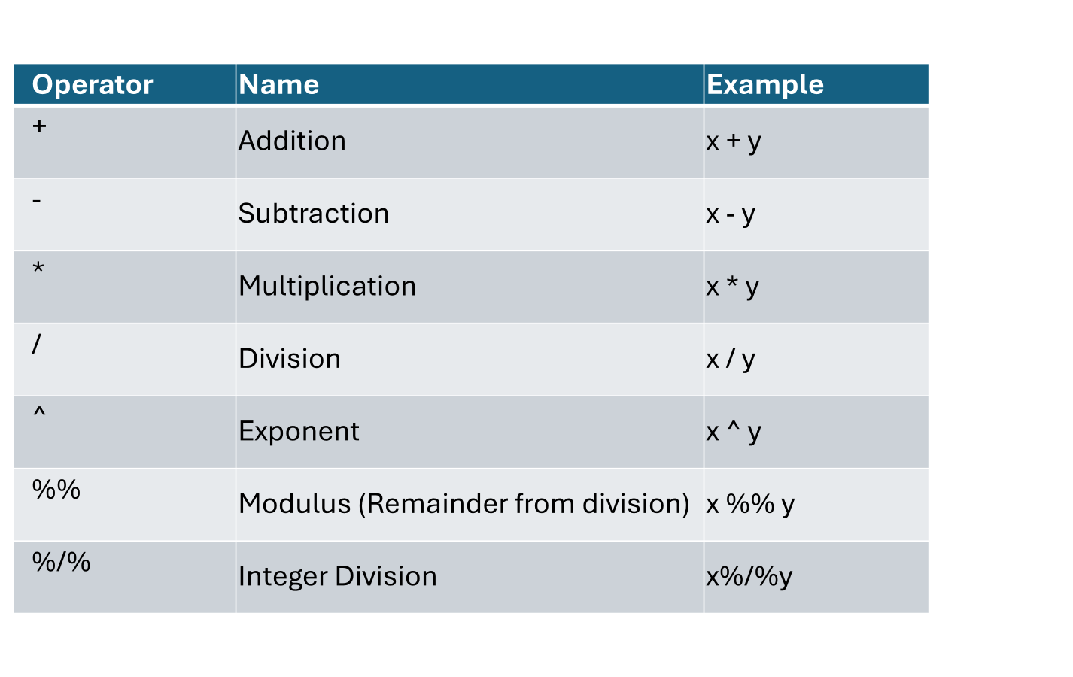
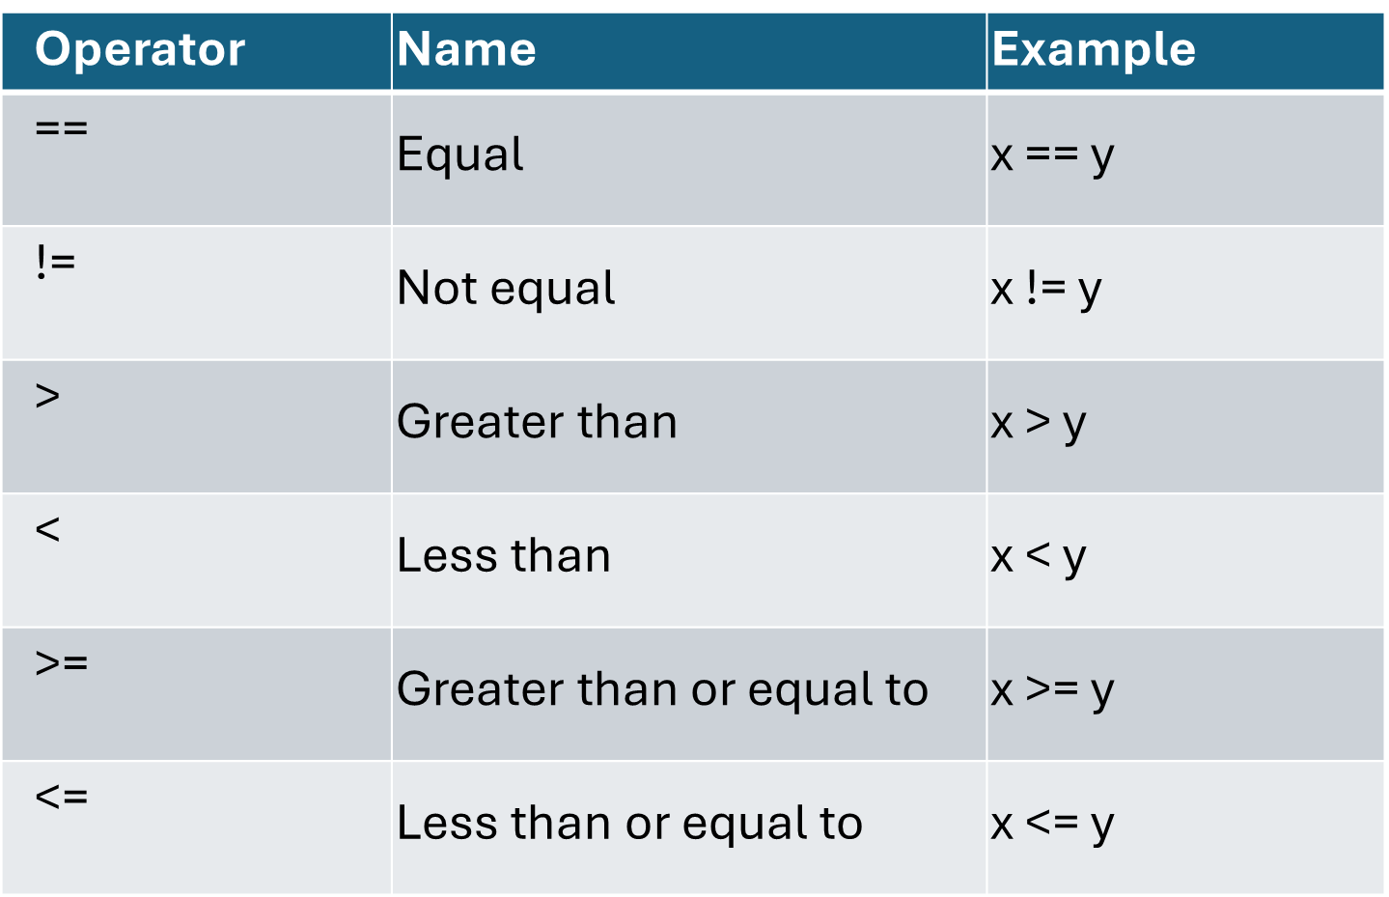
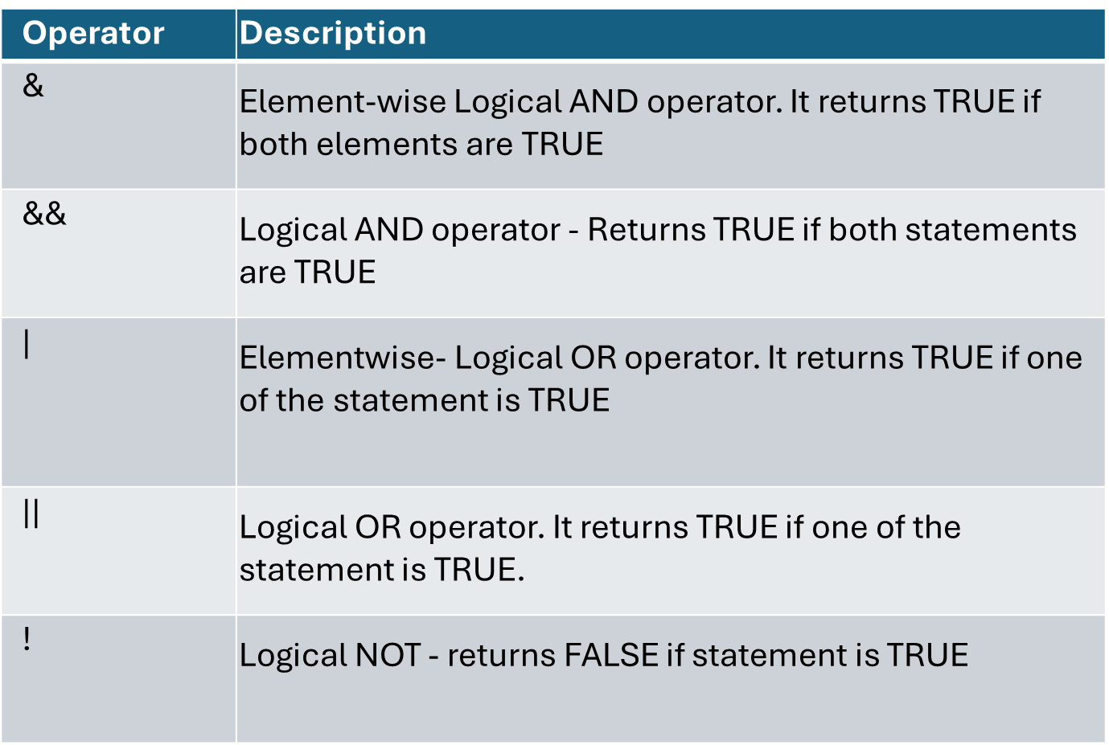

Slide 21
Operator | Name | Example
+ | Addition | x + y
- | Subtraction | x - y
* | Multiplication | x * y
/ | Division | x / y
^ | Exponent | x ^ y
%% | Modulus (Remainder from division) | x %% y
%/% | Integer Division | x%/%y

Slide 22
Operator | Name | Example
== | Equal | x == y
!= | Not equal | x != y
> | Greater than | x > y
< | Less than | x < y
>= | Greater than or equal to | x >= y
<= | Less than or equal to | x <= y

Slide 23
Operator | Description
& | Element-wise Logical AND operator. It returns TRUE if both elements are TRUE
&& | Logical AND operator - Returns TRUE if both statements are TRUE
| | Elementwise- Logical OR operator. It returns TRUE if one of the statement is TRUE
|| | Logical OR operator. It returns TRUE if one of the statement is TRUE.
! | Logical NOT - returns FALSE if statement is TRUE

Slide 24
Operator | Description | Example
: | Creates a series of numbers in a sequence | x <- 1:10
%in% | Find out if an element belongs to a vector | x %in% y
%*% | Matrix Multiplication | x <- Matrix1 %*% Matrix2

Slide 25
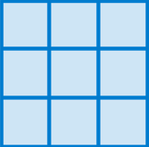
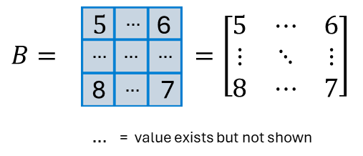


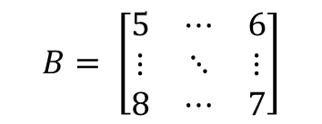

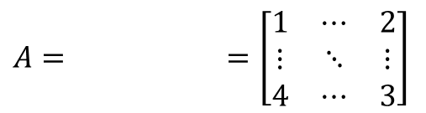



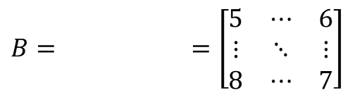


$$1$$
$$…$$
2
$$A= =\left[\begin{matrix}1 & ⋯ & 2 \\ ⋮ & ⋱ & ⋮ \\ 4 & ⋯ & 3\end{matrix}\right]$$
$$…$$
$$…$$
$$…$$
4
$$…$$
3
$…$ = value exists but not shown
$$B= \left[\begin{matrix}5 & ⋯ & 6 \\ ⋮ & ⋱ & ⋮ \\ 8 & ⋯ & 7\end{matrix}\right]$$
$$5$$
$$…$$
6
$$B= =\left[\begin{matrix}5 & ⋯ & 6 \\ ⋮ & ⋱ & ⋮ \\ 8 & ⋯ & 7\end{matrix}\right]$$
$$…$$
$$…$$
$$…$$
8
$$…$$
7
$…$ = value exists but not shown

Slide 26
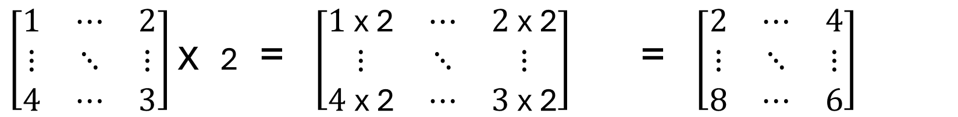
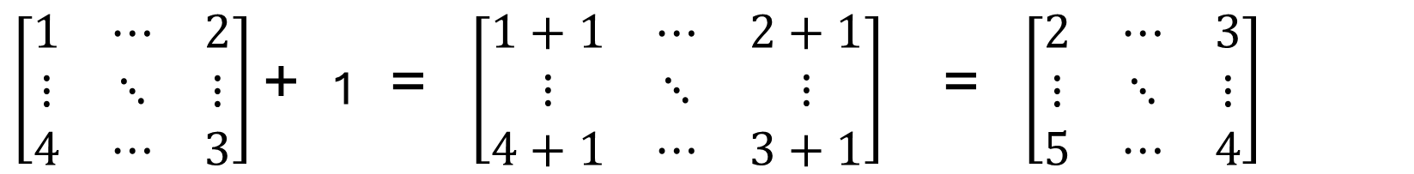
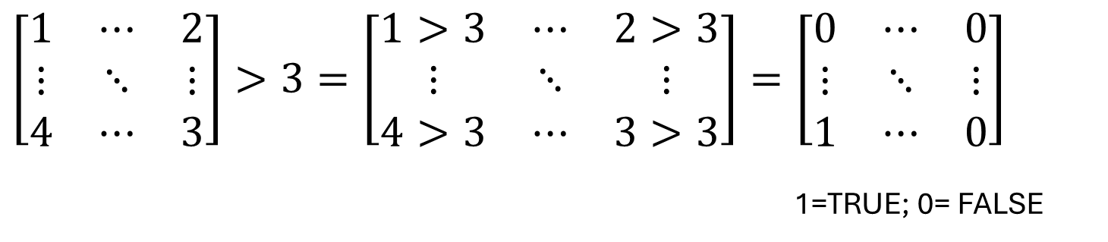
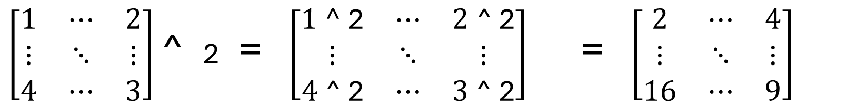
All operations are executed at grid level
$\left[\begin{matrix}1 & ⋯ & 2 \\ ⋮ & ⋱ & ⋮ \\ 4 & ⋯ & 3\end{matrix}\right]$ + 1 = $\left[\begin{matrix}1+1 & ⋯ & 2+1 \\ ⋮ & ⋱ & ⋮ \\ 4+1 & ⋯ & 3+1\end{matrix}\right]$ = $\left[\begin{matrix}2 & ⋯ & 3 \\ ⋮ & ⋱ & ⋮ \\ 5 & ⋯ & 4\end{matrix}\right]$
$\left[\begin{matrix}1 & ⋯ & 2 \\ ⋮ & ⋱ & ⋮ \\ 4 & ⋯ & 3\end{matrix}\right]$ x 2 = $\left[\begin{matrix}1 \text{x}\text{ 2} & ⋯ & 2 \text{x}\text{ 2} \\ ⋮ & ⋱ & ⋮ \\ 4 \text{x}\text{ 2} & ⋯ & 3 \text{x}\text{ 2}\end{matrix}\right]$ = $\left[\begin{matrix}2 & ⋯ & 4 \\ ⋮ & ⋱ & ⋮ \\ 8 & ⋯ & 6\end{matrix}\right]$
$\left[\begin{matrix}1 & ⋯ & 2 \\ ⋮ & ⋱ & ⋮ \\ 4 & ⋯ & 3\end{matrix}\right]$ ^ 2 = $\left[\begin{matrix}1\text{ ^}\text{ 2} & ⋯ & 2 \text{^}\text{ 2} \\ ⋮ & ⋱ & ⋮ \\ 4 \text{^}\text{ 2} & ⋯ & 3 \text{^}\text{ 2}\end{matrix}\right]$ = $\left[\begin{matrix}2 & ⋯ & 4 \\ ⋮ & ⋱ & ⋮ \\ 16 & ⋯ & 9\end{matrix}\right]$
$$\left[\begin{matrix}1 & ⋯ & 2 \\ ⋮ & ⋱ & ⋮ \\ 4 & ⋯ & 3\end{matrix}\right]>3=\left[\begin{matrix}1>3 & ⋯ & 2>3 \\ ⋮ & ⋱ & ⋮ \\ 4>3 & ⋯ & 3>3\end{matrix}\right]=\left[\begin{matrix}0 & ⋯ & 0 \\ ⋮ & ⋱ & ⋮ \\ 1 & ⋯ & 0\end{matrix}\right]$$
1=TRUE; 0= FALSE

Slide 27
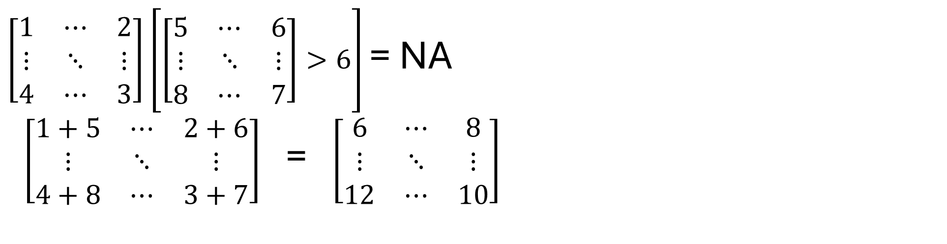
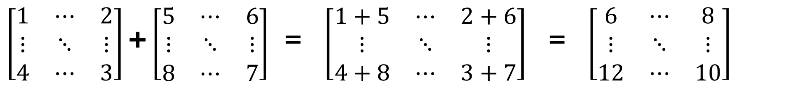
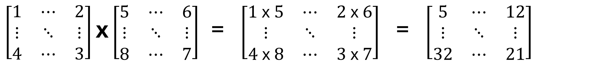
$\left[\begin{matrix}1 & ⋯ & 2 \\ ⋮ & ⋱ & ⋮ \\ 4 & ⋯ & 3\end{matrix}\right]$ + $\left[\begin{matrix}5 & ⋯ & 6 \\ ⋮ & ⋱ & ⋮ \\ 8 & ⋯ & 7\end{matrix}\right]$ = $\left[\begin{matrix}1+5 & ⋯ & 2+6 \\ ⋮ & ⋱ & ⋮ \\ 4+8 & ⋯ & 3+7\end{matrix}\right]$ = $\left[\begin{matrix}6 & ⋯ & 8 \\ ⋮ & ⋱ & ⋮ \\ 12 & ⋯ & 10\end{matrix}\right]$
$\left[\begin{matrix}1 & ⋯ & 2 \\ ⋮ & ⋱ & ⋮ \\ 4 & ⋯ & 3\end{matrix}\right]$ x $\left[\begin{matrix}5 & ⋯ & 6 \\ ⋮ & ⋱ & ⋮ \\ 8 & ⋯ & 7\end{matrix}\right]$ = $\left[\begin{matrix}1 \text{x} 5 & ⋯ & 2 \text{x} 6 \\ ⋮ & ⋱ & ⋮ \\ 4 \text{x} 8 & ⋯ & 3 \text{x} 7\end{matrix}\right]$ = $\left[\begin{matrix}5 & ⋯ & 12 \\ ⋮ & ⋱ & ⋮ \\ 32 & ⋯ & 21\end{matrix}\right]$
$\left[\begin{matrix}1 & ⋯ & 2 \\ ⋮ & ⋱ & ⋮ \\ 4 & ⋯ & 3\end{matrix}\right]$ $\left[\left[\begin{matrix}5 & ⋯ & 6 \\ ⋮ & ⋱ & ⋮ \\ 8 & ⋯ & 7\end{matrix}\right]>6\right]$ = NA
$\left[\begin{matrix}1+5 & ⋯ & 2+6 \\ ⋮ & ⋱ & ⋮ \\ 4+8 & ⋯ & 3+7\end{matrix}\right]$ = $\left[\begin{matrix}6 & ⋯ & 8 \\ ⋮ & ⋱ & ⋮ \\ 12 & ⋯ & 10\end{matrix}\right]$

Slide 28
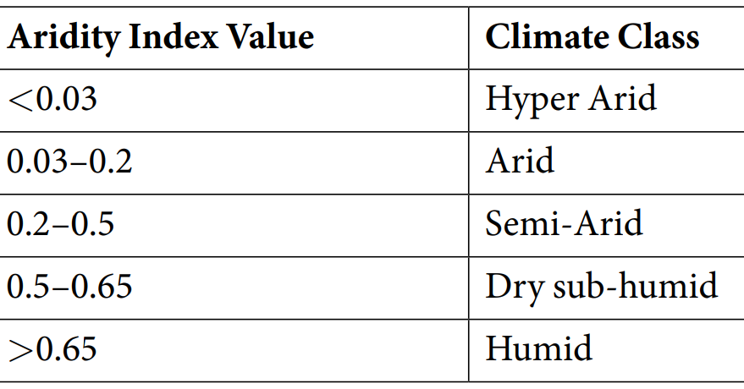

Slide 29
