Slide 1

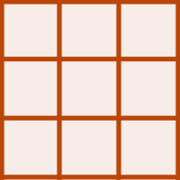

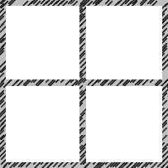
Raster A
Raster A*
L
L*
Upscaling
terra::aggregate
Raster A
L_{A}
Fine Coarse
L*= axL
Raster B
Raster B*
L
L*
Raster B
Downscaling
terra::disagg
L_{B}
Coarse Fine
L*=L/a
Raster A
Raster A*
L_{B} = 2xL_{A}
L
L_{A}*
Resampling
terra::resample
Res A Res B
L_{A}* = L_{B}= 2xL_{A}

