Slide 1

Student Assessment & Performance Tracker
A Modern Approach to Educational Excellence

Slide 2
Introduction & Problem Statement
• Traditional assessment methods are often siloed and delayed.
• Lack of real-time visibility into student progress for parents.
• Manual grading and reporting are prone to errors and inefficiency.
• Solution: A centralized, automated tracker for students, faculty, and parents.

Slide 3
Key Features
✔ Real-time Marks Entry & Tracking
✔ Automated Email & SMS Notifications
✔ Comprehensive Student Dashboards
✔ Faculty Portal for Efficient Assessment
✔ Performance Trend Visualization

Slide 4
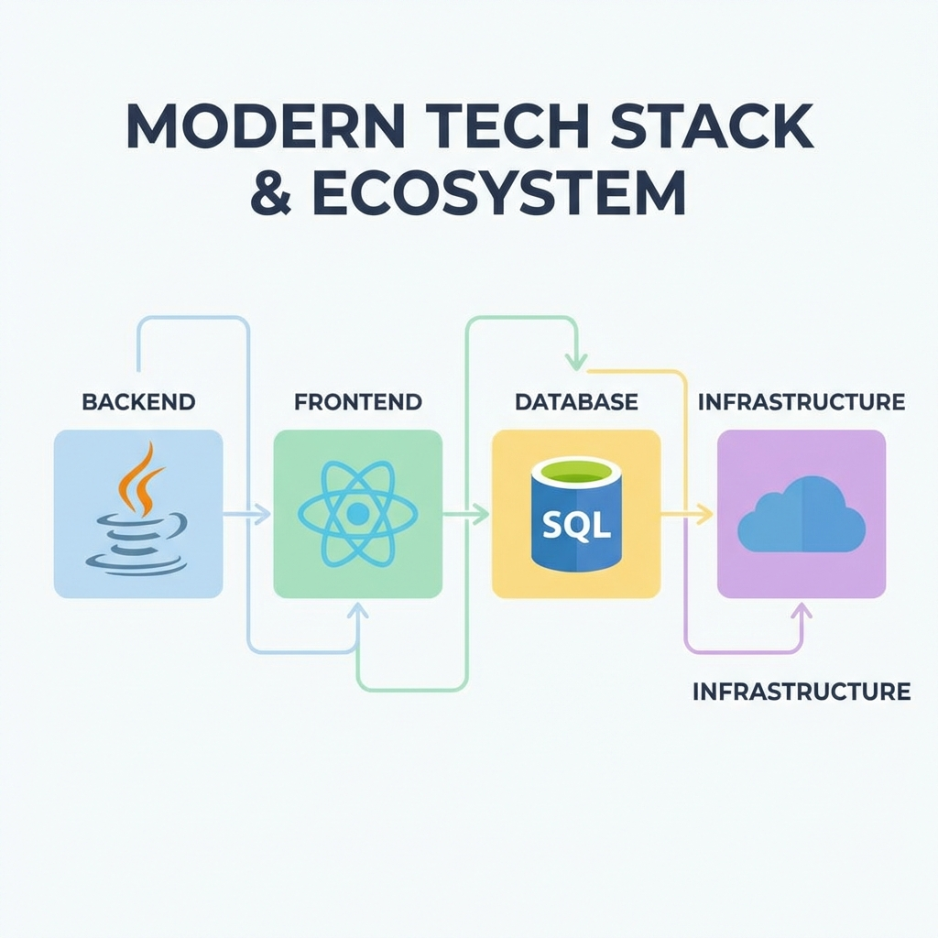
Cutting-Edge Tech Stack

Slide 5
Robust Backend Architecture
• Spring Boot: Restful API development & Microservices logic.
• Spring Data JPA: Seamless ORM for database interactions.
• MySQL: Reliable relational data storage.
• Java Mail & Twilio: Integrated notification ecosystem.
• Reporting Service: Dedicated .NET Core service for analytics.

Slide 6
Responsive Frontend Design
• React.js: Dynamic and interactive user interfaces.
• Vite: Lightning-fast build and development environment.
• Vanilla CSS: Clean, high-performance styling.
• State Management: Efficient data flow across components.
• Mobile First: Seamless experience across all devices.

Slide 7
User Roles & Workflows
👤 Admin: System configuration and user management
👤 Faculty: Course management and assessment entry
👤 Student: Performance review and trend analysis
👤 Parent: Real-time progress monitoring & alerts

Slide 8
Automated Notification System
Project implements a multi-channel notification strategy:
• Email Notifications: Detailed performance reports to personal boxes.
• SMS Alerts: Instant updates on marks and critical events via Twilio.
• Bulk Upload Notifications: Automated alerts after Excel/CSV imports.

Slide 9
Conclusion & Future Roadmap
• The system significantly improves data transparency and assessment speed.
• Future: AI-driven predictive performance analytics.
• Future: Detailed attendance tracking integration.
• Future: Mobile app versions (iOS/Android) for even better accessibility.

Slide 10
THANK YOU

