Slide 1

Student Assessment & Performance Tracker
Revolutionizing Educational Insights with Real-Time Analytics

Slide 2
Market Gap & The Solution
THE PROBLEM:
• Fragmented student data across multiple papers/systems.
• Significant delays in grading and feedback loops.
• Low engagement from parents due to lack of transparency.
OUR INNOVATION:
• Centralized ecosystem for all assessment touchpoints.
• Instant multi-channel notifications (Email/SMS).
• Interactive dashboards for proactive performance monitoring.

Slide 3
Core Functional Modules
MANAGEMENT:
• Bulk Student & Faculty Onboarding
• Course & Semester Curriculum Mapping
• Granular Access Control (RBAC)
ANALYTICS & ALERTS:
• Automated Marks Calculation & CGPA Tracking
• Instant Twilio-powered SMS Gateway
• High-Speed Excel/CSV Data Processing

Slide 4
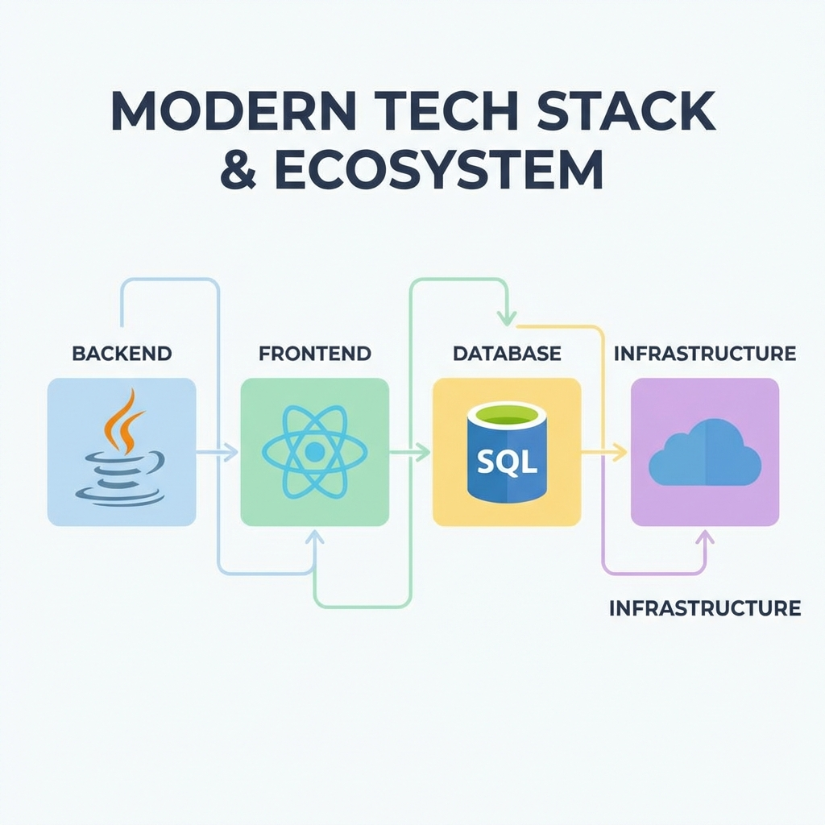
Full-Stack Technology Architecture
Built with Spring Boot 3, React 18, and .NET Core for high availability and scalability.

Slide 5
Robust & Secure Backend
• Microservices ready: Scalable architecture for large institutions.
• Spring Security & JWT: Enterprise-grade authentication protocol.
• Data JPA: Optimized query execution for rapid DB retrieval.
• Reporting Engine: Specialized .NET service for heavy calculation.
• Integrated SMTP: Automated, customizable email templates.

Slide 6
Modern & Reactive Frontend
• Vite-Powered Build: Ultra-fast load times and HMR.
• State Optimization: Minimum re-renders for heavy data tables.
• Global Styles: Unified, clean, and modern UI/UX design.
• Responsive Layouts: Fluid experience from Desktop to Mobile.
• Security: Client-side route guarding and secure storage.

Slide 7
User Experience Journey
• FACULTY: Simply upload Excel sheets; system handles the rest.
• STUDENTS: View visual heatmaps of subject performance.
• PARENTS: Receive instant SMS/Email when assessment is finalized.
• ADMINS: Monitor entire institution metrics from one birds-eye view.

Slide 8
Advanced Reporting & Alerts
• Multi-Channel Strategy: Email (detailed) and SMS (instant alerts).
• Reporting Engine: Generates performance trends and CSV exports.
• Reliability: Asynchronous processing ensures no UI blocking.
• Flexibility: Easily toggle notification settings per event.

Slide 9
Impact & Future Roadmap
• Current Impact: 80% reduction in reporting lead time.
• UPCOMING: AI-based 'At-Risk' student identifying system.
• UPCOMING: Real-time classroom attendance via QR integration.
• UPCOMING: Parent-Teacher meeting scheduling module.

Slide 10
Transforming Education Through Data
THANK YOU

