Slide 1

Student Assessment &
Performance Tracker
A Secure, Automated, and Data-Driven Educational Ecosystem

Slide 2
Problem vs Innovation
Legacy Challenges:
• Fragmented data across departments.
• Manual reporting takes days to compile.
• Lack of real-time parent engagement.
Modern Solution:
• Sub-second automated alert generation.
• Interactive, mobile-responsive portals.

Slide 3
Technology Stack & Security
• Backend: Java 17, Spring Boot 3 with Data JPA.
• Frontend: React 18, Vite for optimal performance.
• Notification: Twilio SMS Gateway & Java Mail (SMTP).
• Reporting: .NET Core dedicated analytics service.
• Security: JWT based authentication & role-based authorization.

Slide 4
Functional Capabilities
• High-speed data processing for assessment marks and grades.
• Secure multi-role access (Admin, Faculty, Student).
• Automated bulk upload processing for CSV/Excel data.
• Dynamic trend visualization.
• Integrated microservices logic for reporting and analytics.
• Score predictor

Slide 5
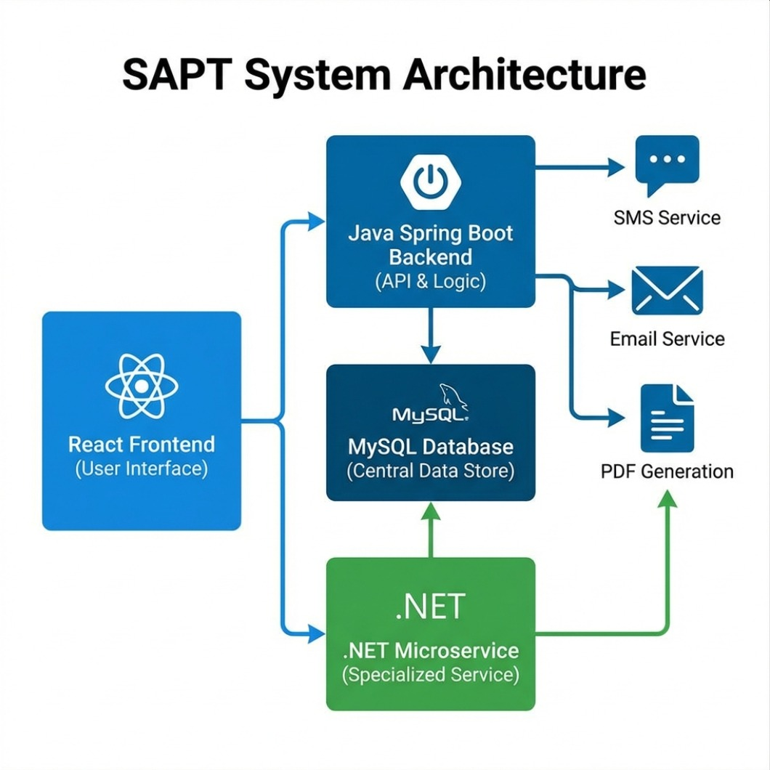
System Architecture Overview
Spring Boot Backend manages REST APIs, Security, and multi-channel Notifications (SMTP/Twilio).

Slide 6
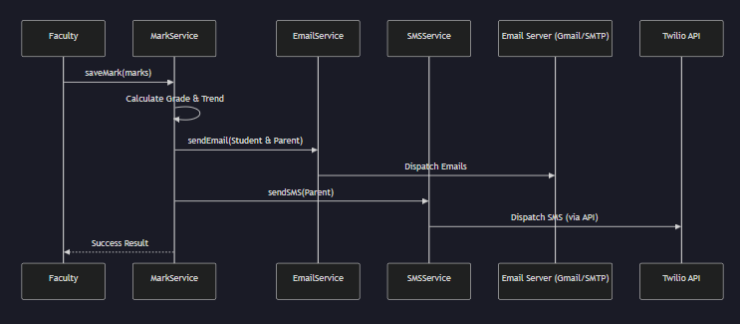
Automation Architechture

Slide 7
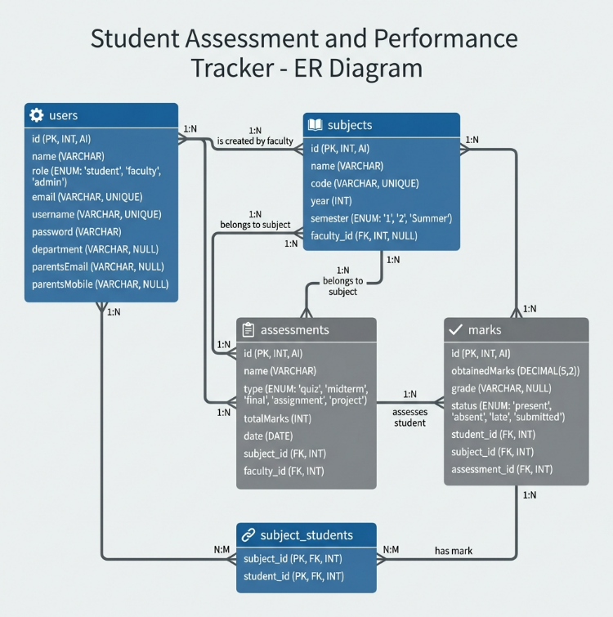

Slide 8
Future Scopes
• Smart Attendance: QR code based tracking system.
• Mobile Ecosystem: Dedicated Android/iOS parent applications.
• Cloud Migration: Enhanced scalability with AWS/Azure.
• Interactive Portals: Virtual Parent-Teacher meeting modules.

Slide 9
Conclusion
"SAPT is more than just a tracking tool; it is a comprehensive academic mentor.
By leveraging a microservice architecture, we have built a platform that
is not only robust but proactive. Through the Target Score Calculator and automated
alerts, we transform raw academic data into actionable goals, empowering every
student to reach their full potential."

Slide 10
THANK YOU

