Slide 1
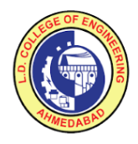

L. D. College of Engineering
INTERNSHIP EVALUATION
PRESENTED BY:
Vinit Patel (200280107016)
INTERNAL GUIDE
PROF. Pinal Salot Ma’am
<number>

Slide 2
Outline
Company Profile
Introduction
Project Profile
Project Modules
Use Case Diagram
Data Flow Diagram
Project Images
References
Conclusion
<number>

Slide 3
Company Profile
TatvaSoft is a custom software development company located in Ahmedabad. . It was founded in 2001 and offers services on diverse technology platforms such as Microsoft, Java,.NET, PHP, Open Source, BI, and mobile.
TatvaSoft delivering splendid business IT Solutions and related services to customers across the globe. . The proficiency in understanding business challenges and professional competence allows them to create a better experience for customers.
TatvaSoft design and implement advanced custom software solutions and mobile apps t to simplify your business problems.
<number>

Slide 4
Introduction
“HalloDoc” is a Health care website.
Patient can register themselves for consultation
Admin can add the patient and provider.
Admin can assign provider to patients.
Provider can schedule patient's reservation.
Patient can order the prescribed medicines also.
<number>

Slide 5
Project Profile
Project Name : HalloDoc
Objective : The main objective of this site is provide people best medication servi through seamless communication.
Technology Used : Asp.Net with C# as a programmin language and PostgreSQL as a database
<number>

Slide 6
Modules
Modules
Admin
Patient
Provider
Login
Home
Request List in New, Pending, Active, conclude, To close, Unpaid state
View Case
View notes
Assign Case
Block Case
View Uploads
Transfer case
Clear case
Close Case
Create, View, Update,Delete shifts
Create vendors
Create providers
Make patient request
Send mail/Sms
Create other admin and manage access
Manage Records
Block user
ChangePassword
Logout
Login
Create request
Submit request on behalf of family, friend, concierge, business partners
Dashboard
View and edit profile
View requests
View uploads
Upload, download, delete files
Change Password
Logout
Login
Dashboard
Request List in New, Pending, Active, Conclude state
Filter requests
Select encounter type
Submit and download encounter form
Transfer request
Edit profile
Manage shifts
Create schedule
<number>

Slide 7
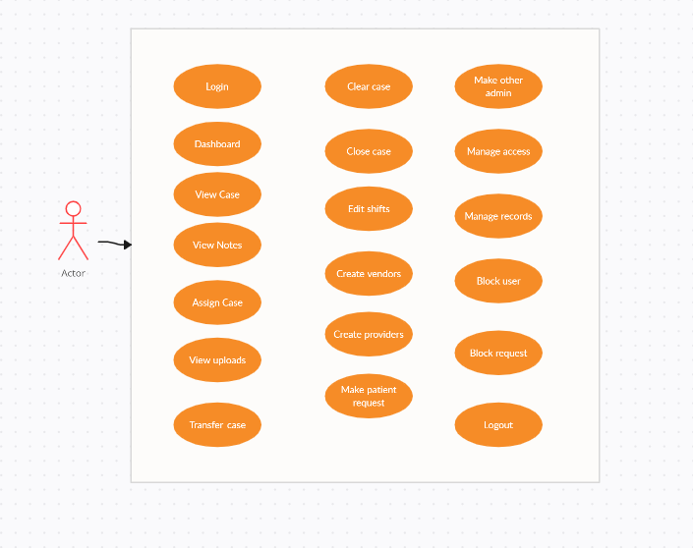
Use Case Diagram of Admin
<number>

Slide 8
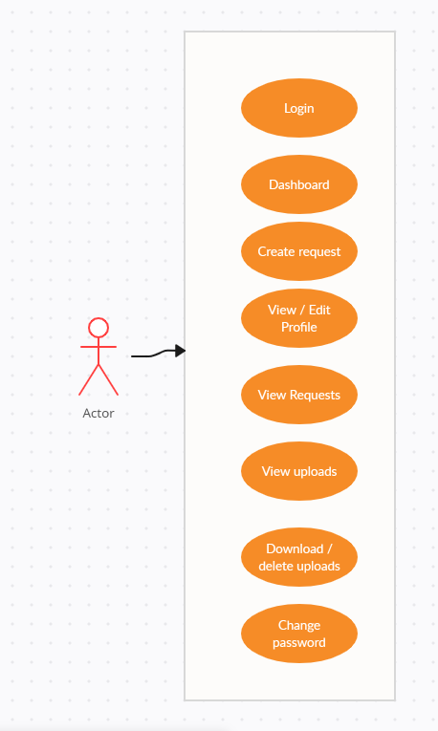
Use Case Diagram of Patient
<number>

Slide 9
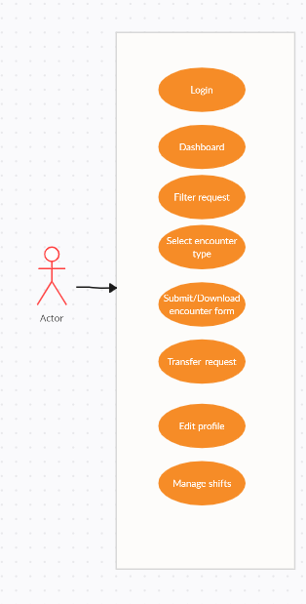
Use Case Diagram of Provider
<number>

Slide 10
Dataflow Diagram of HalloDoc
HalloDoc
Patient
Add Request Data
Get Request Data
Provider
Retrieve Request Data
Manage Request Data
Manage , Access control , modify
all Record
Get all record of
Database
Admin
<number>

Slide 11
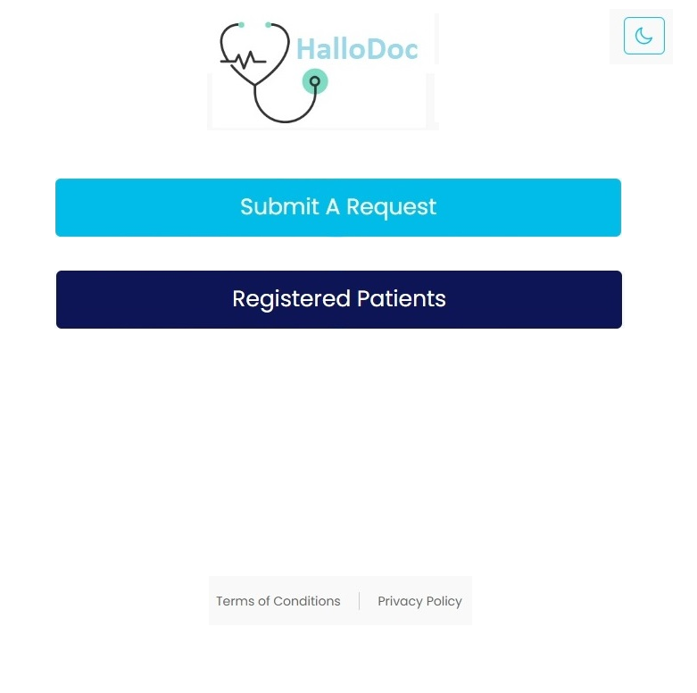
<number>

Slide 12
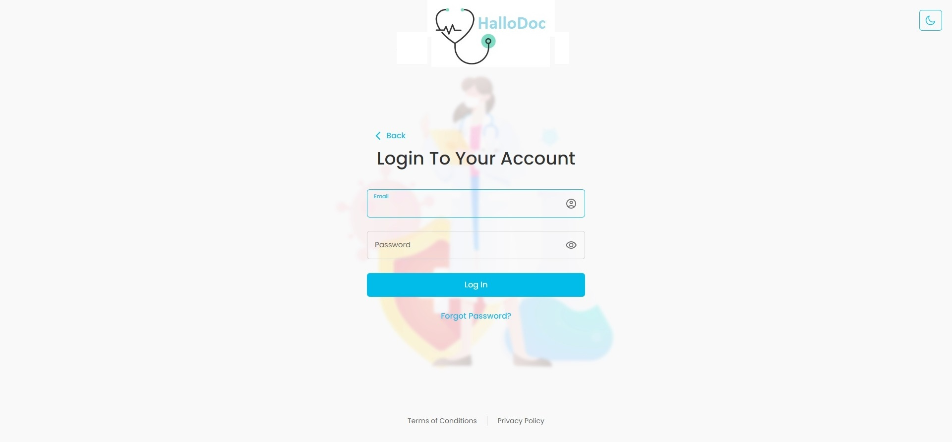
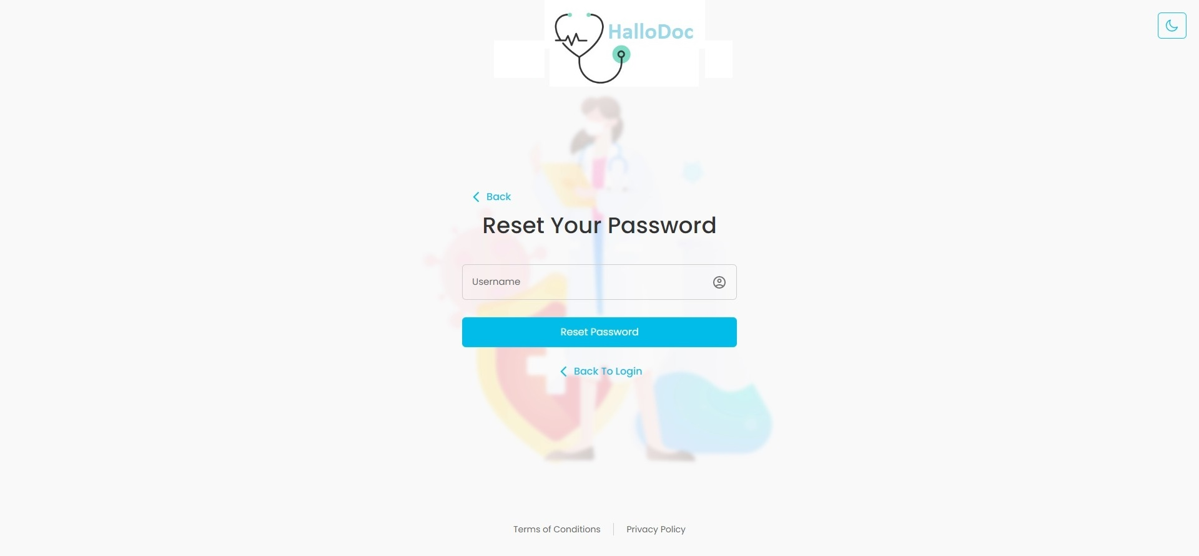

Slide 13
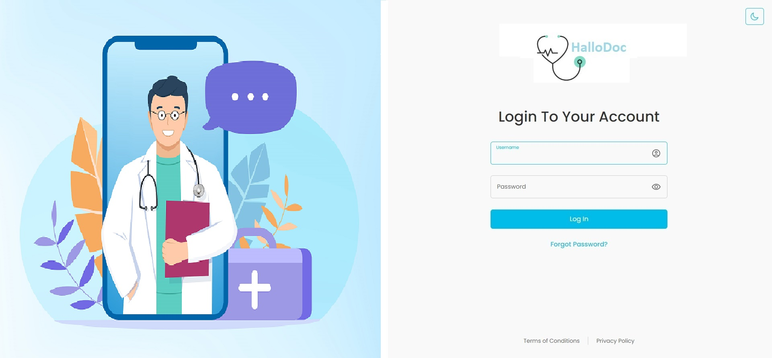
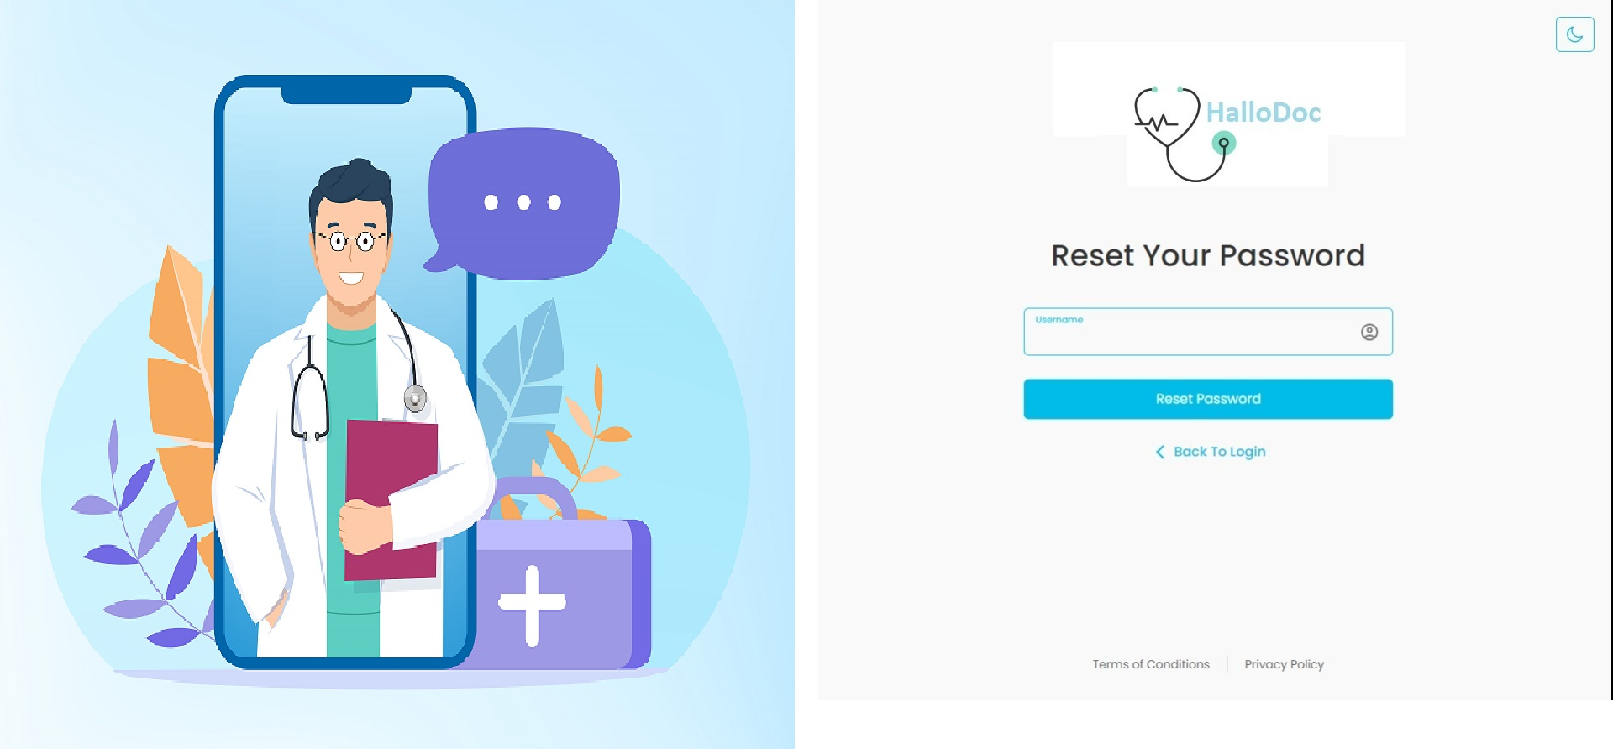
<number>

Slide 14
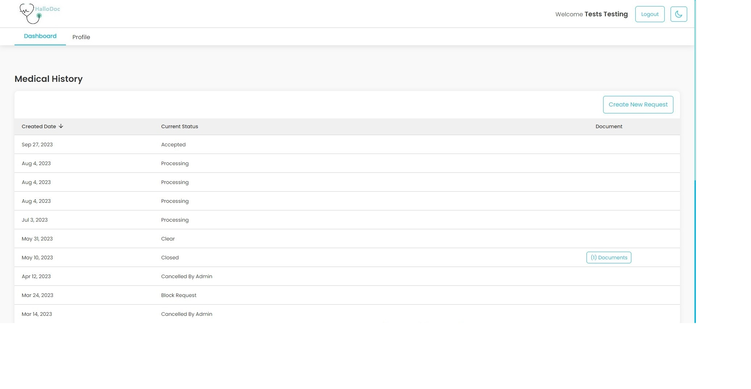
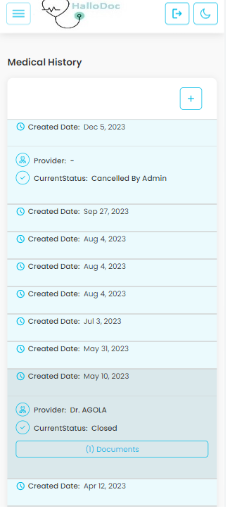

Slide 15
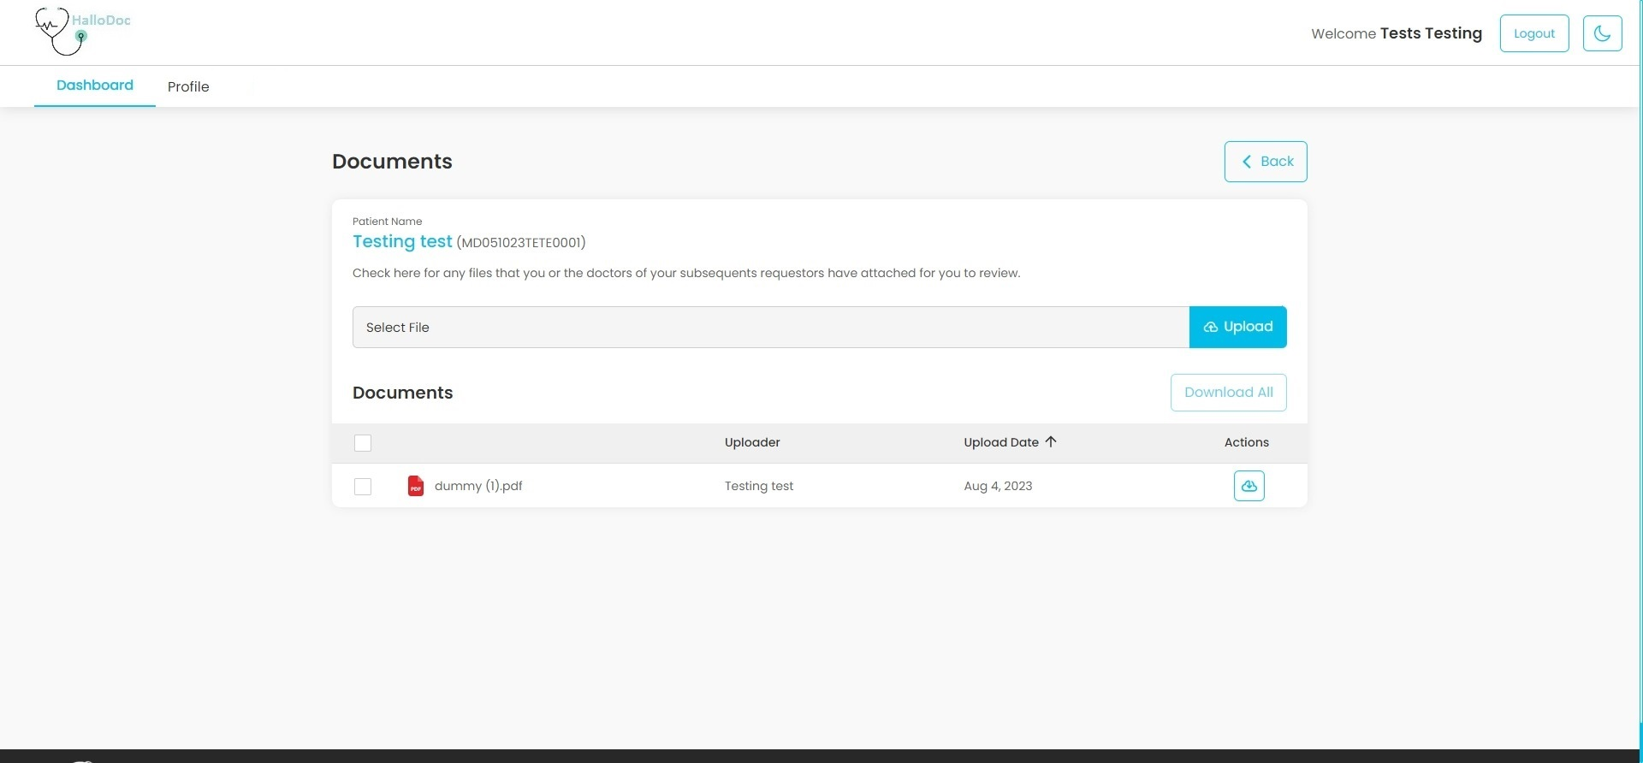
<number>

Slide 16
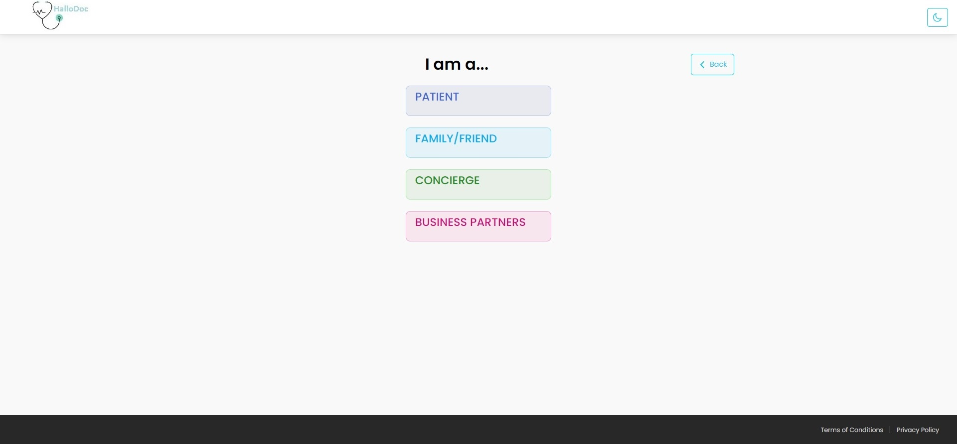
<number>

Slide 17
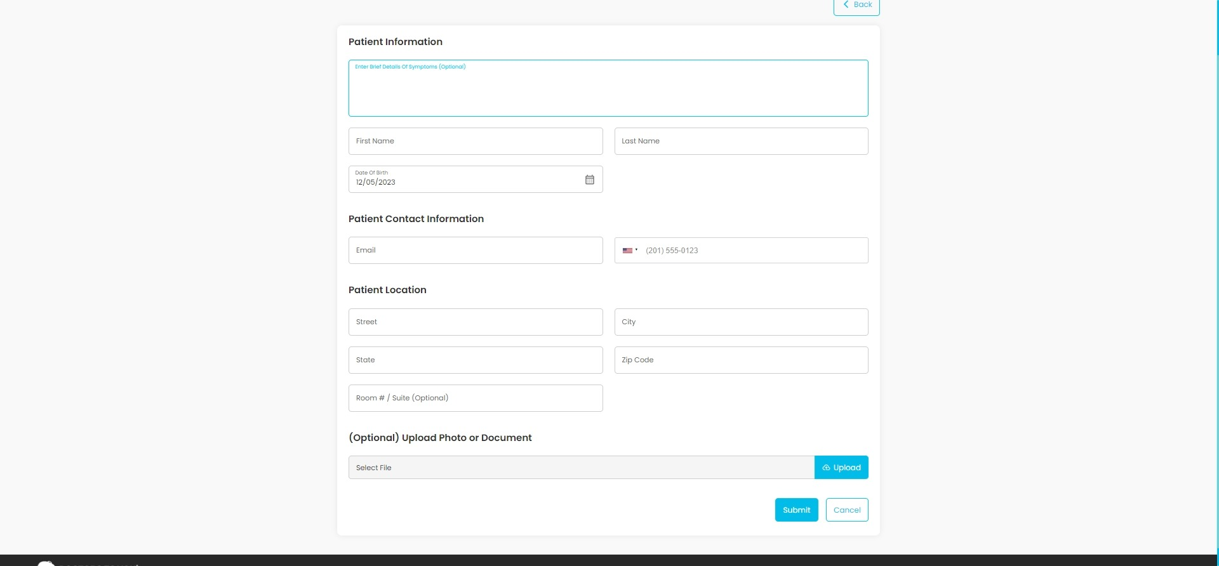
<number>

Slide 18
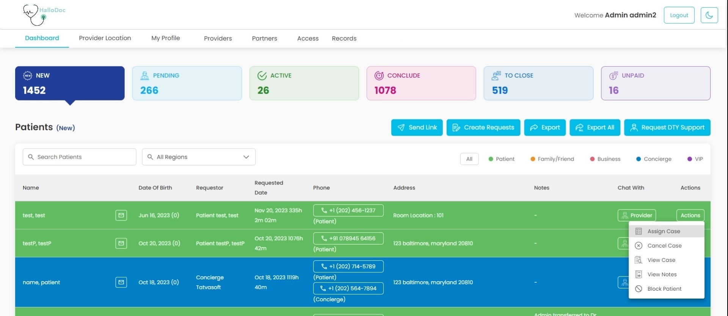
<number>

Slide 19
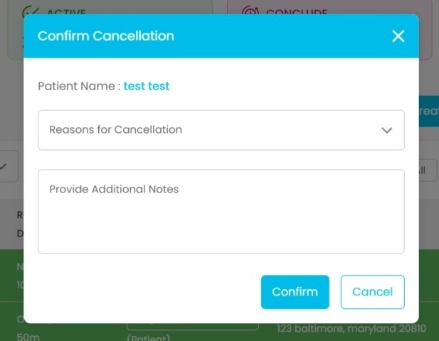
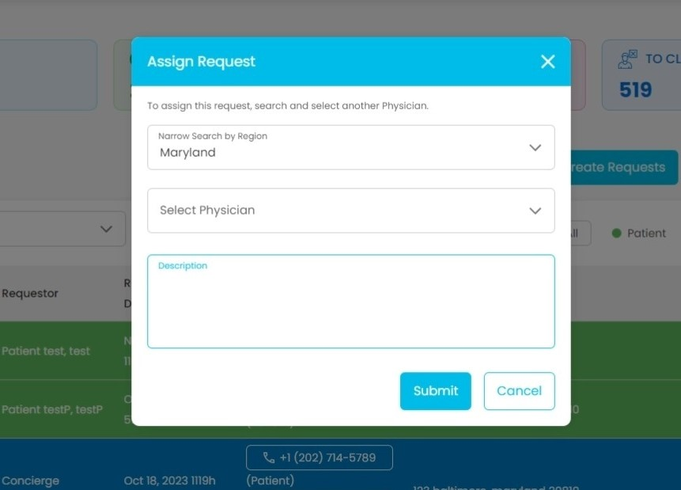
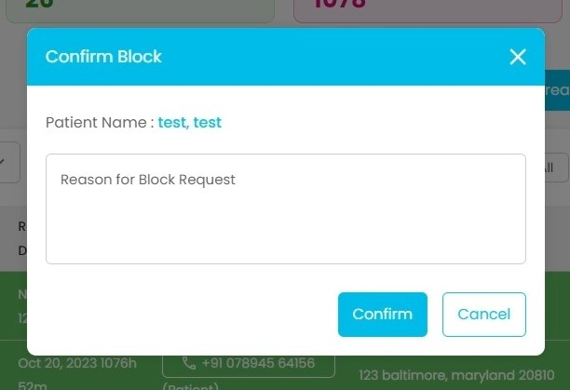
<number>

Slide 20
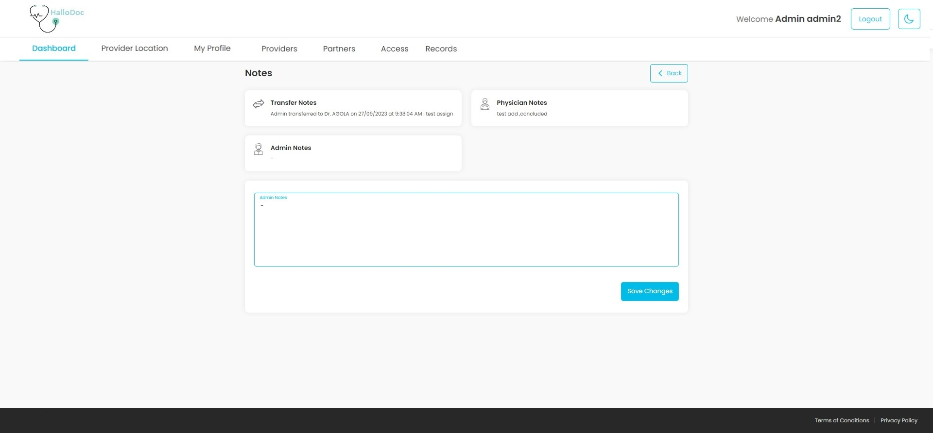
<number>

Slide 21
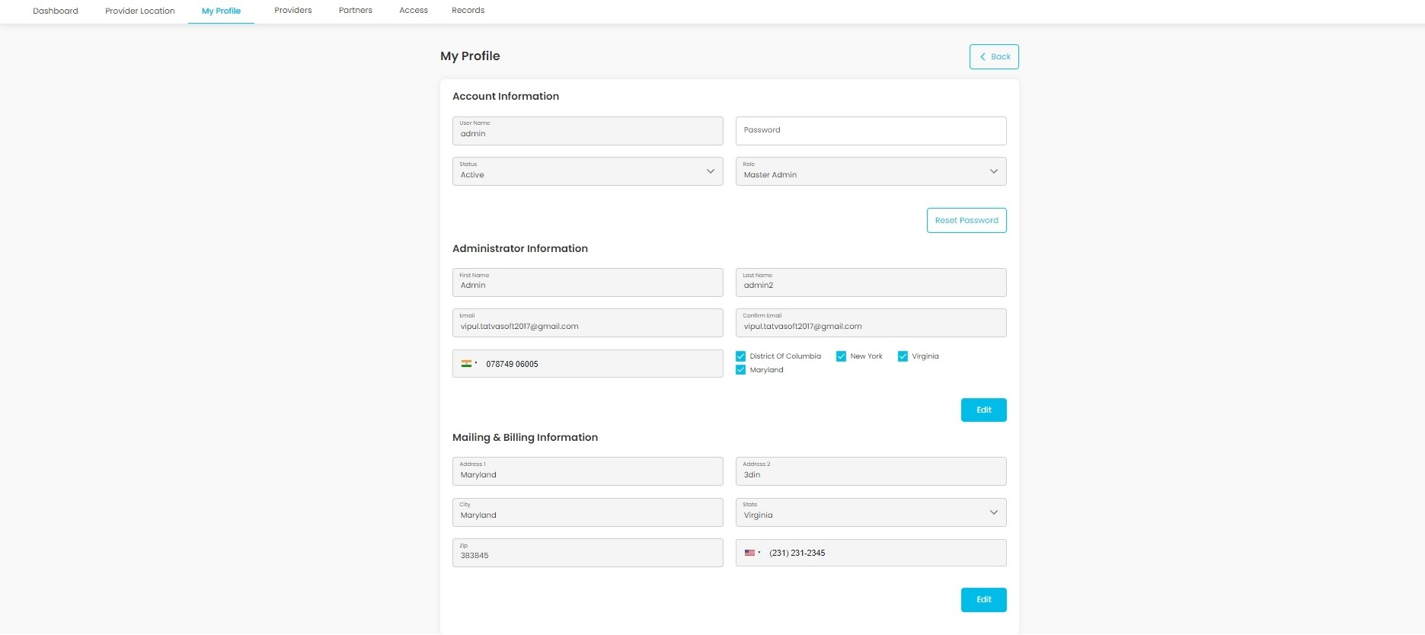

Slide 22
References
1. http://www.msdn.microsoft.com/
All about Microsoft controls in C#
2. http://stackoverflow.com/questions/tagged/asp.net
Error related queries and other queries solution
<number>

Slide 23
Conclusion
HalloDoc is a dynamic online platform facilitating seamless communication and healthcare management between doctors and patients. Offering a user-friendly interface, patients can effortlessly schedule appointments, consult doctors remotely, and securely obtain prescriptions.
<number>

Slide 24
Thank You
<number>

