Slide 1
ECOMMERCE Sales Dashboard – Power BI
ELEVATELABS Task 4: Interactive Dashboard Design
Vinit Ruparelia | 25 April 2025

Slide 2
🔍 Project Vision
Translate raw sales data into strategic business insights.
Empower stakeholders to make informed decisions via data visuals.
Explore performance patterns across products and time.

Slide 3
📁 Dataset Snapshot
Source: Kaggle (Sales & Financial Dataset)
Fields: Sales, Profit, Quantity, Category, Order Date, Shipping Cost
Used for temporal and category-based analysis

Slide 4
🧠 Dashboard Design Strategy
Focused on storytelling through visuals
Prioritized KPIs that matter: Sales, Profit, Growth
Enabled dynamic filtering via slicers

Slide 5
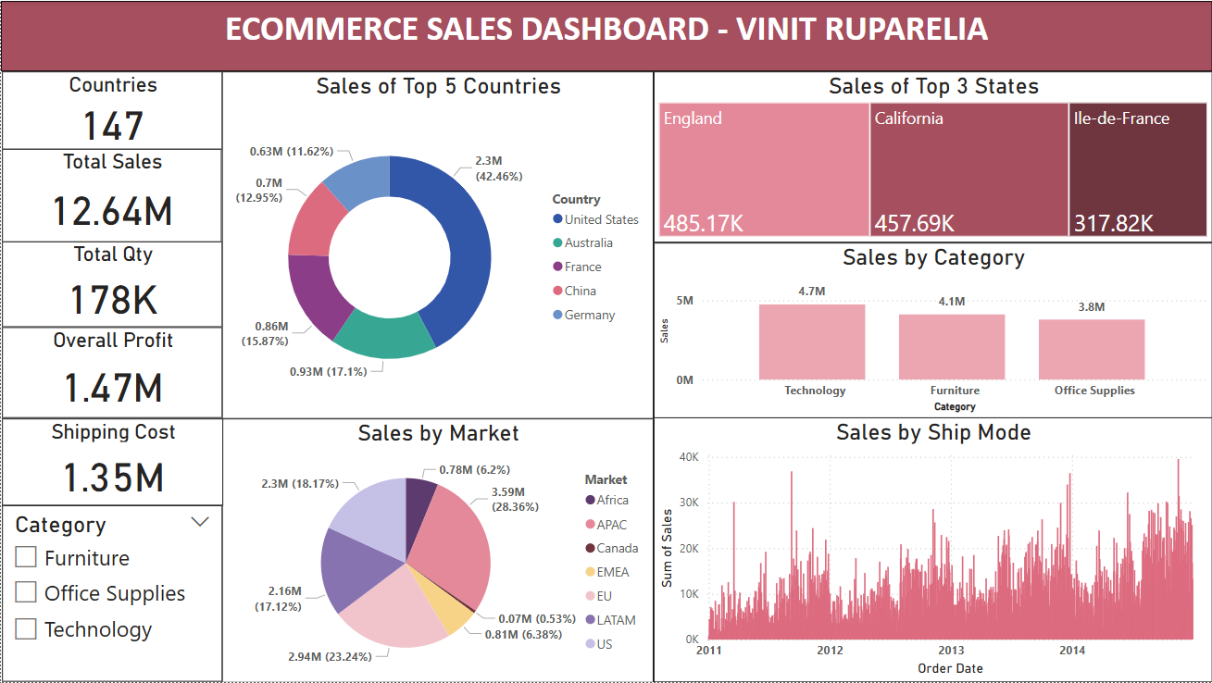
Dashboard

Slide 6
🎨 Visual Highlights
KPI Cards: Immediate performance snapshots
Line Charts: Sales & Profit over time
Interactive Slicers: Category-based filtering
Clean, minimal color palette for readability

Slide 7
⚙️ Smart Metrics with DAX
YoY Growth (Sales & Profit): Compare yearly performance
Running Totals: Understand cumulative trends
Responsive to slicers for flexible insights

Slide 8
📈 Key Takeaways
Sales showed consistent monthly growth
Office Supplies led in quantity sold
Profitability varied significantly by category

Slide 9
🚧 What’s Missing?
Navigation menu/bookmarks not included
Limited filter dimensions (no region or customer segments)

Slide 10
🔮 Future Enhancements
Add navigation controls and bookmarks
Include regional and demographic filters
Leverage AI visuals and predictive models

Slide 11
✅ The Impact
Created a compelling data narrative with visuals
Enhanced stakeholder understanding of trends
Built a strong foundation for business analytics

Slide 12
Conclusion
This dashboard successfully transforms raw sales data into meaningful business insights.
Key performance indicators highlight strong sales and profitability trends, especially in Technology and Office Supplies.
Strategic visualizations enabled clear understanding of patterns across time, markets, and product categories.
This project sets the stage for future enhancements, including predictive analysis and regional segmentation.

Slide 13
Thank You
Thank you for reviewing the E-commerce Sales Dashboard.
Looking forward to your feedback and suggestions.
Created by: Vinit Ruparelia
Date: 25 April 2025

