Slide 1



SMART INDIA HACKATHON 2026
  Problem Statement ID – SIH26179
  Problem Statement Title- An Edge AI-powered platform for real-time shopper analytics, inventory monitoring, and queue management—reducing stock-outs, optimizing operations, and ensuring privacy with minimal cloud dependency.
  Theme- Miscellaneous
  PS Category- Hardware
  Team Name - TechGladiators

Slide 2








Tech Gladiators
IDEA TITLE : StoreMind-Retail By The Edge
Proposed Solution : A smart Hybrid edge-computing system using Raspberry pi and STM32, where Raspberry Pi analyses queues and STM32 keeps track of shelf inventory with AI Intelligence and ML frameworks.
  How it addresses the problem: Enables real-time shopper analytics and inventory monitoring to reduce stock-outs and optimize staffing.
  Innovation and uniqueness of the solution : Privacy-first, fully offline system with no video/facial data storage or cloud dependency.
2

Slide 3

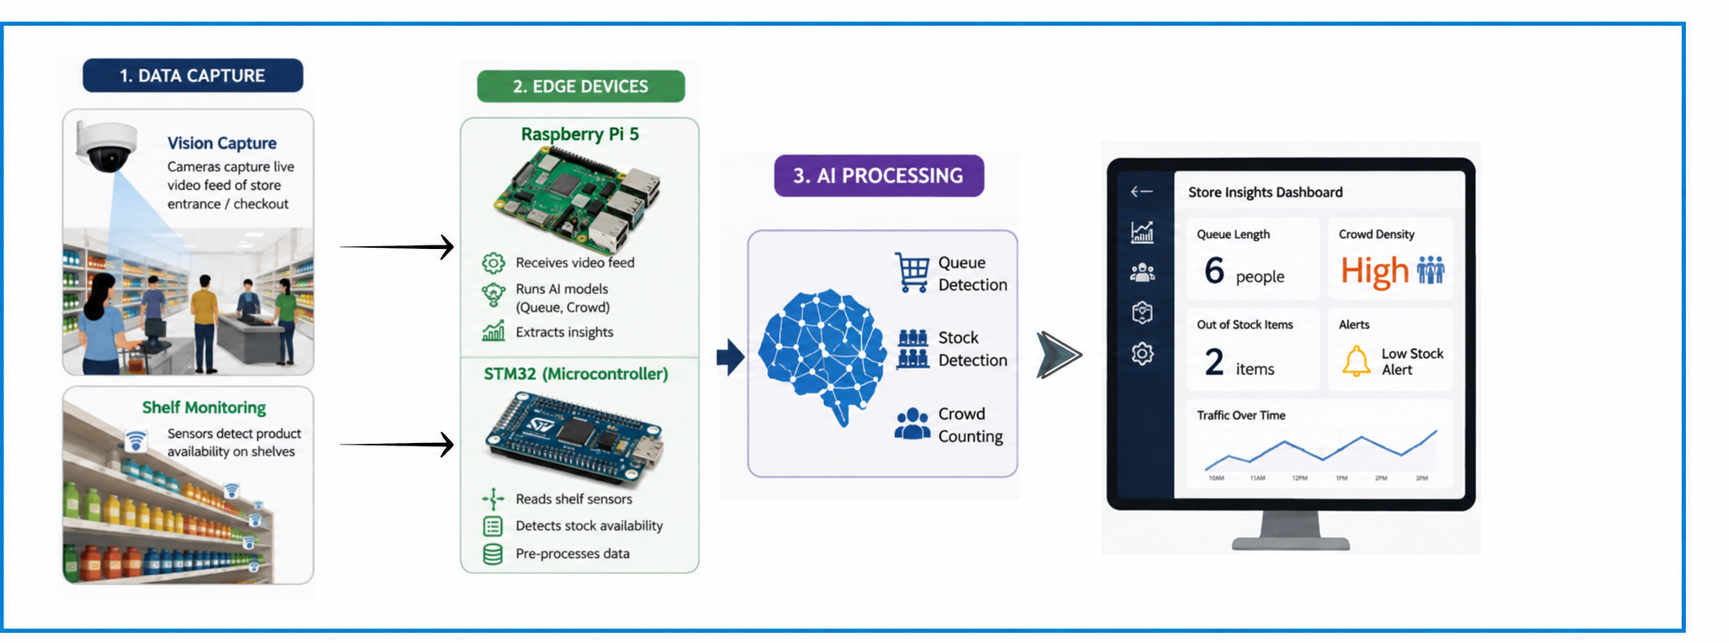
TECHNICAL APPROACH
Tech Gladiators
  We built a hyper-optimized, privacy-first CCTV pipeline that processes retail analytics instantly at the source. Using lightweight AI and smart computer vision, it tracks store footfall, queues, and stock levels offline on cheap hardware, blurring every customer the millisecond they are detected.
Process flow
3

Slide 4

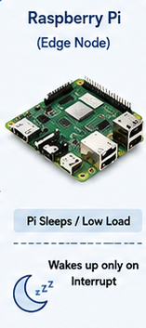
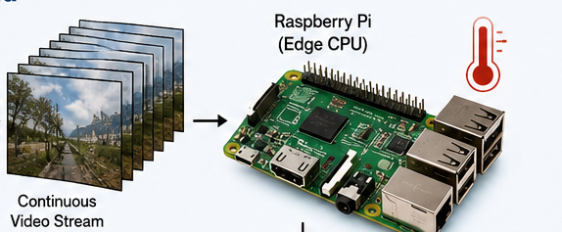
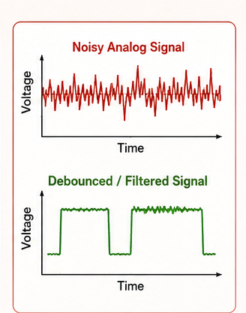
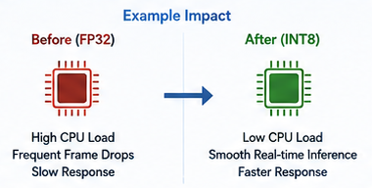
Tech Gladiators
FEASIBILITY AND VIABILITY
Our Approach:
Challenges:
Feasibility:
  Task Distribution: STM32 handles sensor processing, CV handling, reducing the load on raspberry pi.
  High video-processing load
  Highly viable to prototype because it uses readily available hardware and existing open-source AI tools
  Offload basic sensor logic and debouncing entirely to the STM32, along with the ML stack inference.
  low cost : it uses low-cost Commercial Off-The-Shelf (COTS) components and verified permissive open-source libraries
  Inaccurate sensor readings:
  Use INT8 post-training quantization on the vision models to drastically reduce CPU load
4
4

Slide 5

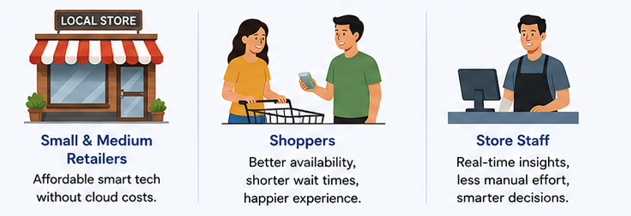
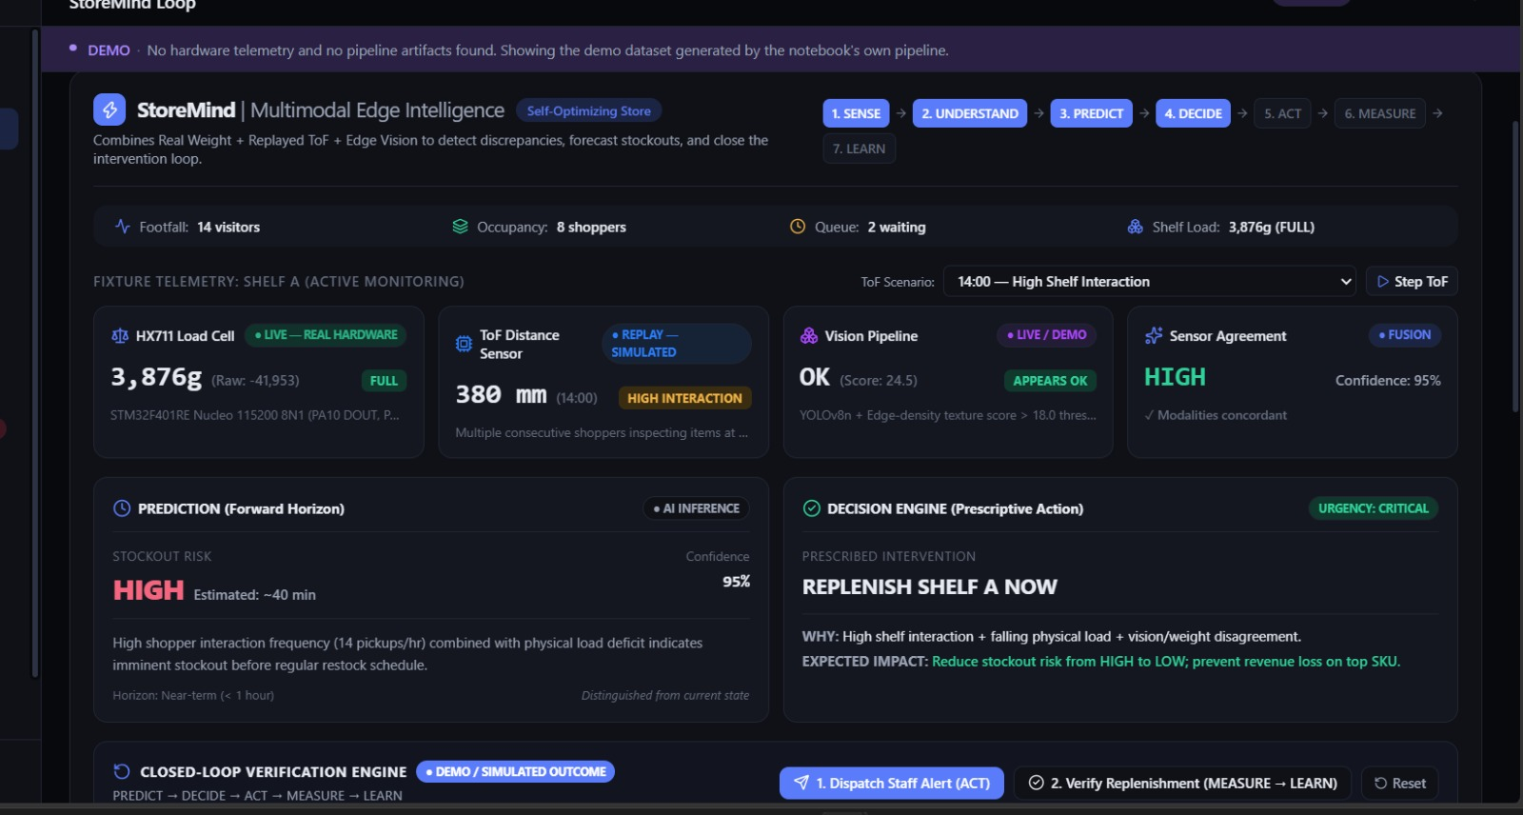
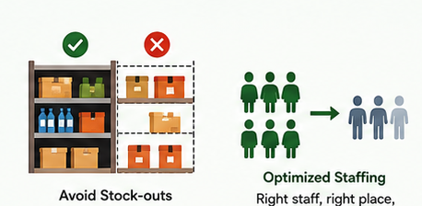
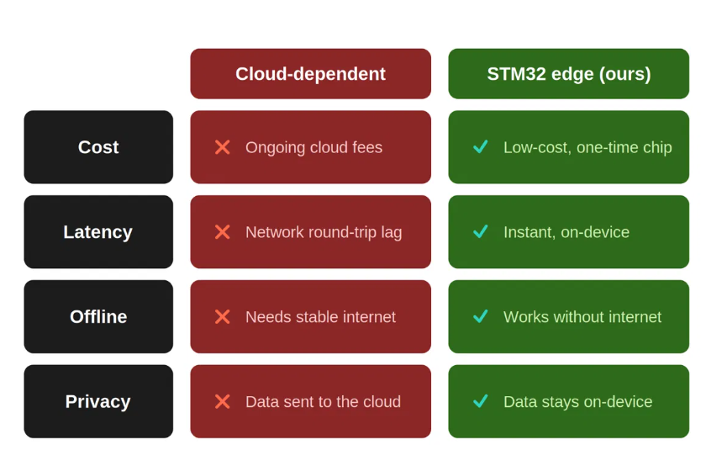
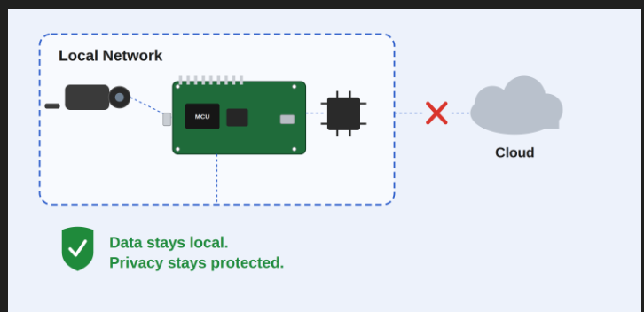
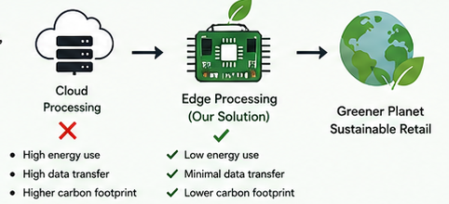
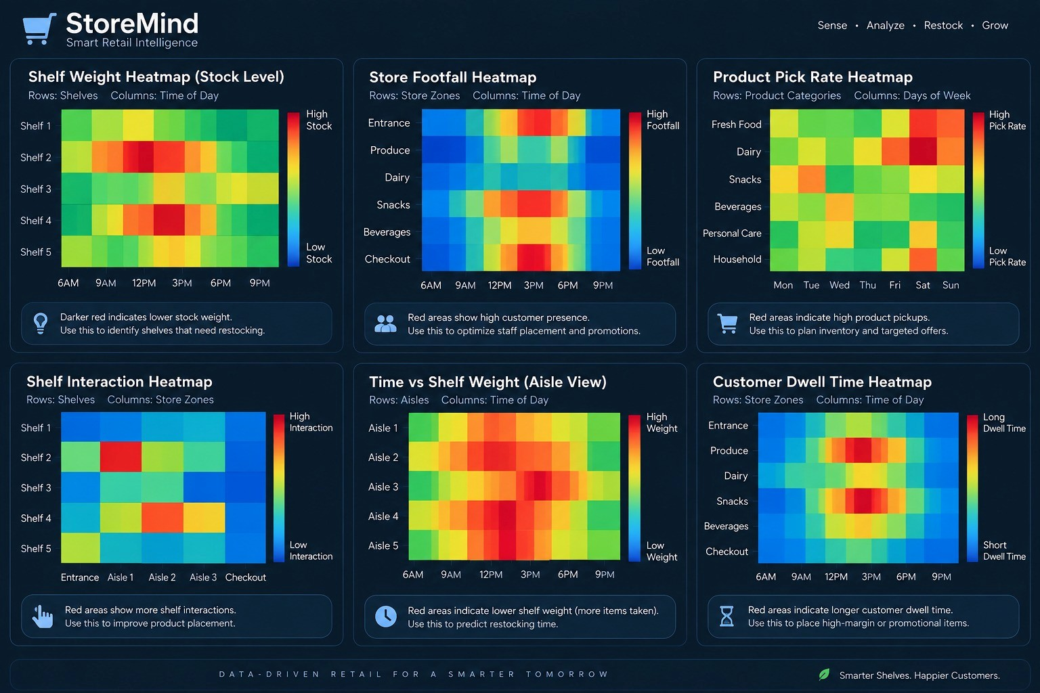
IMPACT AND BENEFITS
Tech Gladiators
Potential impact on the target audience:
Benefits of the solution:
Results:
  Economic:
  Social:
  Environmental:
5

Slide 6

Tech Gladiators
RESEARCH AND REFERENCES
Lecture on BareMetal on the Edge : Greginard Shimposwki: Linux Open Source Summit- 2026
Kumar, K., Patel, S., & Astya, R. (2025). "Smart Shelf Monitoring Using YOLO." 2025 IEEE International Students' Conference on Electrical, Electronics and Computer Science
Deshmukh, A., et al. (2024). "Real-Time Queue Detection and Management System Using YOLO Object Detection." Journal of Real-Time Image Processing / Applied Computer Vision Proceedings
Redmon, J., Divvala, S., Girshick, R., & Farhadi, A. (2016). "You Only Look Once: Unified, Real-Time Object Detection." Proceedings of the IEEE Conference on Computer Vision and Pattern Recognition (CVPR), pp. 779–788.
More, S., & Deshpande, G. (2025). "Computer Vision (AI) Based Retailer Shelves Monitoring System." 5th International Conference on Electrical, Computer, Communications and Mechatronics Engineering (ICECCME).
6

