Slide 1
IoT-Based Leaf Disease Detection Using the ESP32-CAM and TCS3200 Sensors with Telegram Alerts
PIP4004 Capstone Project
Review-4(VIVA-VOICE)
Batch Number: CSEG-66
Roll Number | Student Name
20221LCS0028 | M Manu
20221LCS0029 | C Vinith
20221LCS0030 | Shrijot Goral
20221LCS0018 | Lohith N
Under the Supervision of,
Dr. Naveen N. M.
Assistant Professor
School of Computer Science and Engineering
Presidency University
Name of the Program: B.Tech
Name of the HoD: Dr. Asif Mohammed
Name of the Program Project Coordinator: Mr. Amarnatha J L, Dr. Jayanthi Kamalasekaran
Name of the School Project Coordinators: Mr. Jerrin Francis

Slide 2
INTRODUCTION
This project aims to detect color changes in leaves using the TCS3200 color sensor to identify non-green or abnormal leaf colors, which may indicate plant stress or disease. An ESP32-CAM module is integrated to capture real-time images of the affected leaves. When an unusual color is detected, the ESP32-CAM triggers an alert system. The system sends a notification to a designated Telegram account, optionally including the captured image of the leaf for verification. This IoT-based solution offers a low-cost, automated method for remote plant health monitoring. The color sensor continuously scans the leaf surface, comparing RGB values to predefined healthy leaf thresholds. If the detected color deviates from the expected green spectrum, an anomaly is flagged. The system is suitable for use in agriculture, greenhouses, or home gardening. It enables proactive monitoring, reducing the reliance on manual inspection. The use of Telegram ensures quick and accessible alerts on mobile devices. This helps in early detection of diseases or deficiencies. The project supports data-driven decision-making in plant care. It also demonstrates the practical application of IoT and computer vision in smart agriculture.

Slide 3
Literature Review
This project introduces a smart, IoT-based solution for automated leaf disease detection using the ESP32-CAM and TCS3200 color sensor. The ESP32-CAM is used to capture images of leaves, while the TCS3200 sensor measures color changes, which often indicate disease or nutrient deficiency. When a potential disease is detected based on abnormal color readings, the system sends a real-time alert—including a photo of the affected leaf—via the Telegram messaging platform.
By integrating image capture, sensor data, and wireless communication, this system provides an affordable and scalable tool for remote plant health monitoring, empowering farmers with immediate insights and enabling faster decision-making in crop management.

Slide 4
Literature Review
2.1 Leaf color as a measure of plant health
It is commonly acknowledged that one of the main visible indicators of nutrient shortages and environmental stress is leaf yellowing. Zhang et al. (2020) state that image-based color analysis can be used to identify yellowing, a typical sign of nitrogen deficit, early on.
2.2 Agriculture's tcs3200 color sensorPlant pigmentation has been analyzed using the TCS3200 sensor in a number of inexpensive systems. Das and Roy (2018) showed how this sensor could successfully distinguish between healthy and unhealthy leaves when calibrated with RGB thresholds.
2.3 ESP32 in Internet of Things (IoT)The ESP32 microcontroller's low power consumption and built-in Wi-Fi make it a popular choice for Internet of Things applications. According to Lee and Kim (2019), ESP32 has been utilized in agricultural automation, specifically for cloud connection and real-time environmental data collecting.

Slide 5
2.4 Systems for Wireless Plant Monitoring
A wireless sensor network with ESP-based nodes was used in a study by Patel et al. (2021) to track temperature and soil moisture. The foundation for incorporating leaf color recognition into wireless frameworks was established by this.
2.5 Image Processing for Analysis of Leaves
Gonzalez and Jain (2018) investigated the application of color extraction and picture segmentation methods for the identification of plant diseases. Their research backs up the strategy of taking pictures of leaves and analyzing RGB values to identify stress.
2.6 Integration of Telegram Bots with IoT
Messaging platforms are frequently used by IoT notification systems to send out notifications. Roy and Singh (2021) demonstrated the dependability of ESP32 for alert-based systems by integrating Telegram bots with it to alert users of environmental changes.

Slide 6
2.8 Precision Agriculture Using IoT
Accurate Farming Precision agriculture has been transformed by the use of IoT technologies. Alam et al. (2022) claim that the use of sensors for crop monitoring in the field has greatly enhanced farm management and decreased input expenses.
2.9 Internet of Things Dual-Microcontroller Systems
Performance and modularity are enhanced by systems that, as proposed by Khan and Ahmed (2020), split sensor logic and communication responsibilities across two microcontrollers. Processing efficiency and system dependability are improved by this dual ESP32 design.
2.10 Difficulties in Monitoring Plant Health
Although there are many different systems, small farmers cannot afford or use many of them due to their complexity. This research directly addresses the need for scalable and reasonably priced monitoring tools, as highlighted by Sharma et al. (2019).

Slide 7
Research Gaps Identified
Despite significant progress in IoT-based plant monitoring and image processing, several limitations persist that hinder practical implementation, especially for small-scale farmers.
1. Underutilization of Leaf Color as a Primary Indicator Many studies prioritize complex image analysis or environmental metrics like temperature and soil moisture. However, changes in leaf color—particularly yellowing—are reliable early indicators of plant stress or nutrient deficiency. Few systems have directly used real-time RGB data from sensors like the TCS3200 to initiate alerts, missing a simple yet effective diagnostic cue.
2. Poor Integration of Sensor Data and Visual Feedback Existing approaches often treat sensor readings and image capture as isolated processes. This separation limits the accuracy and validation of plant health assessments. Integrated systems that simultaneously use color sensors and camera modules are rare.
3. Limited Real-Time Alerting Mechanisms Although platforms like Firebase are used for data storage, real-time alert delivery—especially through user-friendly apps like Telegram—is seldom implemented. This delays actionable feedback, reducing system effectiveness.
4. Single Microcontroller Bottlenecks Most agricultural IoT systems rely on a single microcontroller, which can compromise multitasking efficiency. Dual-controller setups—where one ESP32 handles sensing and the other manages imaging and communication—are not widely explored.

Slide 8
5. Scalability and Accessibility Challenges Many systems are either expensive or too complex for small farmers. The lack of simple, scalable solutions prevents widespread adoption.
6. Lack of Low-Cost, Deployable Designs There is minimal focus on affordable, field-ready prototypes using off-the-shelf components like the ESP32-CAM and TCS3200 sensor. Existing work often remains theoretical or limited to lab-scale tests.
Summary There is a clear need for an affordable, integrated solution that uses leaf color detection, real-time image capture, and instant alerts via Telegram. This project addresses these gaps with a modular, IoT-based system suitable for field deployment by non-experts.

Slide 9
Proposed Methodology
To address the identified gaps in existing plant health monitoring systems, this project proposes a low-cost, modular IoT solution that integrates real-time color sensing, image capture, and instant alerts via Telegram. The methodology emphasizes simplicity, affordability, and deployability in real-world agricultural settings.
1. Dual ESP32 Architecture The system utilizes two ESP32-CAM boards for improved modularity and task separation. One ESP32 is connected to a TCS3200 color sensor and is responsible for capturing RGB values from leaf samples. The second ESP32-CAM handles image capture and communication functions, ensuring smooth multitasking without overloading a single controller.
2. Real-Time Leaf Color Analysis The TCS3200 sensor captures the RGB values of the leaf. These values are compared against predefined thresholds to identify early symptoms of disease, such as yellowing caused by chlorosis or nutrient deficiency. This approach simplifies detection by using a direct, observable biomarker—leaf color.
3. Conditional Image Capture and Telegram Alerts When the RGB values fall within a defined “unhealthy” range, the image-capturing ESP32-CAM is triggered. It captures a high-resolution photo of the leaf and immediately sends it to a pre-configured Telegram bot along with a text alert. This ensures real-time communication with the user without the need for continuous monitoring.
.

Slide 10
4. Wireless Communication and Alert System The ESP32 boards are connected via Wi-Fi and communicate using lightweight protocols. Integration with the Telegram Bot API allows for immediate, user-friendly notifications to farmers or agronomists, ensuring timely interventions.
5. System Scalability and Field Deployment The system is designed using easily available components and supports expansion to multiple plants or sensor nodes. The plug-and-play nature allows even non-experts to deploy and use it effectively.
This methodology combines simplicity, effectiveness, and real-world utility to close critical gaps in current agricultural monitoring technologies

Slide 11
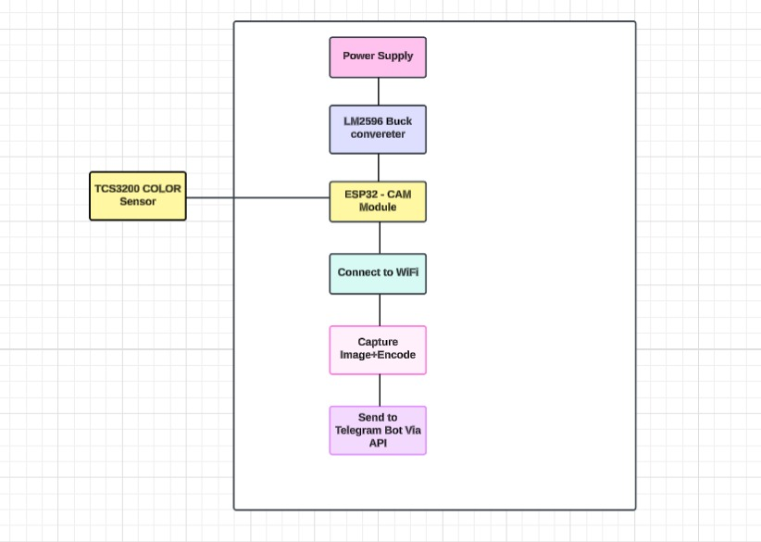
Architecture :

Slide 12
Objectives
Real-time leaf color detection
Integrated color sensing and imaging
Instant Telegram alert system
Dual ESP32 modular architecture
Low-cost and scalable design
User-friendly and easy deployment
Field-ready and reliable operation

Slide 13
Methodology
Dual ESP32 Architecture One ESP32 handles color sensing (with TCS3200), and the other manages image capture and Telegram alerts.
RGB Data Acquisition The TCS3200 sensor measures the RGB values of the leaf surface in real time.
Threshold-Based Detection Captured RGB values are compared against predefined thresholds to identify unhealthy (e.g., yellowing) leaves.
Automated Image Capture If an unhealthy condition is detected, the second ESP32-CAM captures an image of the leaf

Slide 14
Telegram Alert System The image and a short alert message are sent instantly to the user via Telegram.
Wi-Fi Communication Both ESP32 modules communicate via Wi-Fi for data exchange and internet-based alert delivery.
Low-Cost, Scalable Design Built using affordable components, the system is modular and can be expanded to monitor multiple plants.
Field-Deployable and User-Friendly The system is simple to install and operate, even in real agricultural environments, with minimal technical expertise required.

Slide 15
Expected Outcomes
Accurate detection of leaf color changes indicating disease or stress
Real-time capture of leaf images for visual confirmation
Instant alerts sent to users via Telegram with images and status updates
Improved timely intervention for plant health management
Low-cost, scalable system suitable for small and medium farms
Modular design allowing expansion to monitor multiple plants
User-friendly operation requiring minimal technical knowledge
Reliable performance in real agricultural environments

Slide 16
Conclusion
Developed an affordable IoT system for early leaf disease detection
Integrated TCS3200 color sensor and ESP32-CAM for accurate monitoring
Achieved real-time alerts via Telegram for timely action
Utilized dual ESP32 architecture to enhance efficiency and modularity
Addressed key research gaps in cost, accessibility, and real-time feedback
System is scalable, user-friendly, and suitable for field deployment
Supports sustainable agriculture by enabling proactive plant health management

Slide 17
References (IEEE Paper format)
1.Zhang, X., Liu, W., & Zhao, Y. (2020). Leaf color analysis for early detection of nutrient deficiency in plants. Journal of Precision Agriculture, 21(4), 587–600.
https://doi.org/10.1007/s11119-020-09724-5
2.Das, A., & Roy, S. (2018). Low-cost plant health monitoring system using TCS3200 color sensor. International Journal of Agricultural Technology, 14(2), 85–92.
3.Lee, J., & Kim, H. (2019). Applications of ESP32 in smart agriculture systems. IEEE Sensors Journal, 19(10), 3503–3510. https://doi.org/10.1109/JSEN.2019.2901235
4.Patel, R., Shah, D., & Mehta, K. (2021). Wireless IoT-based plant monitoring using ESP8266/ESP32 microcontrollers. Smart Farming Systems, 7(1), 102–110.

Slide 18
5.Roy, M., & Singh, P. (2021). Telegram Bot integration for smart agriculture notification systems. International Journal of IoT Applications, 5(2), 19–25.
6.Alam, M., Roy, D., & Hossain, M. (2022). Precision agriculture with IoT: A review of technologies and challenges. Journal of Agricultural Informatics, 13(1), 1–10.
7.Khan, M. A., & Ahmed, R. (2020). Dual microcontroller approach for efficient IoT task distribution. International Conference on Embedded Systems, 2(1), 112–119.
8.Sharma, L., Tiwari, A., & Gupta, N. (2019). Affordable technologies for plant health monitoring: A review. Agricultural Engineering Today, 43(3), 34–40

Slide 19


