Slide 1

LENDING CLUB LOAN DATASETS BATCH: UNDER THE ESTEEMED GUIDANCE OF: DSE-FT JAN-21 HYD Srikar Muppidi PRESENTED BY : Gundluru Venkat Ritish Harshitha Mor Madanu Vinith Xavier Veenadhari Beeravelli

Slide 2
TABLE OF CONTENTS
INTRODUCTION
PROBLEM STATEMENT
BASELINE SOLUTION
EVALUATION METRICS
EXPLORATORY DATA ANALYSIS
SUMMARY OF INITIAL FINDINGS
BASE MODEL BUILDING
IMPROVING MODEL EFFICIENCY
CHALLENGES
FUTURE WORK

Slide 3
PROJECT FLOW CHART:
DATA SAMPLE EXTRACTION
UNIVARIATE ANALYSIS
DROPPING INSIGNIFICANT VARIABLES
MISSING VALUE TREATMENT
OUTLIER TREATMENT
BIVARIATE ANALYSIS
EDA INSIGHTS
BASELINE MODEL BUILDING
STATISTICAL FEATURE SELECTION
HANDLING
COMPUTATIONAL LIMITATION
IMPROVING MODEL
EFFICIENCY
BASE MODEL BUILDING

Slide 4
INTRODUCTION
Financial technology is embedded into our everyday process chains starting right from the financial service providers to the average consumer – ranging from business models that help institutions manage their finances better to mobile wallets that make it easy for consumers to access their own monetary resources at the click of a finger.
In this project we’re taking the historical financial data of Lending Club, a peer-to-peer loan lending institution which allows direct investment across 28 states in the United States of America. The data extracted is from the final quarter of 2018. The goal is to analyze and interpret our data to build a machine learning model based on binary classification that predicts the defaulter status of a future borrower applicant at Lending Club.

Slide 5
Data Sample Extraction
Number of Attributes | 145
Number of Records | 150792
The below mentioned methods would be analyzed in order to obtain better results and have a realistic model prediction, without deviating from the business goal:
The following three data sampling methods have been selected for the particular dataset sampled from the original dataset used in this project:
1. Stratified sampling: we will take a split of whole dataset which might be around 97.5% and 2.5% as the population size is around 22lakhs and we will try to get equal no.of records from each year (of the 11years data we have)
2. Thus each year has different external factors affecting so keeping our study of concentration only for four months or 3months of a particular year would be more appropriate considering even the business problem statement
3. Or we can also take the two different sample by dividing the dataset by the independent variable "term" ( 36 months and 60 months ) and study the results accordingly.
We’ve utilized the second approach for our project, for the sake of most recent data extraction and time sensitivity.

Slide 6
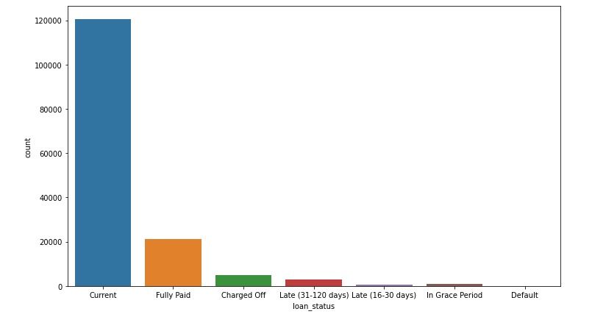
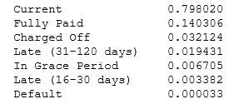
TARGET VARIABLE
loan_status: Current status of the loan
(in terms of repayment)
Statuses include:
Current: Loan is up to date on all outstanding payments
In Grace Period: Loan is past due but within the 15-day grace period.
Late (16-30): Loan has not been current for 16 to 30 days.
Late (31-120): Loan has not been current for 31 to 120 days.
Fully paid: Loan has been fully repaid, either at the expiration of the 3- or 5-year year term or as a result of a prepayment.
Default: Loan has not been current for an extended period of time. ( loan_status = 1)
Charged Off: Loan for which there is no longer a reasonable expectation of further payments. Upon Charge Off, the remaining principal balance of the Note is deducted from the account balance.( loan_status = 1)

Slide 7

We have done uni-variate analysis for all the columns present in the original dataset (145-columns).
The process of the analysis undertaken is listed as follows:
Analysed the data using basic statistics from the describe function of the columns
Visualizing the columns using various plots like box plot (for checking outliers) and distribution plot (for checking the spread of the data) for numerical columns and count plot (for checking the variance among variables in a column) for the categorical columns
Checking for the normality of data using skewness and kurtosis

Slide 8
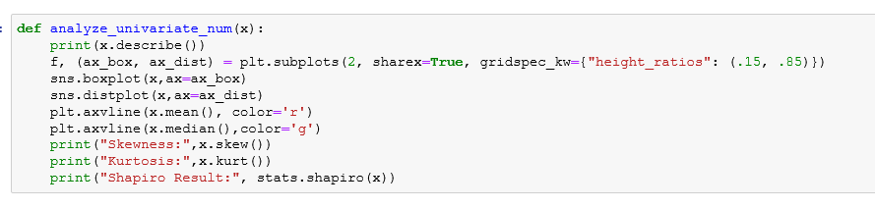
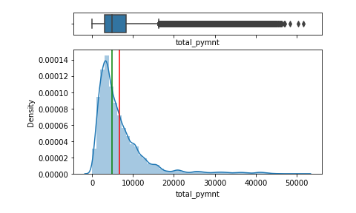
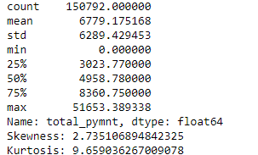

Slide 9

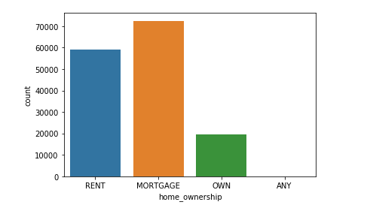

Slide 10
Income and payment plan based features.
dti,annual_inc,int_rate…
[12 features ]
2. Financial accounts based
open_acc, total_acc, earliest_cr_line,open_acc_6m…
[28 Features]
5. Financial inquiries inq_fi, inq_last_12m, mths_since_recent_inq,
intial_list_status…
[4 Features ]
3. Balances and credit limit based data/features
revol_bal, tot_cur_bal, tot_coll_amt, total_bal_il…
[ 15 Features]
4. Bankruptcies, public records and delinquencies
delinq_2yrs, pub_rec, pub_rec_bankruptcies, pct_tl_nvr_dlq…
[4 Features]

Slide 11
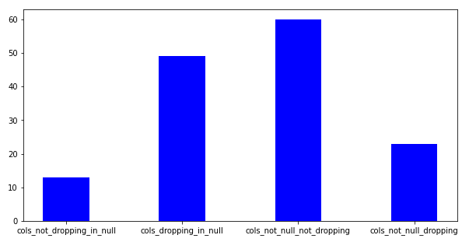
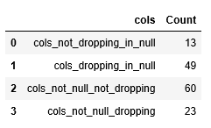
Dropping of columns
While performing the initial Data Cleaning process of the variables, below are the reasons that have been narrowed down for dropping the features:
1.A very low variation among the classes of the variable (Eg: pymnt_plan)
2.High percentage of missing values (Range Chosen: 85-100%) (Eg: num_tl_30dpd, hardship_flag)
3.Columns with repetitive information (Eg: funded_amnt)
4.Low contribution to target variable from a business perspective,(Eg:policy_code)
Due to the huge number of attributes we have divided all the attributes into the following categories

Slide 12
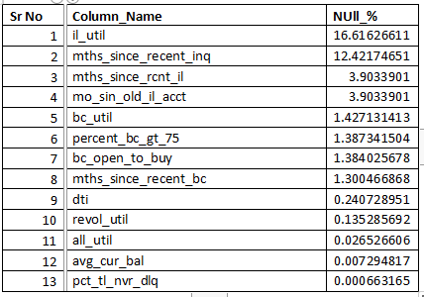
Missing Value Treatment
From the above graph we can infer that there are 13 variables for which has to be treated for missing values. For the base model preparation we imputed the missing values based on the skewness of the data with mean, median(numerical) and mode(categorical).

Slide 13
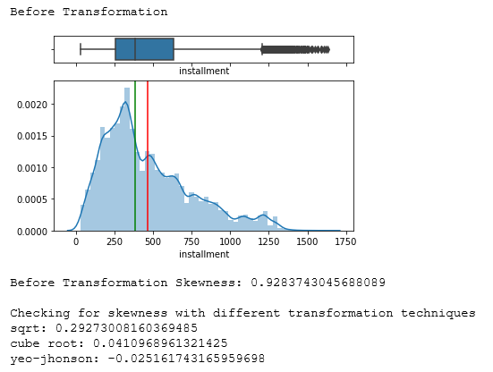
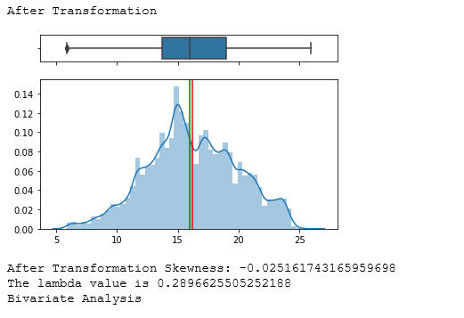
DATA TRANSFORMATION
After the univariate analysis of each feature, we could infer that dropping of columns and transformation was required for many variables to reduce high skewness and heavy outliers so as not to lose the data.
1. We have used square-root, cube-root, log and yeo-johnson transformation and evaluated skewness metric for the same
2. The transformation with the least skewed value was chosen from the above techniques and applied to our data.
3. The reduction in skewness and no.of outliers has been observed after transformation

Slide 14
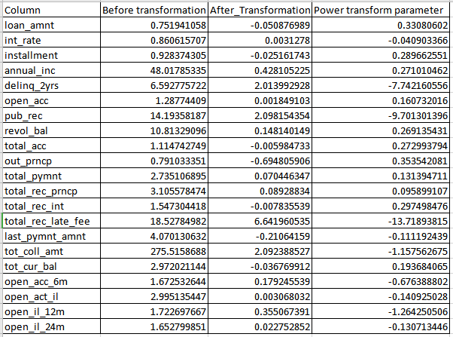

Slide 15
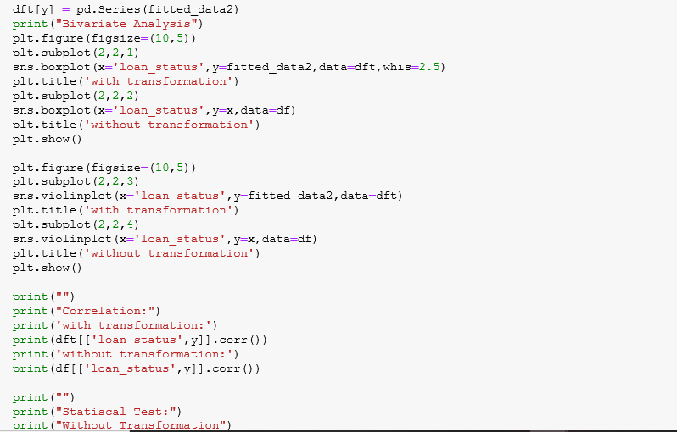
BIVARIATE ANALYSIS
Now that our data has been cleaned and analysed on a univariate basis, the number of variables have reduced from 145 to 70. We've performed bivariate analysis for this finalised set of features with respect to our target variable loan_status to see the impact the independent variable has on our dependent variable.
Using graphical methods:
1. As our target variable is a binary class categorical variable, so we have used the boxplot and violin plot between the continuous independent variable and target variable to understand the relationship between them.

Slide 16
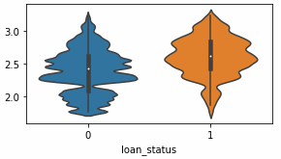
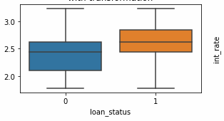
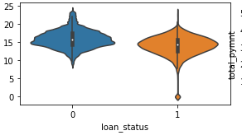
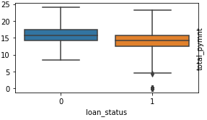
Results: Eg - int_rate (continuous independent) Vs loan_status (target)
Results: Eg - total_pymnt (continuous independent) Vs loan_status (target)

Slide 17
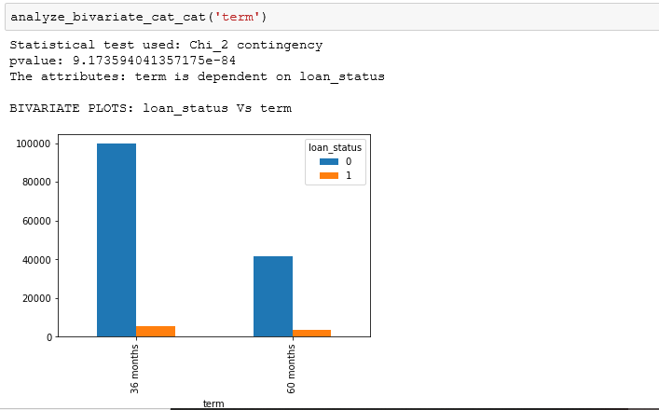
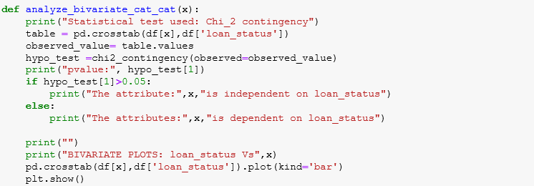
As our target variable is a binary class categorical variable, so we have used the barplot between the categorical variable and target variable to understand the relationship between them.
Results: Eg: term (categorical independent variable) Vs loan_status (target variable)

Slide 18
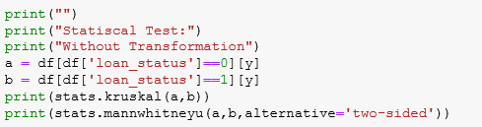
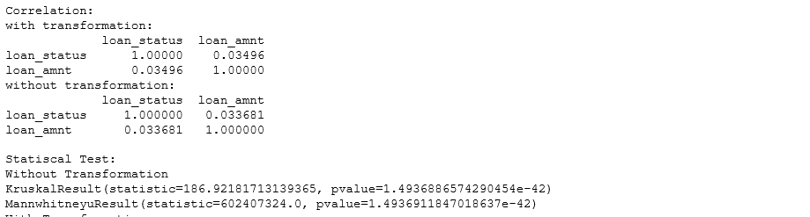
UNI FEATURE SELECTION USING STATISTICAL TESTS
From the above bi-variate analysis , it has been inferred that all the columns are non-parametric and unpaired data. Thus we used the Manwhitneyu (t-test) and kruskal ( ANOVA) between the continous variable and target variable.
Similarly, we have written a function to find the relationship between the independent categorical variable and target variable using the statistical test chi-square independence of attributes.
Results : Eg: term (categorical independent variable) Vs loan_status (target variable)

Slide 19
BASELINE MODEL BUILDING
As our problem statement is binary classification problem indicating that target variable is categorical in nature so we used the following 9 classification algorithms. For the base model building, we have considered all the 72 independent features that have been finalized after our exploratory data analysis and outlier treatment.
Encoding | One Hot Encoding
Imputation Method : | Mean, Mode. Median
Transformation | yeo-jhonson
Scaling | Standard Scaler
Features | All Features
Scoring | "roc_auc"
For all the below models we have used the above metrics and found out the following results.
Metric used for deciding the model : Recall

Slide 20
Why Recall ?
False Negatives are the values which the model predicted negative class(0), that means model predicted the person will not default , but this prediction is false meaning in reality he defaulted , so we have to reduce False Negatives because these people will be a contributing for loss of the company. Recall is defined as TP / (TP + FN) which indicates that while we reduce FN our Recall should increase, thus Recall should be the metric for our model.
Why not Precision?
Precision is defined as TP/(TP+FP) .False Positives are the values which the model predicted positive class(1) , that means model predicted the person will default but prediction is false,meaning in reality he did not default.
But if our problem statement was something like we had to give offers or special benefits for people who did not default , then we could lose these customers , then in that case precision would be our parameter for our model

Slide 21
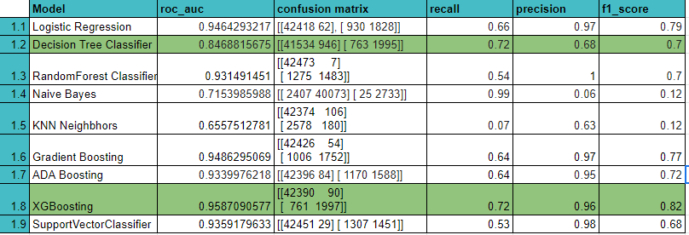

Slide 22
IMPROVING MODEL EFFICIENCY
Machine Learning is an iterative process, there are many methods to improve the efficiency of the model. Some of the methods which we implemented are:
1. Missing Value Treatment using different imputation methods 2. Hyper parameter tuning of the models 3. Feature Selection Methods 4. Sampling Techniques to treat Class Imbalance 5. Taking different samples of data to train the model better

Slide 23
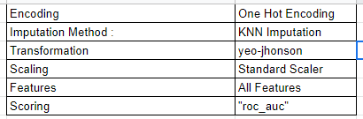
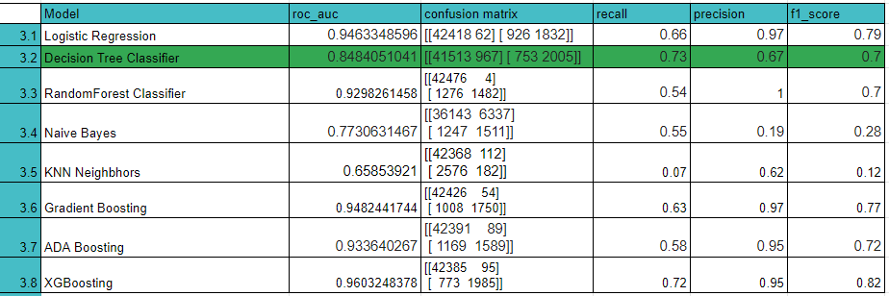
Missing Value Treatment using different imputation methods
KNN IMPUTATION

Slide 24


Imputation Using Multivariate Imputation by Chained Equation(MICE)
Sampling Techniques to treat Class Imbalance
SMOTE

Slide 25
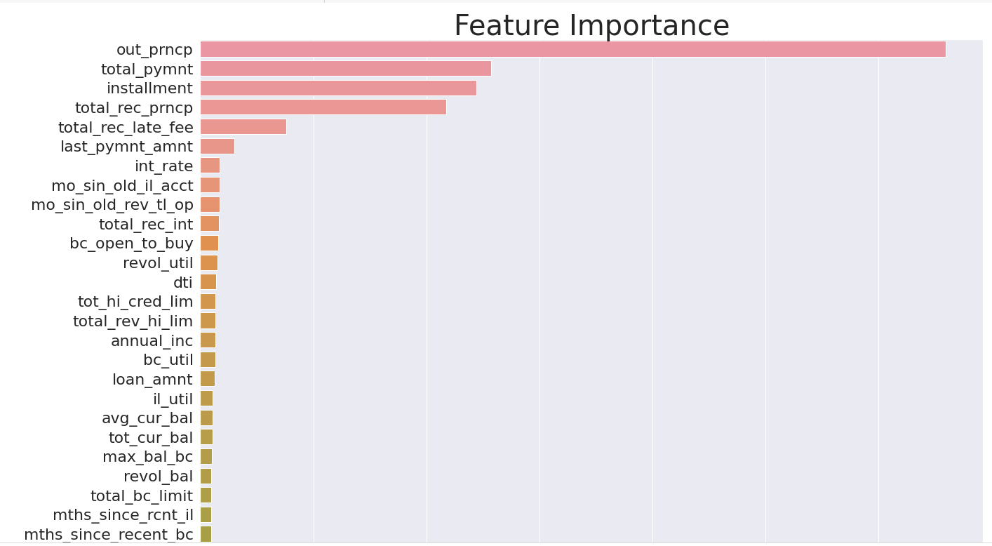
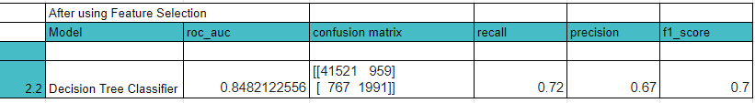
FEATURE SELECTION
The feature selection method we used is feature_importances_:

Slide 26
5. Taking different samples of data to train the model better
Entire Data
1.5 lakh data
5.1
90%
10%
70%
30%
5.2
5.3
50%
50%

Slide 27
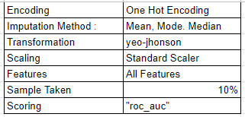
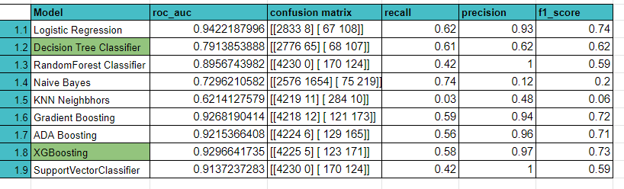
5.1

Slide 28
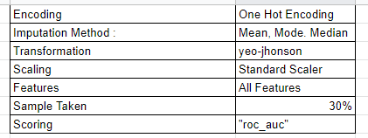
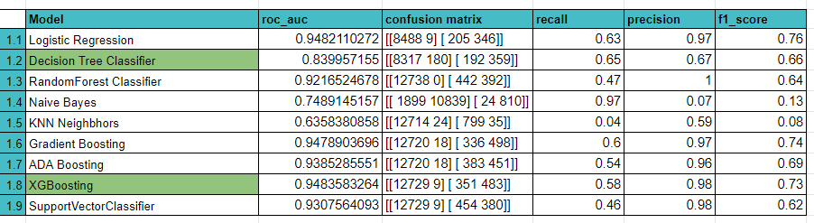
5.2

Slide 29
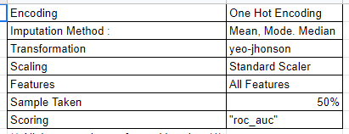
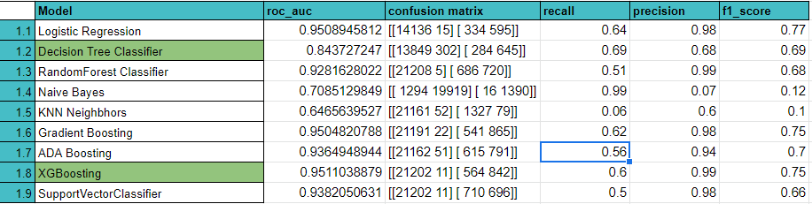
5.3

Slide 30
CONCLUSION
An extensive part of EDA is done all the variables , there are few variables which are affecting whether the person will default or not are:
out_princp:Remaining outstanding principal for total amount funded,
total_pymnt:Payments received to date for total amount funded.
installment:The monthly payment owed by the borrower if the loan originates.
total_rec_prncp:Principal received to date
total_rec_late_fee:Late fees received to date
last_pymnt_amnt: Last payment amount received
We could achieve the highest recall percentage of about 73% with One Hot Encoding; KNN Imputation; All features; Yeo-Jhonson transformation.

Slide 31
FUTURE WORK
Tuning of hyper parameters with greater computational power
Try to improve accuracy of the model
Build the model with neural networks
1
3
5
2
4
6
Define the model confidence interval
Trying to use libraries like LIME and SHAP
Better visualization methods using Tableau for Multi-variate Analysis for improved intuitive insights

